Slide 1
Spring Deans and Chairs Meeting
Kyle Clark • Vice President for finance & administration
March 23, 2017

Slide 2
FSU
Operating Budget
2016-2017 Total Operating Budget Summary
Education & General - State Support | $501,507,195
Education & General - Tuition and Fees | 209,778,182
Designated | 82,576,041
Auxiliary | 211,136,839
Debt Service | 22,910,000
Restricted | 323,197,186
Capital Projects | 178,763,417
Component Units | 85,932,287
Total | $1,615,801,147

Slide 3
FSU
Operating Budget
2017-2018 Total Operating Budget Summary
Education & General - State Support | ?
Education & General - Tuition and Fees
Designated
Auxiliary
Debt Service
Restricted
Capital Projects
Component Units
Total

Slide 4
PECO

Slide 5
PECO-Eligible Project Request Summary 2017-18 through 2021-22

Slide 6
Finance & Administration
Completed Projects
Conducted Rating Agency (Fitch, Moody’s, and Standard & Poor’s) surveillance reviews, affirming the University’s ratings on its outstanding capital improvement bond debt. The rating agencies cited the University’s strong reserves, excellent strategic positioning, low debt burden, consistent positive operating performance and cash flows, and well diversified revenues.
Negotiated new Coke Pouring Rights Agreement, including a 38% increase in annual contributions, student internships, a campus speaker series.
Opened an on-campus lab supply service center with dedicated VWR on campus representative to provide enhanced service, inventory control, and greater availability of frequently used lab supply products: Filtration, Culture Tubes, Multi-Well Dishes, Centrifuge Tubes, Universal Tips, Filter Tips, Safety Supplies, etc.
Completed Projects

Slide 7
Finance & Administration
Completed Projects
Refunded $7.6M of Transportation and Parking outstanding bonds, generating approximately $750k in gross cash flow savings ($680K in present value savings). The University worked with the Division of Bond Finance to structure the first competitive bank bid process for a bond refunding. The winning bank bid of 2.12% provided additional savings when evaluated versus a standard public bond offering.
Negotiated new Food Service Agreement, which will improve and expand the university’s student dining facilities and services. The value of the new contract is over 130% greater than the old contract.
Property Services offered to assist departments with the administrative burden of disposing of unwanted property, with an aggressive effort to rid common areas, laboratories, corridors, and office spaces of old excess equipment and furniture items in order to free up valuable spaces on campus. 58 departments accepted their assistance and 1,325 items have been removed, with another 992 scheduled for pick up.
Completed Projects

Slide 8
Finance & Administration
Completed Projects
Successful completion of the Florida Department of Law Enforcement Technical Audit for conducting background checks.
In November 2016 we were recognized as a silver level bicycle friendly campus by the League of American bicyclists.
Florida State University has the first law enforcement agency in Leon County to issue body cameras for all patrol officers.
Shared services with Ringling, New College of Florida, and University of South Florida Sarasota
Fair Labor Standards Act – The University is continuing to assess and follow the latest developments. Once we receive more concrete direction from the courts and federal government, we will further evaluate our classification system. This may result in additional changes. We will continue to keep the campus community updated.
Completed Projects
Notes:
Significantly expand the capabilities of SpearMart, FSU’s online electronic procurement system.
Project Goals:
Create a “One Stop Shop” for all procurement activity
Streamline the Source to Purchase Order process
Standardize requisition/form workflow and approvals
Facilitate paperless transaction processing
Enhance process efficiency and increasing responsiveness
Deliver outstanding customer service

Slide 9
Finance & Administration
Current Projects
Expand SpearMart Capabilities (FSU’s Electronic Procurement System), providing end users with the most user friendly and efficient procurement experience possible, with greater visibility into the entire procurement process and the ability to maximize spend with contracted suppliers
Expand the University’s Hyperion Budgeting System capabilities for managing salary rates and positions.
FSU is negotiating a new banking service and purchasing card agreement, providing reduced banking fees, a rebate increase, and expanded use of electronic payment services.
FSU working with others in the SUS and E&I Cooperative (our Higher Ed National Consortium) is negotiating an agreement for standard laptop/desktop configurations, providing bundle discounts by leveraging buying power at the National level.
Current Projects
Notes:
Significantly expand the capabilities of SpearMart, FSU’s online electronic procurement system.
Project Goals:
Create a “One Stop Shop” for all procurement activity
Streamline the Source to Purchase Order process
Standardize requisition/form workflow and approvals
Facilitate paperless transaction processing
Enhance process efficiency and increasing responsiveness
Deliver outstanding customer service

Slide 10
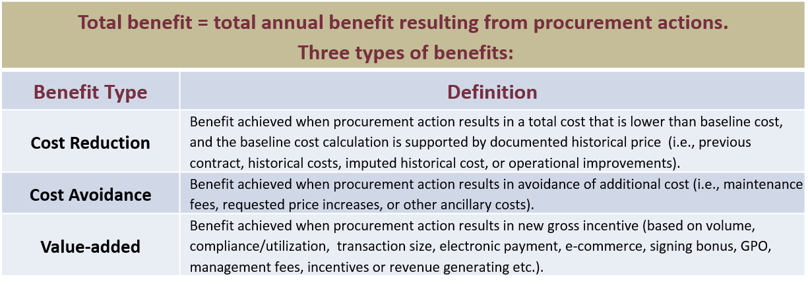
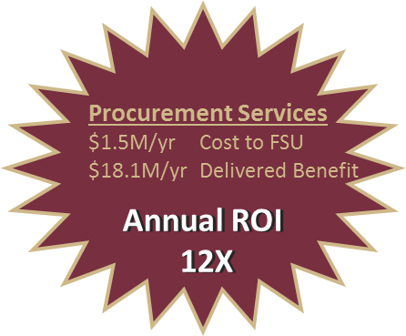
Procurement Total Benefit
Notes:
Savings of more than $19 million in FY16
bpf note:
Discrepancy with Slide 5 - SUS procurement savings of $7.8 + $6.2 = $15 million
SUS savings slide does not include Q4.

Slide 11
Finance & Administration
Pouring Rights
Florida State University and Florida State University Athletics currently have an exclusive agreement for pouring rights for all of the Tallahassee campus.
During May 2016, Florida State University began extension conversations with Coke.
Over the course of the summer, we met with Coke many times expressing our desire to have a preeminent, world class relationship.
Unlike previous contracts, we wanted to try and leverage the entire University’s scope and mission.
After robust conversations, Florida State University and Coke were able to finalize an agreement in December 2016.
Current Projects
Notes:
Significantly expand the capabilities of SpearMart, FSU’s online electronic procurement system.
Project Goals:
Create a “One Stop Shop” for all procurement activity
Streamline the Source to Purchase Order process
Standardize requisition/form workflow and approvals
Facilitate paperless transaction processing
Enhance process efficiency and increasing responsiveness
Deliver outstanding customer service

Slide 12
Finance & Administration
Pouring Rights
10 year contract.
Contract value is over $31 million ($3.1 million a year)
Previous contract value was over $22 million ($2.2 million a year)
38% increase in new contract from old.
Funding for marketing, facilities, internships, events, guest speakers, technology, and strategy sessions.
Based on our analysis of the contracts, our new contract will be the largest pouring rights agreement in the State of Florida.
Current Projects
Institution | Annual Value
Virginia | $ 1.5 million
Auburn | $2.4 million
Washington | $2.5 million
Indiana University System | $2.6 million
Notes:
Significantly expand the capabilities of SpearMart, FSU’s online electronic procurement system.
Project Goals:
Create a “One Stop Shop” for all procurement activity
Streamline the Source to Purchase Order process
Standardize requisition/form workflow and approvals
Facilitate paperless transaction processing
Enhance process efficiency and increasing responsiveness
Deliver outstanding customer service

Slide 13
Finance & Administration
Food Service
During May 2016, Florida State University issued an ITN (Intent to Negotiate) related to its food service program.
Unlike previous contracts, we wanted to try and leverage the University’s food service contract, the Seminole Boosters’ concession contract, and Florida State University Athletics’ dining hall contract into one agreement.
An evaluation committee and technical advisory committee was selected made up of faculty, staff, and students.
After a rigorous evaluation and due diligence, the committee unanimously selected Sodexo.
Current Projects
Notes:
Significantly expand the capabilities of SpearMart, FSU’s online electronic procurement system.
Project Goals:
Create a “One Stop Shop” for all procurement activity
Streamline the Source to Purchase Order process
Standardize requisition/form workflow and approvals
Facilitate paperless transaction processing
Enhance process efficiency and increasing responsiveness
Deliver outstanding customer service

Slide 14
Finance & Administration
Food Service
10 year contract. Previous agreement was for 15 years.
Contract value is over $173 million including residential dining, catering, athletic dining hall, and concessions. If spread equally annually, the new contract would generate approximately $17.3 million a year.
Previous contract value was over $74 million including residential dining, catering, athletic dining hall, and concessions (3 contracts combined). If spread equally annually, equates to $4.9 million a year.
Funding for facilities, scholarships and internships, meal plans, sustainability, wellness, employee activities and incentives, utilities, and program enhancements.
Removal of mandatory meal plans starting in 2018-2019 contract year.
Sodexo will be a premier recruiter and participate in Florida State University career fairs.
Anticipate transitioning on or before August 31, 2017.
Current Projects
Notes:
Significantly expand the capabilities of SpearMart, FSU’s online electronic procurement system.
Project Goals:
Create a “One Stop Shop” for all procurement activity
Streamline the Source to Purchase Order process
Standardize requisition/form workflow and approvals
Facilitate paperless transaction processing
Enhance process efficiency and increasing responsiveness
Deliver outstanding customer service

Slide 15
https://www.dropbox.com/scl/fi/g0fddrphmgohfbuvncjw8/FSU%20Home%20Lyrics.mp4?dl=0&oref=e&r=AAXCgmFLsN4hESfh1l4Yp-JilAh05J2xMtsxEU1cop5yyEj9MnJkVuvDPHKUDuYAhWLxVNznnEpMaXAV1lj9egO3Rp42D8cvtXSJS3HXEC9H5xJgW22NujSDg44NfYt1nhaGms5L3waW43eKUitFBavNn4JdDR9AIDskTZvaoy4A2RFwCypeDxInArPTvRzpMEk&sm=1

Slide 16
https://diningtransition.fsu.edu/

Slide 17
Facilities Updates

Slide 18
University Housing Replacement Phase II
Substantial Completion Date: 6/1/2017
GSF: 209,000 (Buildings 3 & 4); 19,300 GSF for Urban Eateries
Total Cost: $ 69,663,254
Fund Source: University Funds
Project Information:
A 912-bed facility will be constructed in a suite style configuration. Magnolia Hall (Building 3), Azalea Hall (Building 4) consists of 912-bed suites and the 1851 Dining concept which were ready for Fall 2017 semester. Common areas for study, lectures, recreation, and laundry are all included, as well as landscaped courtyards. 1851 Dining Concept is a unique food service venue located along Jefferson Street.
Consultants:
Architect – Gilchrist, Ross, Crowe Architects, Tallahassee, FL
Contractor – Culpepper Construction, Inc., Tallahassee, FL

Slide 19
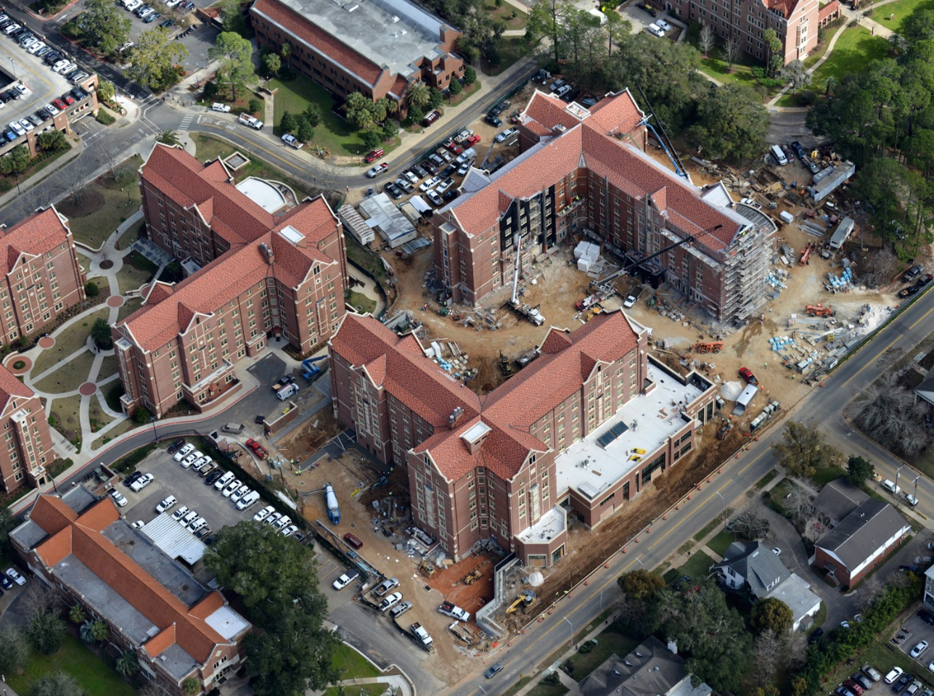
University Housing Replacement Phase II
Interior furnishings currently being selected
1851 under construction and to be completed this Summer

Slide 20
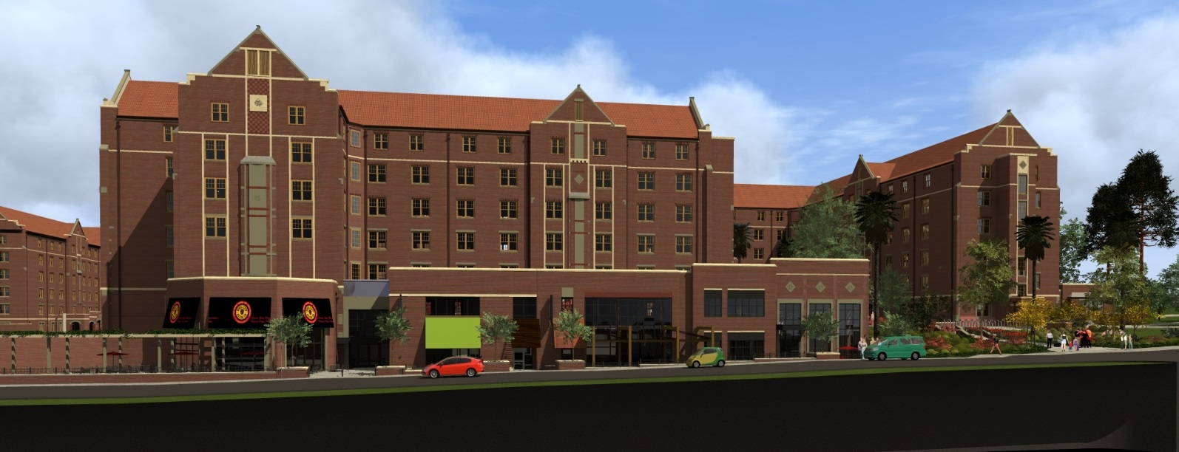
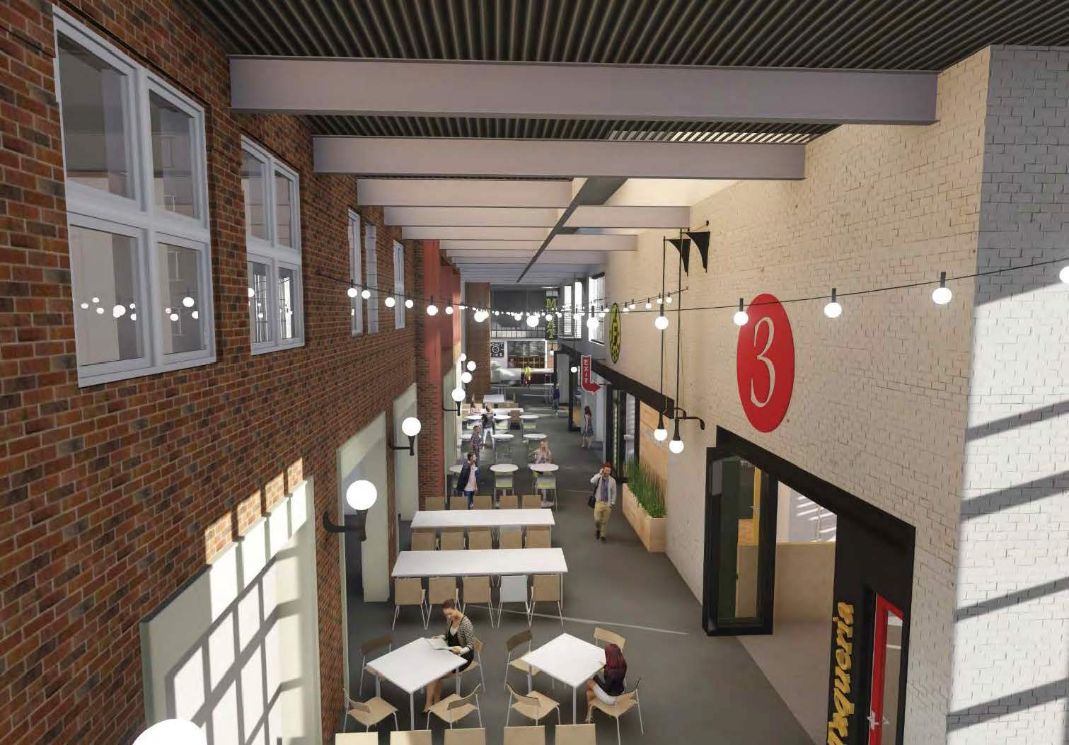
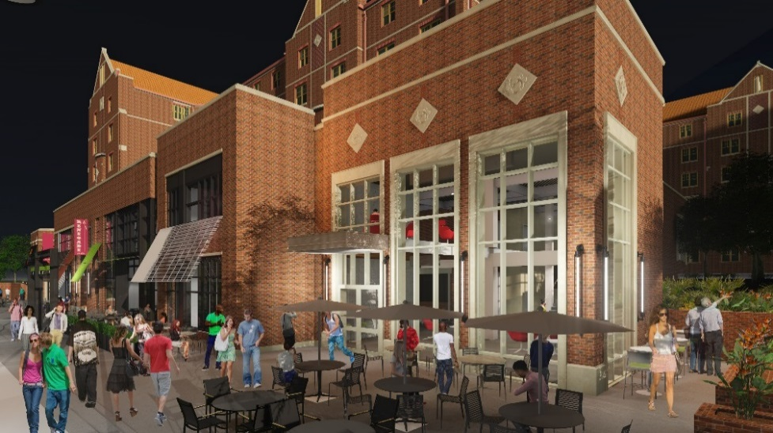
University Housing Replacement Phase II

Slide 21
Jim Moran School of Entrepreneurship / Jim Moran Institute
Substantial Completion Date: 11/15/2017
GSF: 20,000
Total Cost: $8,250,000
Fund Source: University Funds
Project Information:
This project renovates the Guaranty Bank Building located at 111 South Monroe Street in Tallahassee. This project will create space for faculty, staff & students. This facility will accommodate collaboration, presentation, reception and event spaces for students to connect with entrepreneurial mentors in a creative environment.
Design-Build Consultants:
Architects – Currently in selection
Contractor – Currently in selection

Slide 22
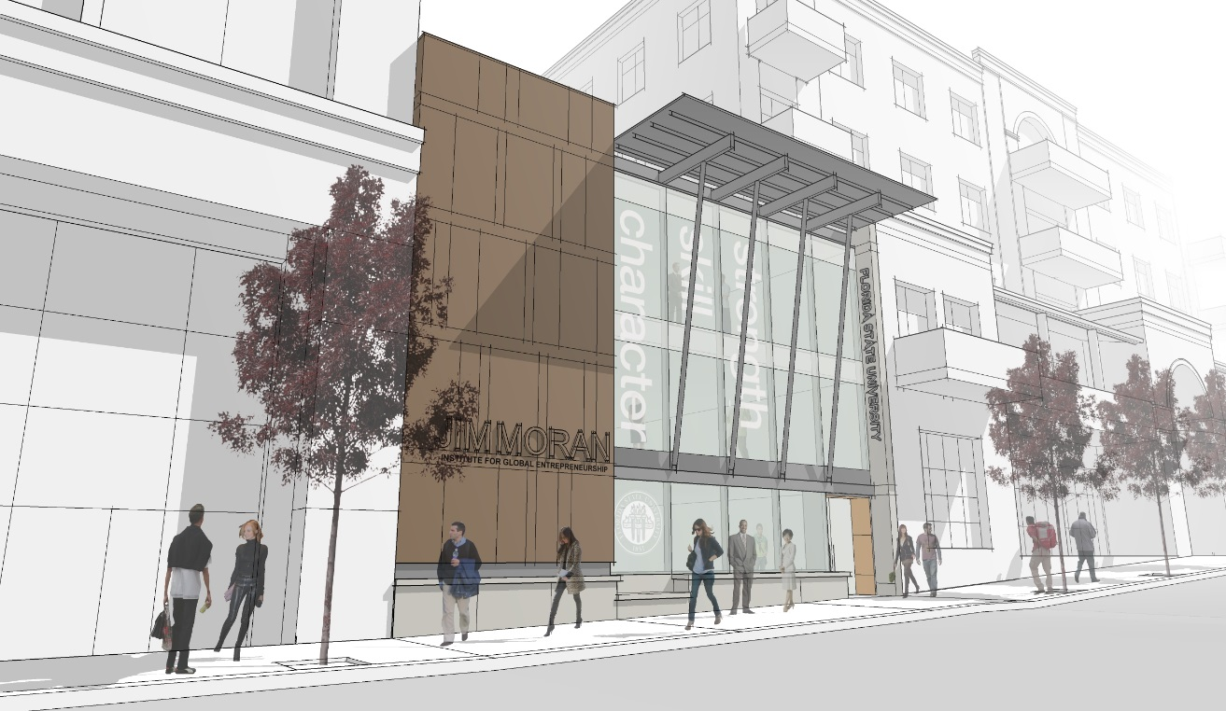
Jim Moran School of Entrepreneurship / Jim Moran Institute

Slide 23
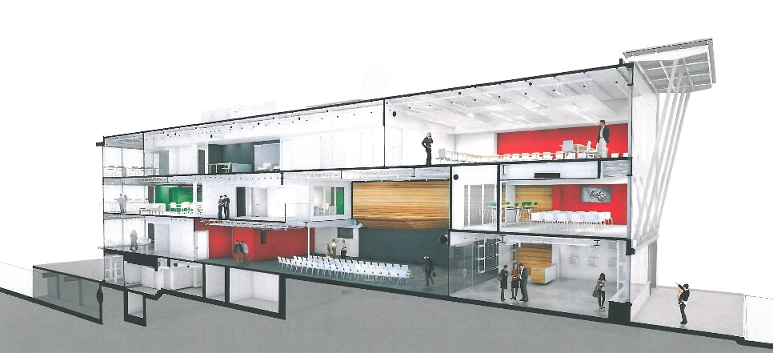
Jim Moran School of Entrepreneurship / Jim Moran Institute

Slide 24
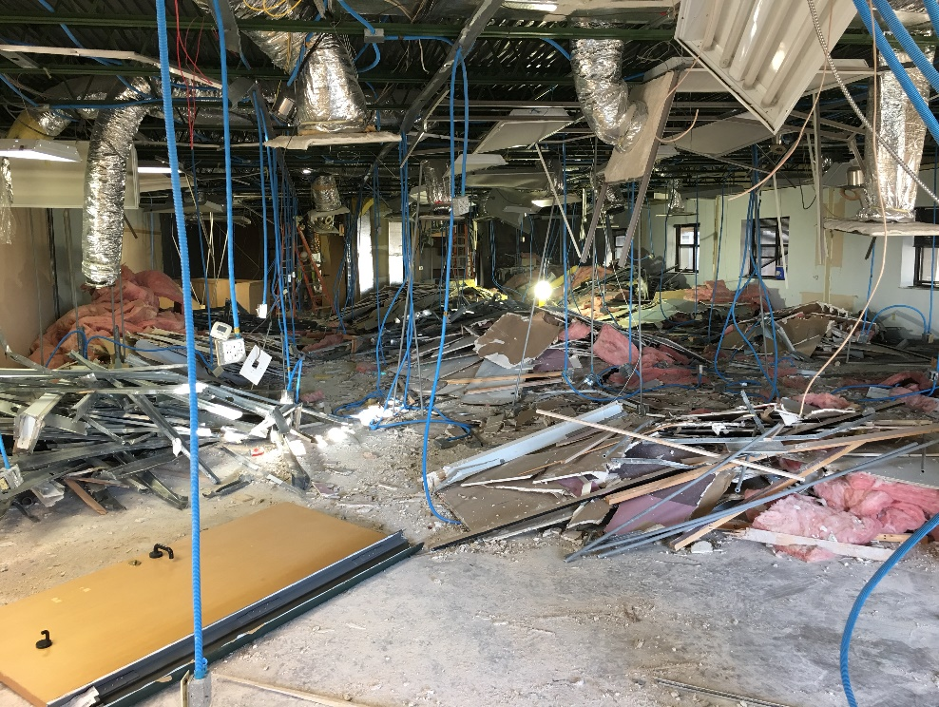
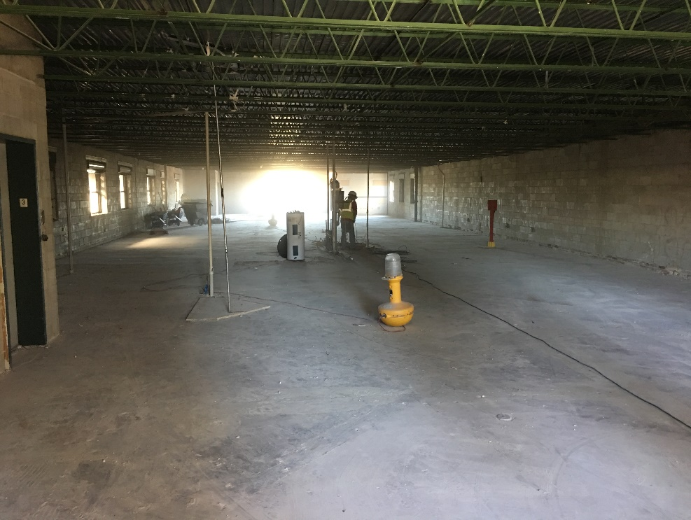
Jim Moran School of Entrepreneurship / Jim Moran Institute
Currently undergoing demolition

Slide 25
Black Student Union / African American Study Center
Substantial Completion Date: 10/01/2017
GSF: 6,500
Total Cost: Over $2,000,000
Fund Source: FCO/Private Funds
Project Information:
This project provides new space for the Black Student Union and African American Study Center. This facility will include a gallery, student lounge, multipurpose space, and administrative space.
Consultants:
Architects – Gilchrist, Ross, Crowe Architects, PA, Tallahassee, FL
Contractor – Mad Dog Construction/One Day Came, Tallahassee, FL

Slide 26
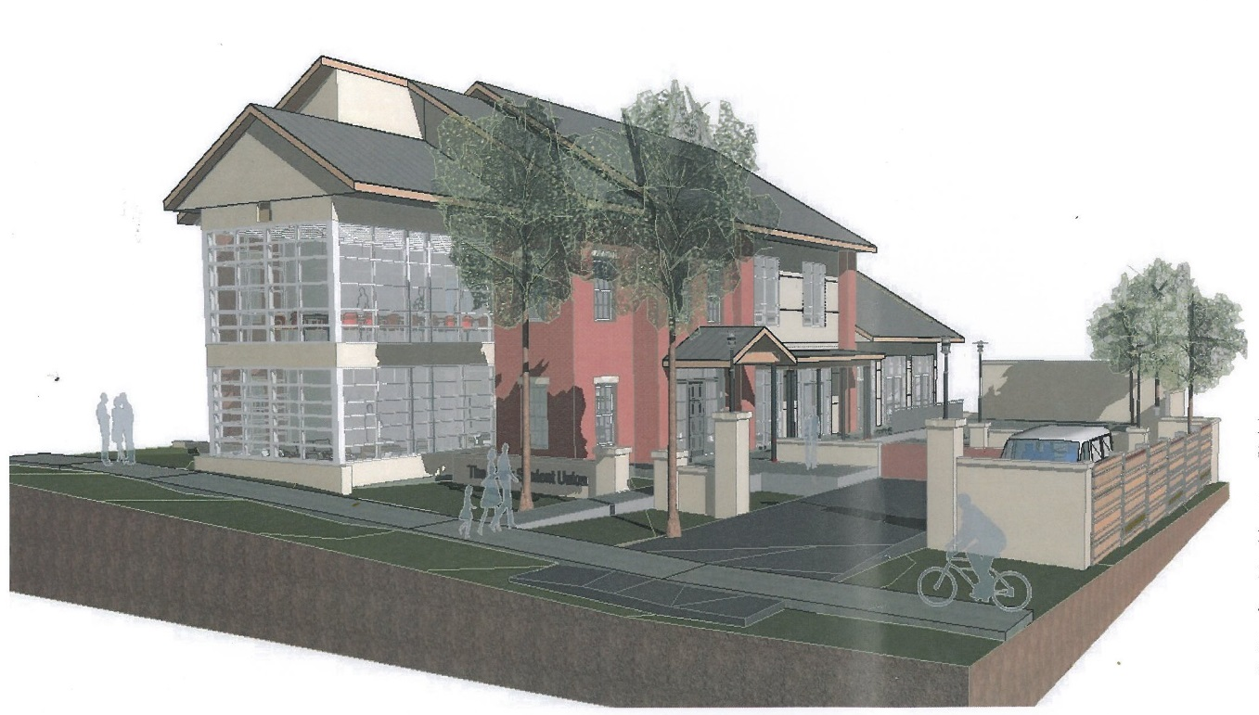
Black Student Union / African American Study Center

Slide 27
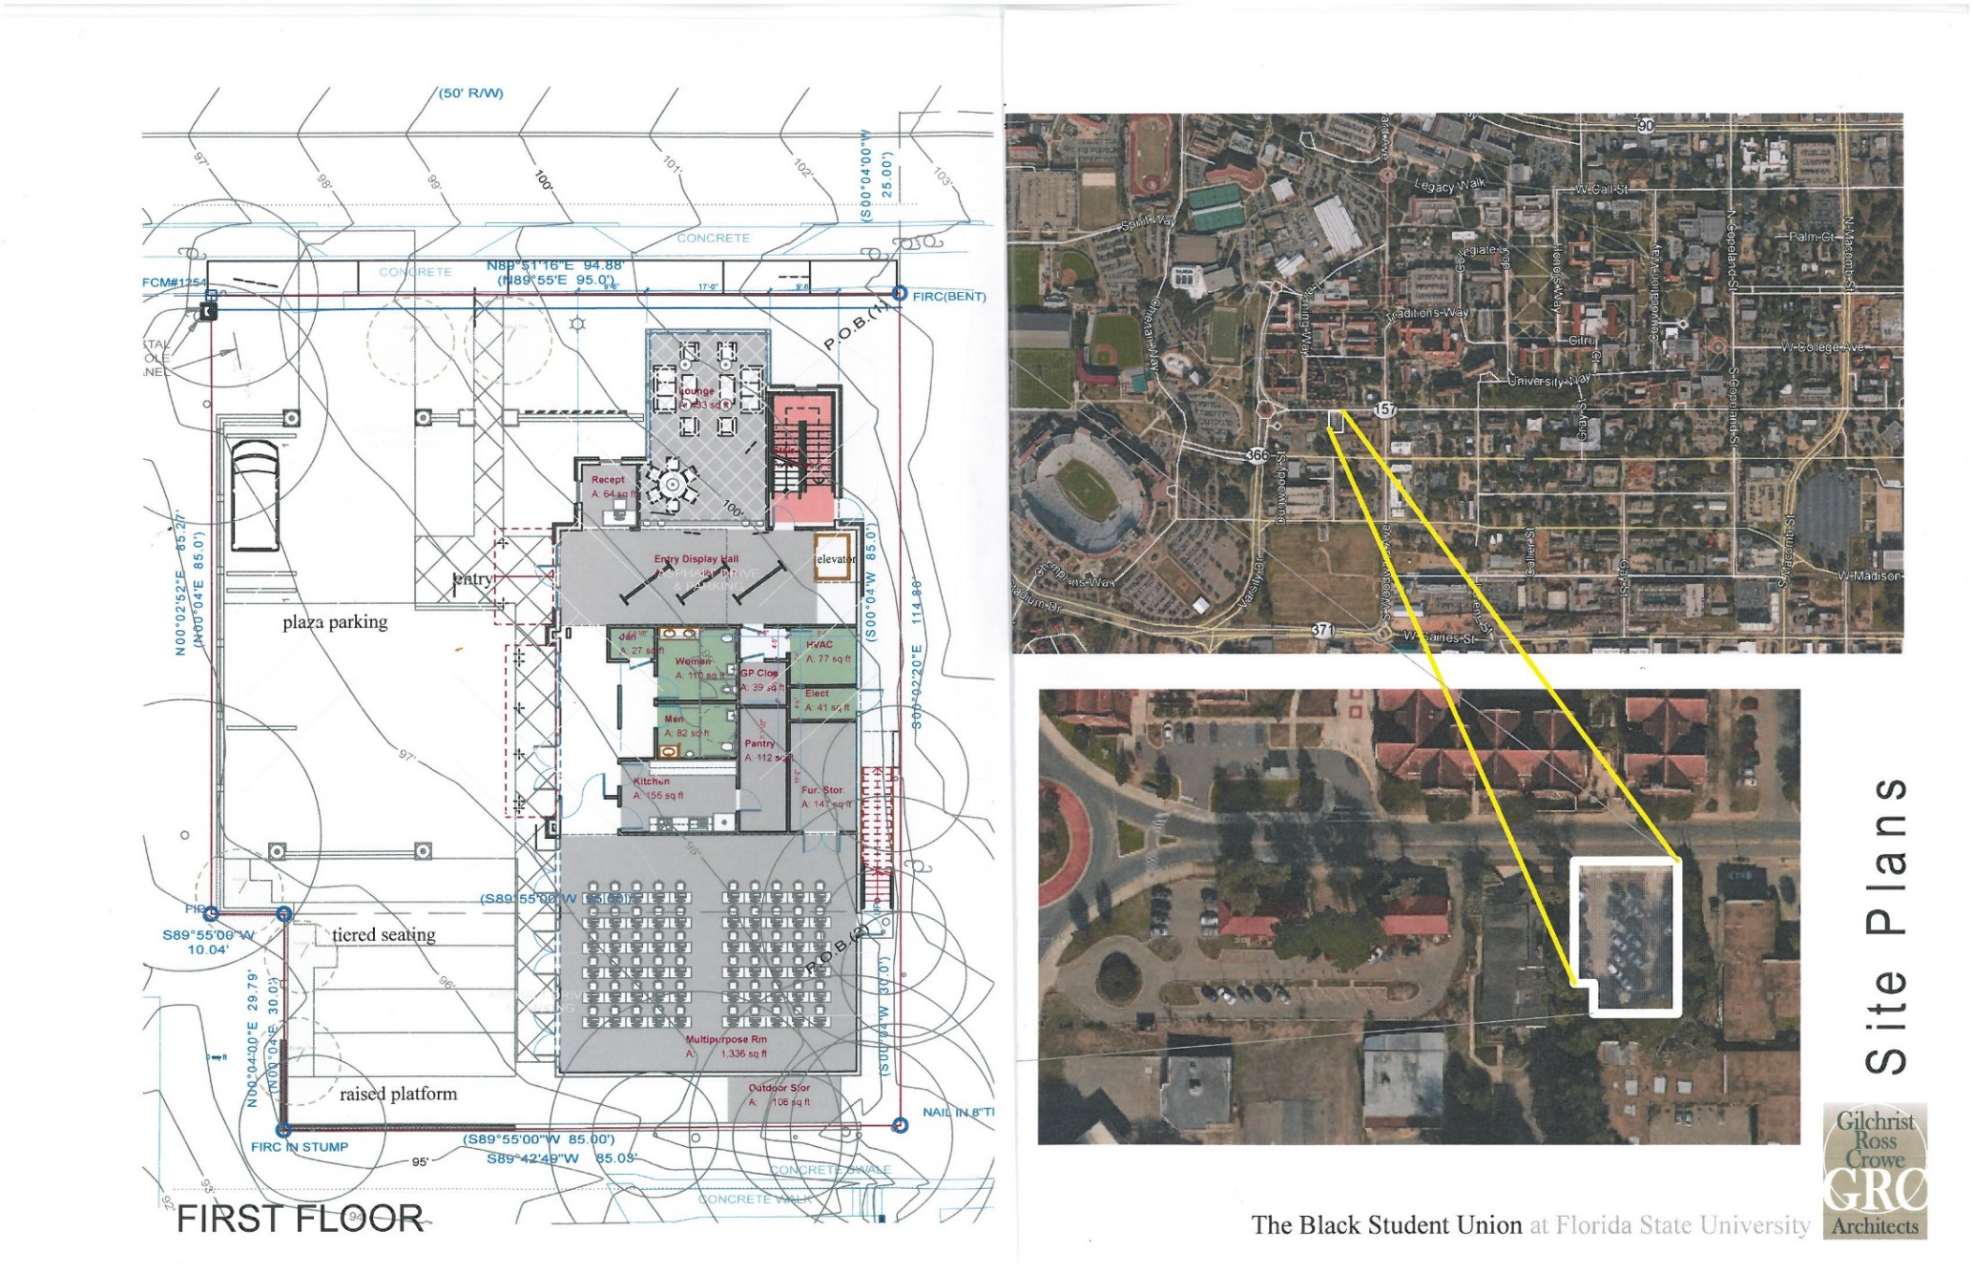
Black Student Union / African American Study Center

Slide 28
Black Student Union / African American Study Center

Slide 29
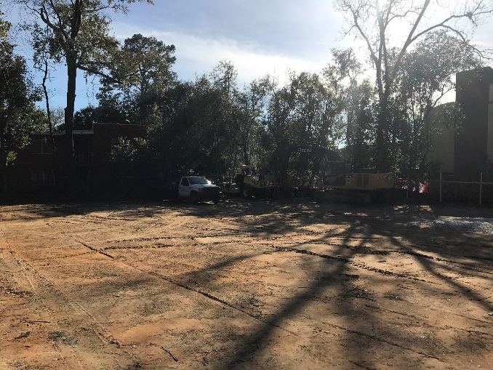
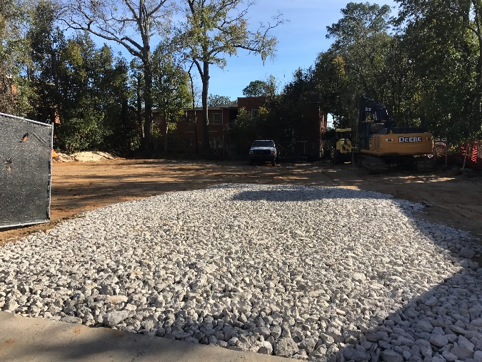
Black Student Union / African American Study Center

Slide 30
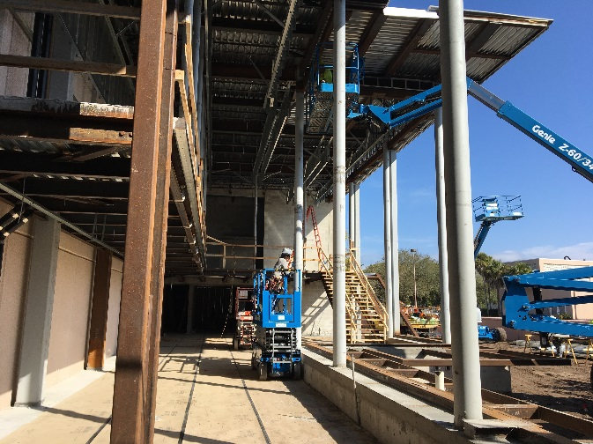
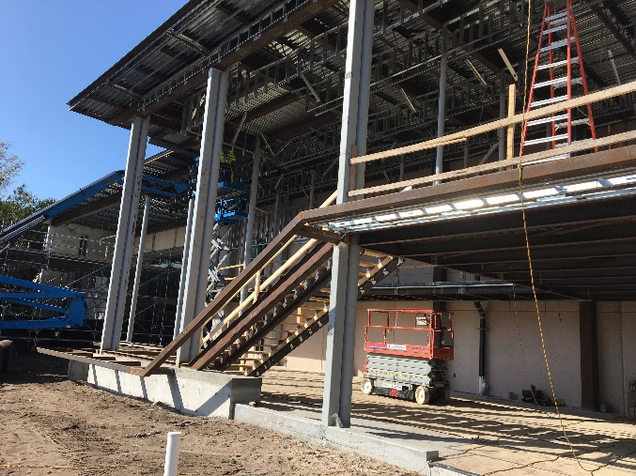
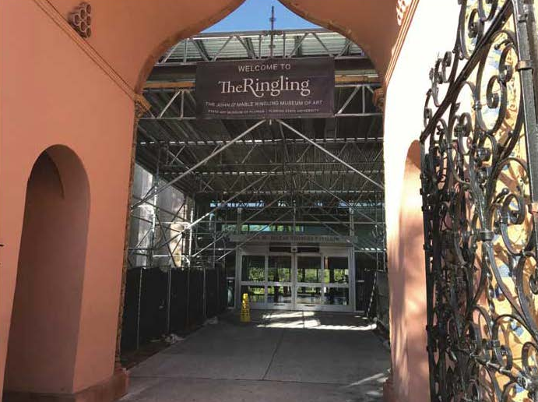
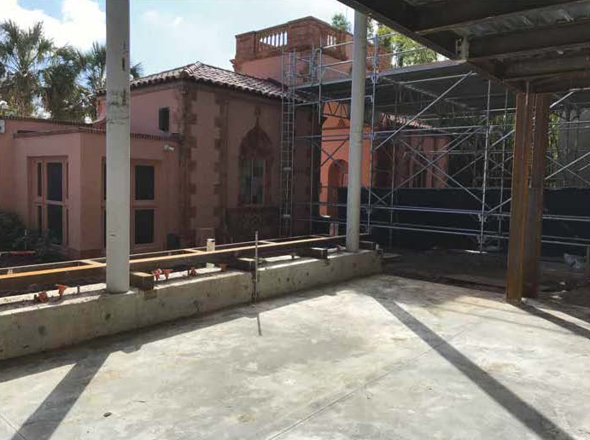
Glass Pavilion at the Ringling

Slide 31
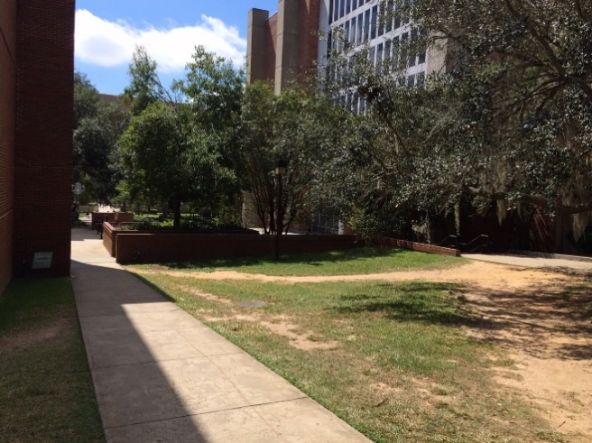
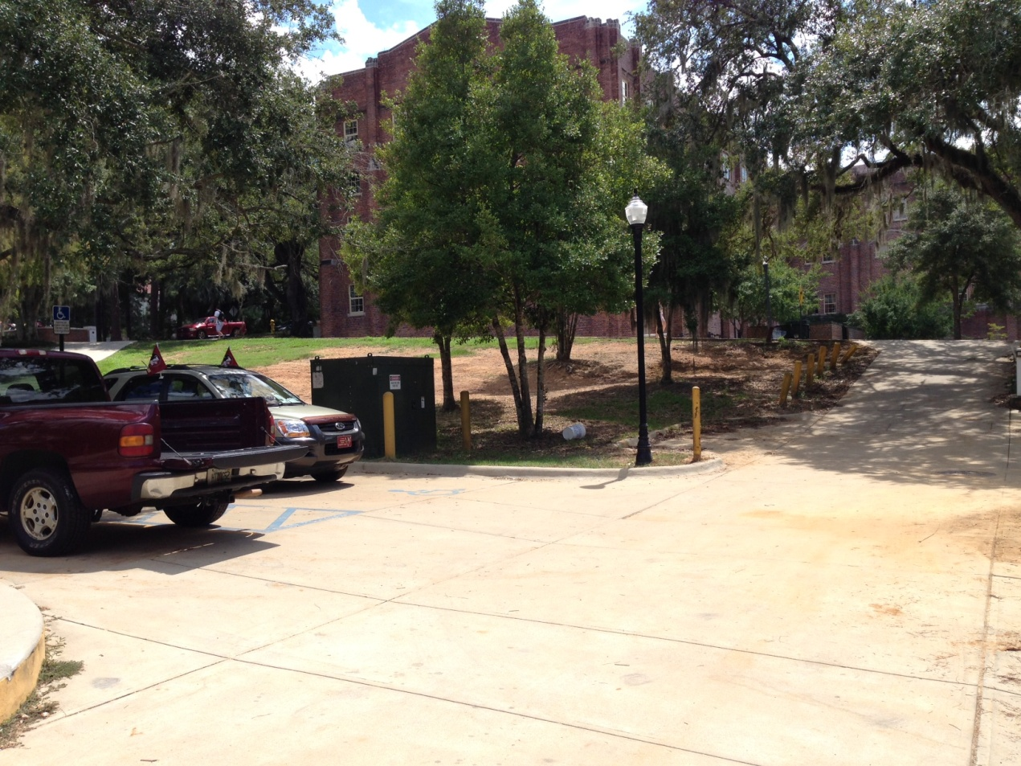
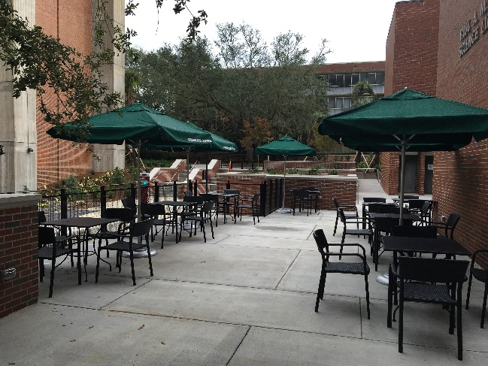
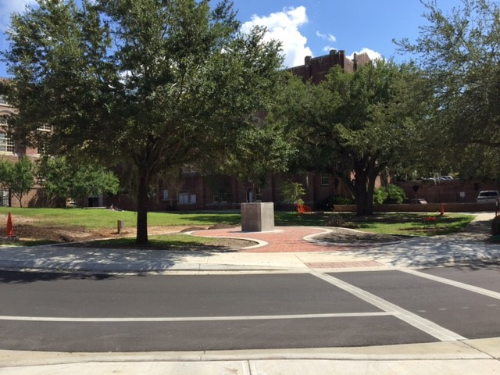
Dirac & Thagard Plazas

Slide 32
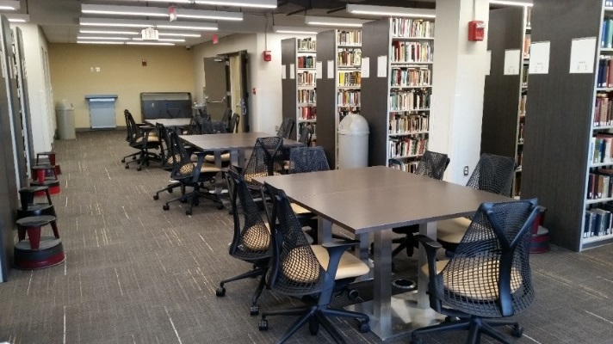
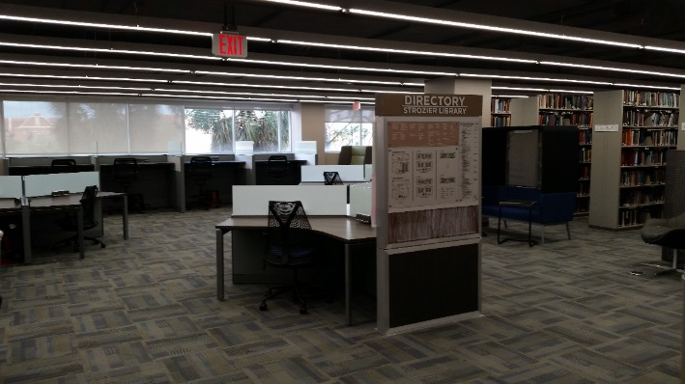
Strozier Library

Slide 33
Spring Deans and Chairs Meeting
Kyle Clark • Vice President for finance & administration
March 23, 2017

