Slide 1
Spring 2017 Deans and Department Chairs Meeting Research at FSU
Gary K. Ostrander Ph.D.
Vice President for Research
President, FSU Research Foundation

Slide 2
Today’s Topics
Research Funding Trends-FSU
Research Funding Trends-Washington DC
Federal Relations
Assistant VP for Research and Academic Affairs

Slide 3
FY16 vs. FY17 High-Level Overview of Proposals, Awards and Dollars
CATEGORY | # PROPS FY16 | # PROPS FY17 | PROP CNT DIFF | # AWDS FY16 | # AWDS FY17 | AWD CNT DIFF | $ AWDS FY16 | $ AWDS FY17 | AWD $ DIFF
Federal | 592 | 601 | +9 | 368 | 432 | +64 | 73,770,668 | 96,150,651 | 22,379,983
State | 75 | 90 | +15 | 93 | 109 | +16 | 13,004,866 | 14,742,986 | 1,738,121
Other | 223 | 236 | +13 | 260 | 282 | +22 | 14,565,749 | 15,567,107 | 1,001,358
TOTAL | 890 | 927 | +37 | 721 | 823 | +102 | 101,341,282 | 126,460,744 | 25,119,462

Slide 5
Federal Relations

Slide 6
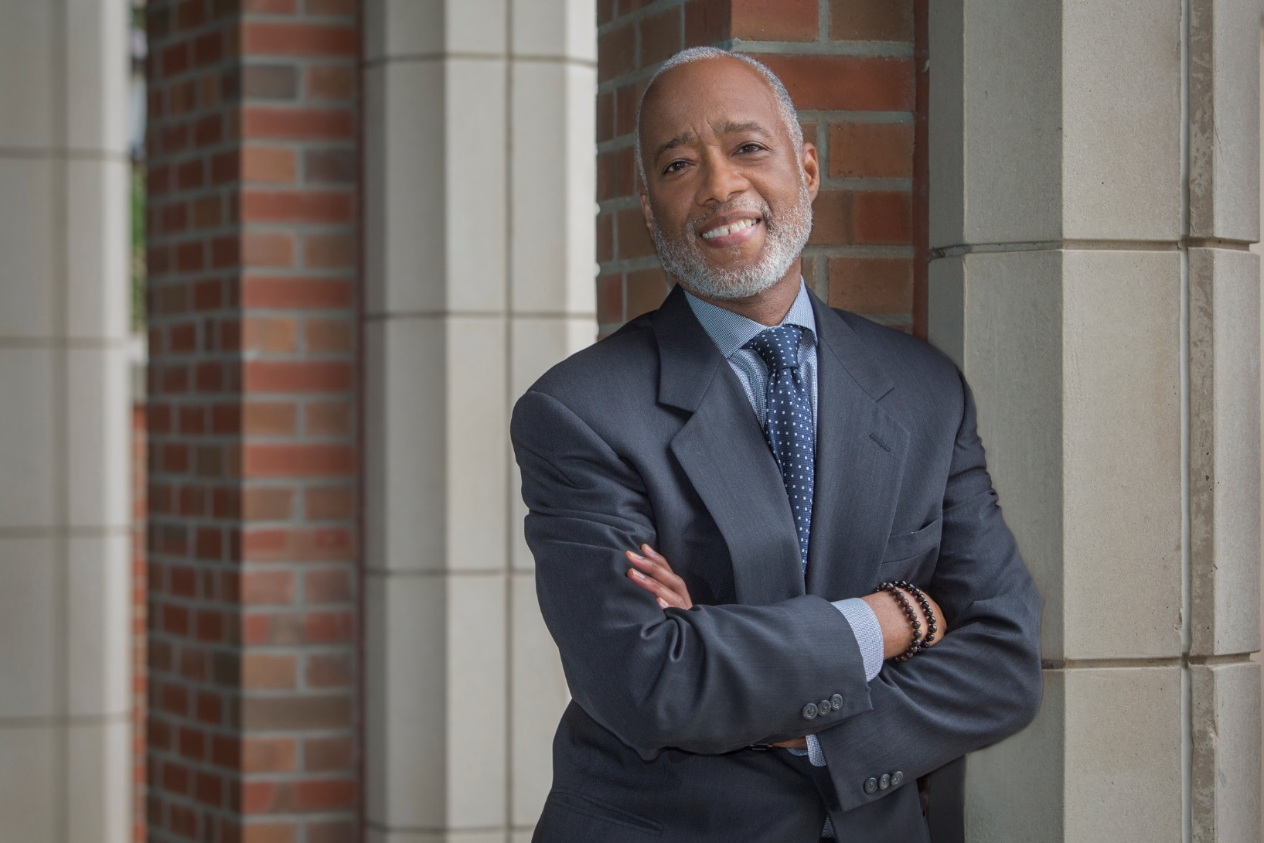
Dr. Norman Anderson VP for Research and Academic Affairs

