Slide 1
Department Dashboards
OFFICE OF INSTUTIONAL RESEARCH
James Hunt, PhD
Assoc. Vice Provost and Chief Data and Analytics Officer
Samantha Nix, PhD
Program Director, Curricular & Student Success Analytics

Slide 2
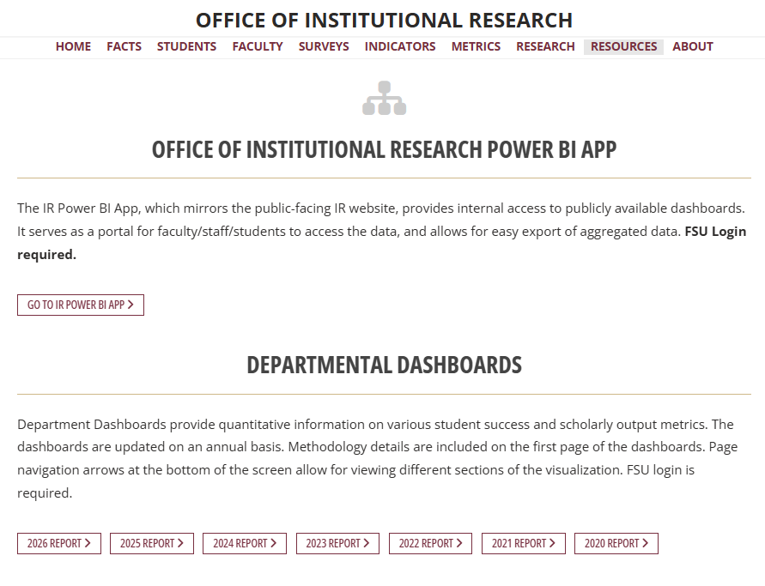
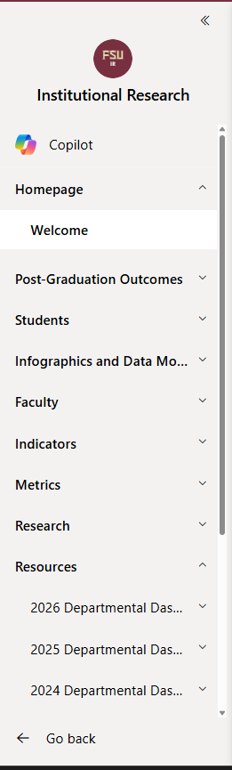

Where to find the Department Dashboards
Navigate to: ir.fsu.edu > Resources tab
IR Power BI App
IR Power BI App
(allows tabular export)
Traditional Report

Slide 3
Featured on the Department Dashboards
Student Admissions and Enrollment Headcount
Student Success
New for the 2026 Edition
Certificates Granted
Degree Completion
Courses & Instructors
Faculty Headcount
Faculty Productivity
Masters Graduation Rates
Masters Time to Degree

Slide 4
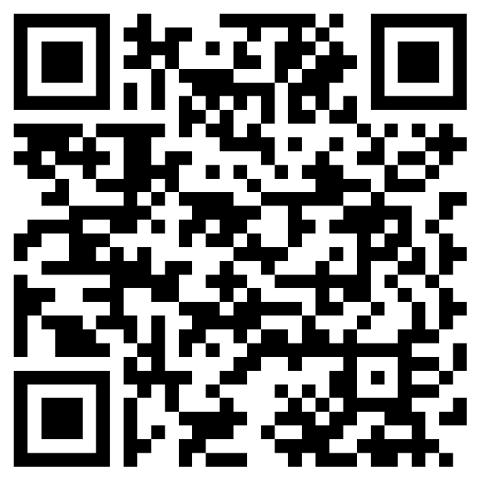
Live Demonstration
Registration: https://forms.cloud.microsoft/r/yJevrZf5bE
Department Dashboards
2026 Edition
Location: Teams meeting
Date: Tuesday, April 7th
Time: 3:00-4:00 pm ET
This information will be repeated in a following slide.

Slide 5
New Academic Analytics Tools
OFFICE OF THE PROVOST
Rick Burnette, PhD
Senior Vice Provost and Chief Strategy Officer
Laurel Harbin, PhD, AICP
Director of Strategic Initiatives

Slide 6





Four Analytic Modules
External Discovery Site
Faculty Insights
Industry Insights
Medical Insights

Slide 7


What to Expect
New FSU Analytics Website
New Faculty Profile Tool
Resources Webpage for Faculty & Staff
Faculty Training Webinar

Slide 8


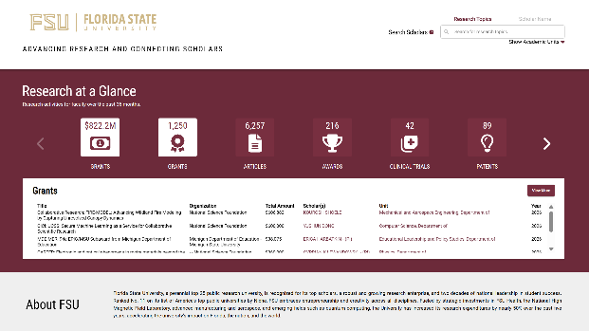
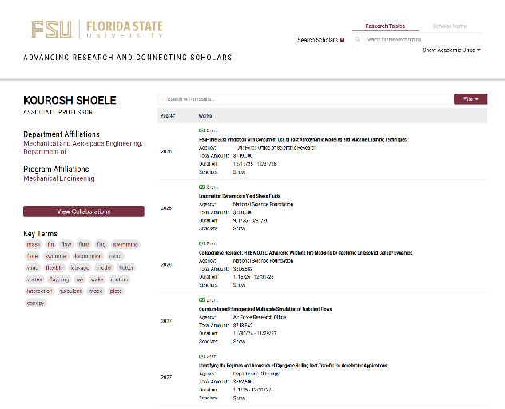
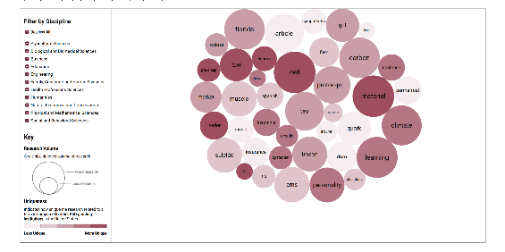
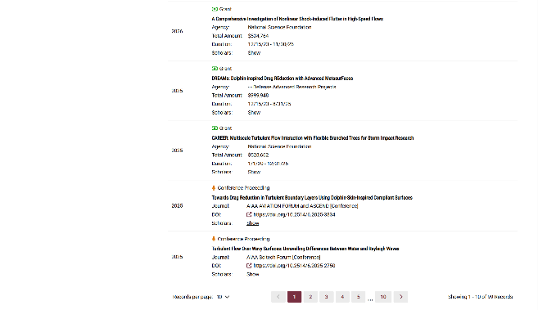
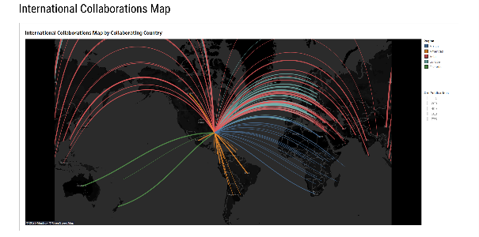
Discovery
Faculty Profiles
FACULTY NAME

Slide 9


University Branding
Search by Research Topic, Faculty Name,
or Academic Unit
Select University Research Metrics
Scholarly Work with Links to Faculty Profiles and Academic Unit Pages
Trending Research Topics with Filters by Discipline
Topics with Pop-up Menus listing Scholar Works and Links to Authors’ Faculty Profiles

Slide 10
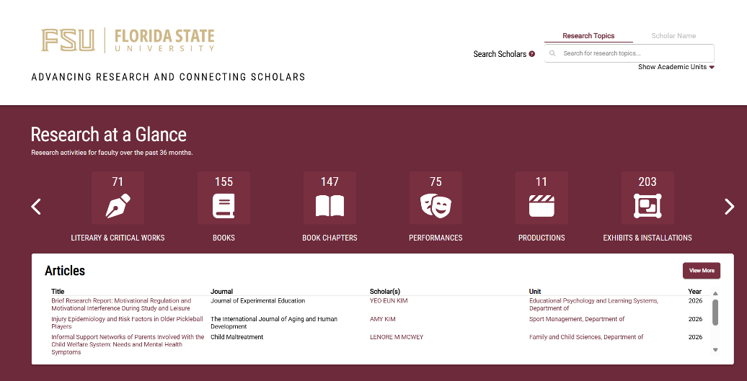
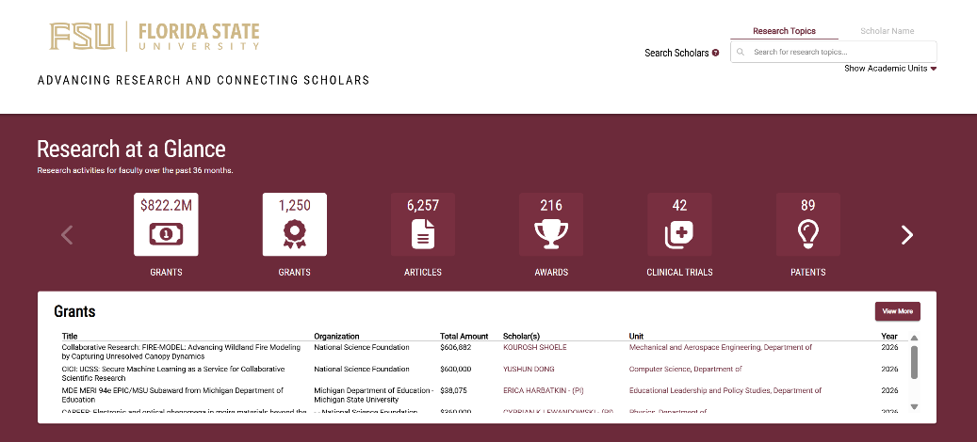
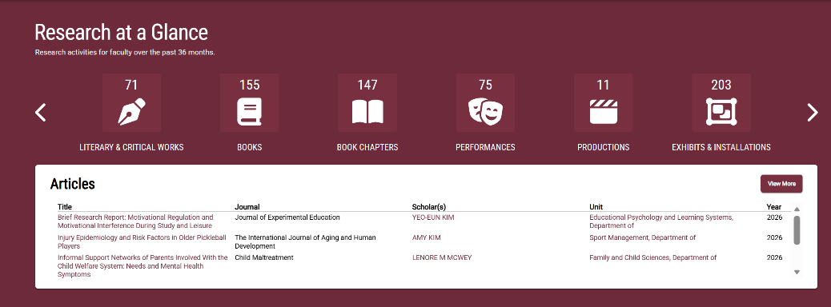
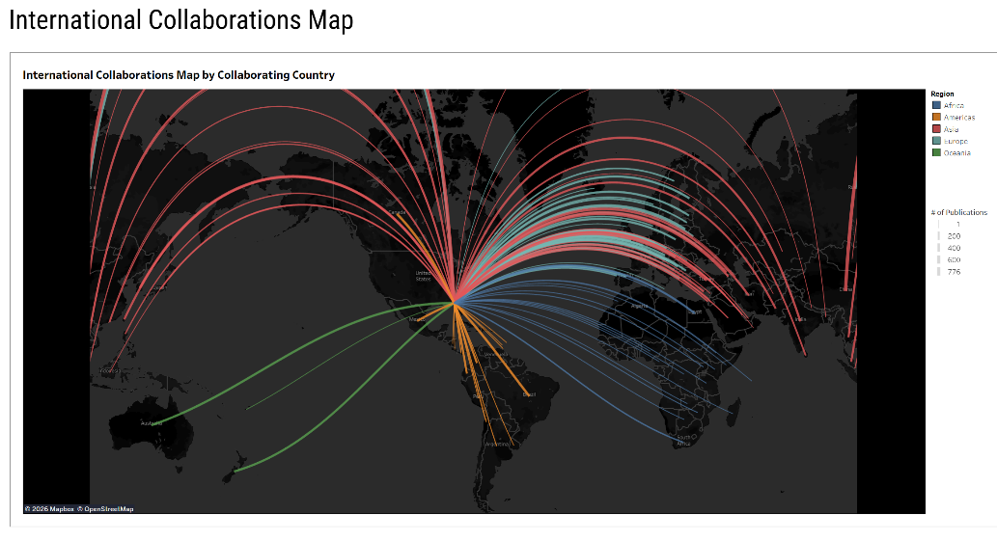
Additional Research Categories reflecting Fine Arts & Humanities
Scholarship
International Collaborations Map

Slide 11
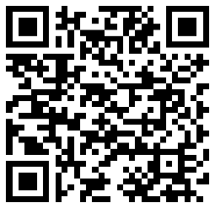
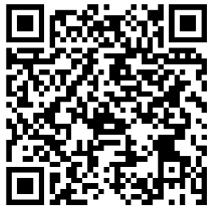
Live Demonstrations
Department Dashboards
2026 Edition
Location: Teams meeting
Date: Tuesday, April 7th
Time: 3:00-4:00 pm ET
Registration: https://forms.cloud.microsoft/r/yJevrZf5bE
FSU Analytics
Training Webinar
Location: Zoom Meeting Room
Date: Monday, April 13th
Time: 2:00-3:00pm est
Registration:
https://fsu.zoom.us/webinar/register/WN_Wa282YMOT9SxVXoSFEklhA#/registration

