Slide 1
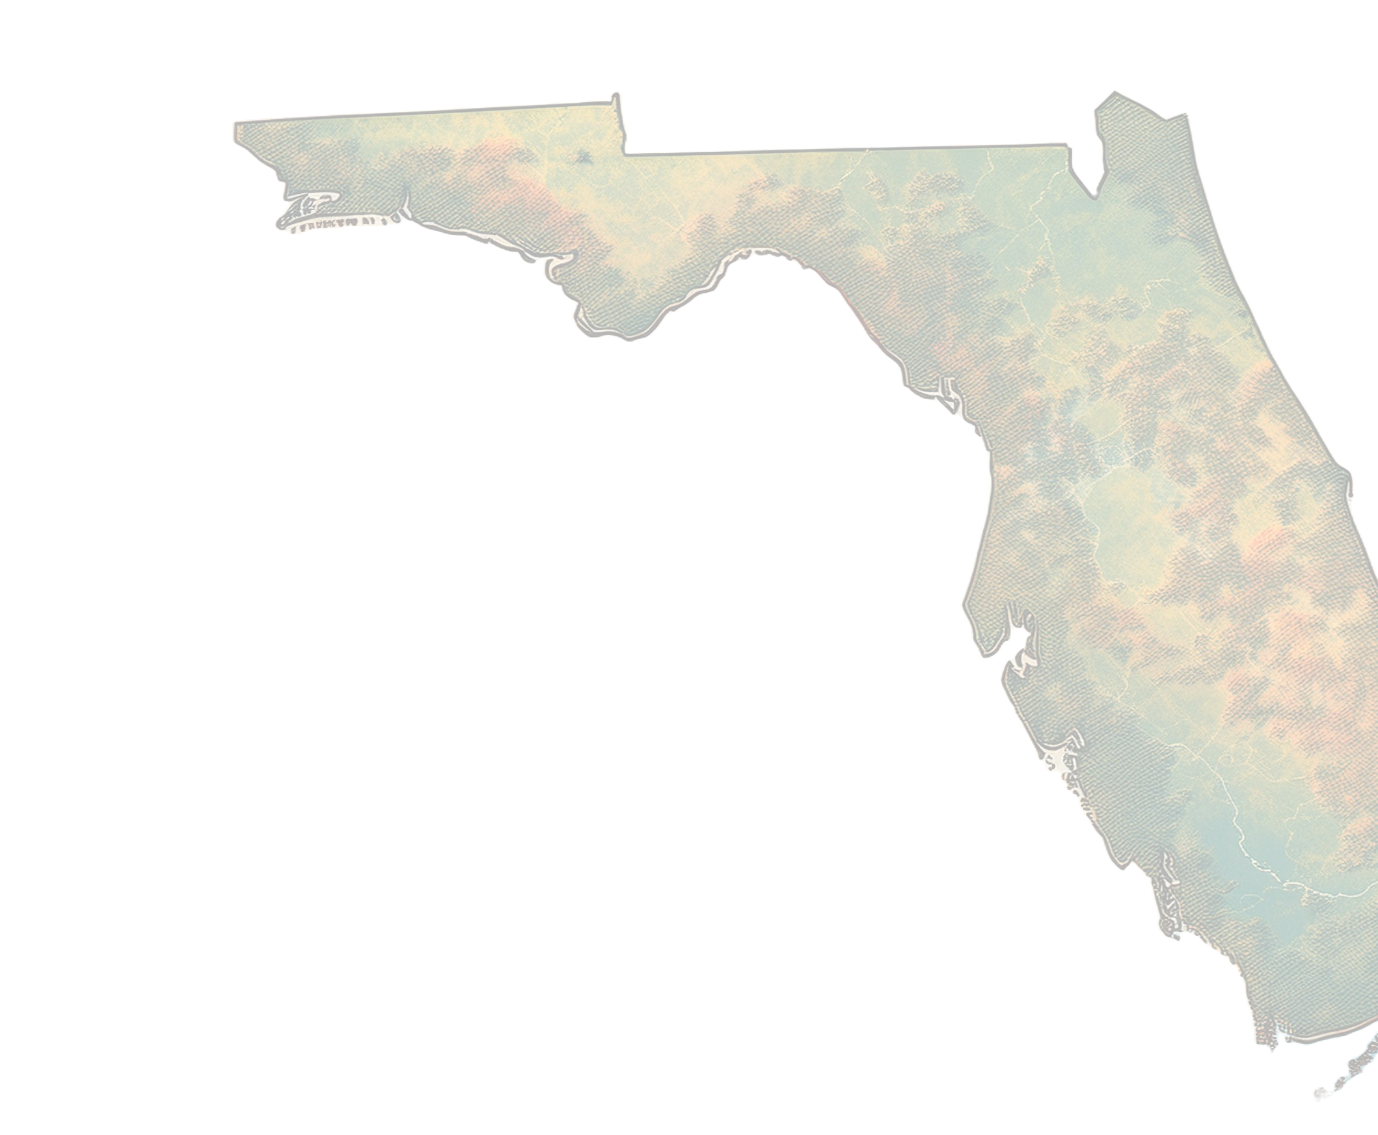
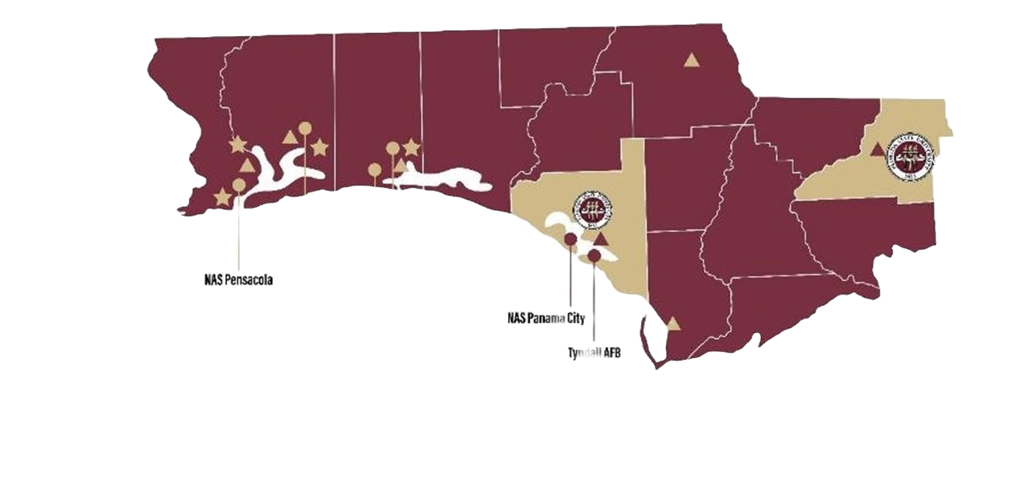


FSU Health: Our Role in a Fast‑Shifting Market
FSU Health fills a statewide gap: Florida lacks sufficient academic‑clinical capacity to meet population growth, and FSU is positioned to anchor North Florida’s research‑driven care model.
Our structure integrates research, education, and clinical delivery, allowing us to tackle access challenges private competitors cannot.
The timing is advantageous: Florida’s growth + public sector momentum put FSU in a position to shape the region’s health future.
Whiting Field
Eglin AF Base
NAS Pensacola
Hurlburt Field
University State College
NAS Panama City
Tyndall AFB
F L O R I D A

Slide 2
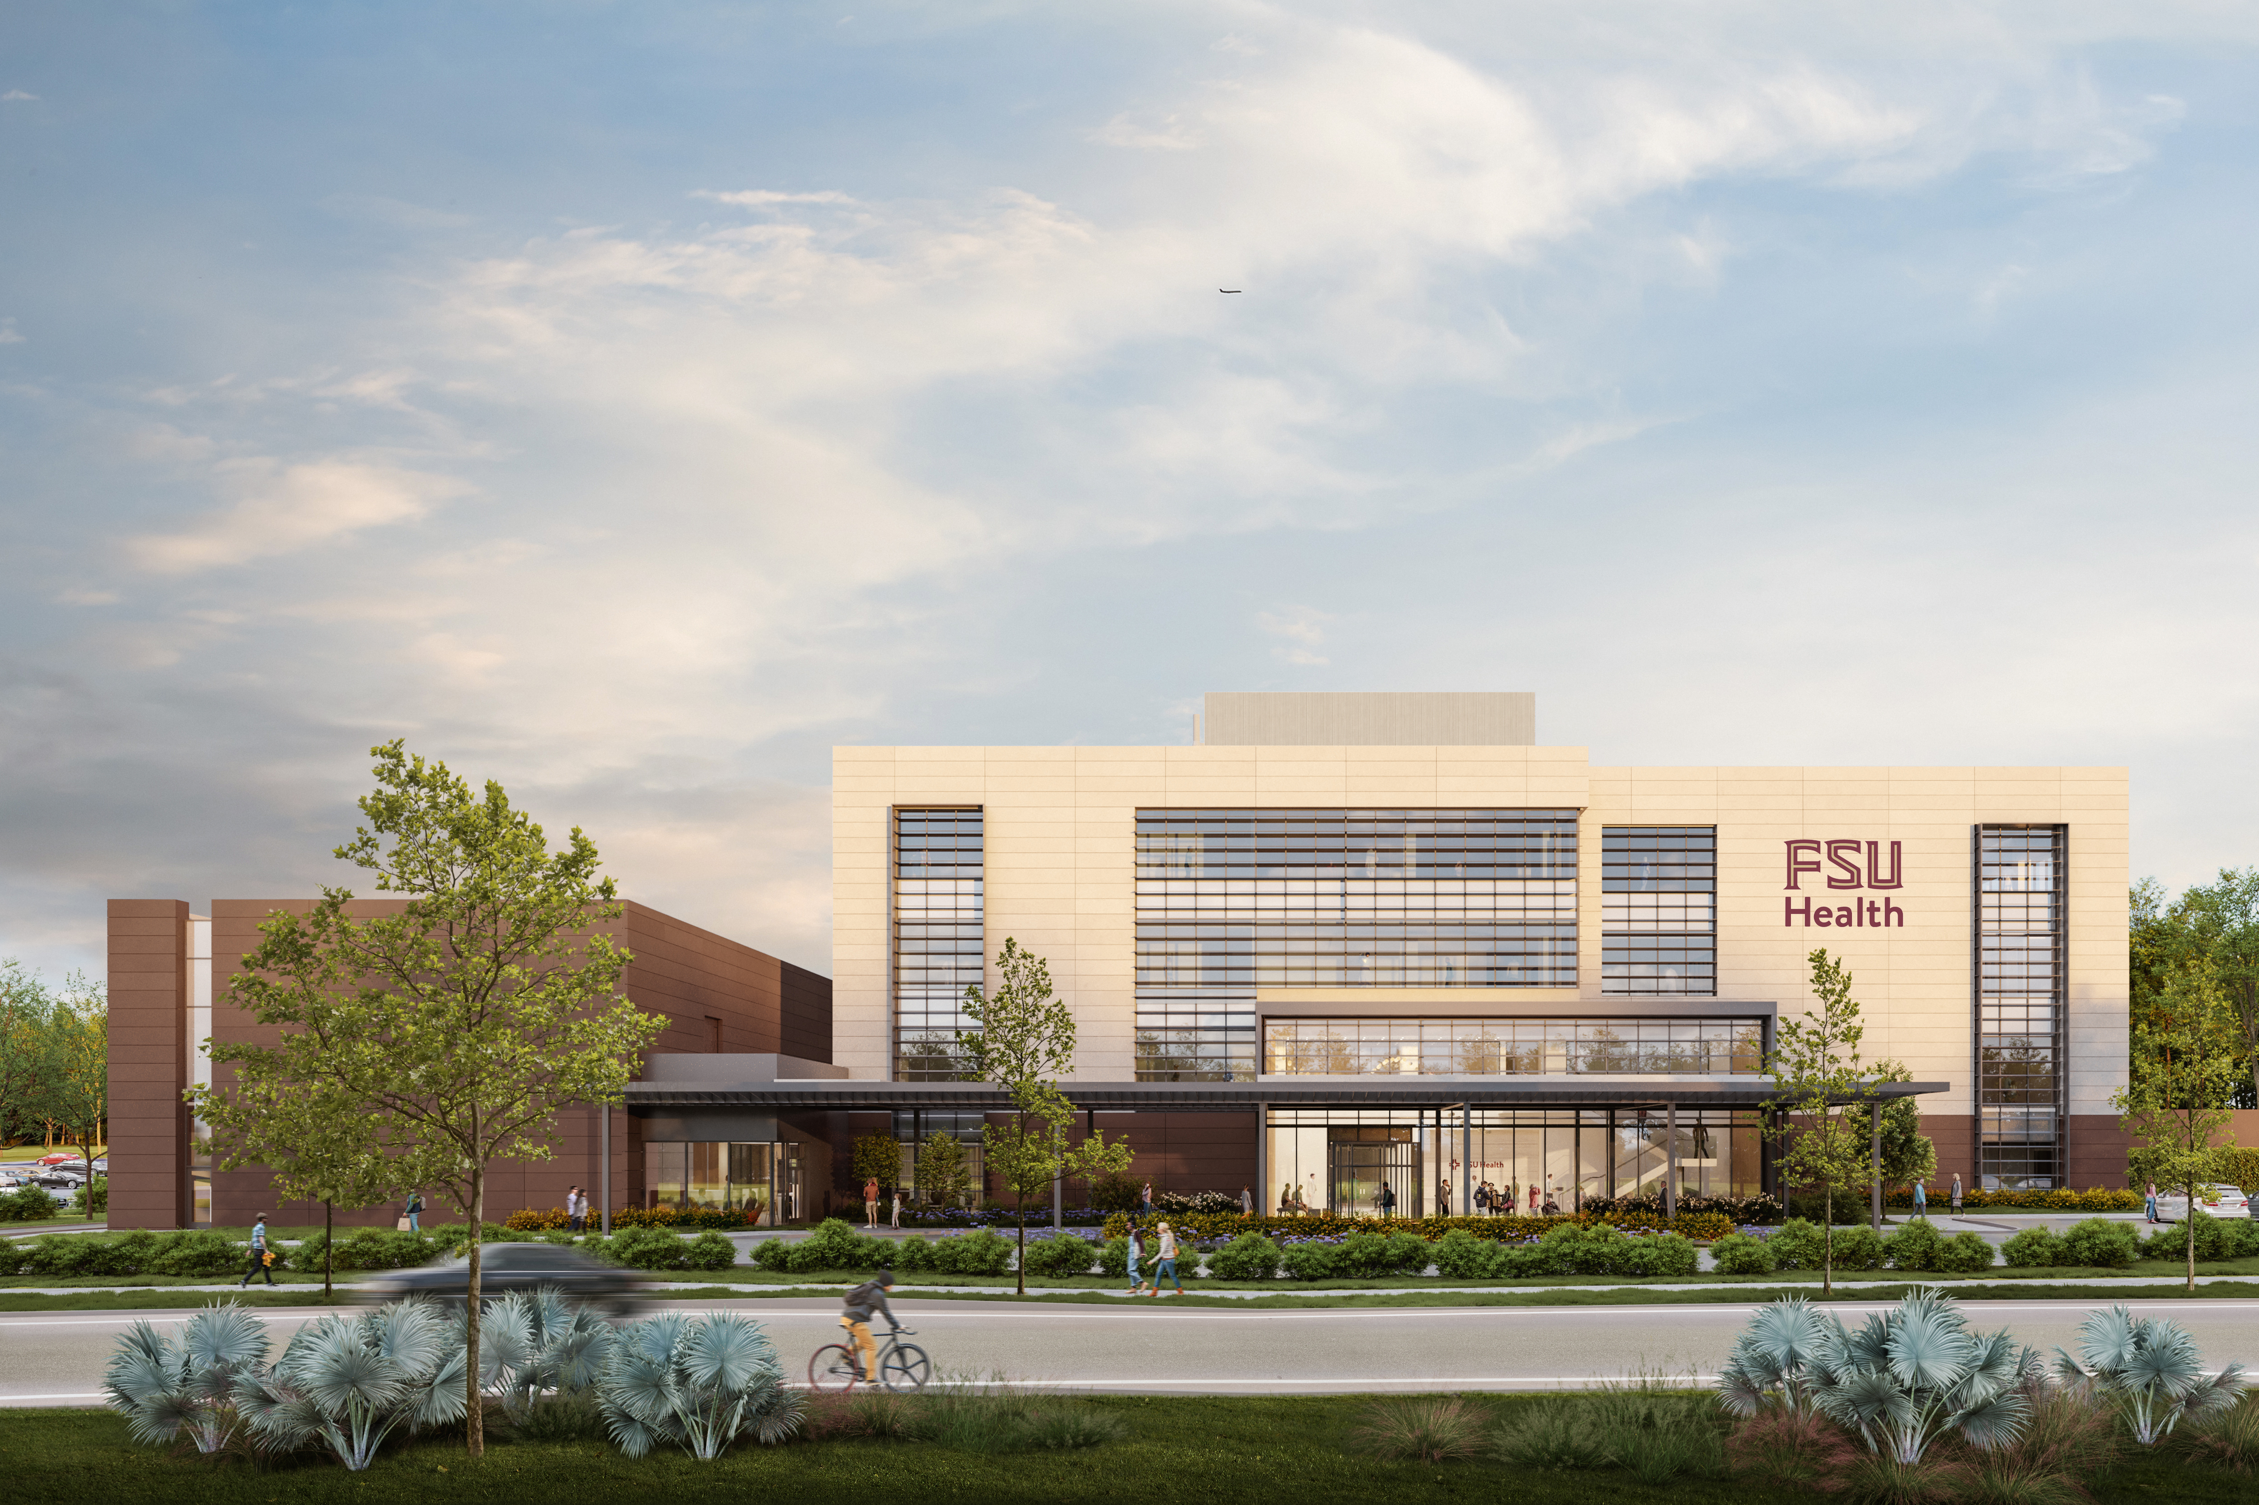
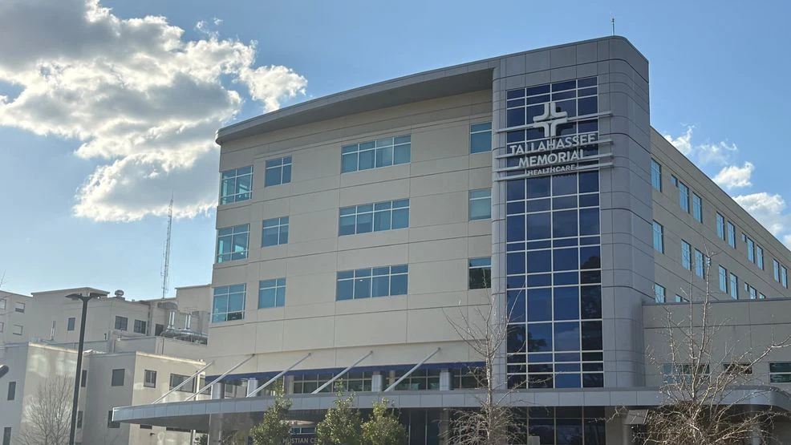
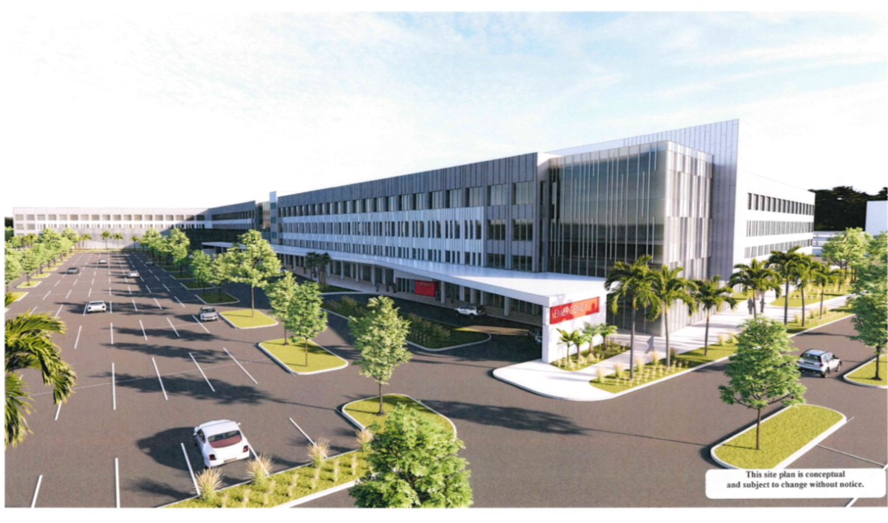
Concrete Progress: Facilities, Funding, Timeline
Academic Health Center at TMH (Opening 2026)
  140,000 sq. ft. academic health building with clinical research space, laboratories, and a family medicine residency clinic, designed to bridge research and patient care.
Tallahassee Memorial Hospital (Partnering 2026)
  A longstanding regional anchor hospital, TMH is the clinical home for FSU Health’s expanding academic‑clinical programs.
FSU Health Panama City Beach
  Phase 1 (Completed 2024): 80,000‑sq‑ft Medical Office Building offering urgent care, outpatient surgery, cardiology, orthopedics, and primary care.
  Phase 2 (Opening 2028): A 100‑bed (up to 180-bed) inpatient hospital with emergency services, surgery, cardiology, imaging, and other inpatient programs

Slide 3
12–24 Month Priorities: Growth With Fiscal Discipline
Open the Tallahassee Academic Health Center on time (late 2026)
Expand ambulatory and community‑based care with partners to match the industry shift to outpatient/home settings and relieve acute‑care pressure.
Operational resilience in a margin‑tight cycle: target research grants/commercial partnerships; apply AI/IT for research opportunities; leverage economies of scale.
Market presence & convening power: attract partners and talent

Slide 4
Connecting academic excellence with real-world health care delivery
Opportunity Area | Aligned FSU College(s) | Notes
Patient & Guest Experience | Dedman College of Hospitality | Wayfinding, navigating the episode of care, patient care journeys, service recovery.
Clinical Operations, Analytics, MIS | Herbert Wertheim College of Business | SOP, staffing, patient attribution, and throughput to predictive and reactive analytics.
Behavioral Adherence, SDOH, Policy | College of Social Sciences & Public Policy; College of Social Work | SDoH Hub, Care Plan Adherence, Health economics, Public Health workforce pipeline.
Healing Environment, Arts Integration | College of Fine Arts | High frequency settings, trauma informed care.
Communication, Health Messaging | College of Communication & Information | Patient Facing education, trauma informed care.
Engineering, Devices, Systems | FAMU/FSU College of Engineering | Bench to bedside.
Career track and simulations | College of Nursing | Revisit Epic sims (example), scholarships-to-jobs.
Legal | College of Law | Advance Directives Clinic, Medical-Legal Partnership, Governance Programs, Health Law Certificate.
Health Justice | College of Criminology and Criminal Justice | Educational & Workforce Development Programs, Hospital Security Modernization (environmental assessment, weapon detection, protocol development, etc.), Emergency Department (ED) Crisis Response, Elder fraud and exploitation prevention.

