Slide 1
Deans & Chairs
Kyle Clark
Senior Vice President for Finance & Administration
March 10, 2026

Slide 2
FY 2025-2026 Operating Budget

Slide 3
2025-2026 Total Operating Budget Summary
 | 2024-2025 | Amended 2025-2026
Education & General - State Support | $937,468,379 | $1,014,635,024
Education & General - Tuition and Fees | 246,948,346 | 257,997,379
Designated | 88,880,058 | 92,291,982
Auxiliary | 433,441,908 | 505,566,530
Restricted | 583,679,742 | 547,748,153
Debt Service | 29,761,724 | 24,976,271
Capital Projects | 519,758,280 | 486,423,573
Component Units | 162,454,627 | 148,579,653
Total | $3,002,393,064 | $3,078,198,565

Slide 4
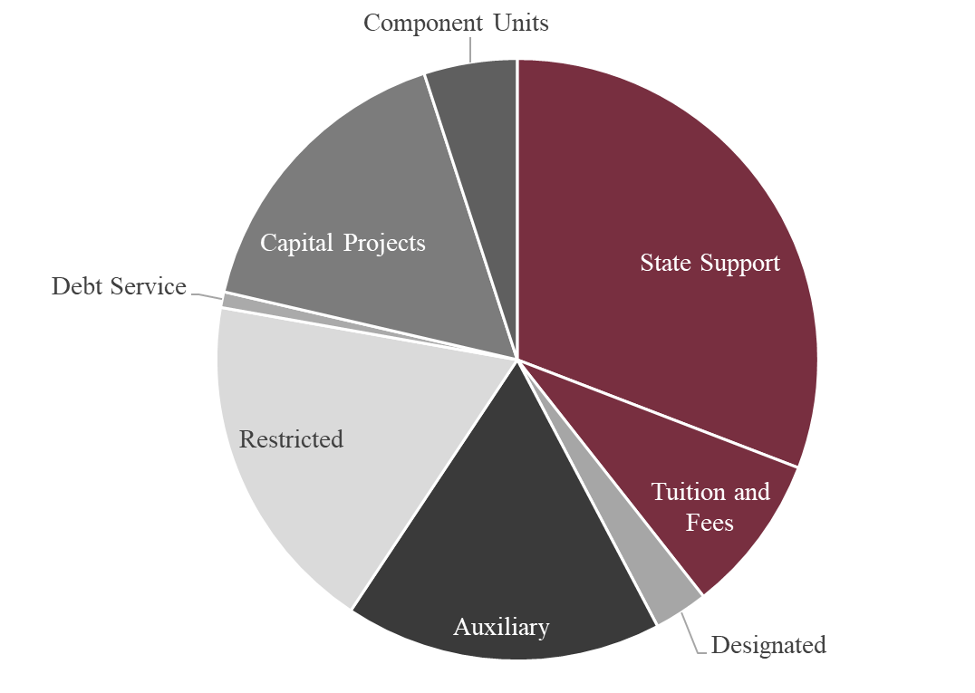
Education & General (E&G)
Education and General (E&G): Largely funds appropriated by the State Legislature, including General Revenue (primarily Florida’s sales tax revenue) and Lottery. This also includes tuition and certain fees.
$1,272,612,403
41.34% of total budget

Slide 5
State Funding as a Percentage of Total Revenues
Institution | Percentage
Florida State University | 44.4%
North Carolina State University | 34.2%
University of Maryland | 33.7%
University of Tennessee | 33.5%
University of Georgia | 33.0%
Texas A&M University | 29.3%
University of Florida | 25.3%
University of California – Berkeley | 17.6%
University of Texas at Austin | 11.8%
University of California – Los Angeles | 6.7%
*Based on fiscal year 2023-24 and includes state Contract and Grants

Slide 6
Total Budget - Top Spending Categories
Spending Category | Amount
Wages & Benefits | $1,314,249,463
Capital Projects | $485,637,264
Financial Aid | $297,643,386
Professional Services | $170,226,186
Utilities | $85,454,370
Equipment & Supplies | $85,448,746
Student Financial Aid | $58,183,230
*Before reduction for internal sales

Slide 7
2025-26 Recurring Pay Increases
Group | E&G | Non-E&G | Total
Faculty | $11,764,347 | $1,582,480 | $13,346,827
Staff | $5,676,016 | $5,036,662 | $10,712,678
Police | $138,952 | $24,901 | $163,853
Graduate Assistants | $1,093,358 | $550,438 | $1,643,796
Total | $18,672,673 | $7,194,481 | $25,867,154
*Includes fringe benefits

Slide 8
State Appropriations
 | 2021-22 | 2022-23 | 2023-24 | 2024-25 | 2025-26
Operations
General Revenue | $332,226,348 | $389,323,359 | $451,122,894 | $530,853,965 | $499,815,012
Lottery | 72,127,729 | 89,400,319 | 102,291,145 | 96,436,301 | 94,800,582
Preeminence | 58,487,179 | 58,487,179 | 91,820,512 | 116,820,512 | 126,820,512
Performance | 53,879,537 | 54,605,672 | 70,974,333 | 73,279,444 | 73,448,412
Total Operations | $516,720,793 | $591,816,529 | $716,208,884 | $817,390,222 | $794,884,518
Capital
General Revenue | $36,578,996 | $148,421,258 | - | - | -
PECO | 19,353,901 | 62,500,000 | 107,767,202 | 82,900,000 | 127,500,000
CITF | 4,508,474 | 4,151,205 | 4,263,520 | 4,575,908 | 4,600,000 | *
Total Capital | $60,441,371 | $215,072,463 | $112,030,722 | $87,475,908 | $132,100,000
Total State Appropriations | $577,162,164 | $806,888,992 | $828,239,606 | $904,866,130 | $926,984,518
* Departmental budget; will be updated to actuals when available

Slide 9
Unfunded Mandates
Description | Estimate
Retirement | $23,674,127
Health Insurance | $4,069,016
Minimum Wage | $2,518,730
FLSA | $1,285,814
Tuition and Fee Waivers | $10,275,000
PO&M | $12,400,000
2% FCO Reserve | $2,200,000
Total | $56,422,687

Slide 10
Key 2026 Budget Dates
JANUARY
Regular Session Convenes
SUN | MON | TUES | WED | THURS | FRI | SAT
 |  |  |  | 1 | 2 | 3
4 | 5 | 6 | 7 | 8 | 9 | 10
11 | 12 | 13 | 14 | 15 | 16 | 17
18 | 19 | 20 | 21 | 22 | 23 | 24
25 | 26 | 27 | 28 | 29 | 30 | 31
13
13

Slide 11
Key 2026 Budget Dates
MARCH
Regular Session Concludes
SUN | MON | TUES | WED | THURS | FRI | SAT
1 | 2 | 3 | 4 | 5 | 6 | 7
8 | 9 | 10 | 11 | 12 | 13 | 14
15 | 16 | 17 | 18 | 19 | 20 | 21
22 | 23 | 24 | 25 | 26 | 27 | 28
29 | 30 | 31
13
Operating Budget & Position Budgeting Entry Opens
13
23
Budget Entry Training Opportunities Begin
23
24
24

Slide 12
Key 2026 Budget Dates
APRIL
Budget Entry Training Ends
SUN | MON | TUES | WED | THURS | FRI | SAT
 |  |  | 1 | 2 | 3 | 4
5 | 6 | 7 | 8 | 9 | 10 | 11
12 | 13 | 14 | 15 | 16 | 17 | 18
19 | 20 | 21 | 22 | 23 | 24 | 25
26 | 27 | 28 | 29 | 30
6
Position Budgeting Entry Closes
6
12
12
Operating Budget Entry Closes
19
19

Slide 13
Key 2026 Budget Dates
JUNE
BOT Considers Operating Budget for Approval
SUN | MON | TUES | WED | THURS | FRI | SAT
 | 1 | 2 | 3 | 4 | 5 | 6
7 | 8 | 9 | 10 | 11 | 12 | 13
14 | 15 | 16 | 17 | 18 | 19 | 20
21 | 22 | 23 | 24 | 25 | 26 | 27
28 | 29 | 30
18
30
Fiscal Year Ends
18
30

Slide 14
Component Units
  Includes Direct Support Organization (legally separate not-for-profit corporations that operate exclusively to provide the university with supplemental resources) operations, along with the Florida Medical Practice Plan

Slide 15
Component Units
Component Unit | Amount
Seminole Boosters, Inc. (includes FSU Financial Assistance, Inc) | $83,155,000
FSU International Programs Association, Inc. | $33,041,616
Florida Medical Practice Plan, Inc. | $18,829,557
FSU Foundation, Inc. | $18,496,691
FSU Research Foundation, Inc. | $9,970,400
John and Mable Ringling Museum of Art, Inc. | $2,906,135
FSU Athletics Association, Inc. | $2,895,000
FSU Alumni Association, Inc. | $1,960,254
FSU College of Business Student Investment Fund, Inc. | $10,000
*
*
*The 2025-2026 budget has not yet been approved by the component unit’s Board.

Slide 16
Finance & Administration Updates

Slide 17
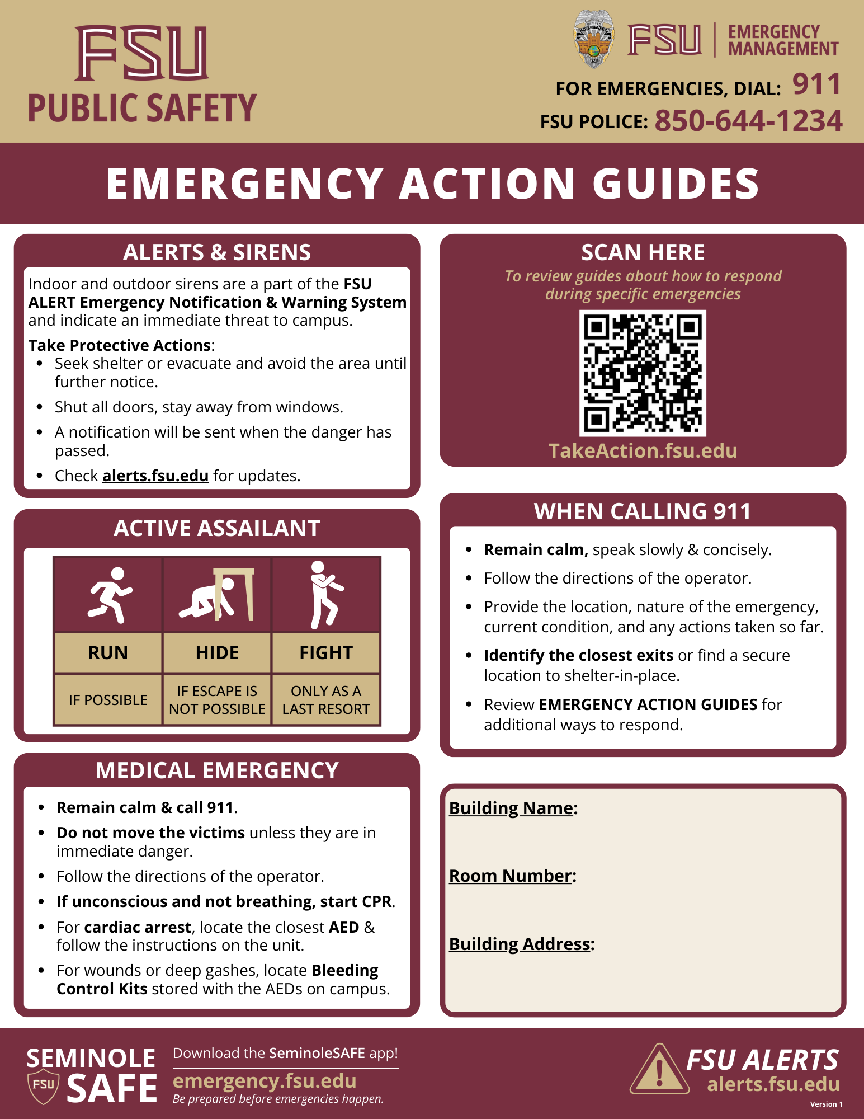
Campus Security
Working to centralize security systems to a single unified system
Classroom safety
Cameras and License Plate Recognition Systems
Suicide mitigation fencing
Pedestrian safety enhancements
Real Time Crime Center
Improve equipment for police officers
Expansion of Police command and dispatch staff
Firearms/Rifles
Body Cameras/Armor
Metal detectors

Slide 18
Procurement Efficiencies
Benefit Type | Definition
Cost Reduction | Benefit achieved when procurement action results in a total cost that is lower than baseline cost, and the baseline cost calculation is supported by documented historical price (i.e., previous contract, historical costs, imputed historical cost, or operational improvements).
Cost Avoidance | Benefit achieved when procurement action results in avoidance of additional cost (i.e., maintenance fees, requested price increases, or other ancillary costs).
Value-Added | Benefit achieved when procurement action results in new gross incentive (based on volume, compliance/utilization, transaction size, electronic payment, e-commerce, signing bonus, GPO, management fees, incentives or revenue generating etc.).

Slide 19
The State of Talent Acquisition at FSU
FSU Talent Acquisition is now supporting a broad portfolio leadership searches across campus, including multiple dean‑level, senior administrative, and director roles.
Key focus areas: speed, quality, branding, and strengthening partnerships with departments to keep high‑impact searches moving efficiently.
Search committees are increasingly seeking structured guidance, tools, and best practices to support consistent, well‑run recruitment processes.

Slide 20
Services Supporting Academic Units
  Position Intake & Market Alignment - Guidance to ensure positions are clearly defined, competitive, and aligned to evolving organizational needs.
  Search Committee Partnership - Tools, templates, and structured support to help chairs and committees conduct efficient, consistent searches.
  Targeted Sourcing for Specialized Roles - Proactive outreach to prospective candidates, particularly important for hard-to-fill, specialized, and leadership positions.
  Reputation & Messaging Support - One-on-one consultation to consistently represent and communicate FSU’s Employer Brand and to elevate job seeker interest in critical roles.
  Compliance and Process Navigation - Real-time advising to ensure searches stay on track and aligned with institutional requirements, regulations, and best practices.
Steve Capenos, Director, Talent Acquisition
850-644-4433 | scapenos@fsu.edu

Slide 21
Capital Project Updates
February 2026

Slide 22
Fixed Capital Outlay
Projects by Category
 | 2026 Spend
Athletics | $ 127,203,323
Instruction/Research | 118,720,485
Academic Health | 113,640,562
Administrative | 35,232,467
Student Support | 31,883,625
State Appropriated Deferred Maintenance | 29,099,311
Deferred Maintenance/Capital Renewal | 25,141,722
Infrastructure | 5,502,079
Grand Total | $ 486,423,573

Slide 23
NW Housing, Dining & Parking – Phase I
Project Status: Design and Construction
GSF: 1,000,000 gsf (965,000 sf is housing, 35,000 sf is dining)
Project Budget: $374,000,000
Project Schedule: Commence Construction: Spring 2026
Goal: Parking Garage Summer 2027, Housing & Dining - Fall Semester Occupancy 2028
Project Information:
This project includes master planning for Housing needs. The overall objective is to reach 8,300 beds by 2030. This is a multi-phase project with an initial phase adding additional housing for approximately 1,200 beds, 750 dining seats, and a parking ramp with 930 parking spaces. Planning and programming wrapped up May 2025, design was completed on the parking garage and will be completed for the Housing, dining and utilities by Summer 2026, and construction will commence in March 2026 for all Phase I scope.
Project Partners:
Design Professional: Walker Architects, Gainesville, FL and VMDO
Contractor: Culpepper Construction, Tallahassee, FL
Owner's Representative: Cumming Management Group, Nashville, TN
23

Slide 24
NW Housing, Dining & Parking – Phase I
Largest project in FSU History has begun!
Constructing new bus stop pull off lanes north of Rogers Hall along Academic Way over spring break
Constructing temporary lots to offset the impacts of parking closures
Closing parking lots 466 and 468 on March 31st
Closing Chieftan Way and adjacent select parking areas on May 2nd
Constructing right-hand turning lane on Academic Way to Murphree Street
24

Slide 25
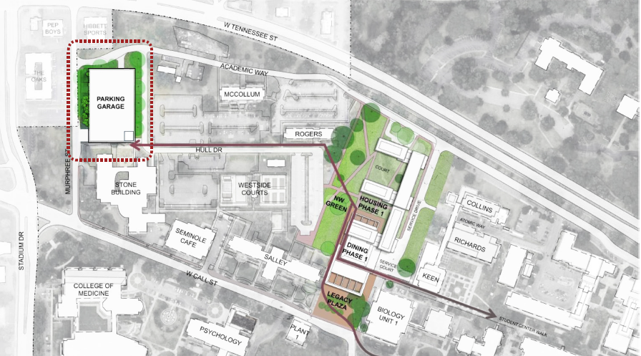
NW Housing, Dining & Parking – Phase I

Slide 26
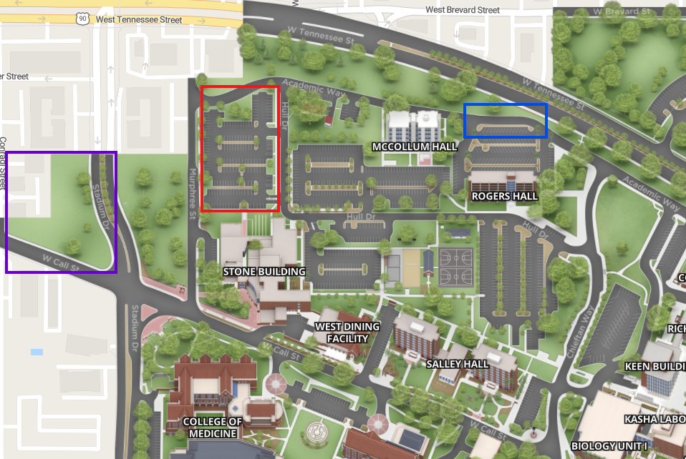

NW Housing, Dining & Parking – Phase I
New Parking Garage
New Bus Stops
Temp Parking Lot

Slide 27
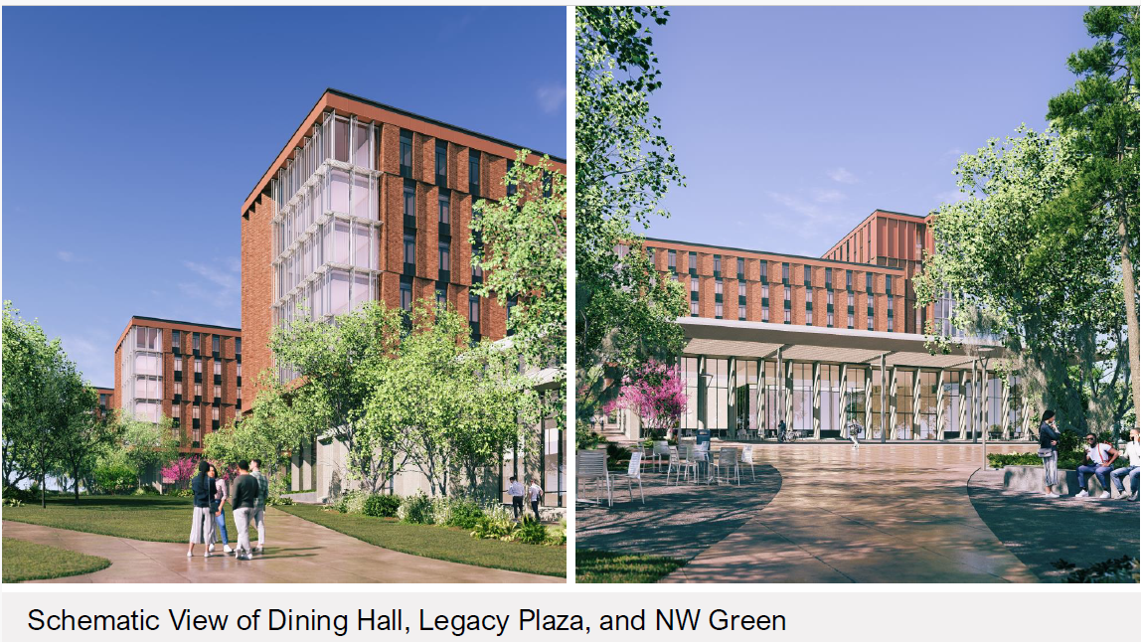
NW Housing, Dining & Parking – Phase I
27

Slide 28
NW Housing, Dining & Parking – Phase I

Slide 29
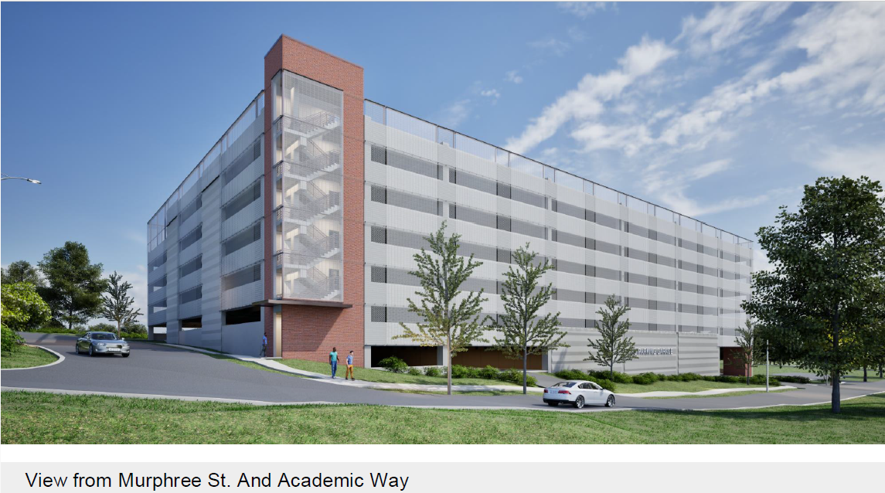
NW Housing, Dining & Parking – Phase I

Slide 30
FAMU – FSU College of Engineering – Building C
Project Status: Design
GSF: 163,950 gsf
Project Budget: $156,975,000 / Funding: $65,000,000
Project Schedule: Design Completion May 2026, Construction start 2026, Goal: spring semester occupancy 2029 pending funding approval
Project Information:
This project plans, designs and constructs the third building, Building C, on the originally conceived FAMU – FSU College of Engineering complex. The College of Engineering is currently sharing classroom space in FSU's Mag Lab, Research Buildings A & B, as well as offices and conference rooms. Study space is currently spread out in hallways and lobby areas within Building A and B. Events that require auditorium space must be scheduled in spaces on FAMU or FSU campus when available, and there is no space to display projects or achievements. This project also provides for renovation/remodel funds for spaces impacted by the tie-in between the existing and new construction, allowing for upgrading and replacing room signage and wayfinding, and expands the food service from a snack bar into a cafeteria.
Project Partners:
Design Professional: HOK, Tampa, FL
Contractor: CMR Selection - Future
30

Slide 31
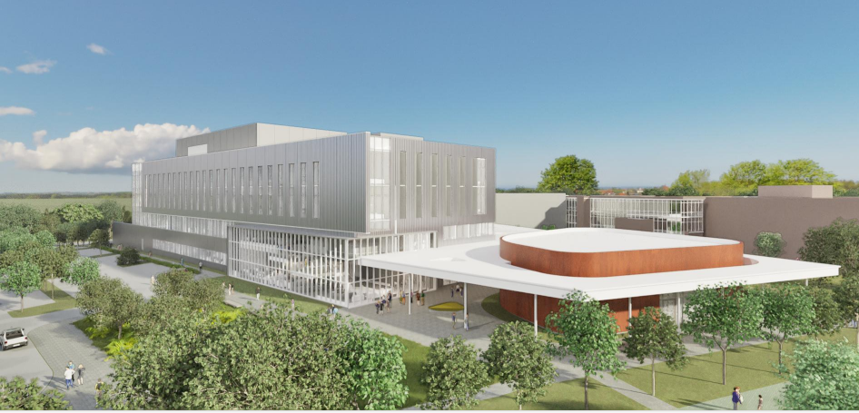
FAMU – FSU College of Engineering – Building C
31

Slide 32
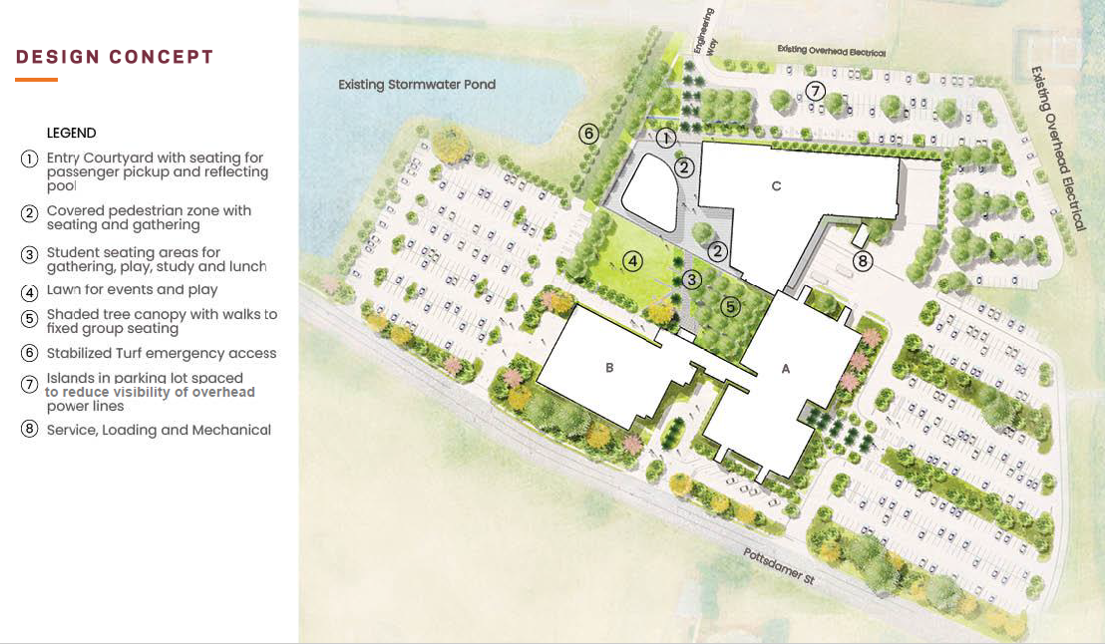
FAMU – FSU College of Engineering – Building C
32

Slide 33
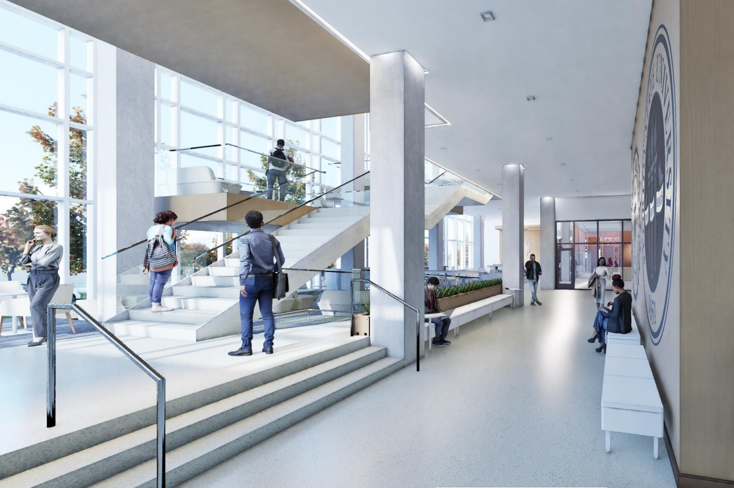
FAMU – FSU College of Engineering – Building C
33

Slide 34
Deferred Maintenance
Project Status: Various (Construction and Warranty)
Main Tallahassee Campus - $66,187,052
Panama City Campus - $5,000,000
College of Engineering - $855,000
28+ Roofing improvement projects
26+ Building Envelope (windows and foundations) improvement projects
13+ Fire & Life Safety improvement projects
16+ HVAC system improvement projects
52 projects are completed (12 additional projects since October 2025)
Over 200 contracts/purchase orders have been issued
All SFRF funds fully committed and to be paid out before December 31, 2026.
34

Slide 35
Deferred Maintenance Buildings
Bellamy
Bio Medical
Bio Unit One
Ca’d Zan
Carothers Hall
College of Engineering
Collins
Critchfield
Diffenbaugh
Dittmer
Fine Arts
HCB
Housewright
Immokalee
Love
Marine Lab
Maryland Circle
Master Craftsman
Panama City Campus
Pepper
Recycling/Solid Waste
Medicine Research
Ringling Art Museum
Rogers
Rovetta
Sandels
Shaw
Strozier
Thrasher
Turnbull
University Center
Westcott
Williams

Slide 36
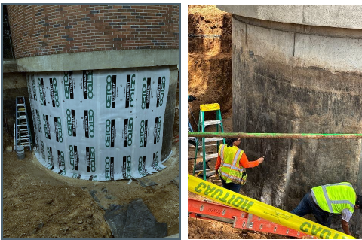
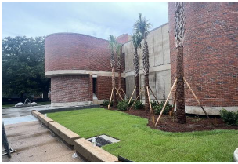
Deferred Maintenance – February 2026 Photos
Fine Arts – Building Envelope

Slide 37
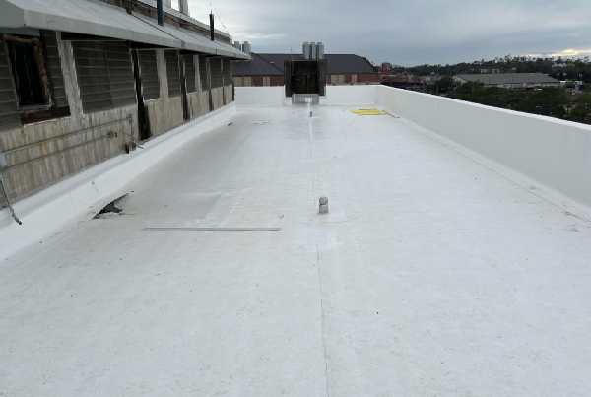
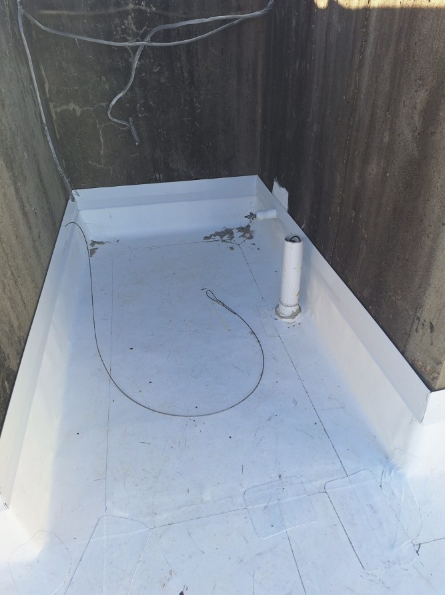
Deferred Maintenance – February 2026 Photos
Dittmer Chemistry Lab - Reroofing

Slide 38
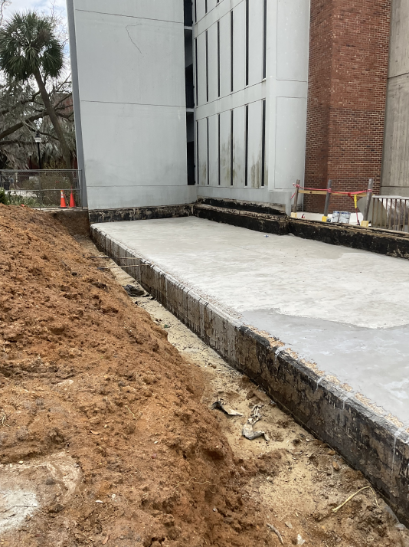
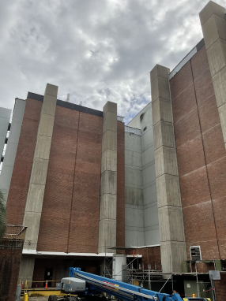
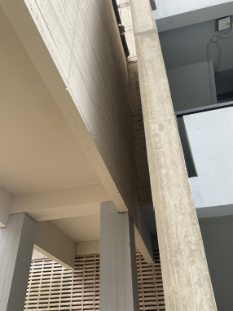
Deferred Maintenance – February 2026 Photos
Dittmer Chemistry Lab – Building Envelope

Slide 39
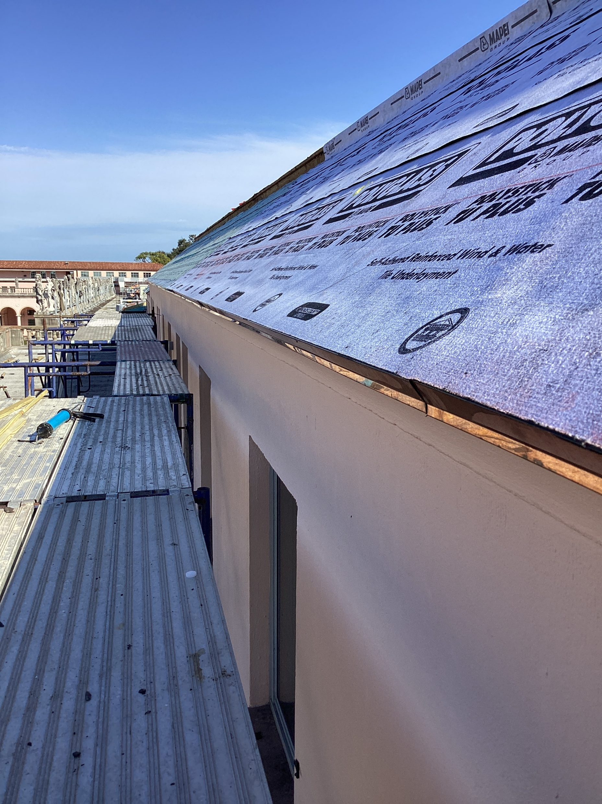
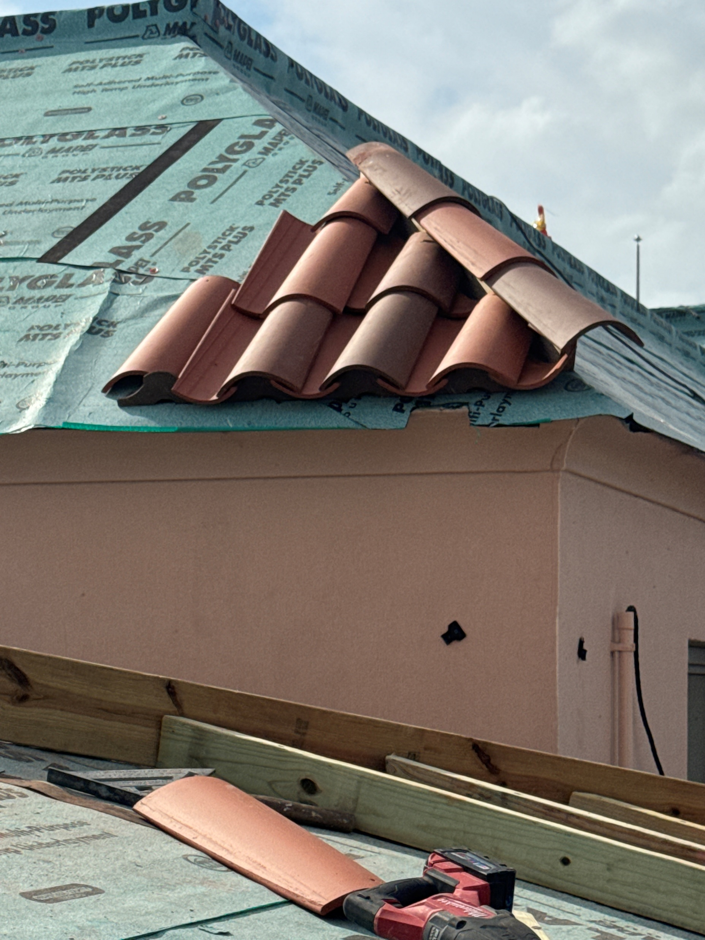
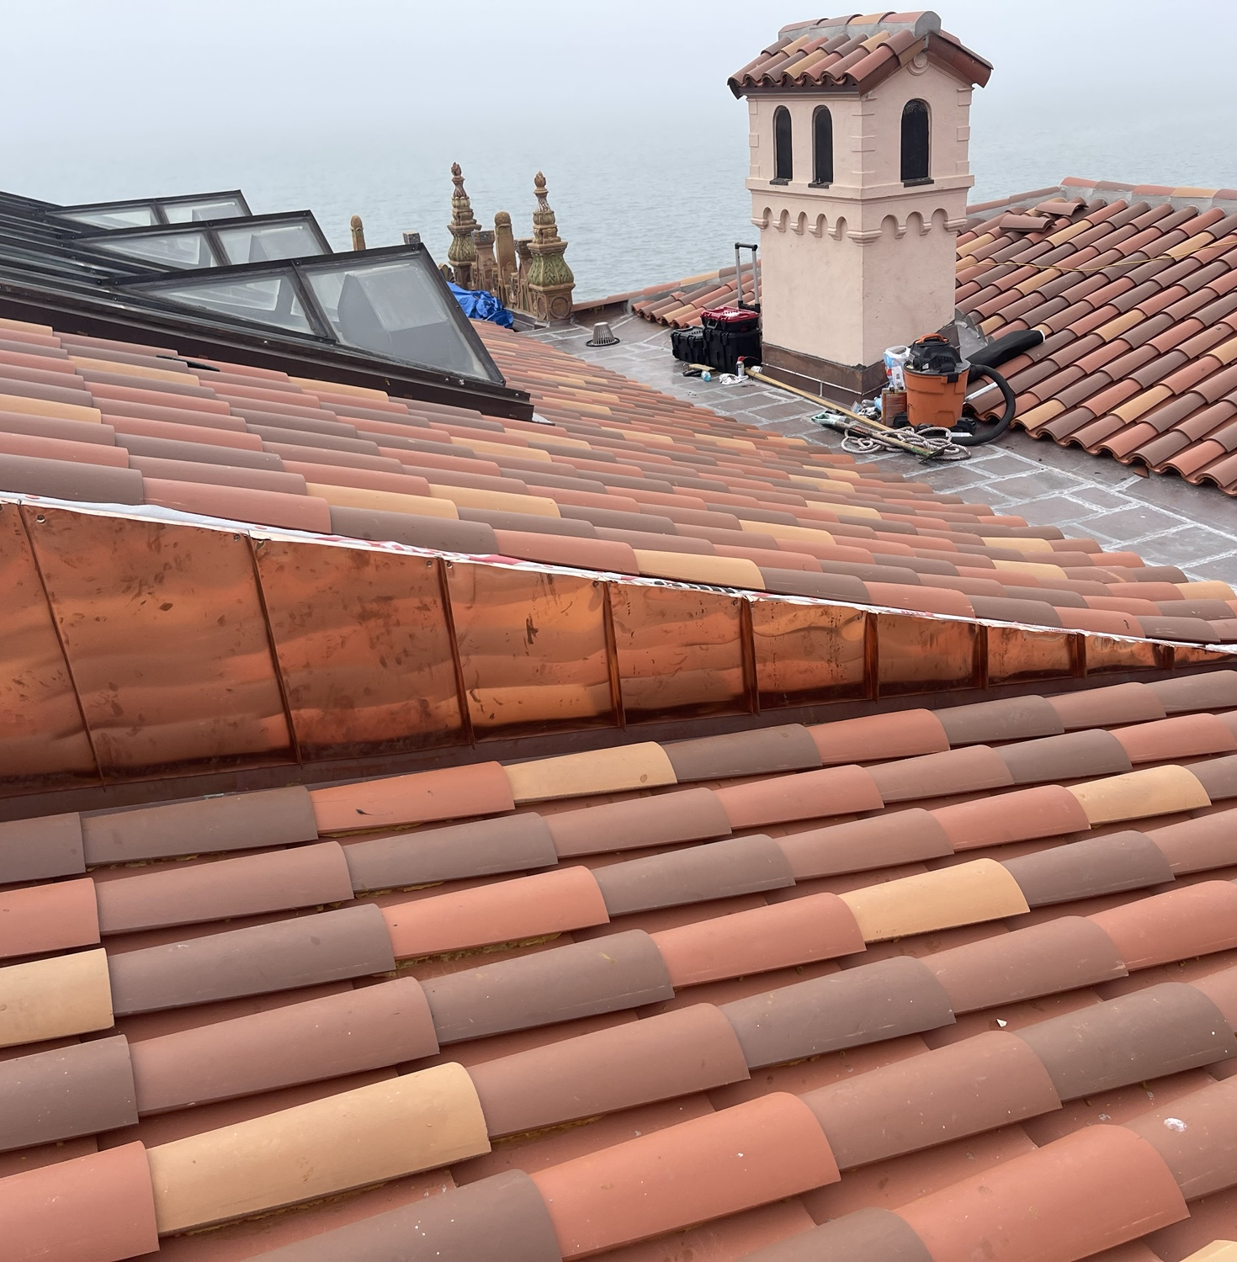
Deferred Maintenance – February 2026 Photos
Ringling - Museum of Art and Ca'd'Zan - Reroofing

Slide 40
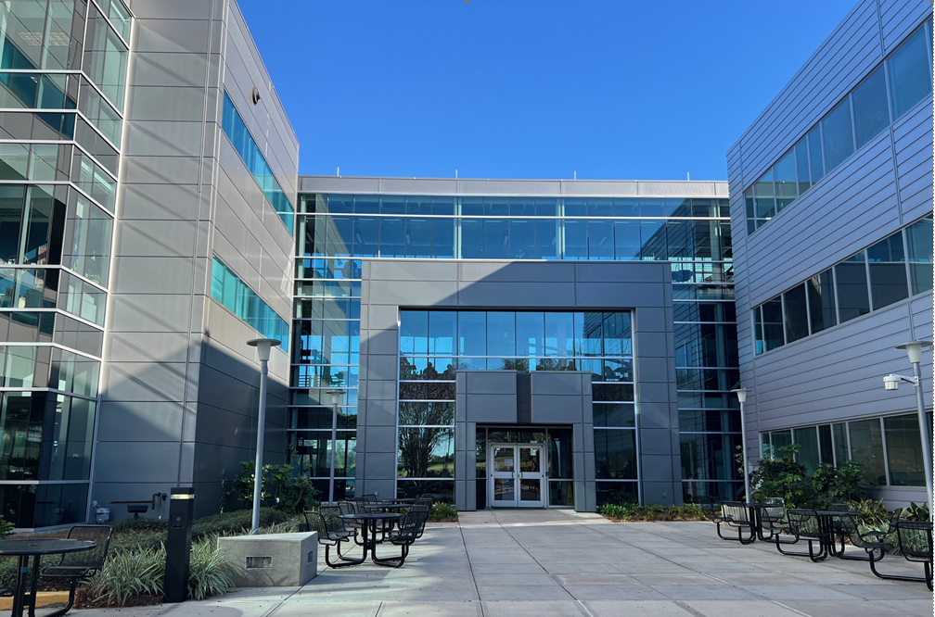
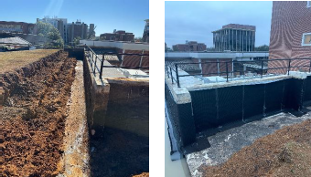
Deferred Maintenance – February 2026 Photos
FAMU-FSU College of Engineering A & B – Building Envelope
Collins – Building Envelope

Slide 41
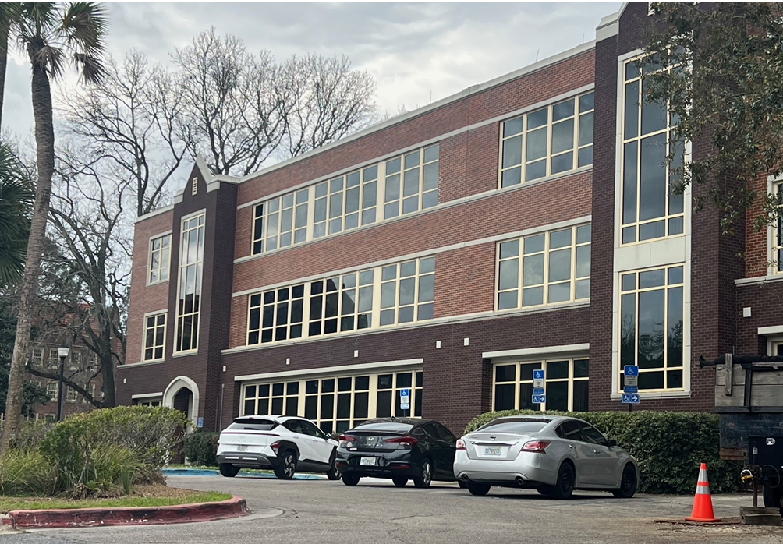
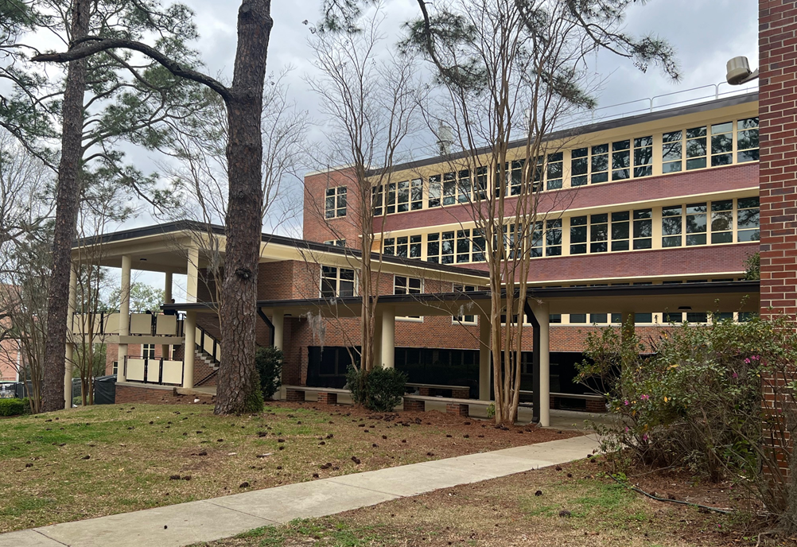
Deferred Maintenance – February 2026 Photos
Sandels Building – Building Envelope

Slide 42
FSU Academic Health Center
Project Status: Construction
GSF: 139,700 gsf
Project Budget: $137.5M
Project Schedule: Substantial Completion anticipated Fall 2026
Project Information:
Constructs an Academic Health Center that will accommodate both wet and dry labs, clinical space, administrative space, teaching space, and research space. The facility includes space to be utilized by TMH Family Medical Residency Program.
Project Partners:
Design Professional: HOK, Tampa, FL
Contractor: AJAX Building Company, Midway, FL
Owner's Representative: Cumming Management Group, Nashville, TN
42

Slide 43
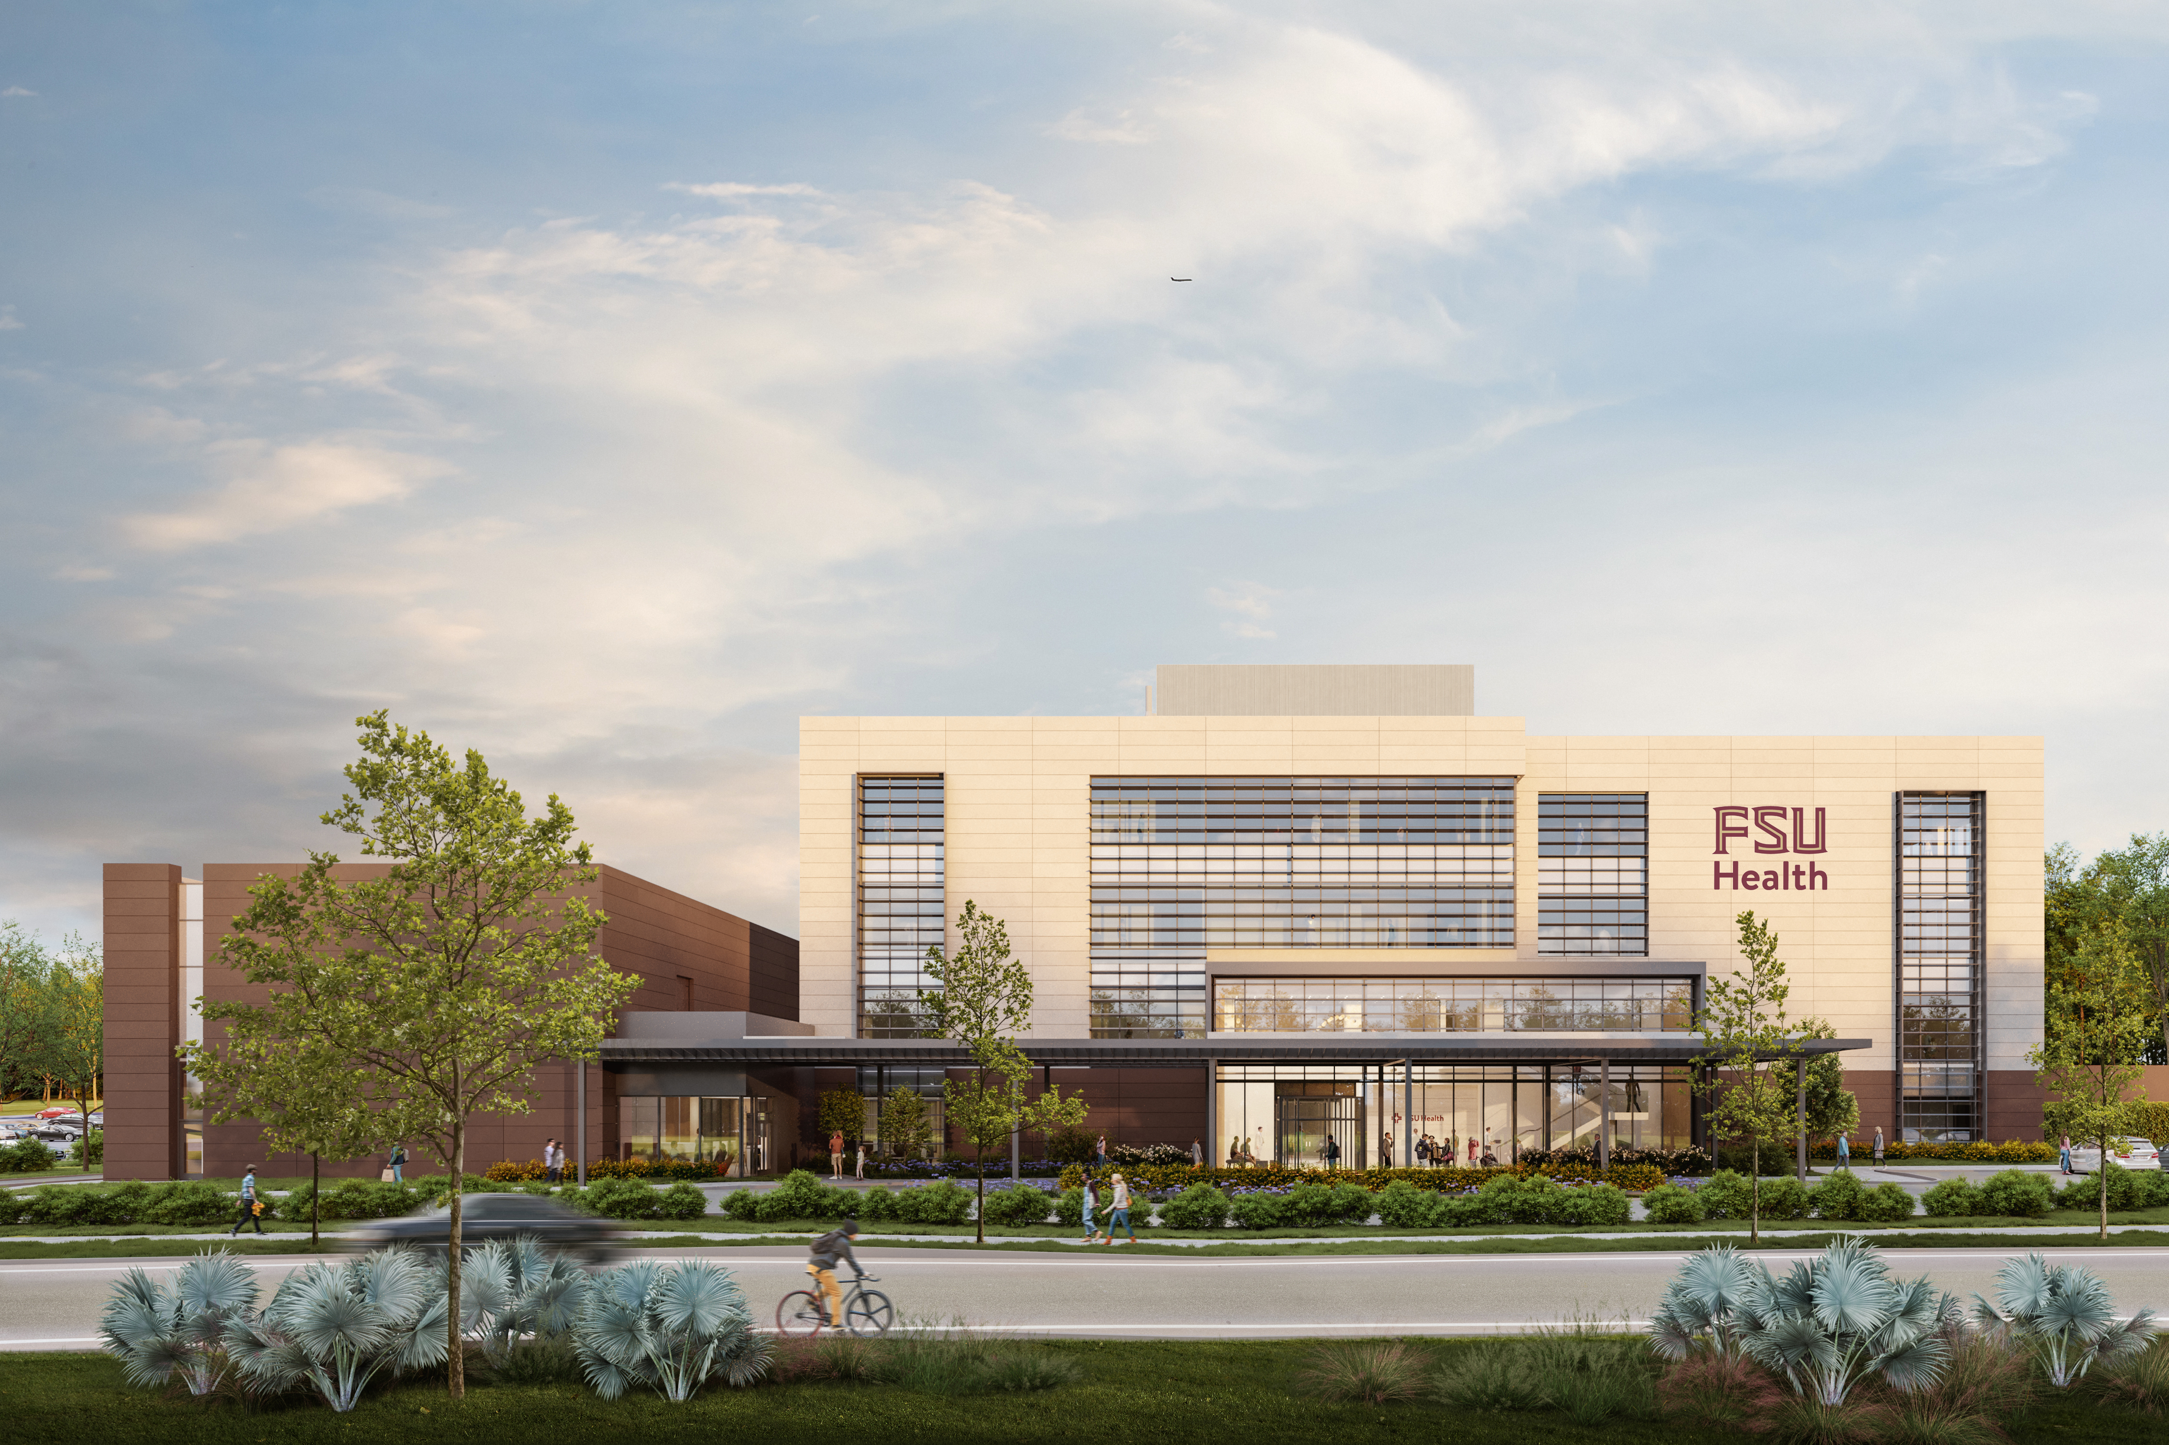
FSU Academic Health Center – October 2025 Photos
43

Slide 44
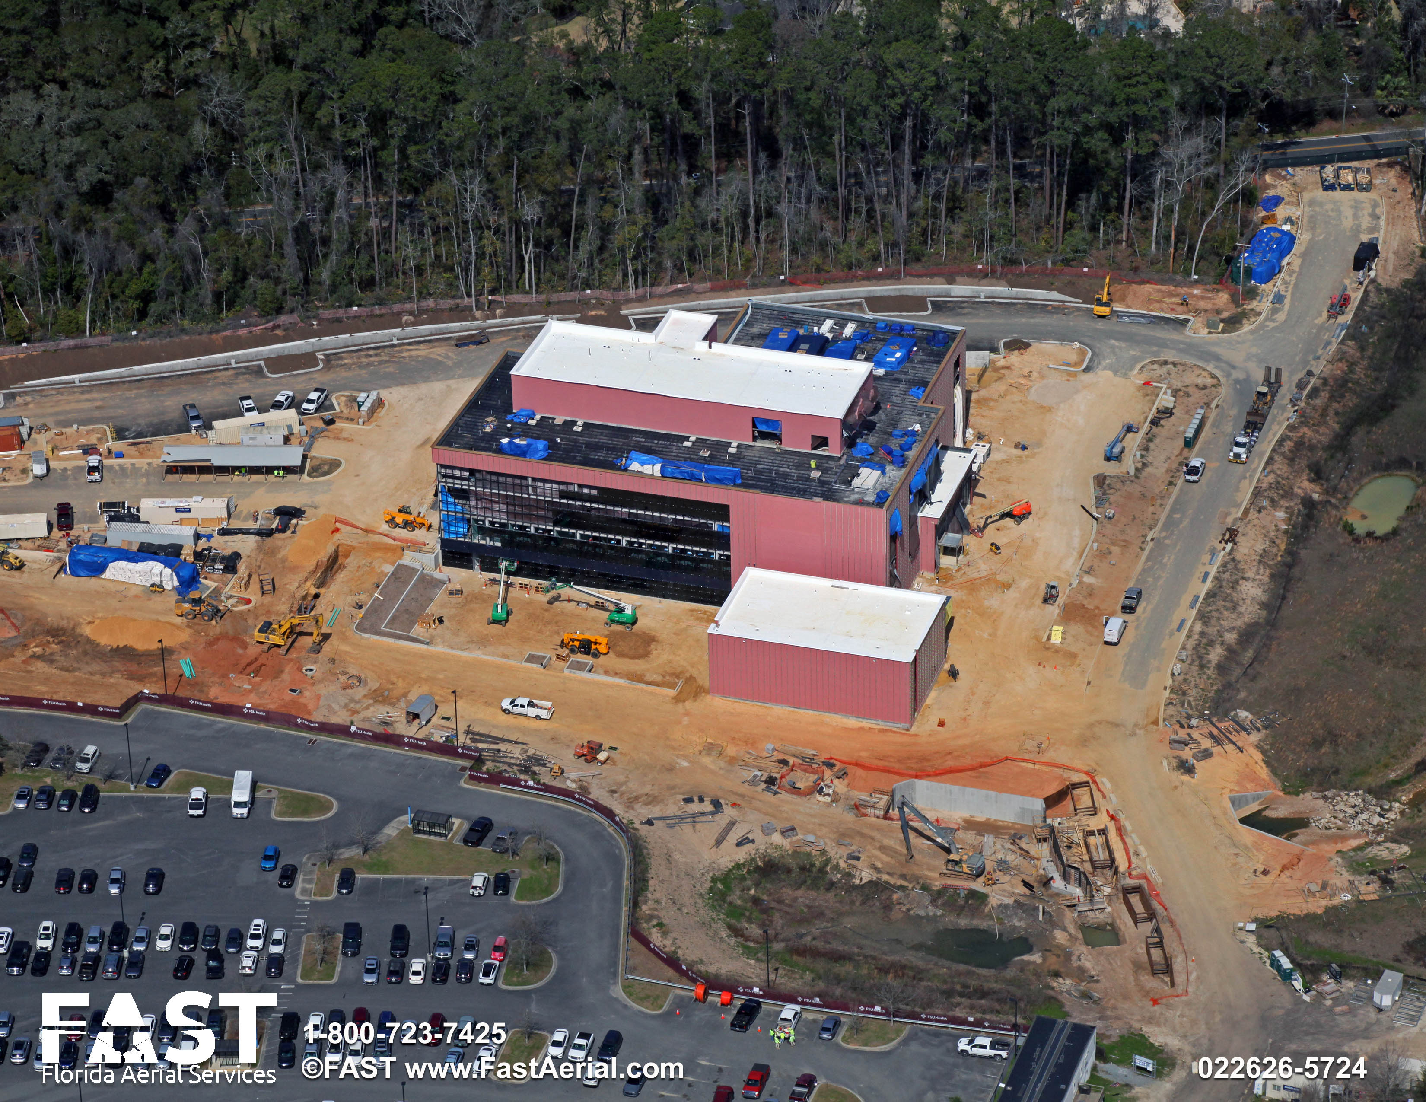
FSU Academic Health Center – February 2026 Photos
44

Slide 45
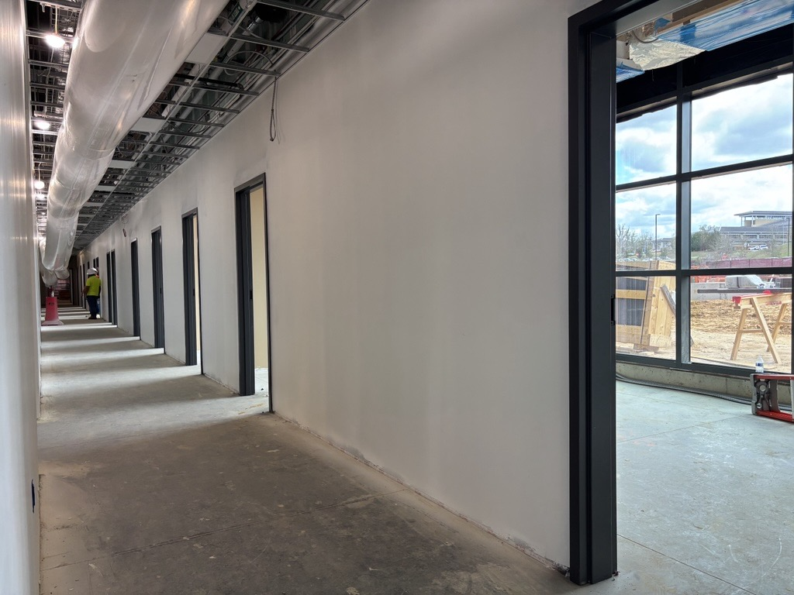
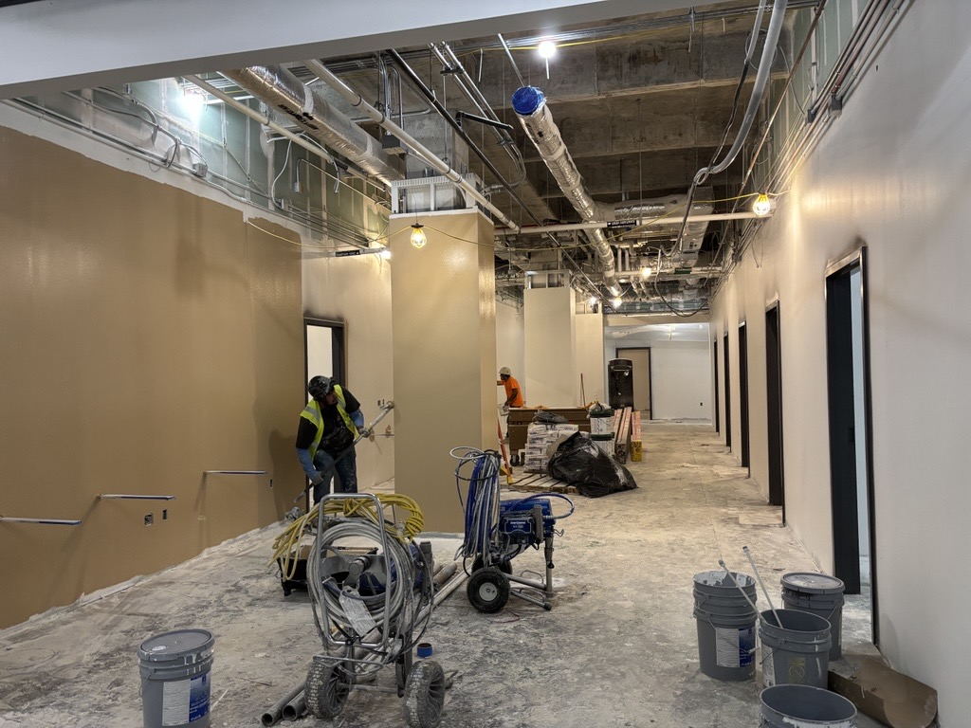
FSU Academic Health Center – February 2026 Photos
45

Slide 46
Rovetta A & B - Remodel
Project Status: Planning
GSF: 123,000 gsf
Project Budget: $36,750,000
Project Schedule: Design Completed by Spring 2027
Construction to be phased - pending funding
Project Information:
This project plans and designs modernizing classrooms, teaching laboratories, meeting spaces, an existing auditorium, and areas dedicated to student success and shared services. It will also address deferred maintenance including improvements to building systems such as HVAC, fire and life safety, accessibility, and ADA compliance, building envelope, mechanical and electrical systems, and supporting IT infrastructure. Objectives include optimizing functional adjacencies, improving accessibility and wayfinding, enhancing exterior entryways, strengthening connections to adjacent campus destinations, and creating flexible, collaborative environments that support contemporary instruction, learning, and student engagement while reinforcing the campus core and overall student experience.
Project Partners:
Design Professional: Selection underway
Contractor: CMR Selection - Future
46

Slide 47
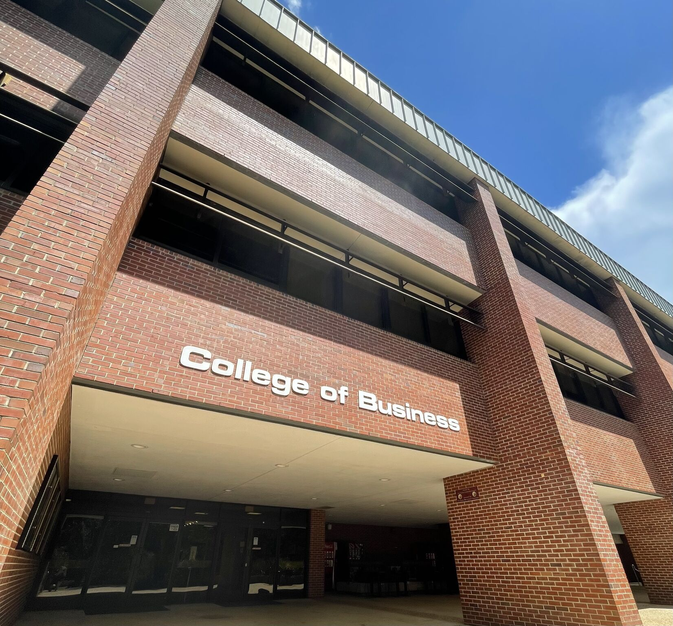
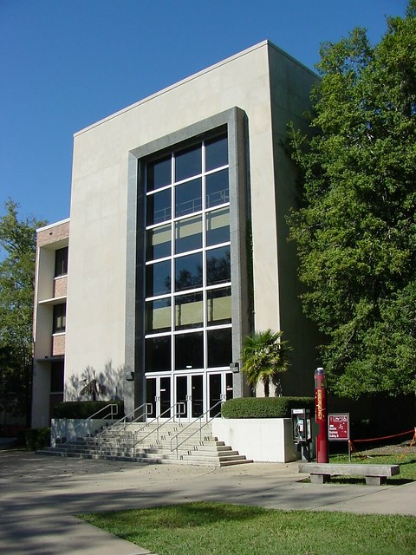
Rovetta A & B - Remodel

Slide 48
Moore Auditorium – Addition and Remodel
Project Status: Planning
GSF: 34,411 gsf (21,875 gsf new construction and 12,536 gsf renovation)
Project Budget: $33,000,000
Project Schedule: Design Completed by end 2026
Construction Completed Fall 2028
Project Information:
  This Project will renovate Moore Auditorium into a dynamic, central hub to create a versatile space that supports academic, administrative, and community functions, while also serving as the primary starting and ending point for all campus tours. The redesign will include modern amenities such as a welcoming lobby, a renovated auditorium, a historical gallery, classrooms, meeting rooms, and spaces for staff. The redesign will also seek options for alternative seating configurations, upgrade the audio/visual technology and restrooms, address building code and ADA requirements and other building enhancements that improve functionality of space including enhancing the outdoor spaces with a patio entry and gathering area.
Project Partners:
Design Professional: The S/L/A/M Collaborative
Contractor: CMR Selection - Future
48

Slide 49
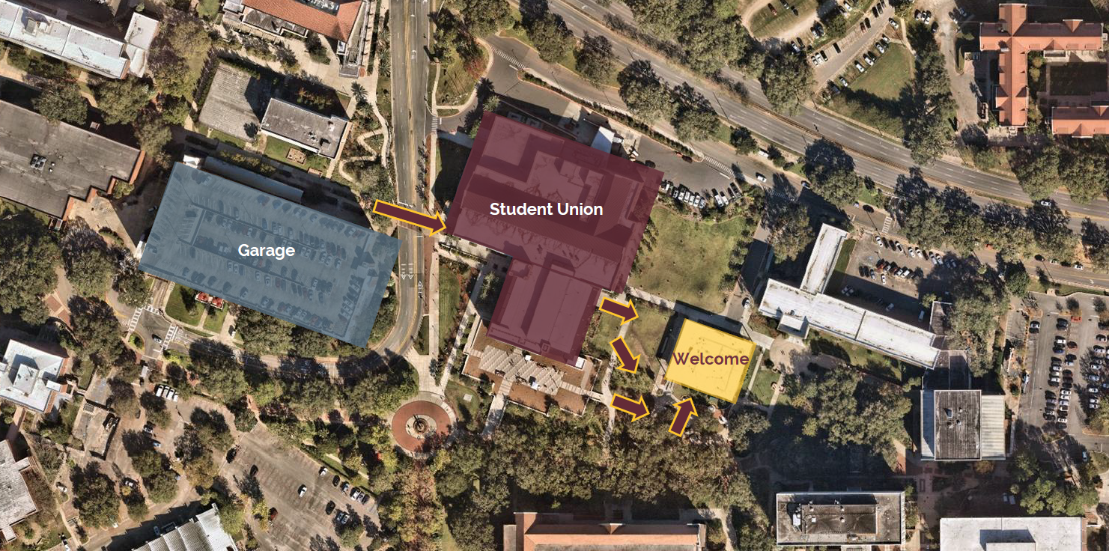
Moore Auditorium – Addition and Remodel

Slide 50
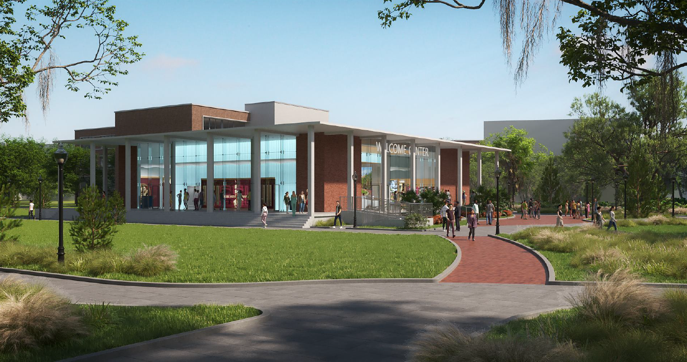
Moore Auditorium – Addition and Remodel
DRAFT

Slide 51
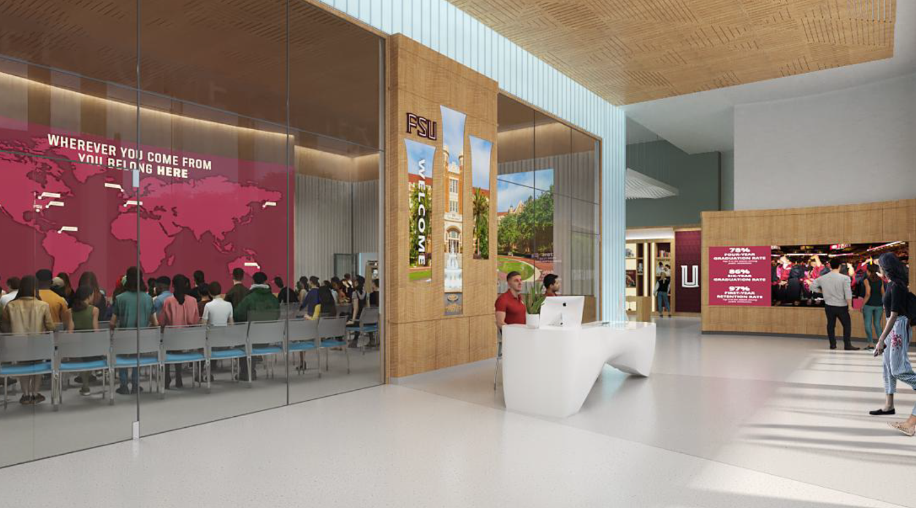
Moore Auditorium – Addition and Remodel
DRAFT

Slide 52
Turnbull Conference Center – Remodel
Project Status: Substantial Completion
GSF: 7,500 gsf
Project Budget: $7,725,000
Project Schedule: Substantially Complete
Project Information:
This project renovates the kitchen, conference room and exterior courtyard at the Turnbull Conference Center. Work includes new kitchen equipment, a new service elevator, interior wall modifications, security camera installation, card access upgrades, and new finishes throughout. Exterior scope of work will include sidewalk improvements, utility upgrades and outdoor seating in the courtyard. The project will increase the capacity of the Conference Room to accommodate multiple large events simultaneously.
Project Partners:
Design Professional: EMI Architects, Tallahassee, FL
Contractor: Southern Standard Construction, LLC, Tallahassee, FL
52

Slide 53
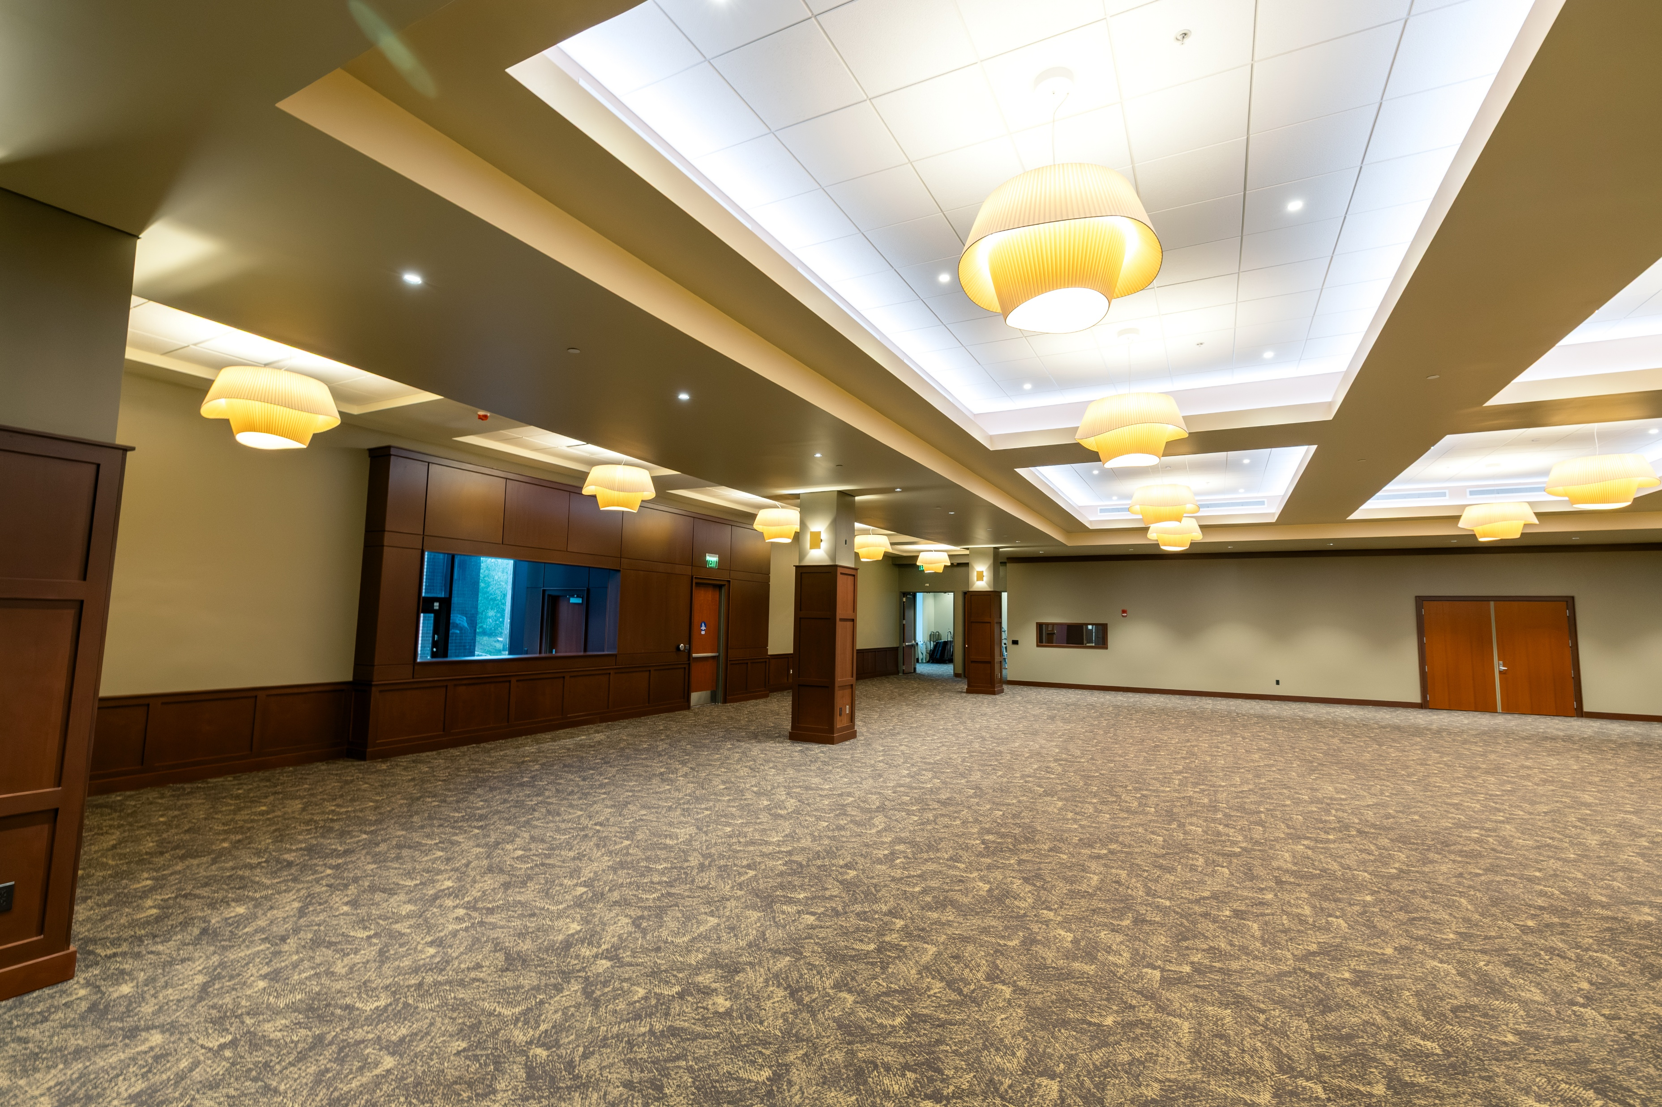
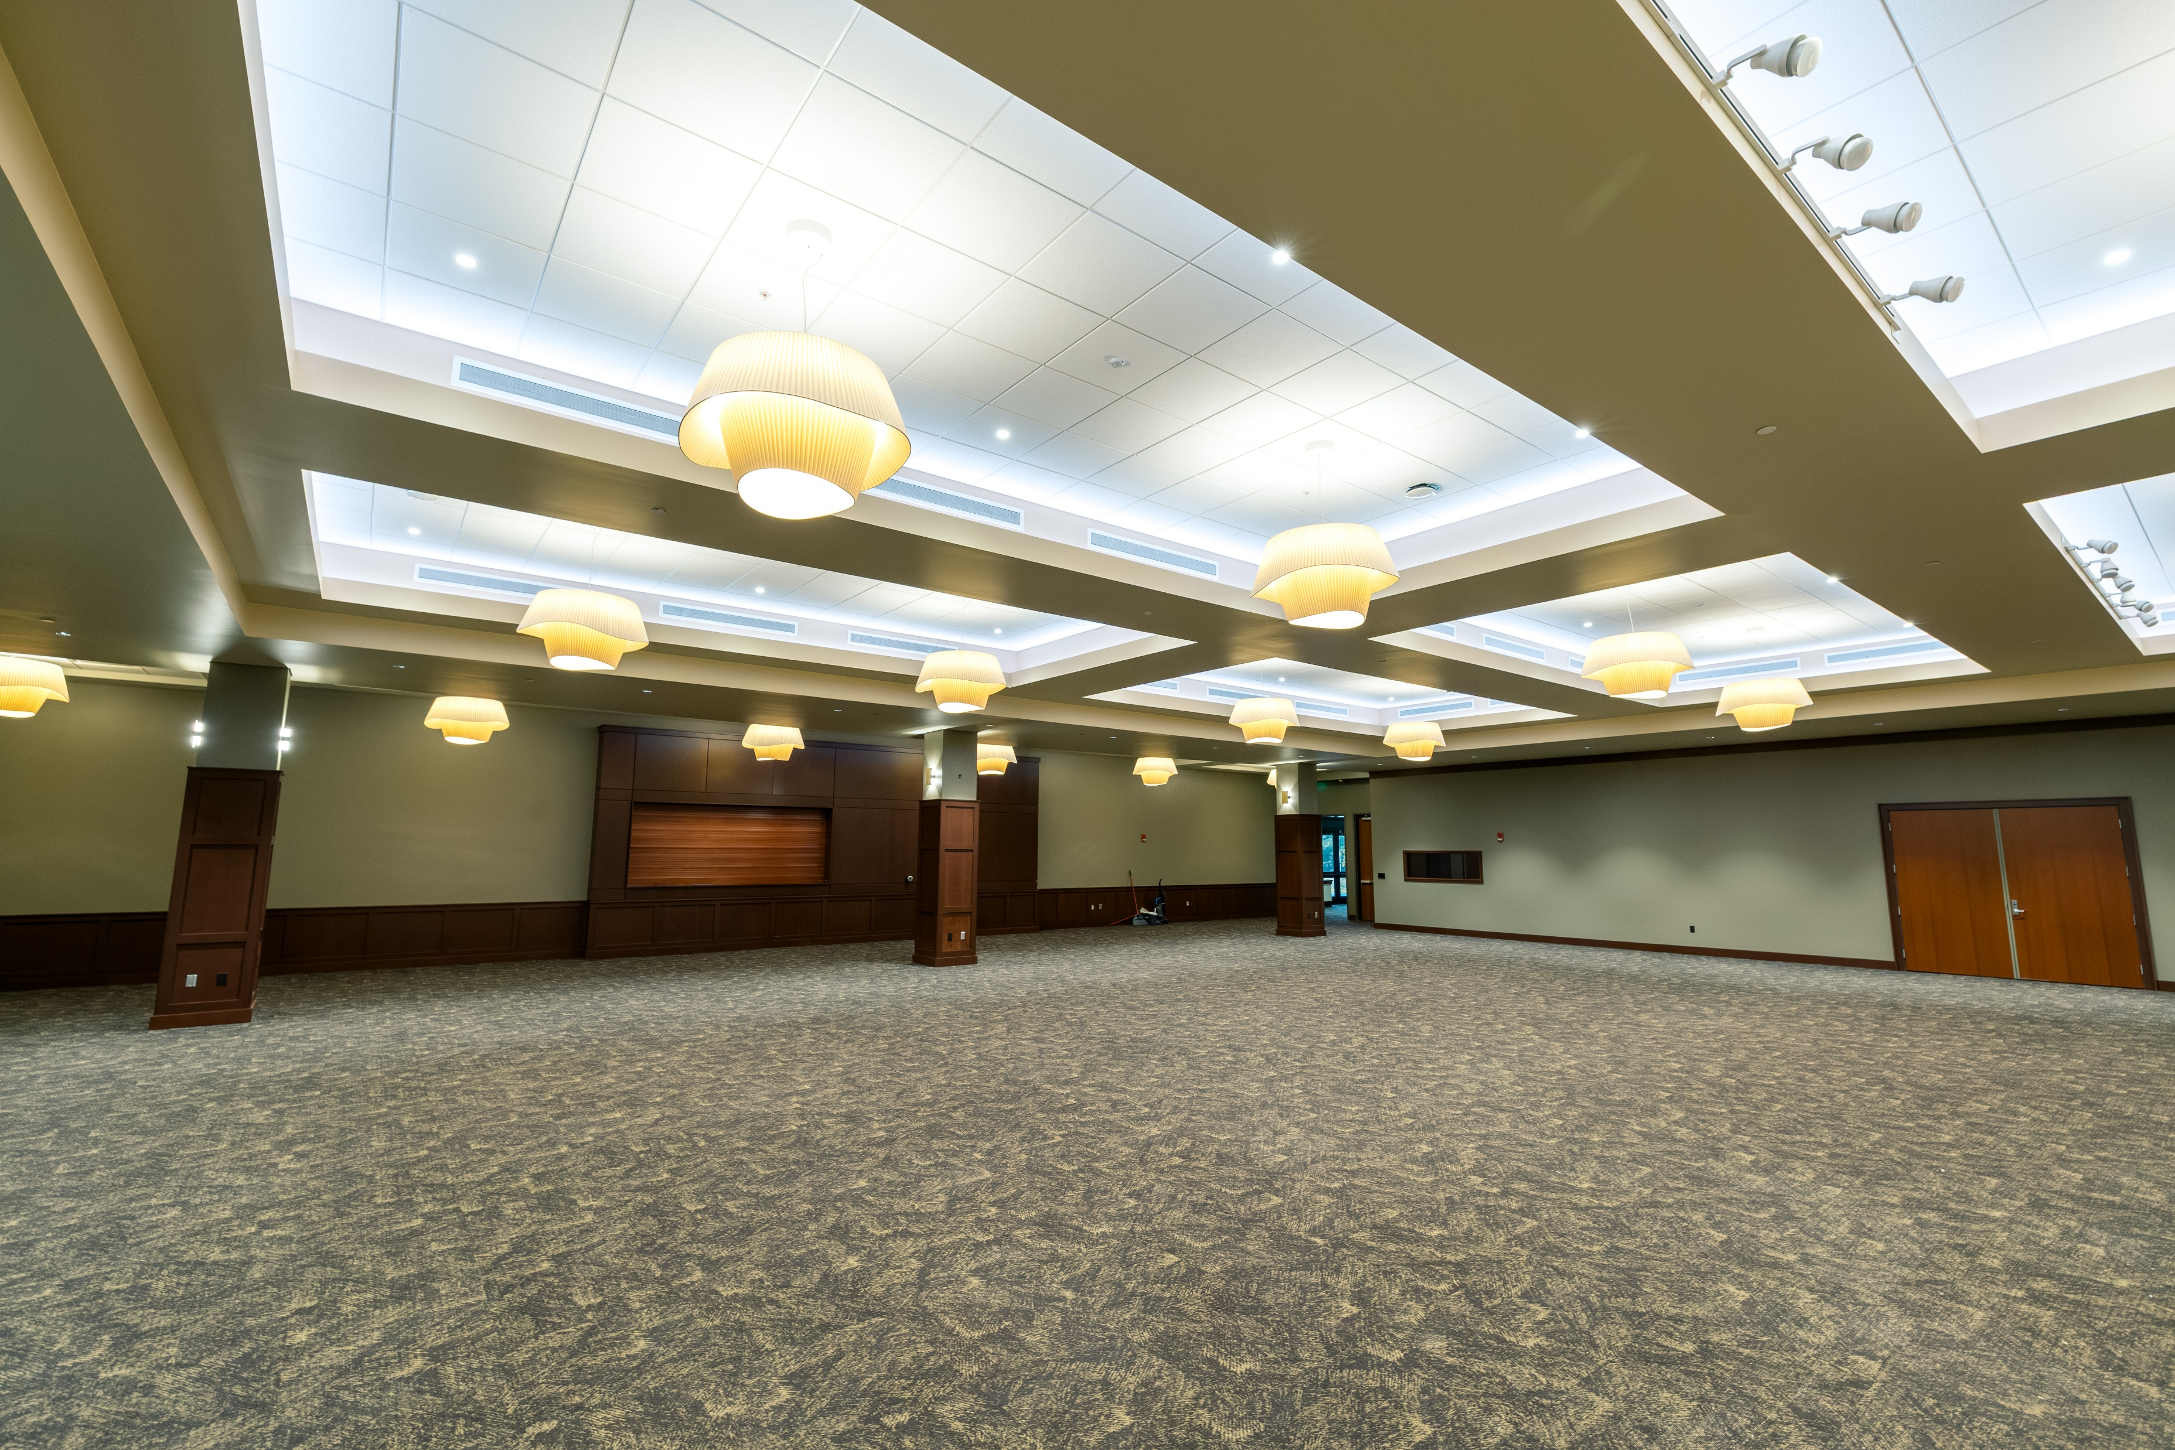
Turnbull – Remodel
Conference Room

Slide 54
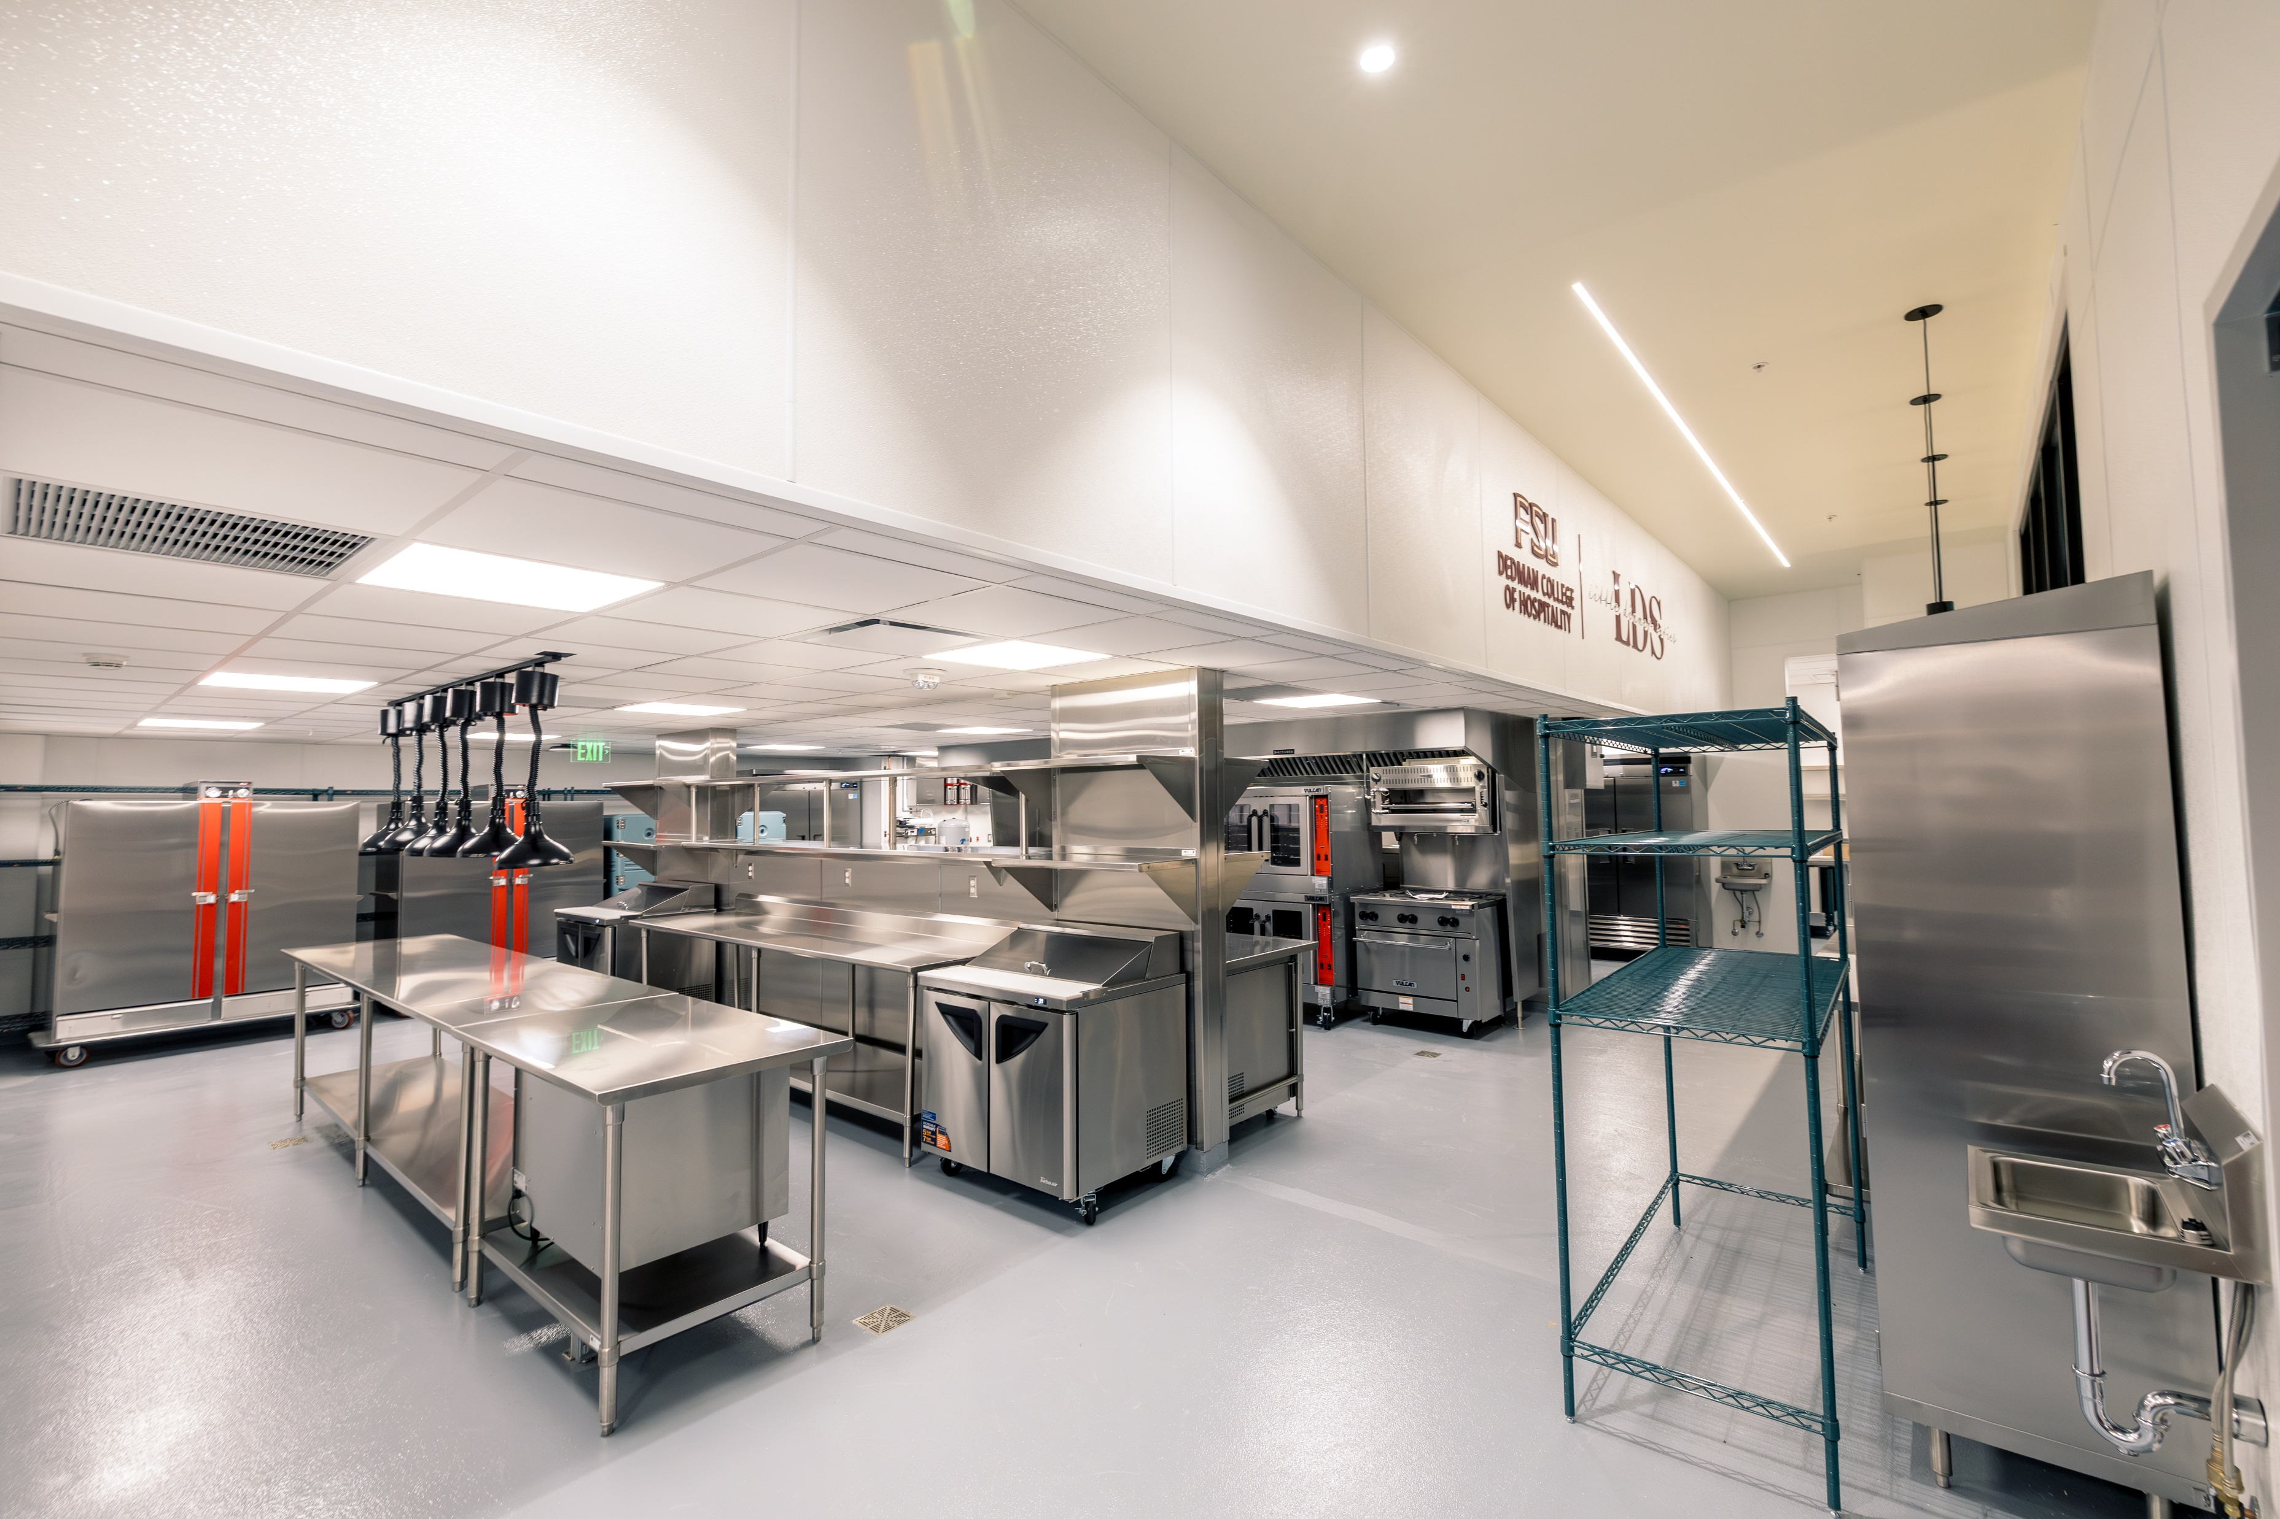
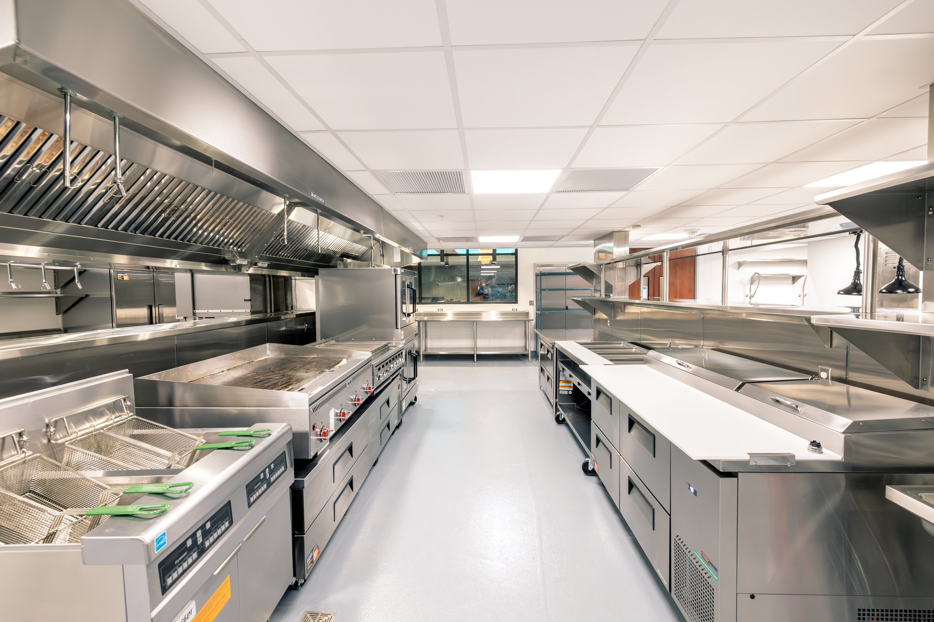
Turnbull – Remodel
Dedman College of Hospitality – Little Dinner Series

Slide 55
Middleton Center – Addition & Remodel
Project Status: Design
GSF: 43,725 gsf
Project Budget: $28,171,608
Project Schedule: Design is underway, overall schedule pending funding availability
Project Information:
This project will remodel and expand the Middleton Center, adding a new building for Dedman College of Hospitality and FSU programs. It includes reorganizing interiors, designing a tower/atrium for educational use, and enhancing ancillary facilities. The initial phase focuses on detailed design plans and optimizing space. The project scope of work will include planning the reconfiguration of the existing parking lot, site access, and coordination for the future Airport Gateway project through the eastern portion of the site as well as conduct a survey, utility analysis, document existing spaces, conduct stakeholder meetings, site visits, hold design charettes, and analyze adjacent project impacts.
Project Partners:
Design Professional: Architects Lewis + Whitlock, Tallahassee, FL
Contractor: CMR Selection - Future
55

Slide 56
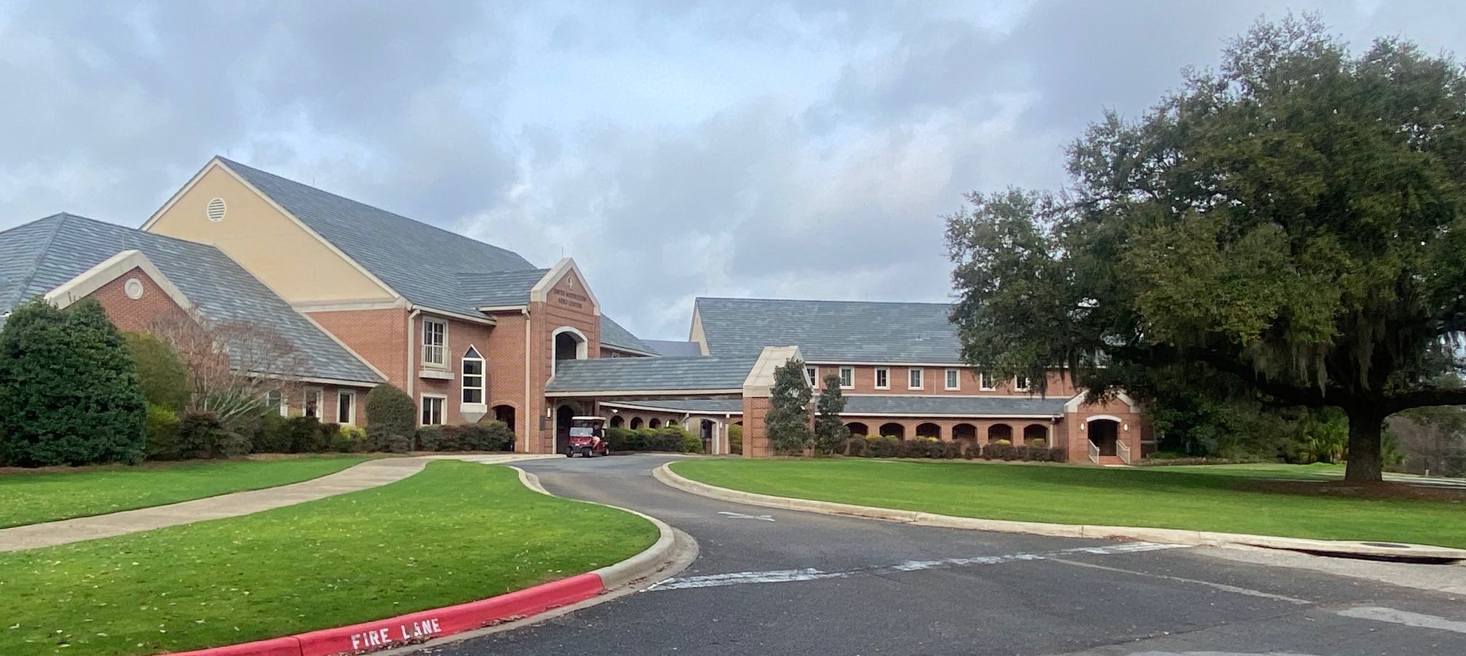
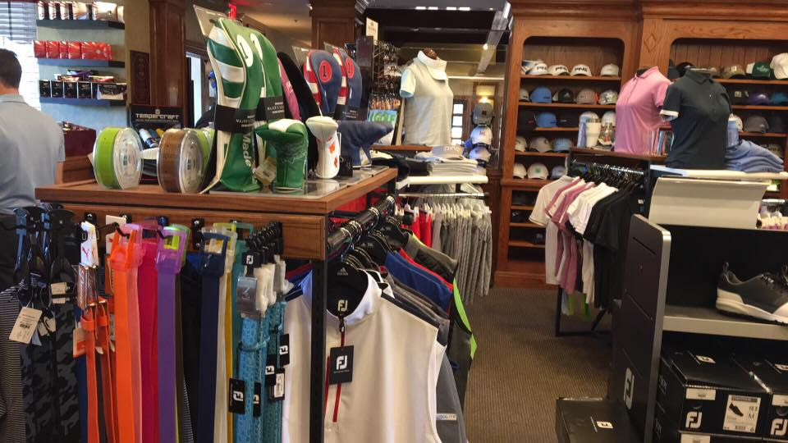
Middleton Center – Addition & Remodel

Slide 57
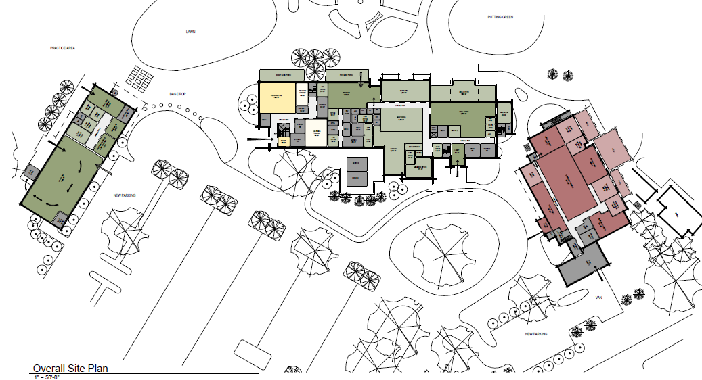
Middleton Center – Addition & Remodel

Slide 58
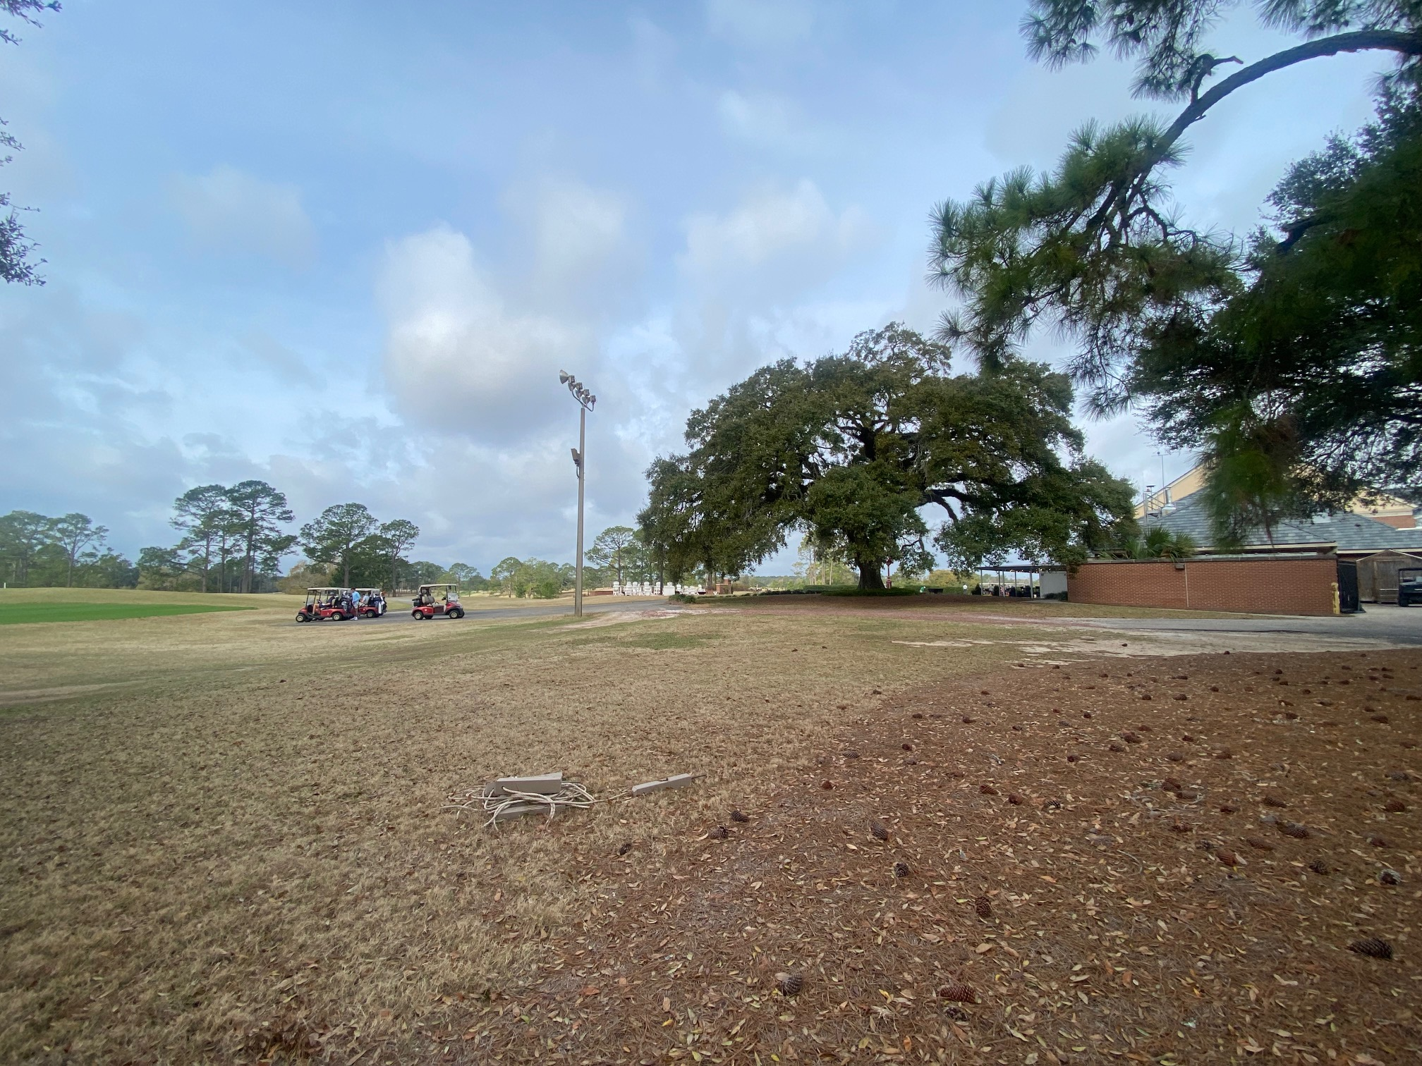
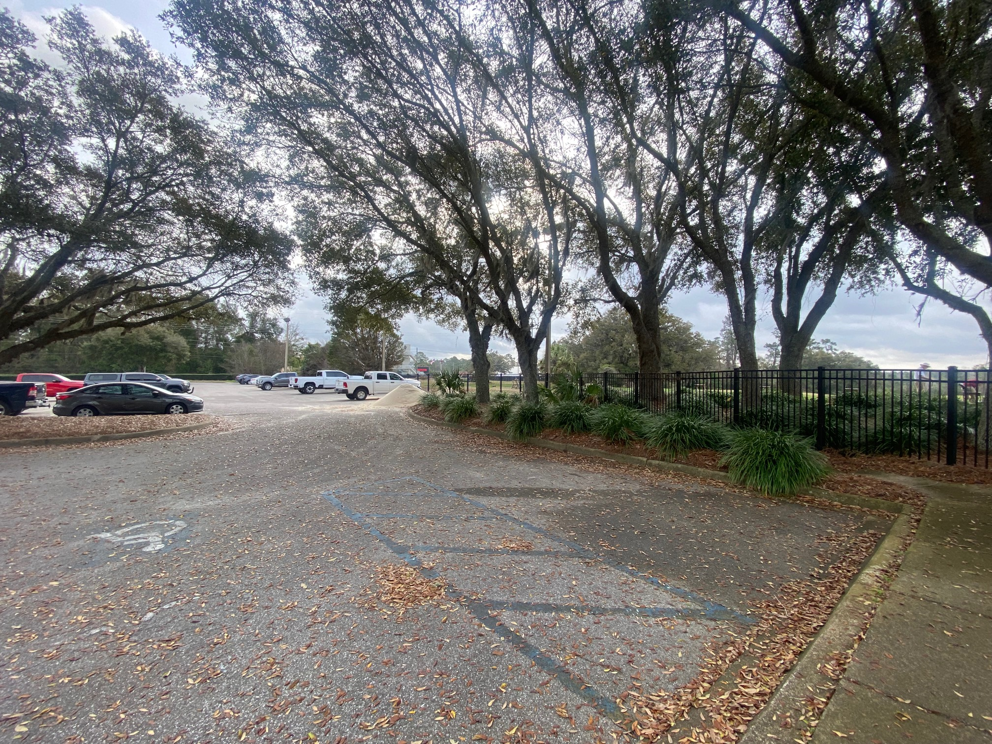
Middleton Center – Addition & Remodel
Future Building Site
Existing ADA Parking

Slide 59
Dittmer Chemistry Lab – Remodel
Project Status: Planning
GSF: 144,881 gsf
Project Budget: $95,400,000
Project Schedule: Design completed spring 2027
Asbestos Abatement summer 2026
Construction completed end 2028
Project Information:
This project will remodel the entire building, including but not limited to, new architectural and engineering systems to meet current code and campus design standards. Dittmer Building was built in 1967 and has never been substantially remodeled. All architectural and engineering systems have reached the end of their useful life. Remodeling the Dittmer Building will support FSU's number one strategic goal: Expanding research and academic excellence.
Project Partners:
Design Professional: HOK, Tampa, FL
Contractor: Whiting-Turner Contracting Company, Tampa, FL
59

Slide 60
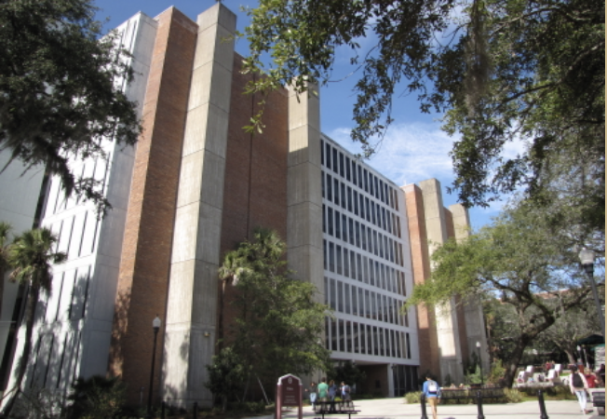
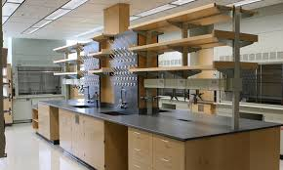
Dittmer Chemistry Lab – Remodel

Slide 61
Biology Unit 1 – Second Floor Remodel
Project Status: Construction
GSF: 26,185 gsf
Project Budget: $17,208,000
Project Schedule: Substantial Completion August 2026
Project Information:
This project remodels the entire second floor of Biology Unit 1, converting the space into teaching labs. The project includes consolidation of the lower-level biology teaching labs into one location. This includes labs currently in Carothers, King, HCB, and Biology Unit One. It also includes decommissioning of existing research labs. The increase in Teaching Lab NASF is a consequence of transferring the space from King Life Sciences Bldg.
Project Partners:
Design Professional: Walker Architects, Gainesville, FL
Contractor: Childers Construction Company, Tallahassee, FL
61

Slide 62
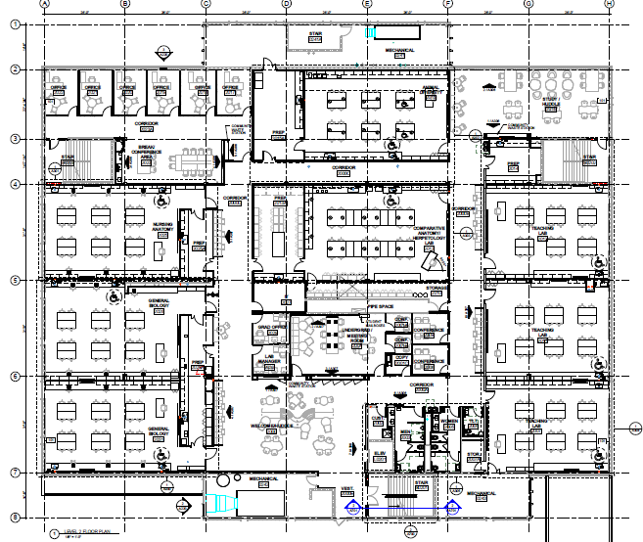
Biology Unit 1 – Second Floor Remodel

Slide 63
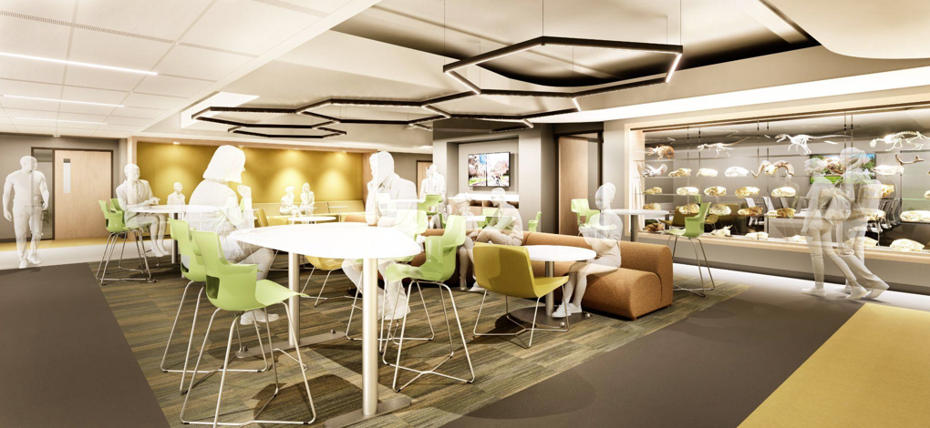
Biology Unit 1 – Second Floor Remodel

Slide 64
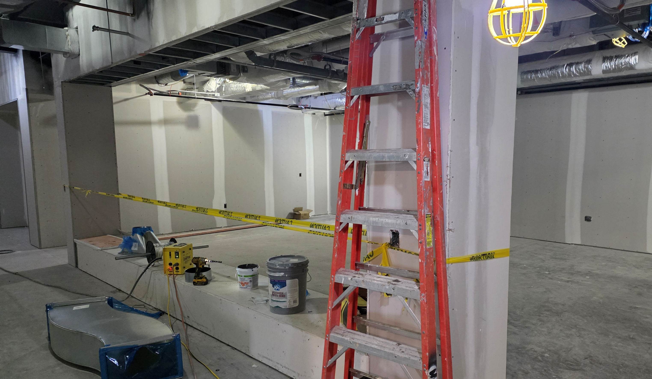
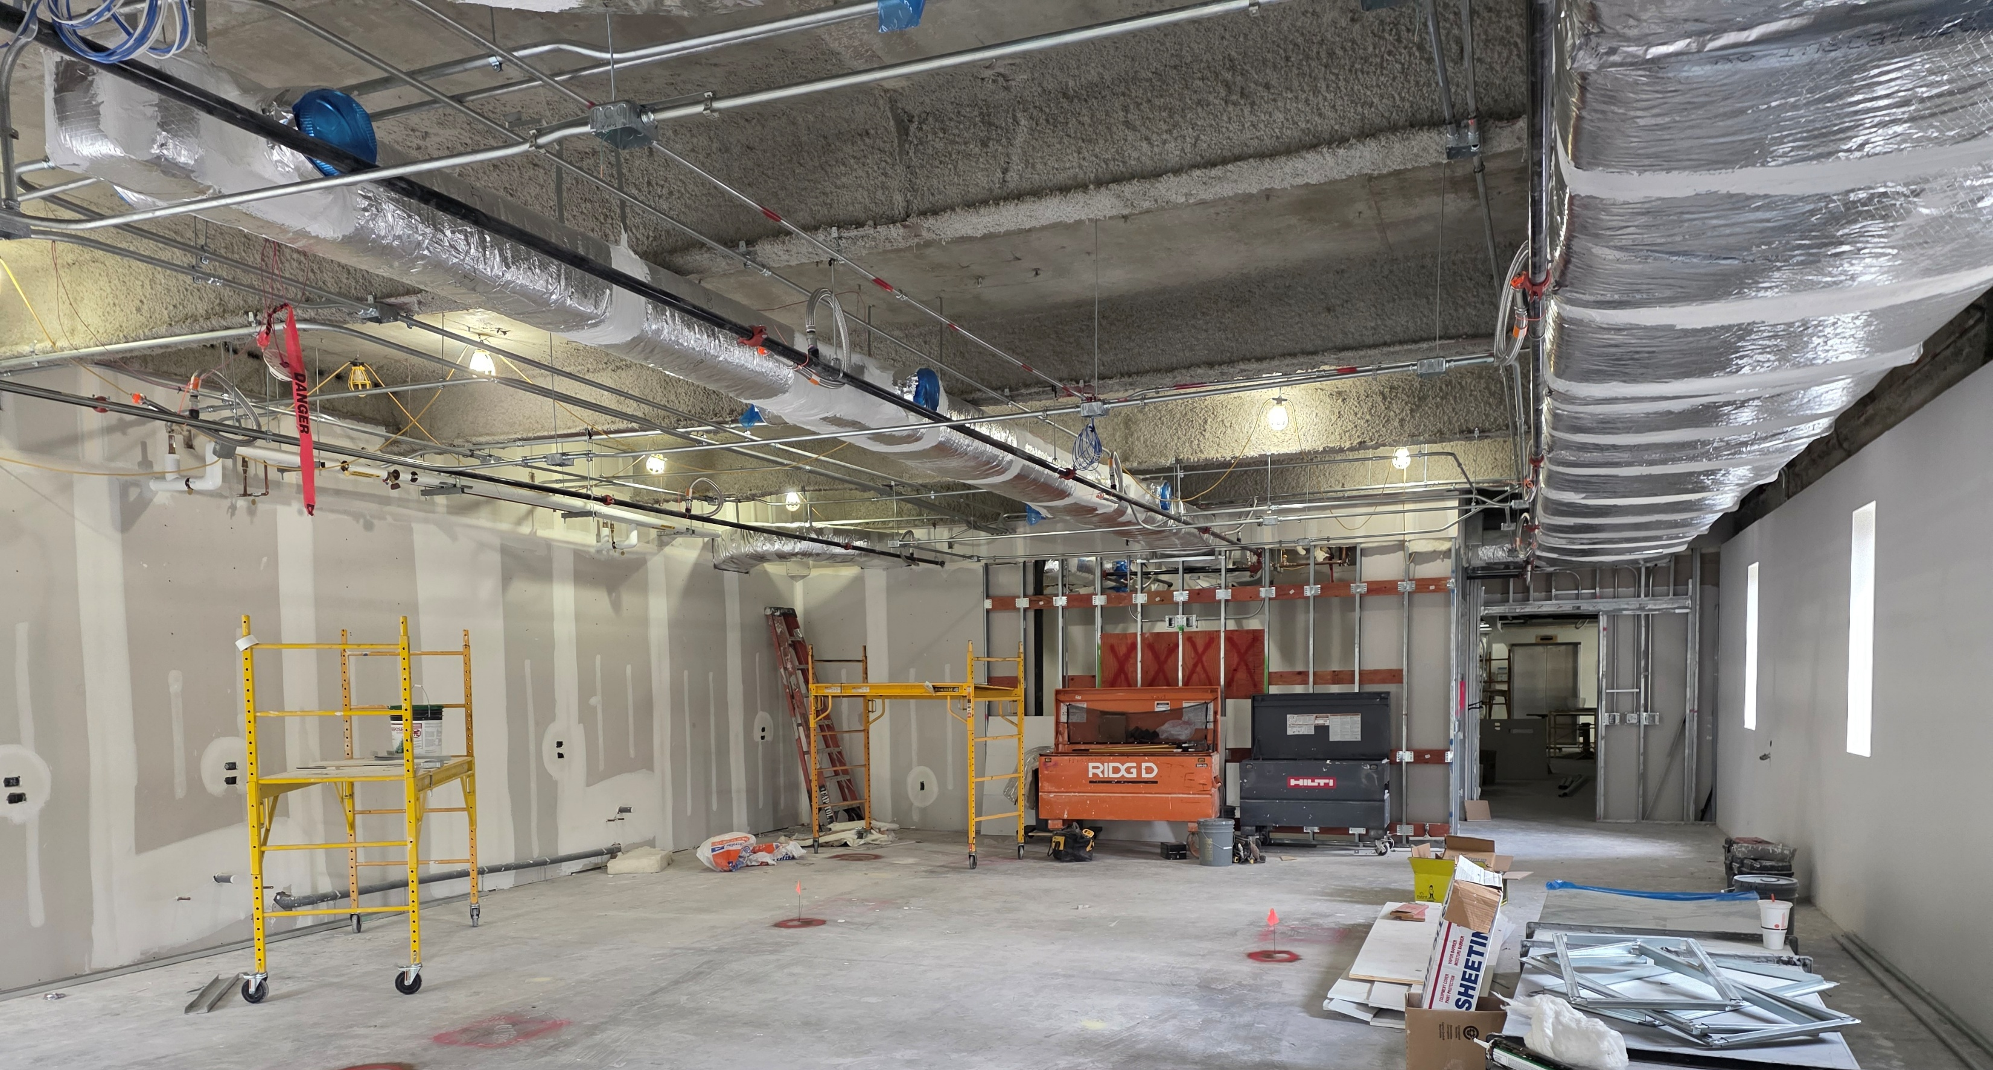
Biology Unit 1 – Second Floor Remodel

Slide 65
Deans & Chairs
Kyle Clark
Senior Vice President for Finance & Administration
March 10, 2026

