Slide 1
RESEARCH
Deans and Chairs Meeting
March 10, 2026

Slide 2
FSU Research by the Numbers

Slide 3
Official Fiscal Year 2025
$488,242,111.00
Up ~50% in four years!

Slide 4

February FY26 versus FY25
(Eight months into the Fiscal Year)
Awards
$868.5M
$210.4M
Proposal Amount
Award Amount
9%
2.9%
*Available funding opportunities have shifted

Slide 5
Federal Landscape

Slide 6
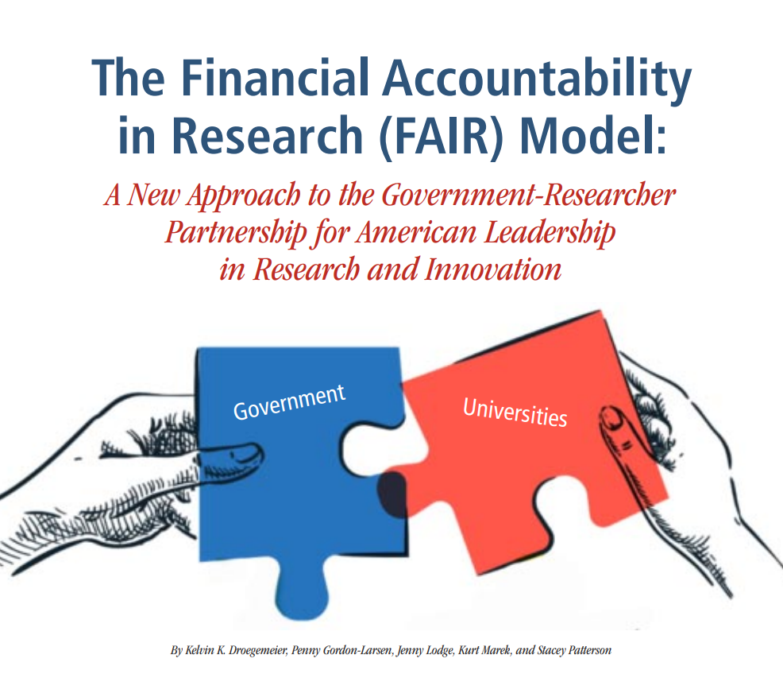
Recent Strategic Intelligence
FY26 Congressional Appropriations
E.O. on Improving Oversight of Federal Grantmaking
Administration Research Priorities
OMB Task Force to Reduce Regulatory Burden
Indirect Costs—JAG FAIR model
Notes:
So, we have to pay attention to the queues as they come and watch for things that may impact our operation…and I hope you feel that we are doing that.
This administration has been transparent, and with that has come to the table with their priorities…a right I they have to help determine where they would like to see funds invested.

Slide 7
Current Federal Landscape
The FY26 Budget – Doesn’t look so bad!
Agency | FY25 Enacted | FY26 Budget Request | FY26 House Mark | FY26 Senate Mark | FY26 Enacted
NSF | $8.80B | $3.90B | $7.00B | $9.00B | $8.75B
NIH (exc. ARPA-H) | $46.89B | $26.68B | $46.90B | $47.20B | $48.7B
DOE Office of Science | $8.24B | $7.09B | $8.40B | TBD | $8.4B
ARPA-E | $460.0M | $200.0M | $350.0M | $1.50B | $470M
DOD RDT&E | $141.26B | $143.19B | $147.62B | $142.47B | $145.9B
NASA | $24.84B | $18.81B | $24.84B | $24.90B | $24.4B
NIST (Commerce) | $1.16B | $833.0M | $1.28B | $1.60B | $1.85B
NOAA (Commerce) | $6.18B | $4.46B | $5.80B | $6.14B | $6B
NIFA (USDA) | $1.69B | $1.05B | $1.65B | $1.69B | $1.677B
NSF
NIH (exc. ARPA-H) DOE Office of
Science
ARPA-E
DOD RDT&E
NASA
NIST (Commerce)
NOAA
(Commerce)
NIFA (USDA)
$8.80B $46.89B $8.24B
$3.90B $26.68B $7.09B
$7.00B $46.90B $8.40B
$9.00B $47.20B
TBD
$460.0M
$141.26B
$24.84B
$1.16B
$6.18B
$200.0M
$143.19B
$18.81B
$833.0M
$4.46B
$350.0M
$147.62B
$24.84B
$1.28B
$5.80B
$1.50B
$142.47B
$24.90B $1.60B $6.14B
$1.69B
$1.05B
$1.65B
$1.69B
Notes:
The focus around the budget has been on the President’s “skinny” budget. While this gets a lot of attention every year, it is rarely reality. A reminder that congress sets the budget and the senate and house marks are much friendlier to science.
NIST – AI measurement science funding
NOAA specific operational research and facility funding was protected

Slide 8
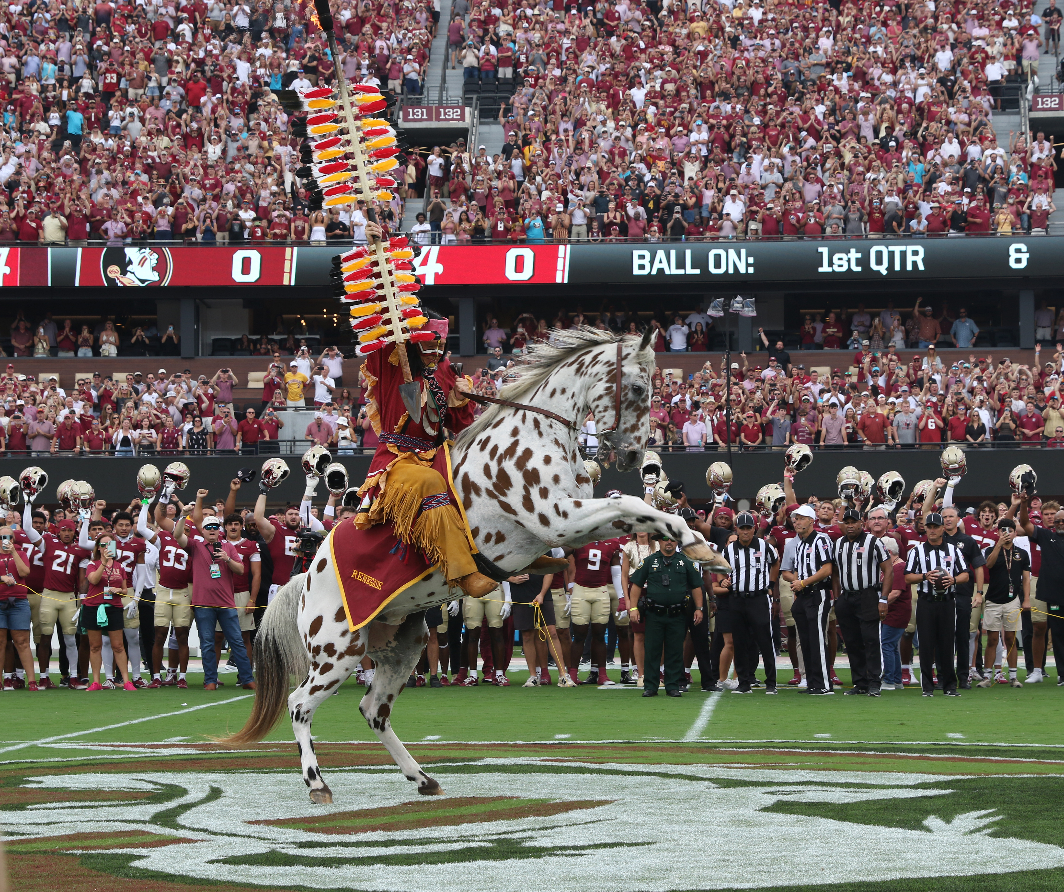
The Game has Changed
Reallocation and consolidation.
Agency missions and goals are different.
Review criteria are undergoing change.
The makeup of review panels includes broad input.
New funding mechanisms.
Funding decisions being made outside of reviewer scorings and rankings.

Slide 9
Agency | Previous | Current | Changes in Administration Priorities
AHA | Did not exist | Chronic Care, Disease Prevention, Low-Income Healthcare | Consolidate the work of multiple HHS agencies that includes OASH, HRSA, SAMHSA, ATSDR, and NIOSH
DoD | Defense Modernization, Basic Research, STEM Pipeline | Hypersonics, AI / Machine Learning, Quantum, Biodefense, Supply Chain Resilience | Increased focus on global competition
DOE | Clean Energy, Climate Science, Basic Energy Research | Critical Minerals, Nuclear Innovation, Energy Security, AI for Grid Resilience | Pivot from climate mitigation to energy dominance and industrial resilience
NASA | Earth Science, Climate Monitoring | Lunar and Mars Missions, Commercial Partnerships, Defense Aligned R&D | Deprioritize climate science, shift to space and exploration dominance
NIH | Public health, Biomedical innovation, Health disparities | Biosecurity, Biotechnology, Nutrition, Chronic Disease Management | Shift from institute autonomy to a centralized model, proposed reorganization from 20+ institutes and centers to 8
NIST |  | AI and Quantum Standards, Semiconductors | Focusing on national security and technology sovereignty
NOAA | Climate Modeling, Oceanic Research, Weather Forecasting | Commercial Weather Data, Arctic Security, Deep Sea / Critical Mineral Access | Reduced emphasis on climate change
NSF | Basic Science, STEM Education, Open Science | AI, Quantum, Biotechnology, National Security, Industry Collab | Shift from inclusive, curiosity-driven research to applied, security-focused science
USDA | Climate-Smart Agriculture, Rural Development, Food Equity | Biosecurity, Robotics, AI in Agriculture | Shift from sustainability and equity in agriculture to argi-biodefense and technology-driven production
Standards Developments,
Manufacturing Innovation

Slide 10








Key Elements for Success
Align research with new priorities
Broaden funding
Strengthen internal and external partnerships
portfolio
Notes:
Three makeovers happening – reallocation, consolidation and collaboration – Dept of Ed programs have moved to Dept of Labor – Labor has taken multiprograms and consolidated them into ONE BIG BEAUTIFUL program (Make America Skilled Again) MASA – ED and Labor are collaborating and they will expect us to do the same!
We must diversify our funding portfolio
Industry relationships – direct and collaborative (for federal awards)
Foundations
Philanthropy
Increased focus on shorter term impacts and economic outcomes
Research driven by industry and DOE national labs
Focus on agency missions (know them)
AI, AI, AI…education and research
Career readiness – new models and approaches for faster development
Engagement with and for ALL Americans

Slide 11

Developing competitive proposals
Strategic Planning
Editorial Support
Collaborator Identification
Expert/Mock Reviews
Funding Search Tools
On-Demand Learning
Competitive Intelligence
Limited Submissions
Connections – i.e. Research Interest Groups (RIGS)
Notes:
Some of the ways RD can assist
Support from your college…

Slide 12


Strengthening Partnerships
Notes:
How to strengthen partnerships. Formal and Informal Get-Togethers. RD hosts Collaborative activities to help you meet potential partners and also facilitates Research Interest Groups.

Slide 13
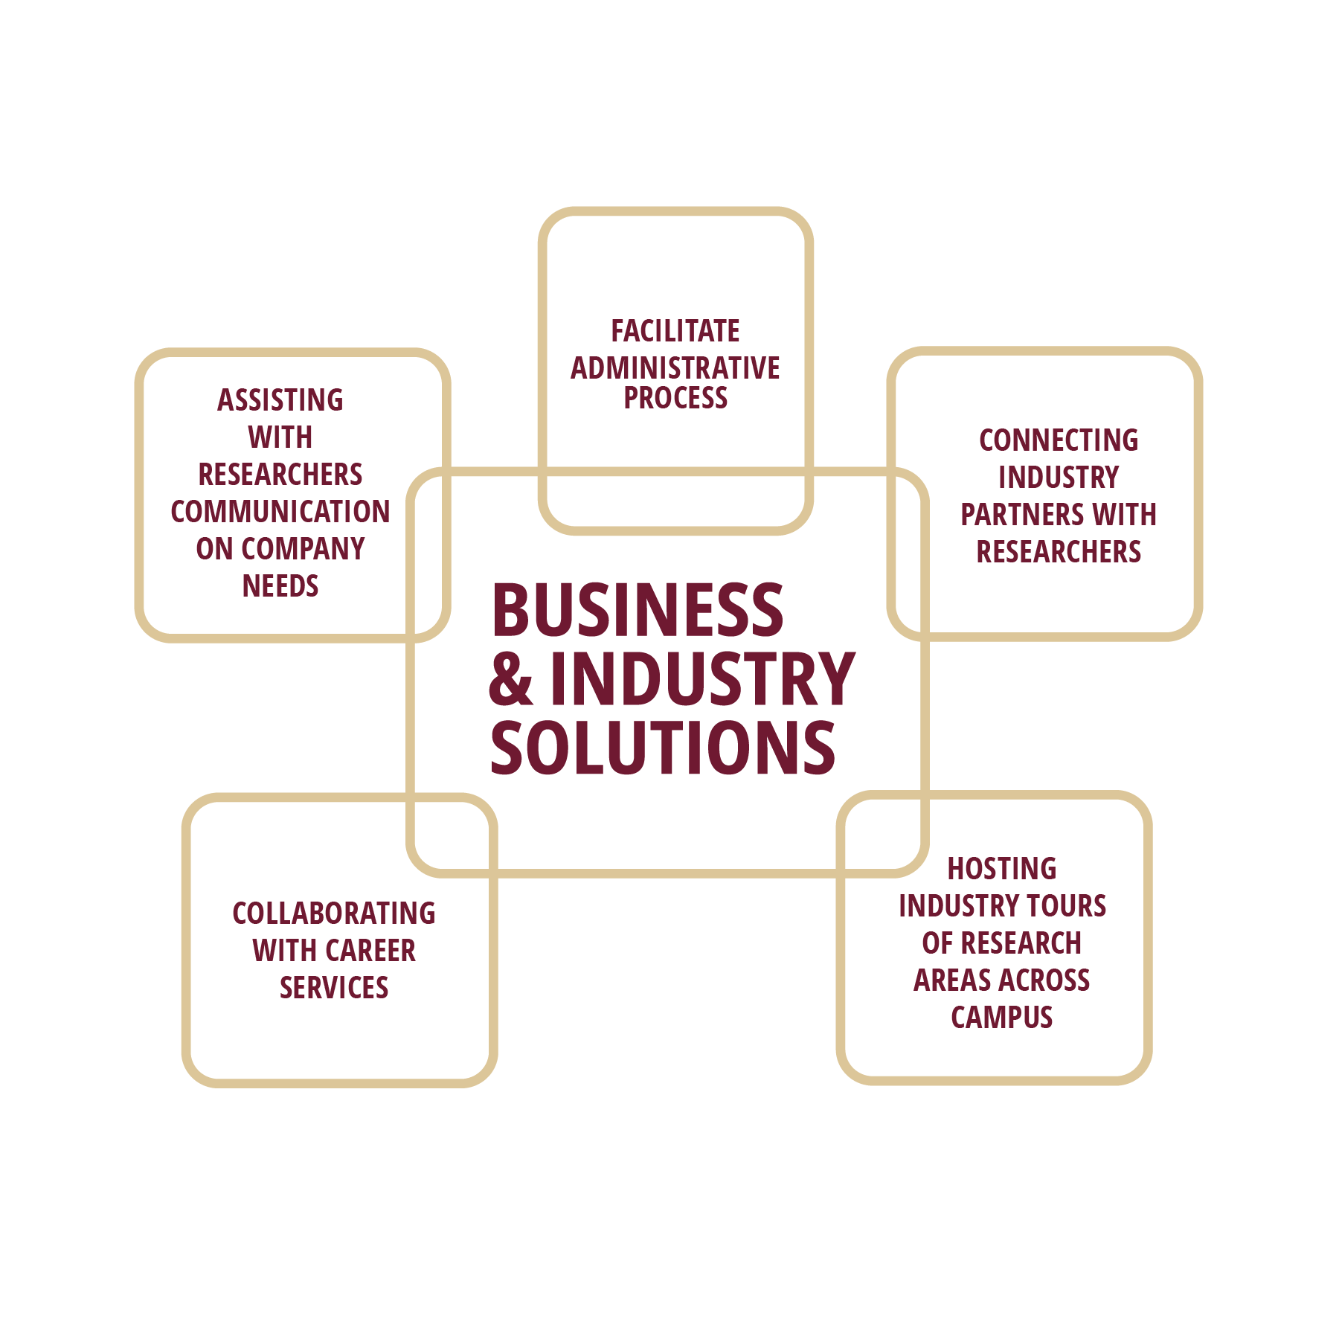

Connecting with the private sector

Slide 14
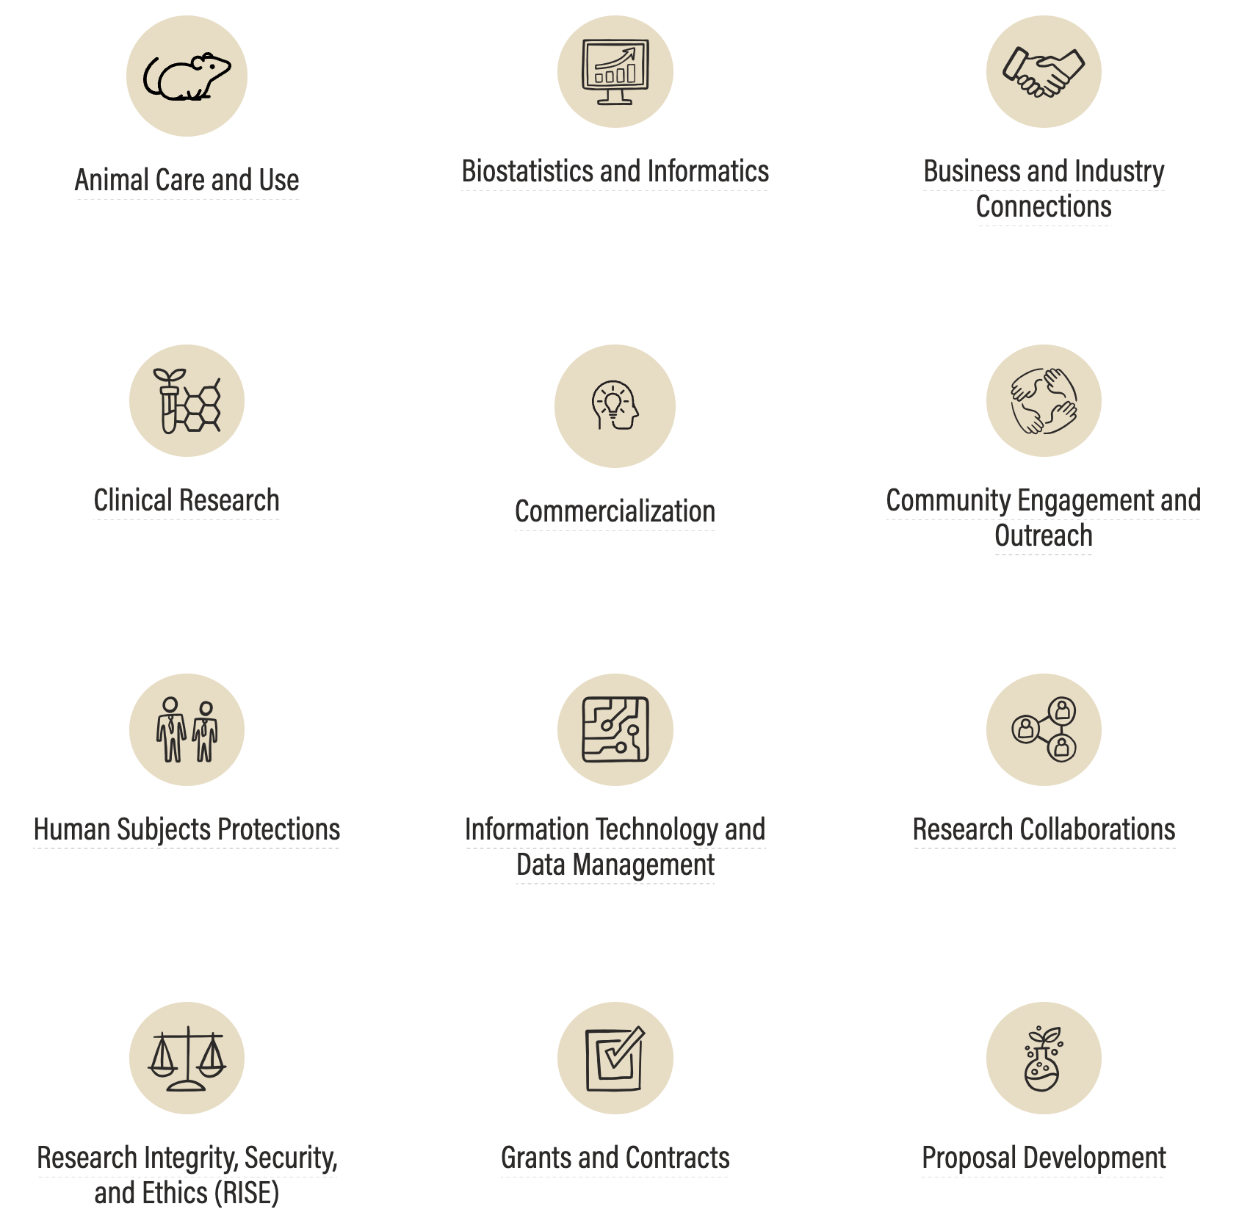




Making New Health Connections
Request Portal
Website
Phone
Email
ChatBot*
*under development

Slide 15

Developing new ways to support growth
Strong connections between ITS and Research
Director of AI Research Solutions
  New position – search underway
    Concierge-style service
    Build a program
    Student/early-talent support

Slide 16
A few take aways from the past year
With every challenge, comes opportunity.
Back to basics - proposal writing 101.
  Give them their words back to them.
  Write for a general audience.
  Focus on significance.
Be proactive – those who prepare will win!
Feedback is a gift - solicit feedback broadly!
You have to play to win - keep submitting proposals.
Our researchers…including early career investigators: are doing some really cool, impactful work!

Slide 17
Questions?

