Slide 1
Welcome!
Amy R. Guerette & Craig Stanley
Office of Faculty Development and Advancement
Notes:
Amy and Craig Introduce Ourselves

Slide 2
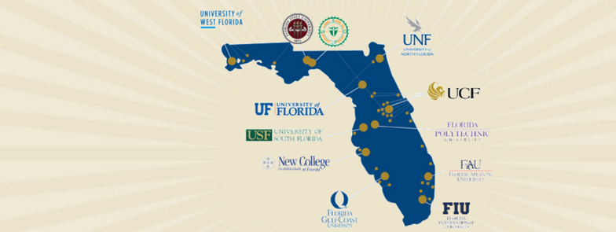
Florida Board of Governors (BOG) & State University System (SUS)
Notes:
Amy
Florida Board of Governors (BOG) is a 17-Member governing board that serves as the governing body for the Florida State University System (SUS). There are 12 institutions represented in the State University System.

Slide 3
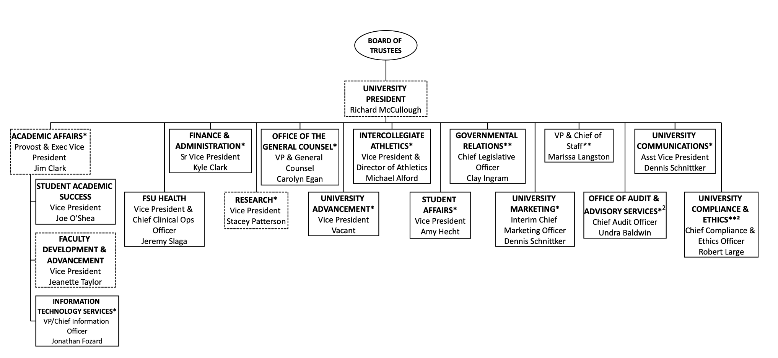
FSU Organizational Structure
Notes:
Amy

Slide 4
History of Florida State University
1851-1857
1863
1901
1905
1909
1947
West Florida Seminary
The Florida Military College and Institute
Florida State College
Florida Female College
Florida State College for Women
Florida State University
Notes:
Amy
Institutional History
1851/1857: West Florida Seminary
• Located on the hill where Westcott Budling stands
• Became co-ed the following year when it absorbed the Tallahassee Female Academy
1863: Name Changed to The Florida Military and Collegiate Institute
• 1891 focused on what we would call today higher education – awarded bachelor degrees
1901: Florida State College
• 4 departments – the College, the School for Teachers, the School of Music, and the College Academy
1905: The state legislature reorganized 6 state institutions into two – one for men at the University of Florida and one for women at the Florida Female College (male students moved to Gainesville)
1909: Florida State College for Women
• Grew to become the 3rd largest women’s college in the nation
• However, after World War II, veterans demand for men’s education increased dramatically
1947: Florida State University
• Arts and Sciences, Education, Home Economics, and Music
• In the 50’s added Library Science, Social Welfare (later split into Social Work and Criminology), Business, Journalism (later discontinued), and Nursing

Slide 5
Campus Locations
Main Campus: 487.1 acres in Tallahassee, Leon County.
Panama City Branch: 25.6 acres in Panama City, Florida
Republic of Panama: Located in the City of Knowledge, across from the Panama Canal
The University owns a total of 1,810 acres in Leon, Bay, Collier, Franklin, Gadsden, and Sarasota counties. Sites are leased in various counties in Florida and other locations overseas. locations overseas.
Main/Tallahassee Campus
Panama City Campus
Republic of Panama Campus
Study abroad centers in London, Florence, Valencia, and Panama
Regional medical campuses
Notes:
Craig – Updated 8-12-26

Slide 6
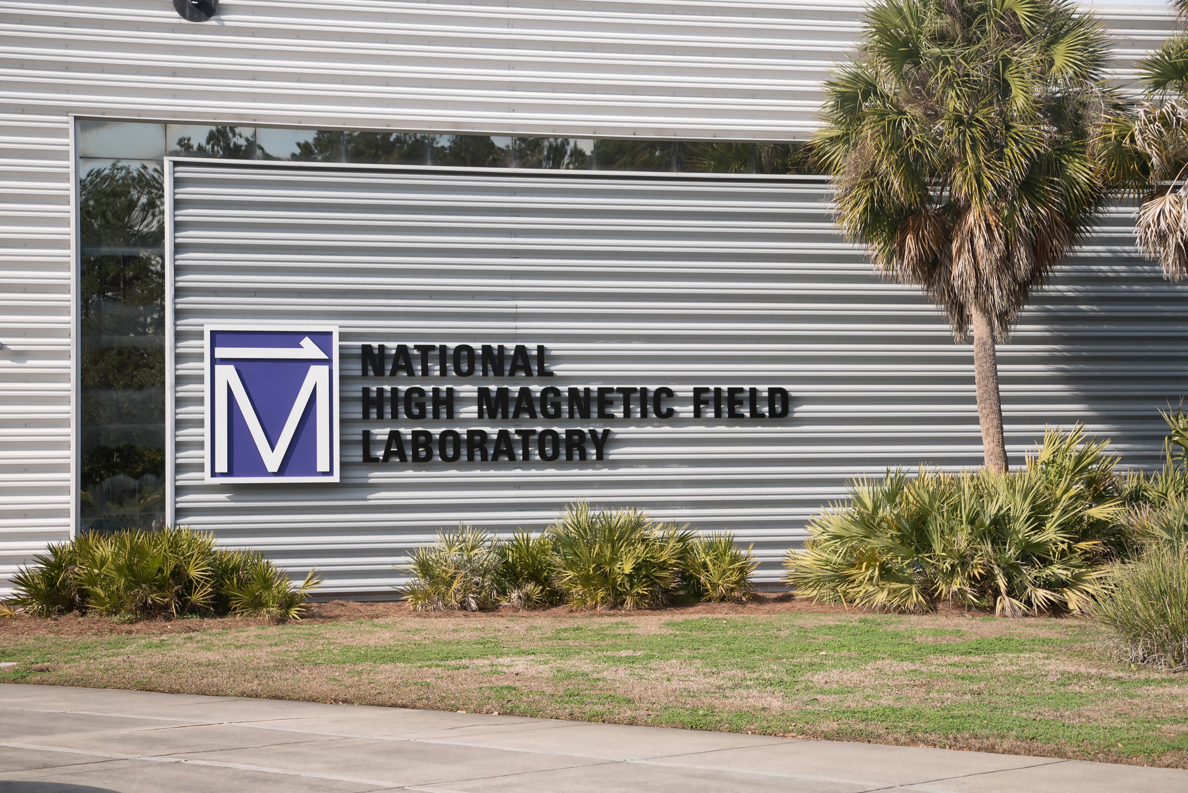

Tallahassee Campus
FSU Lakefront Park
Seminole Golf Course
FSU Circus
Marine Laboratory on the Gulf Coast
Innovation Park
  Home to the National High Magnetic Field Laboratory and FAMU/FSU College of Engineering
FSU Health
  FSU Health Research Center
  Tallahassee Memorial Hospital
Notes:
Craig- Updated 8-12-26

Slide 7
Colleges at FSU
College of Applied Studies*
College of Arts and Sciences
Wertheim College of Business
College of Communication and Information
College of Criminology and Criminal Justice*
Anne Spencer Daves College of Education, Health, and Human Sciences
College of Engineering (FAMU/FSU)
Moran College of Entrepreneurship*
College of Fine Arts
Dedman College of Hospitality*
College of Law*
College of Medicine
College of Motion Picture Arts*
College of Music*
College of Nursing*
College of Social Sciences and Public Policy
College of Social Work*
*No departments
Notes:
Amy
FSU has 17 colleges offering undergraduate and graduate programs.
College of Applied Studies*
Panama City Campus; 2010
College of Arts and Sciences
Oldest and largest College – larger than many universities
Located ALL over campus!
College of Business
Rovetta next to the Union but getting a fancy new building on St. Austine
College of Communication and Information
Merged in 2009
College of Criminology and Criminal Justice*
College of Education, Health, and Human Sciences
Education was 2nd oldest and Health/Human Sciences 3rd oldest
Merged in 2023
College of Engineering (FAMU/FSU)
Joint College with FAMU – Innovation Park
Moran College of Entrepreneurship*
Established in 2017
College of Fine Arts
Arts are highly valued at FSU
Dedman College of Hospitality*
Established in 2017
College of Law*
College of Medicine
Established 2001
College of Motion Picture Arts*
College of Music*
4th oldest college; national reputation
College of Nursing
College of Social Sciences and Public Policy
College of Social Work*

Slide 8
Academic Offerings
We offer 276 distinct Degrees:
100Bachelors
102 Masters
6 Specialist
64 Doctoral
4 Professional
And 581 unique Majors:
201Bachelors
226 Masters
17 Specialist
129 Doctoral
8 Professional
Additionally, we offer our degree programs in various formats such as Bachelors/Graduate Pathways. Certificate programs are also popular among our students at the undergraduate and graduate levels!
Notes:
Amy

Slide 9

FSU's Student Body
Over 46,184 students from all 50 states and over 130 countries
Undergraduate enrollment: 33,068
Graduate & Professional enrollment: 11,022
Second-year retention rate: 96.4%
Six-year graduation rate: 85.8%
Notes:
Craig (Updated 8-12-26)
FSU has over 42,000 students from all 50 states and over 130 countries. 33,068 of these students are pursuing undergraduate degrees, while 11,022 are pursuing graduate or professional degrees. FSU's first-year retention rate is 96%, well above the national average. Six-Year graduation rate is 85.8%.

Slide 10
Enrollment Breakdown
College | Total Students | Graduate Students | Degrees Offered
Arts and Sciences | 10,6531 | 1,633 | 87
Business | 8,430 | 1,004 | 15
Social Science and Public Policy | 4,428 | 761 | 28
Education, Health, and Human Sciences | 3,630 | 1,516 | 40
Engineering | 3,029 | 463 | 24
Communication and Information | 2,436 | 837 | 13
Nursing | 1,772 | 423 | 4
Criminology and Criminal Justice | 1,670 | 293 | 4
Medicine | 1,299 | 714 | 7
Law | 1,221 | 1,221 | 5
Social Work | 1,200 | 1,040 | 3
Fine Arts | 1,070 | 298 | 18
Music | 1,031 | 341 | 17
Entrepreneurship | 534 | 37 | 4
Hospitality | 526 | 47 | 4
Applied Studies | 526 | 315 | 6
Motion Picture Arts | 189 | 79 | 3
Notes:
Amy
Fall 2025

Slide 11
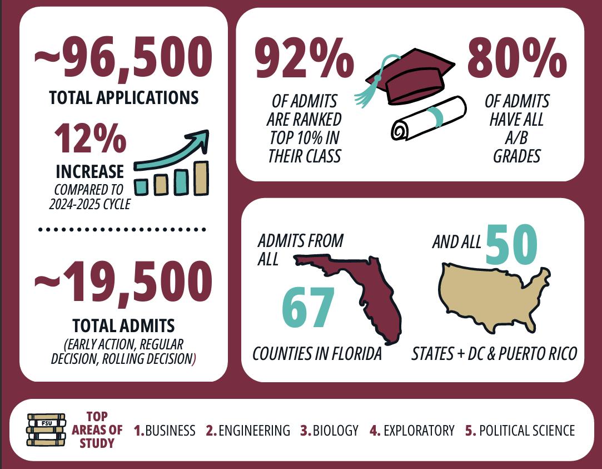
Class of 2030
Notes:
Craig

Slide 12
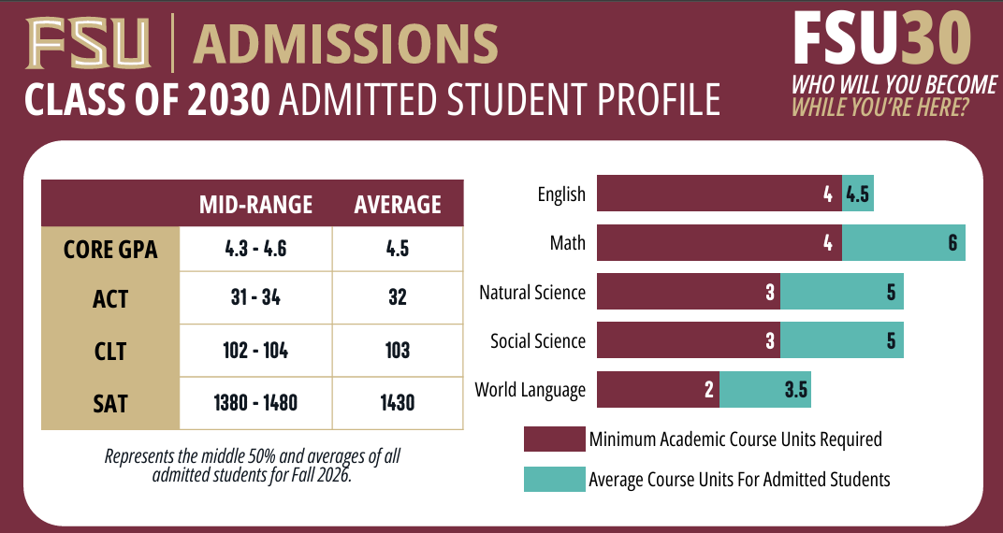
Notes:
Craig

Slide 13
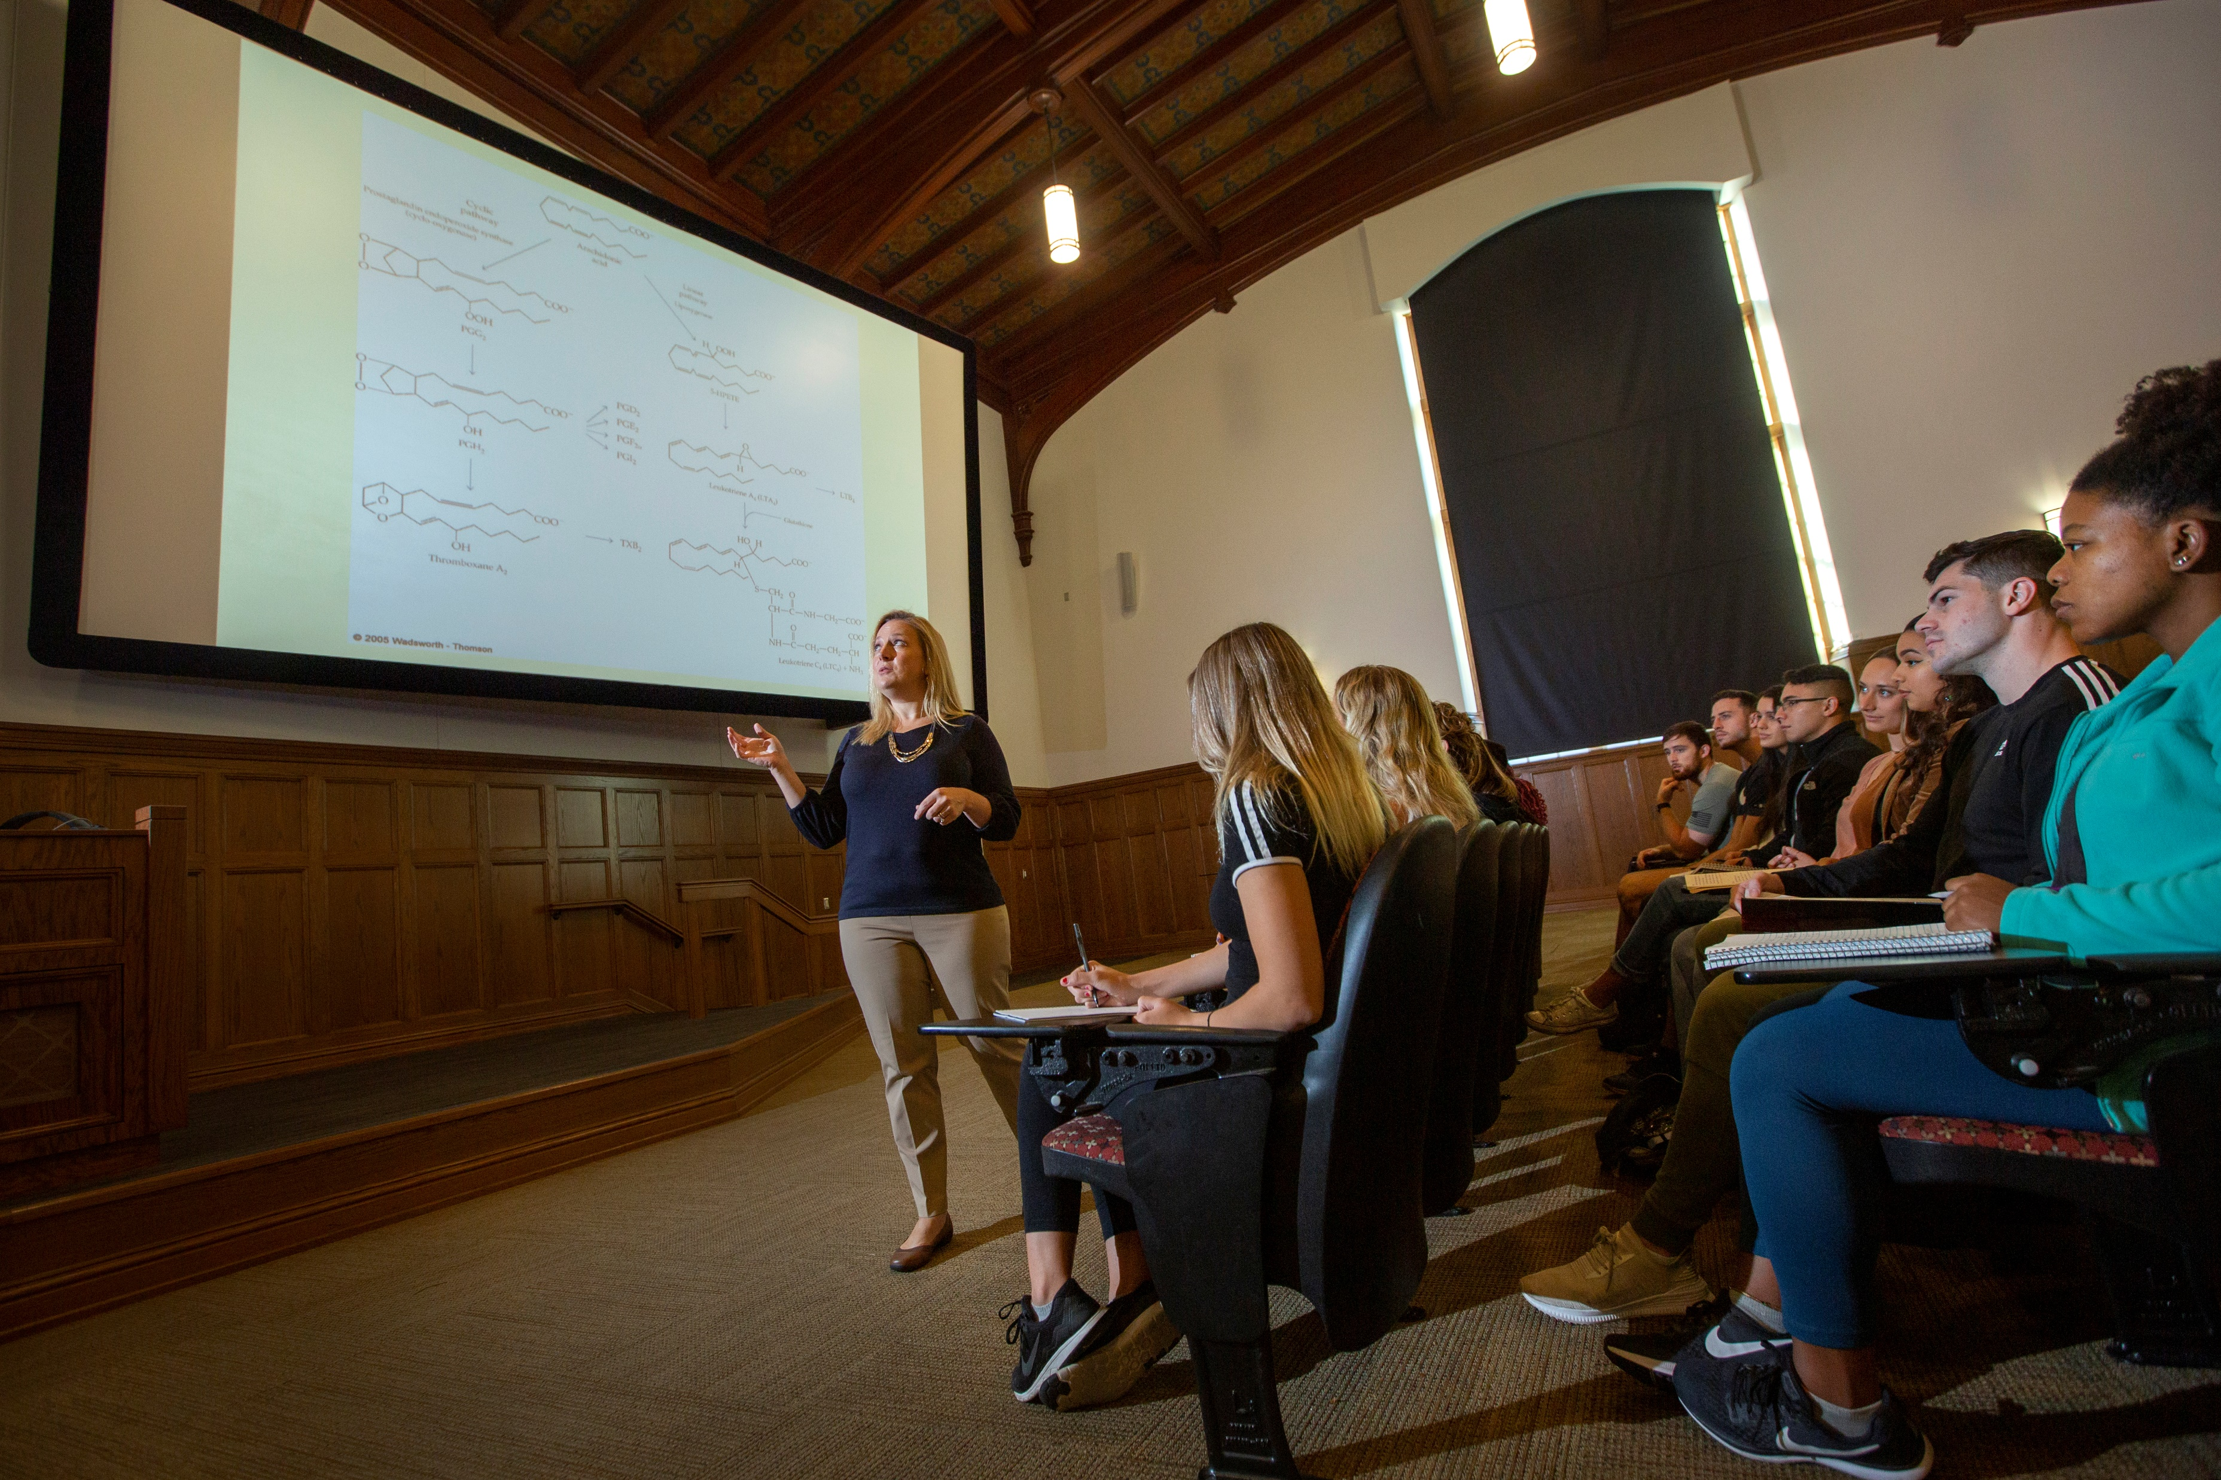
FSU Faculty
With over 2,300 full-time faculty members, FSU provides a 22:1 student-to-faculty ratio.
Over 76% of upper-division classes are taught by salaried faculty.
FSU professors hold numerous awards and recognitions for their contributions to their field through their scholarship and creative works.
Notes:
Craig (Updated 8-12-26)
Florida State University boasts a diverse and accomplished faculty over 2,000 members strong, providing a 22:1 student-to-faculty ratio. FSU professors hold numerous awards and recognitions for their contributions to their field.

Slide 14
Department and College Bylaws
Leadership Structure
Faculty Membership and Voting
Faculty Meetings
Faculty Committees
Annual Faculty Evaluation Criteria
Promotion and Tenure Criteria
  Criteria for Promotion and Tenure of Tenure-track Faculty
  Criteria for Promotion of Specialized Faculty
Notes:
Craig Each academic unit has a set of bylaws that govern many aspects of the unit
College and Department Bylaws are a good starting place for getting acclimated to your new position!

Slide 15
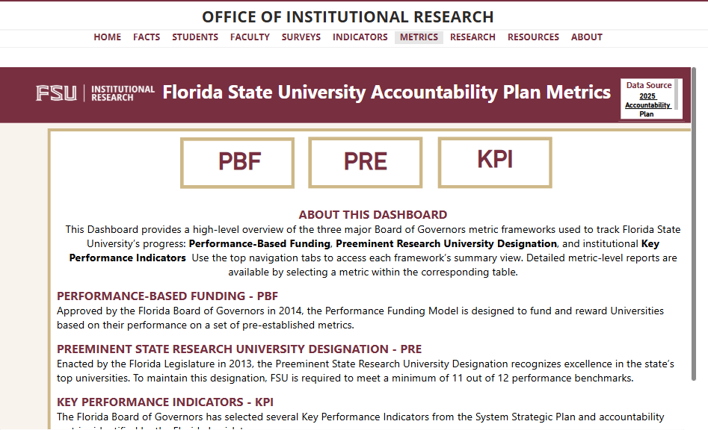
Pursuit of Excellence
Notes:
Amy: (Updated 8-12-26) FSU is a top public research university, ranked #25 among public universities by U.S. News & World Report. and #11 by Niche, FSU is also one of three institutions within the SUS to have earned preeminence status.

Slide 16
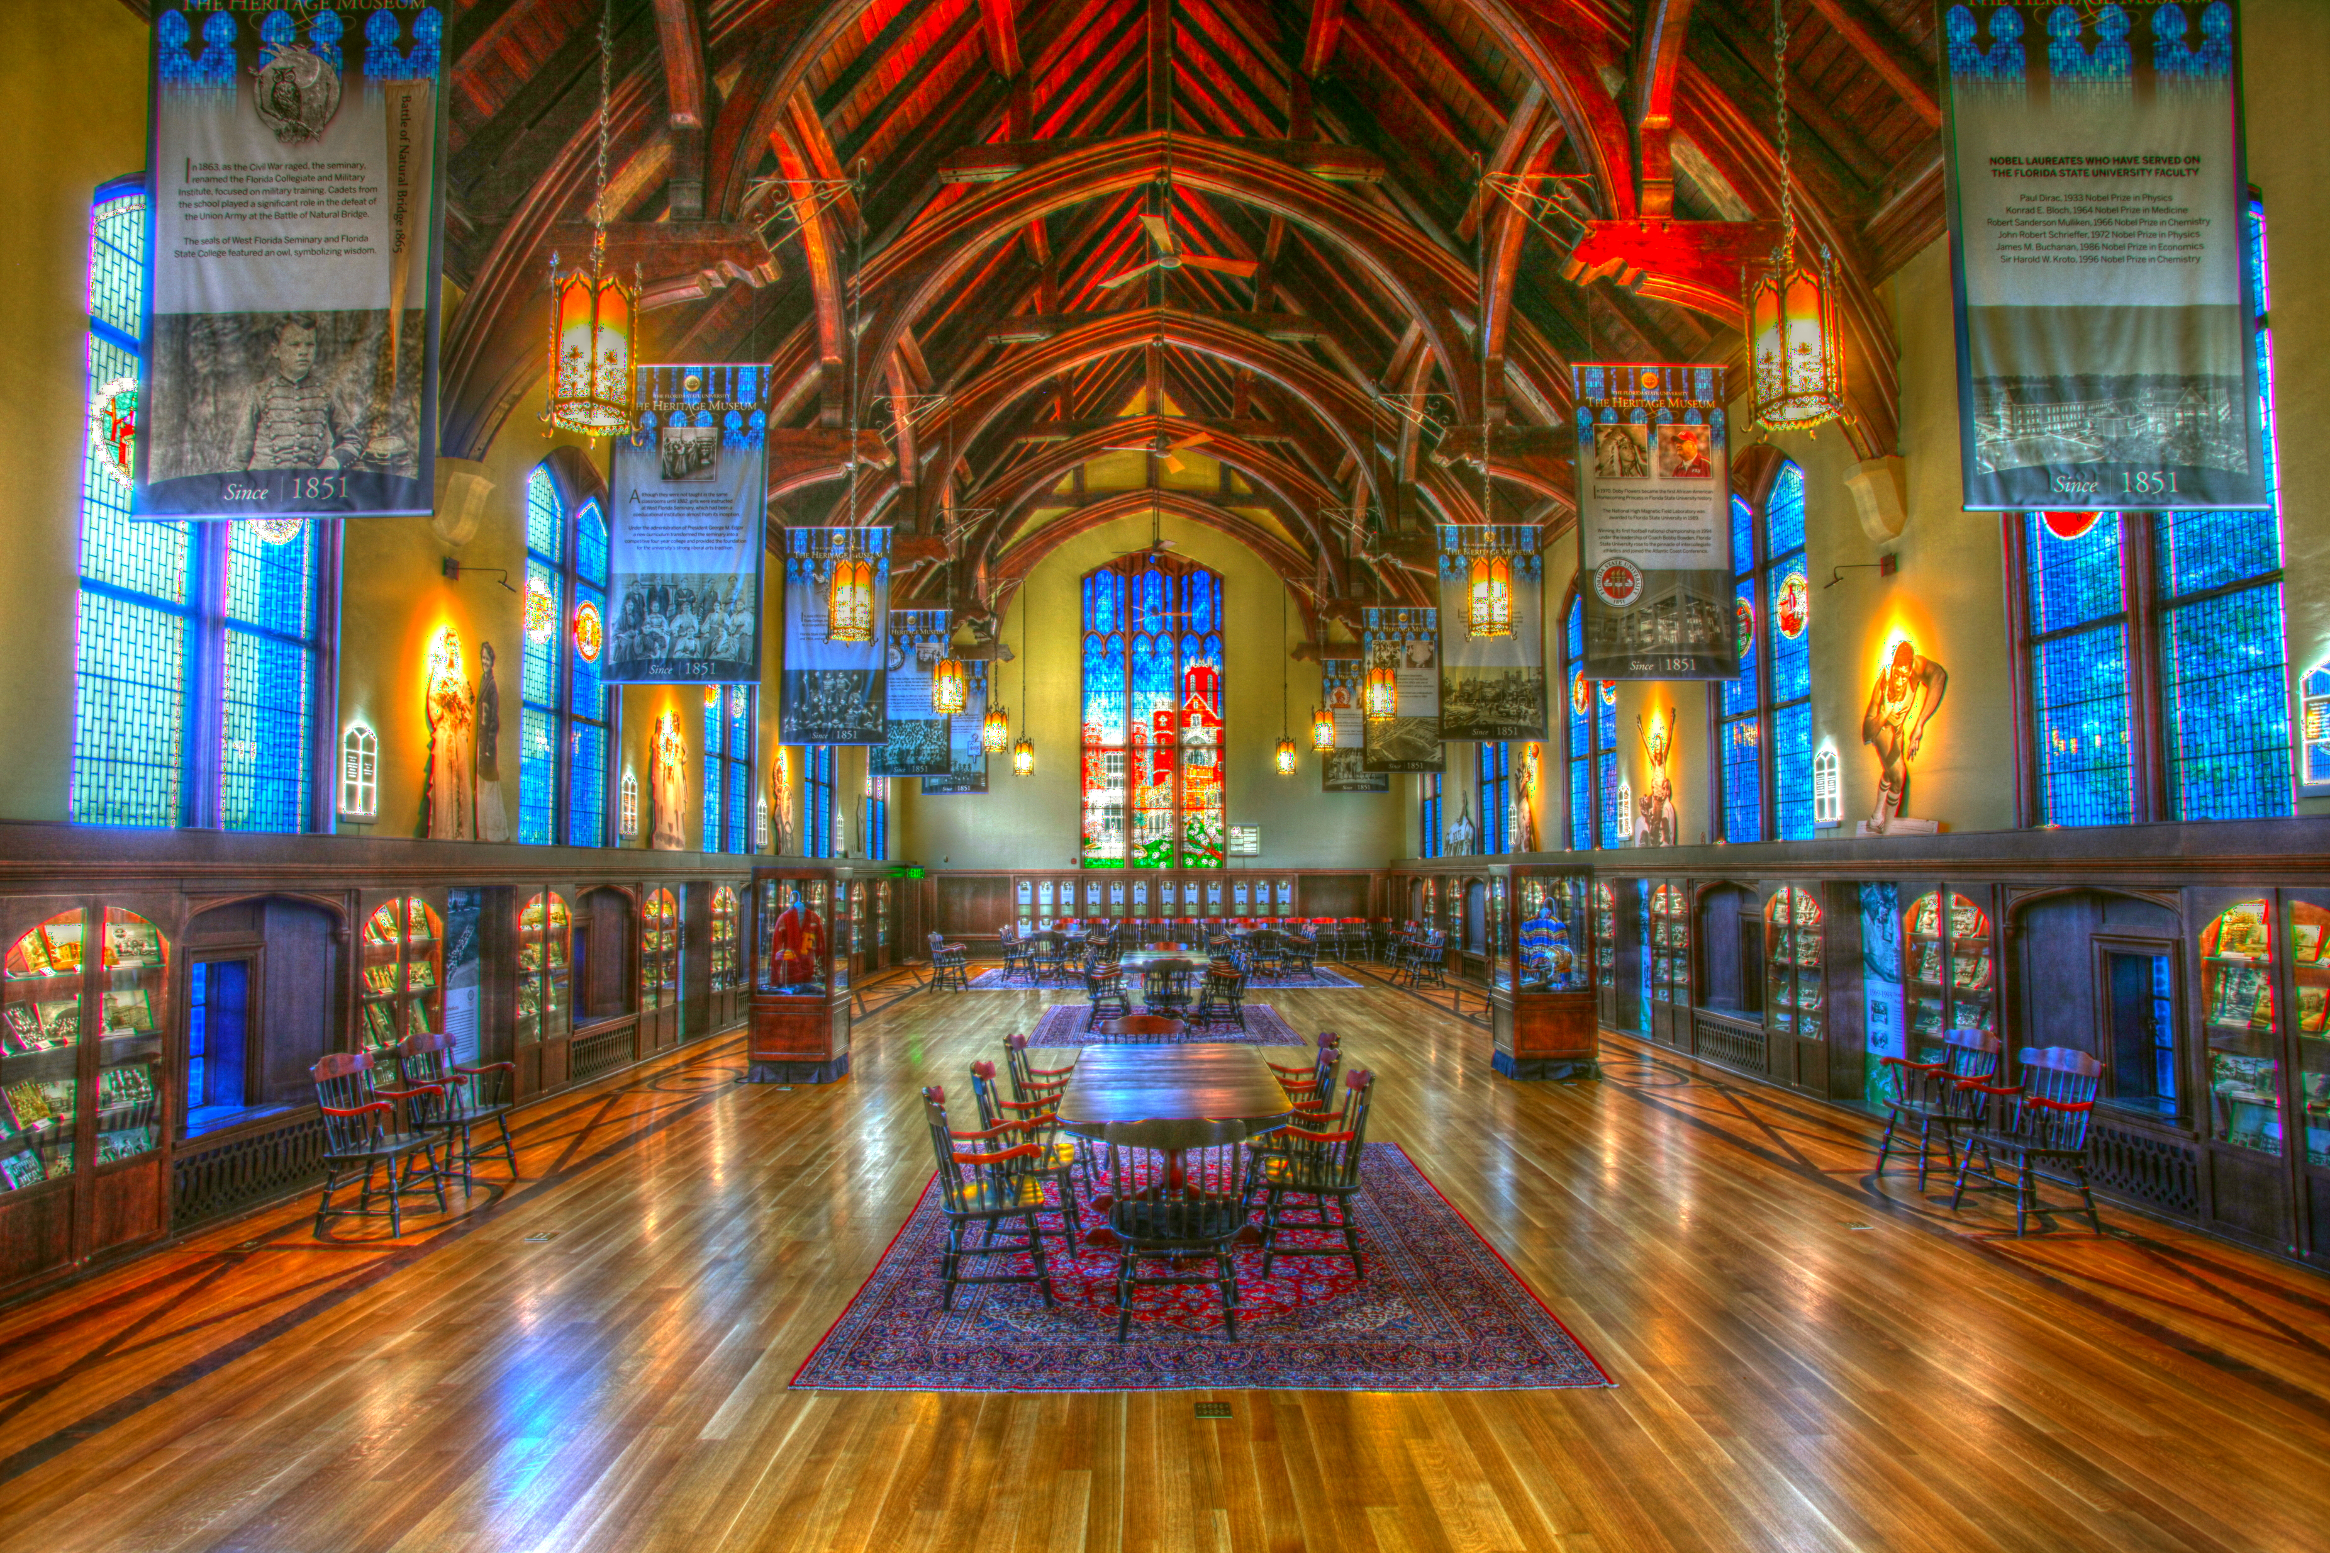
Welcome To FSU!!

