Slide 1



New Faculty Orientation 2026

Slide 2

Our Mission
UFF-FSU is a professional organization of, by, and for the FSU faculty. We are a democratic, member-supported, volunteer-powered voice for higher education faculty at FSU and statewide. We advocate for the best possible working conditions for FSU’s faculty. A union gives us a powerful voice with which to meet the administration on equal footing.

Slide 3
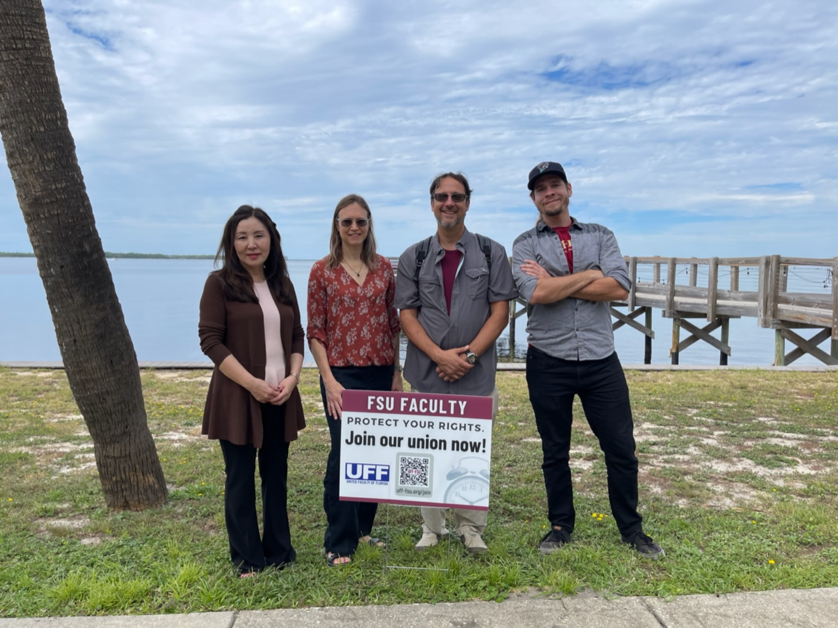
Who do we represent?
All faculty except for those in the Colleges of Law and Medicine
Tenured, Tenure Track and Specialized Faculty (Non-tenured)
All regular, visiting, provisional, affiliate or joint appointments are
included.

Slide 4
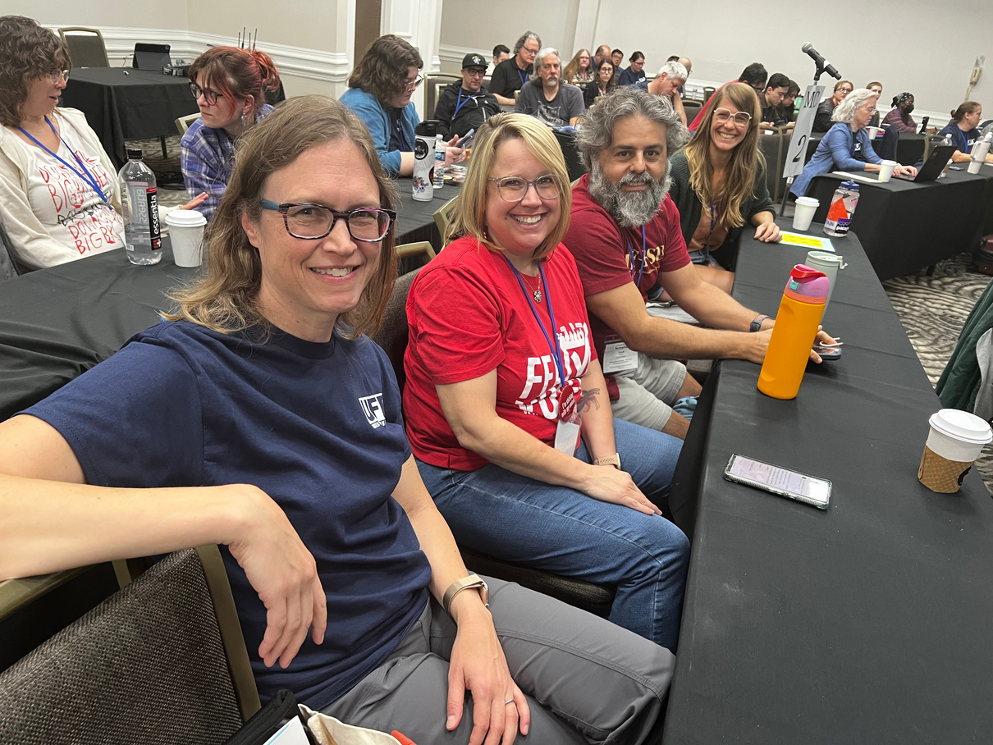
Membership Benefits
More members mean a louder, more credible voice in negotiations, activism, and lobbying.
Dues fund all union efforts, enabling us to secure better pay, benefits, and working conditions.
Union membership
ensures we maintain the power to negotiate fair and equitable
employment terms.

Slide 5

But wait... there’s more!
Educators Employment Liability (EEL) - $1,000,000 of liability coverage provided automatically for all UFF members
Monthly social events! Join us for our next one on Friday, Sept.4!
Benefits programs through FEA, NEA and AFT including insurance and travel discounts, and financial services

Slide 6


JOIN YOUR FACULTY UNION!
To help make FSU a better place to work. To protect your rights as an employee. To support a strong faculty voice and collective bargaining power.
Website
Email
Mailing Address
www.uff-fsu.org
contact@uff-fsu.org
PO Box 1053
Tallahassee, FL 32302

