Slide 1


STUDENT AFFAIRS
Partnering for Student Success: An Introduction to the Division of Student Affairs
Amy Hecht, Ed.D., Vice President for Student Affairs
August 2026

Slide 2

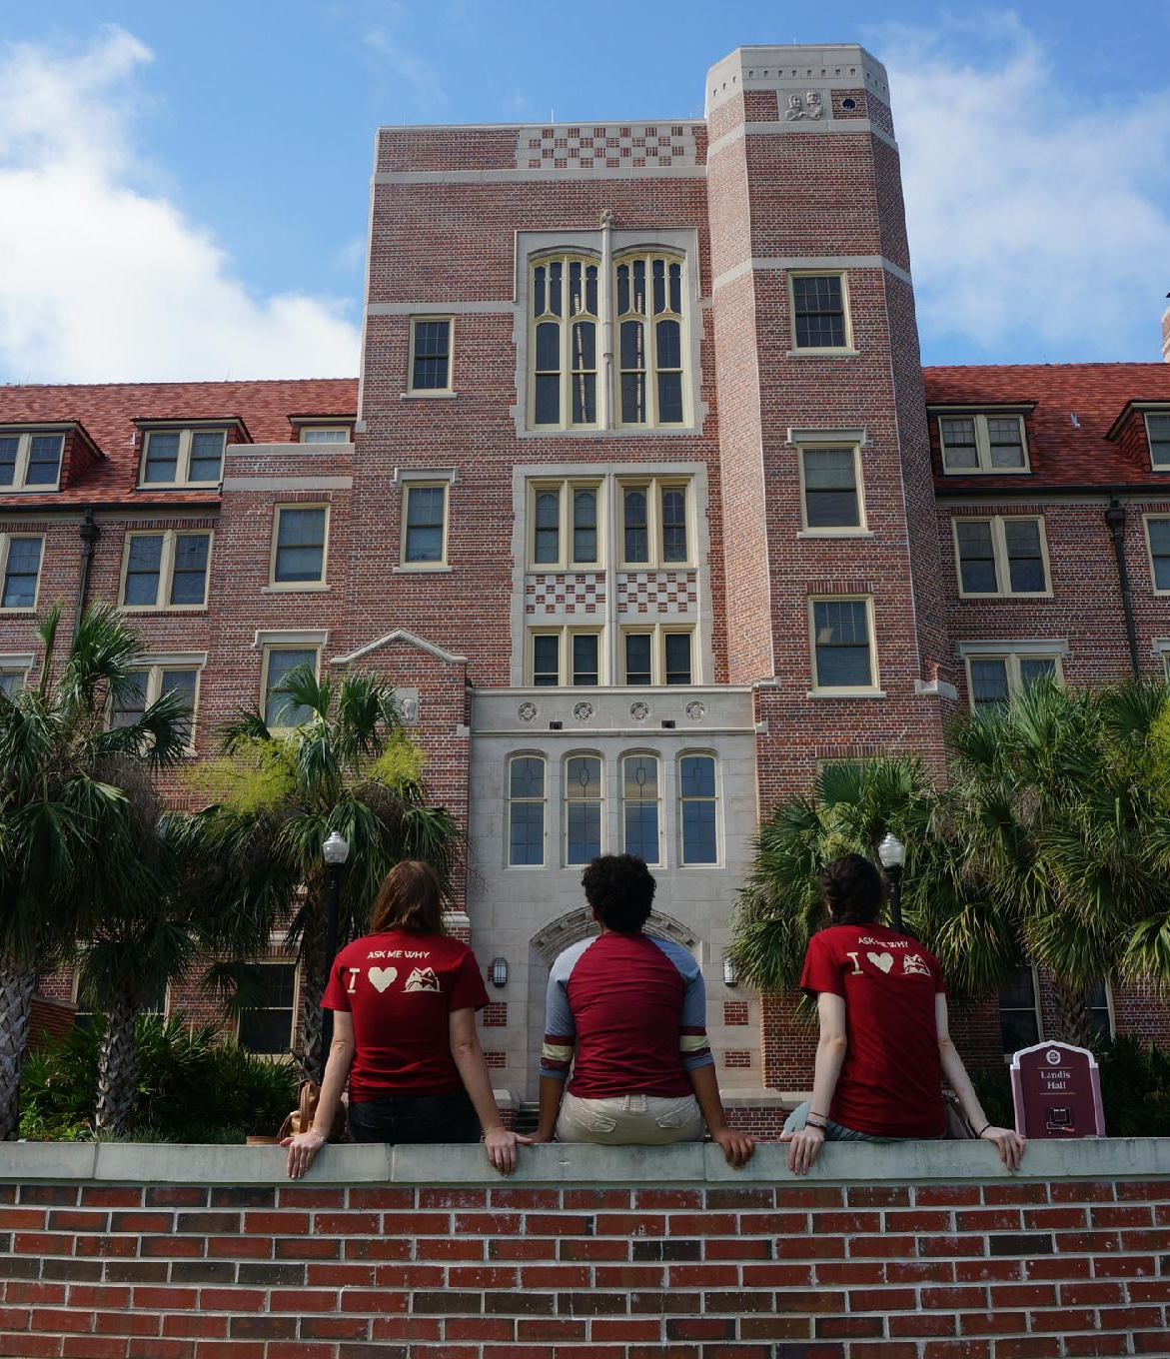




STUDENT AFFAIRS
Our Mission is student success. The Florida State University Division of Student Affairs empowers and supports students to achieve their full potential.
Engagement
Community
Health and Wellness
Career Readiness
Notes:
To share how the Division of Student Affairs supports student success and how we collaborate with faculty.

Slide 3
STUDENT AFFAIRS DEPARTMENTS
Engagement
Community
Fraternity and Sorority Life
Student Engagement
University Housing and Childcare
New Student and Family Programs
Panama City Campus Student Affairs
Center for Academic Retention and Enhancement (CARE)
Center for Leadership and Service
Information Technology
Center for Global Engagement
Student Union
Marketing and Communications
Health and Wellness
Career Readiness
Title IX Office
Counseling and Psychological Services
Campus Recreation
University Health Services
Student Conduct & Community Standards
Student Support and Transition
Career Center

Slide 4

Student Success =
academic + personal + social development + health and wellness

Slide 5
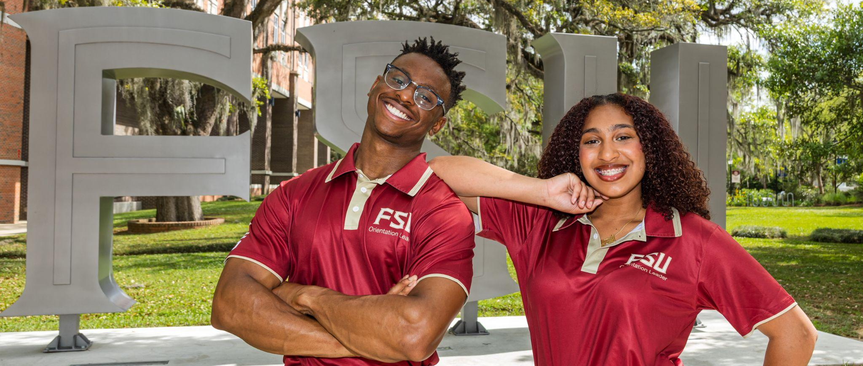
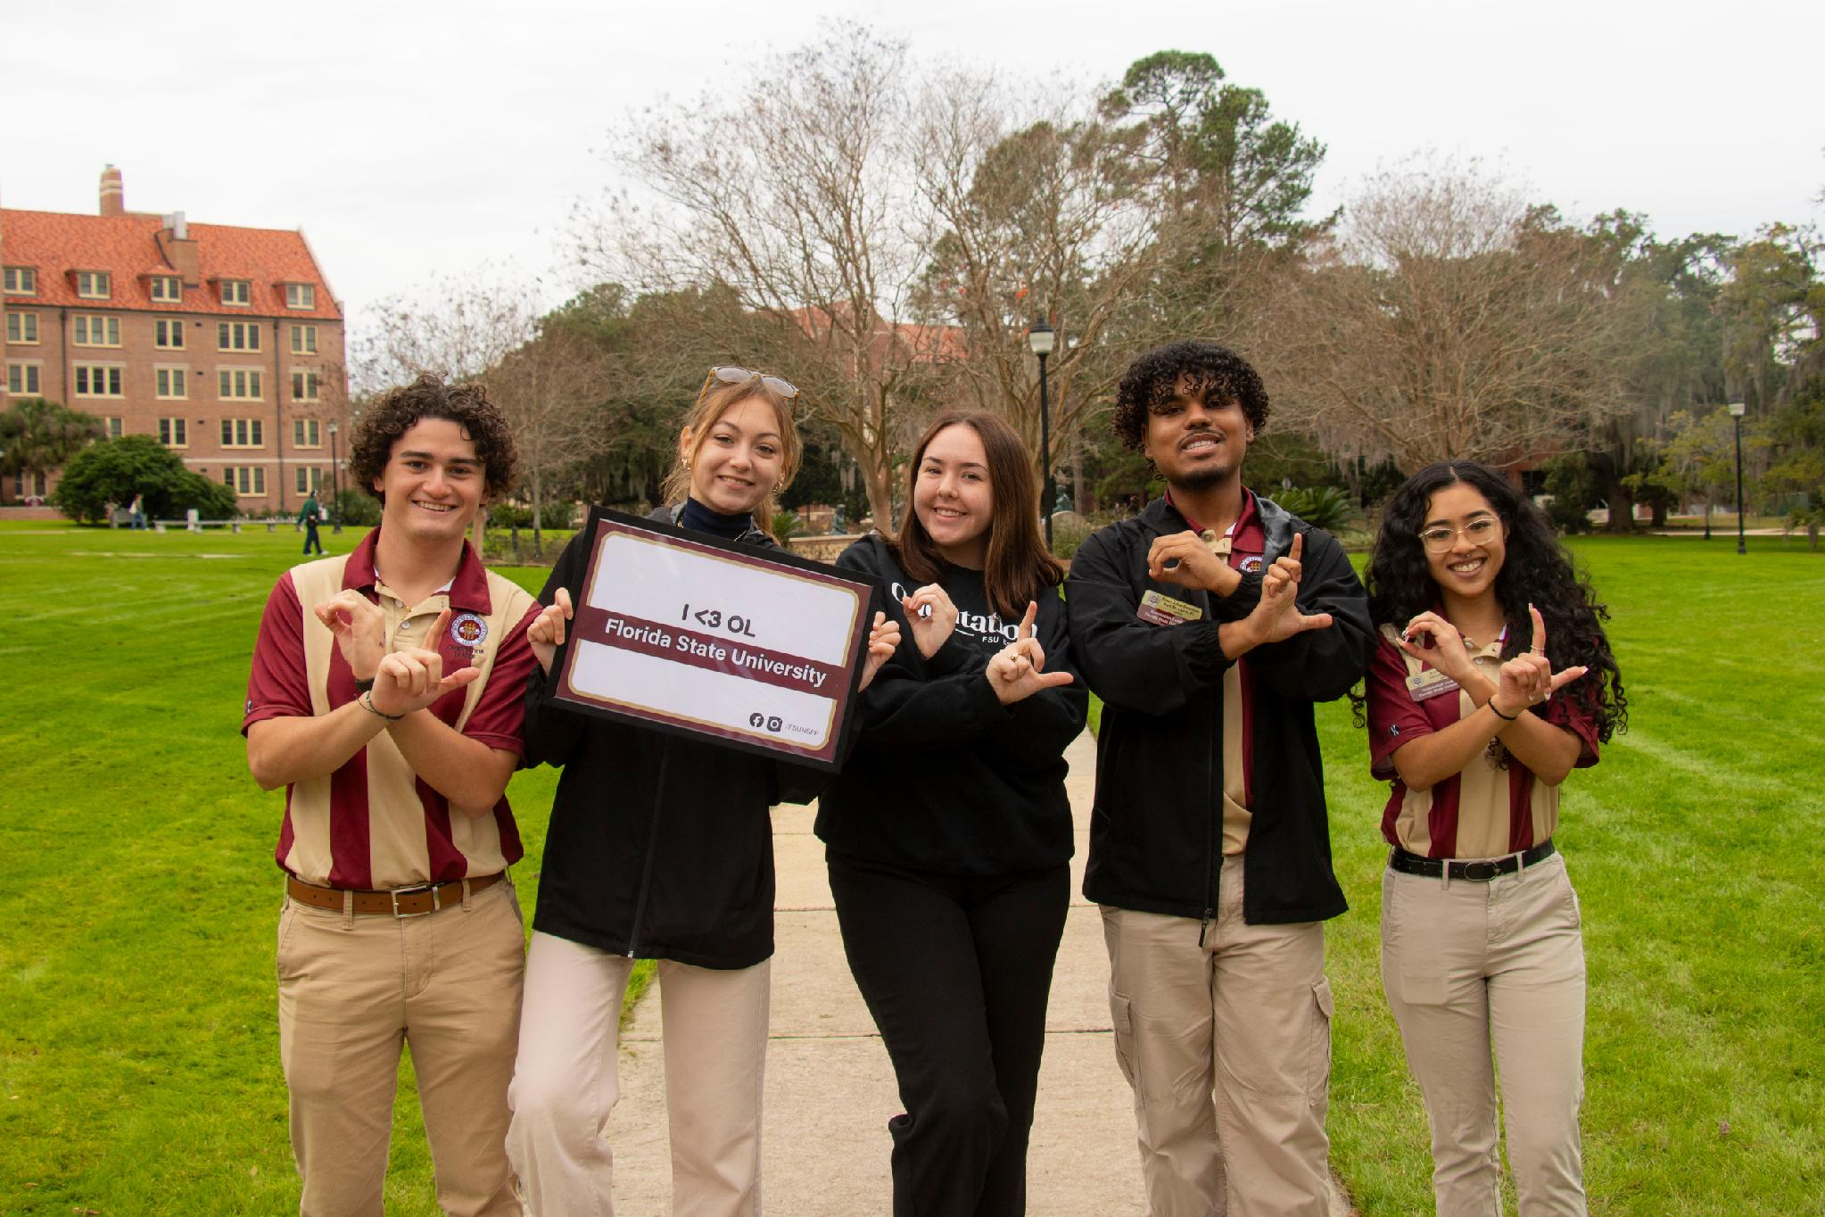
THE STUDENT EXPERIENCE TODAY​

Slide 6
HEALTH AND WELLNESS
Top academic impacts: procrastination, stress, and anxiety.
Anxiety is the number one presenting issue for students in Counseling and Psychological Services (CAPS)
CAPS has seen an increase in students served for 3 consecutive years.
There has been a 69% increase in student stress levels since January 2025.
There has been a 41% increase in student anxiety since January 2025.
There has been a 150% increase in students experiencing post-traumatic/acute distress symptoms since January 2025.
More than 60% of our students get less than 7 hours of sleep each night (up from 42% in 2024)

Slide 7
HEALTH AND WELLNESS
Students experience significant wellness trade-offs as they balance academic, work and personal demands (considerations for faculty that as academic demands increase, students are giving up other well-being opportunities, including sleep)
Students often struggle to navigate and connect with available resources (Faculty can help by including health & wellness resources on their syllabus and reminding students how to navigate to these resources throughout the semester)
A strong sense of connection and belonging plays a critical role in student well-being (Faculty can help by offering opportunities in their classes for students to connect with one another)

Slide 8
KEY PARTNERSHIPS WITH FACULTY

Slide 9
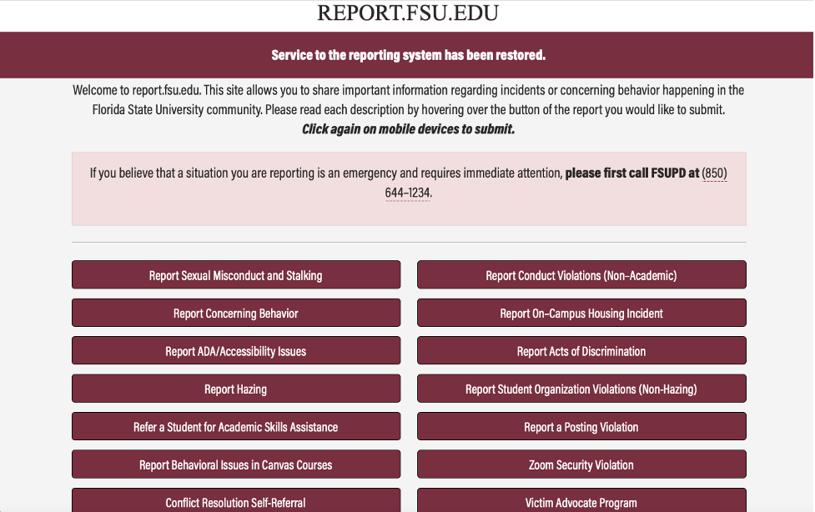
SUPPORTING STUDENTS IN DISTRESS
What to report:
Unusual behavior change in appearance, attendance, performance that is out of character and gets your attention or the attention of multiple individuals
Student makes a statement which makes you question safety and well-being
Student is disrupting the classroom, event, or normal business operations

Slide 10
CLASSROOM DISRUPTION
Document specifically what is happening. What has been said and the impact on the learning environment.
Alert your Department Chair and/or appropriate leadership of your concern.
Involve the office of Faculty Development & Advancement as needed for support.
File a report at report.fsu.edu with specific information (have individuals with first-hand knowledge also file a report).
What Guardrails are in place? Syllabus, Code of Ethics, Professional Standards, Departmental Expectations - does the student have these in writing?
Has the behavior been addressed with the student? Have they been told to stop? Has that conversation been documented?

Slide 11
RESPONSE OVERVIEW
Level 4: Low Risk (Student of Concern Committee)
Level 3: Moderate Risk (Student Situation Resolution Team)
Level 2: High Risk (Behavior Intervention Team)
Level 1: Extreme Risk (Threat Response Team)

Slide 12
HAZING PREVENTION RESOURCES
What is hazing?
Hazing is any activity expected of someone joining or participating in a group that humiliates, degrades, abuses, or endangers them, regardless of a person’s willingness to participate.
REPORT.EDU.FSU
According to The Stop Campus Hazing Act, FSU must report all hazing incidents that occur on campus, in or on non-campus buildings or property, and on certain public property, as defined by the Clery Act.
Report.fsu.edu is available to all members of the FSU community to alert the Department of Student Support & Transitions of concerns about students and organizations so appropriate follow-up and support can be provided.

Slide 13
HAZING PREVENTION RESOURCES
IDENTIFY IT
ACT ON IT
PREVENT IT
Hazing is any action or situation that recklessly or intentionally endangers the mental or physical health or safety of a student. Hazing can include, but is not limited to: physical acts, forced alcohol consumption, humiliation, sleep deprivation, etc.
If you see or experience hazing, don’t ignore it. You can make a difference. Talk to a trusted university official. You can also report incidents anonymously through report.fsu.edu.
Be a leader and stand up to hazing. Don’t participate in or condone these activities. Promote a positive and growth-enhancing environment within your student organization.
Be the ONE.

Slide 14
Students connected to appropriate resources were retained at 95% versus those who were not connected.

Slide 15
CO-CURRICULAR LEARNING: COMMUNITY-ENGAGED LEARNING
We are a Carnegie Community-Engaged campus and require documentation of this work to tell our institution's story.
The Center for Leadership & Service is home to the ServScript program. This program allows students to record their eligible service directly onto their academic transcripts. This unique opportunity allows students to enhance their resume for graduate and/or professional schools and careers.
We hold long-term relationships across Florida and the Big Bend region. The center has built trust with these communities, so are a valuable resource to you as we seek to advance community engagement, including community engaged research, across campus.
For course and partnership development consultations, along with presentation and training requests, feel free to reach out directly to Dr. Joi N Phillips at jnphillips@fsu.edu or Maria-Paula McIntyre Nwenyi at mmcintyre@fsu.edu.

Slide 16
CO-CURRICULAR LEARNING: CAREER CENTER
Embedded liaisons in Schools and Colleges provide programs and services to support career exploration, acquisition of skills, job/internship search, and graduate success.
  Find your liaison here: career.fsu.edu/about-us/career-liaisons
Career-Related Class Assignments are pre-built class assignments are available in Canvas Commons that can be tailored to you class and specific learning objectives.

Slide 17
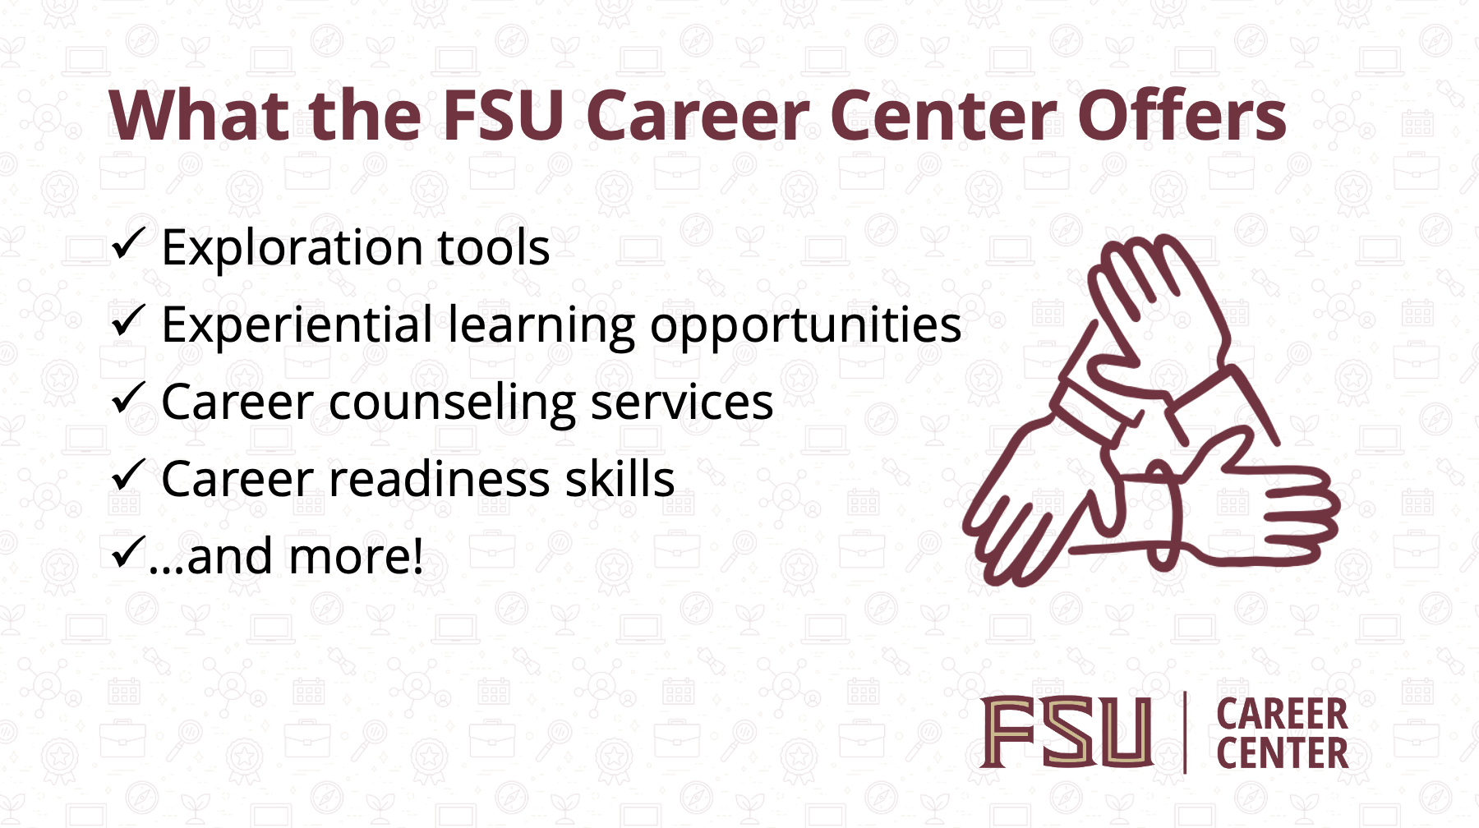

Slide 18


Slide 19


Slide 20


Slide 21
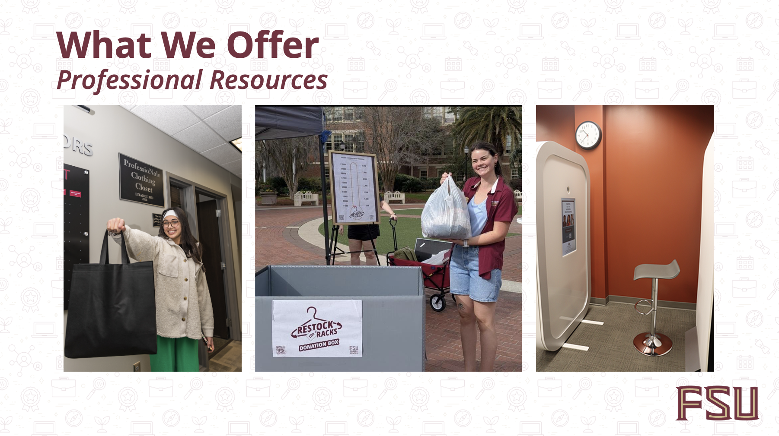

Slide 22
CO-CURRICULAR LEARNING: LEADERSHIP DEVELOPMENT
Now offering FSUHQ, an online hub to enhance the student engagement experience. FSU HQ is the digital space for student organizations and involvement information along with discovering pathways and badges, curated opportunities designed to help students navigate campus life with purpose while tracking their involvement and building career-ready skills
Utilizing a curricular approach to student leadership and success pinpointing a student’s FSU experience from Admission to Commencement
  Referencing Astin’s theory of student involvement, Tinto’s theory of student departure, and Baxter-Magolda’s theory of self-authorship
Offering programs for individuals such as our Freshman Leadership Institute, Transfer Leadership Institute and LEAD FSU for student organizations.

Slide 23
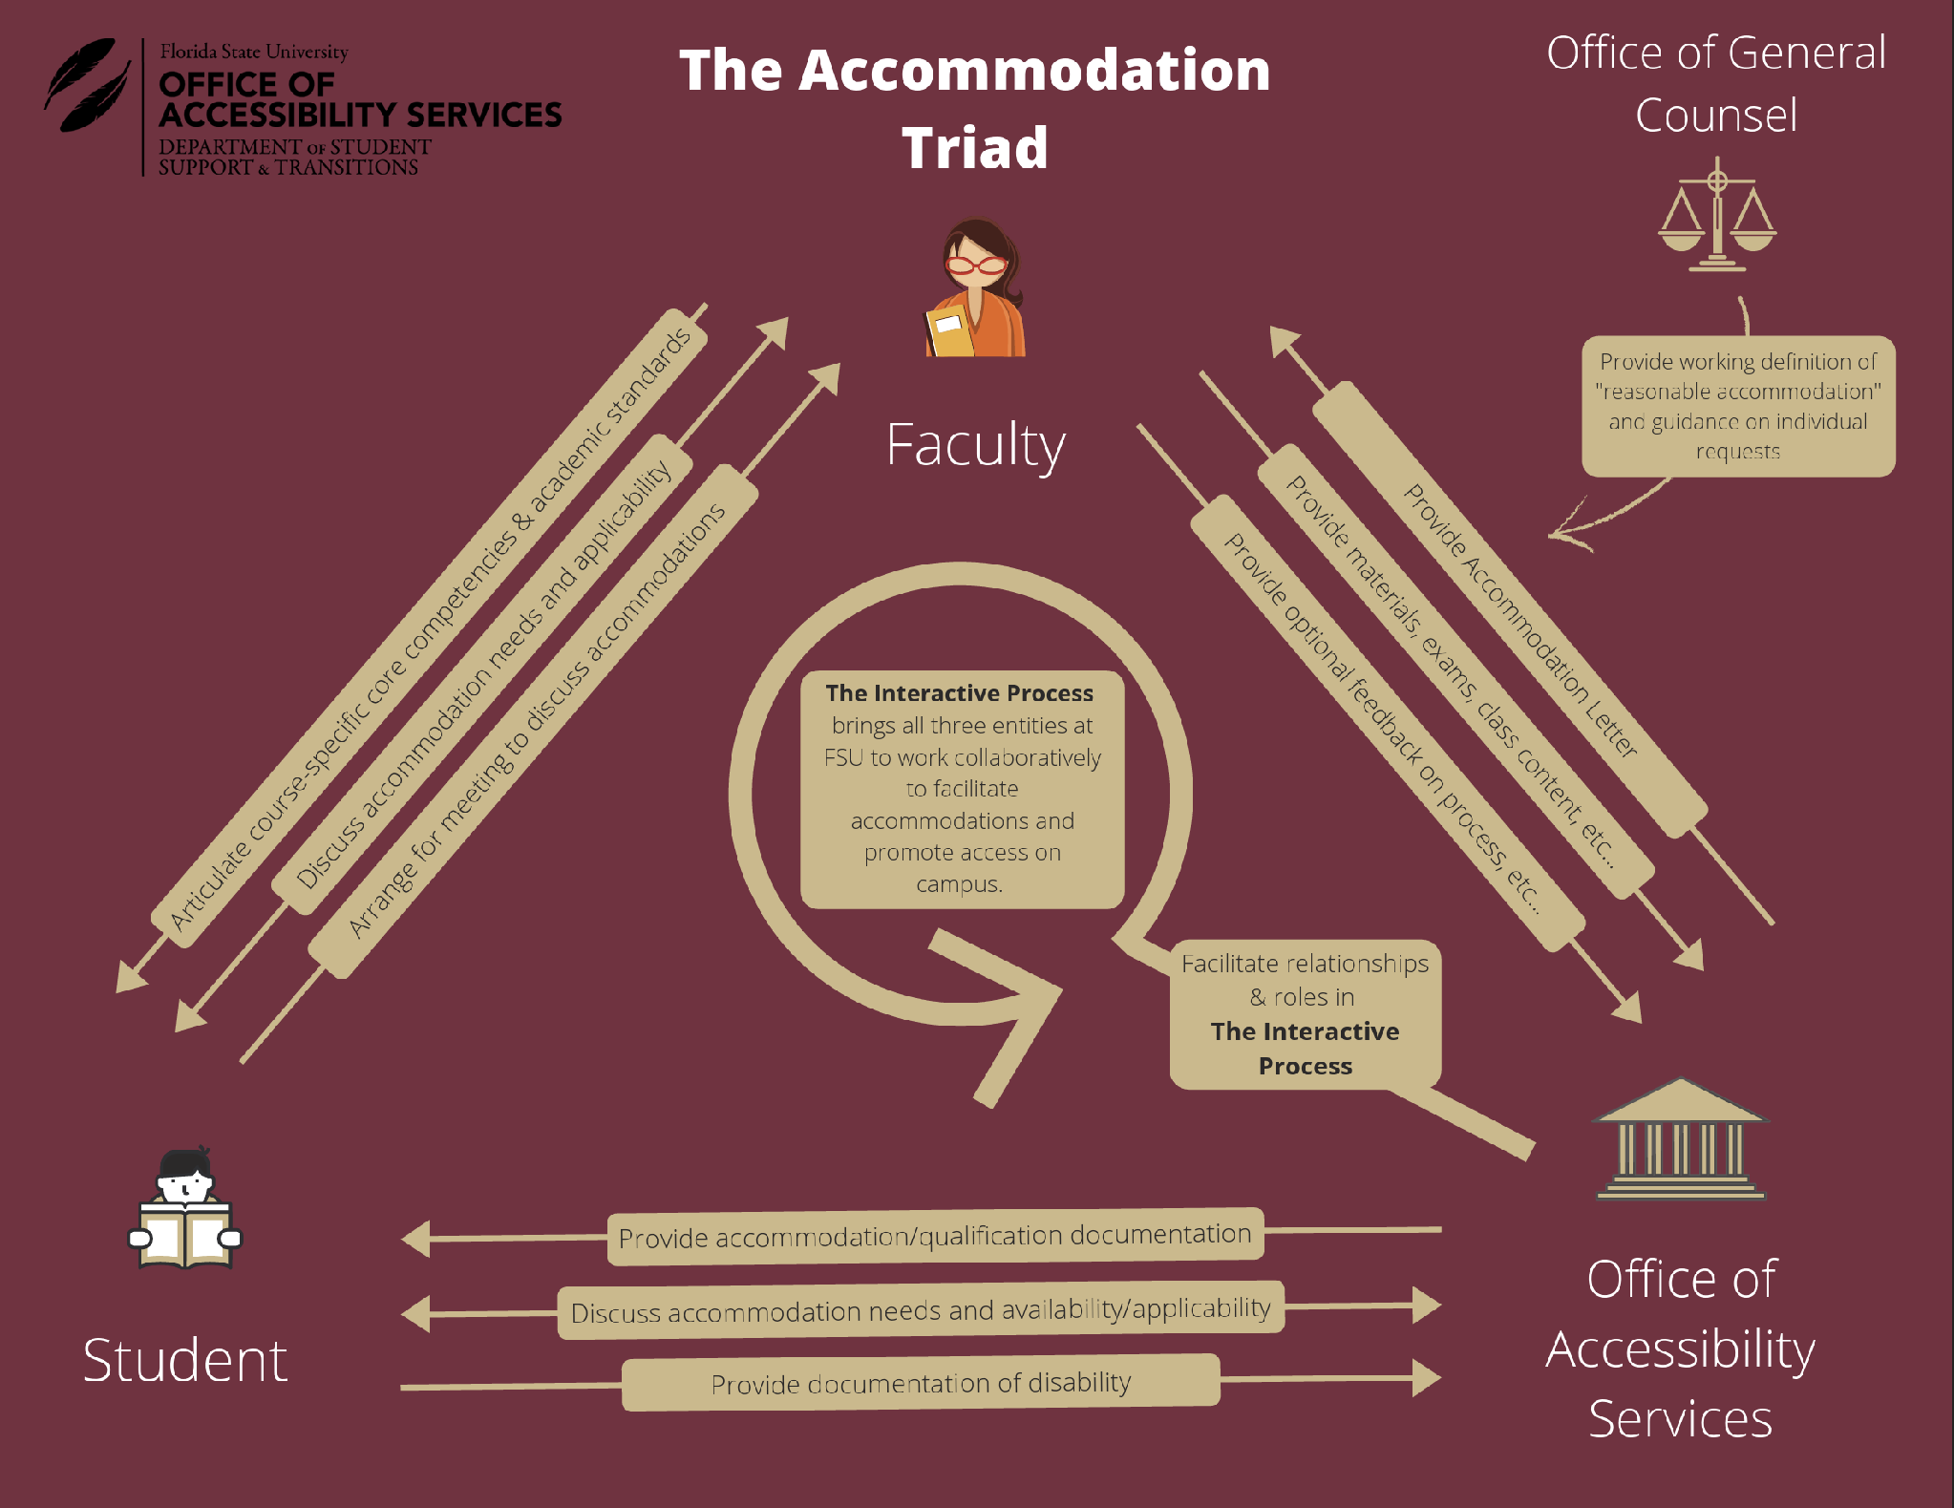


Slide 24

Engaging students in practices that promote mental health is the responsibility of not
just one department on campus, but of the entire campus community.
This guidebook is to help faculty make small shifts that could make a major difference in students' behavior and well-being. Click here to download the guide.
Notes:
Promoting Well-being in
Learning Environments

Slide 25
DON’T CANCEL THAT CLASS!
Instead of canceling a class, faculty are encouraged to partner with the DSA to provide engaging, informative sessions for students.
Wellness Topics
General Wellness, Alcohol and Drugs Alcohol, Tobacco & Other Drugs (AOD), Nutrition & Body Image, Power-Based Personal Violence Prevention, Sexual Health & Title IX Awareness
Request a Health Services workshop at chaw.fsu.edu/dontcancelclass
Career Topics
Matching Majors to Occupations, Resume Writing/Cover Letters, Internship Search Strategies, and Career Fair Strategies
Request a Career Services workshop here.

Slide 26
TRAININGS, EVENTS, OPPORTUNITIES
Flu Vaccine Campaign
Narcan
  uhs.fsu.edu/narcan
Stop the Bleed
  uhs.fsu.edu/health-care/mru/stop-the-bleed
Green Dot Bystander Intervention Training
  knowmore.fsu.edu/know-more-initiative/green-dot
Serve as a hearing officer. Email sccs@fsu.edu to serve and visit sccs.fsu.edu for more info.

Slide 27
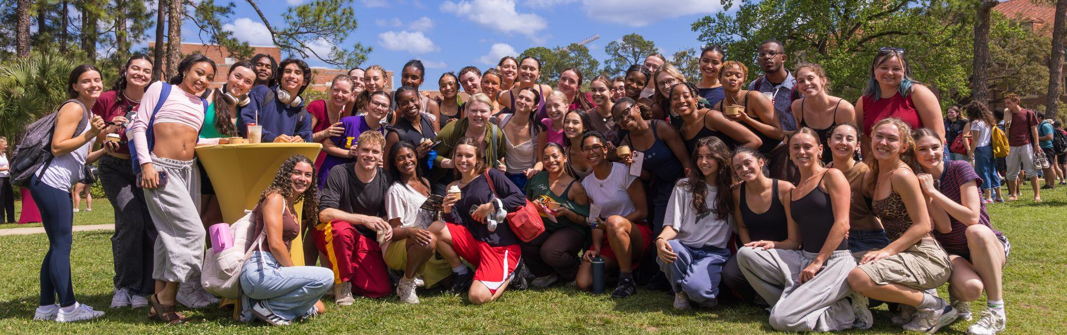
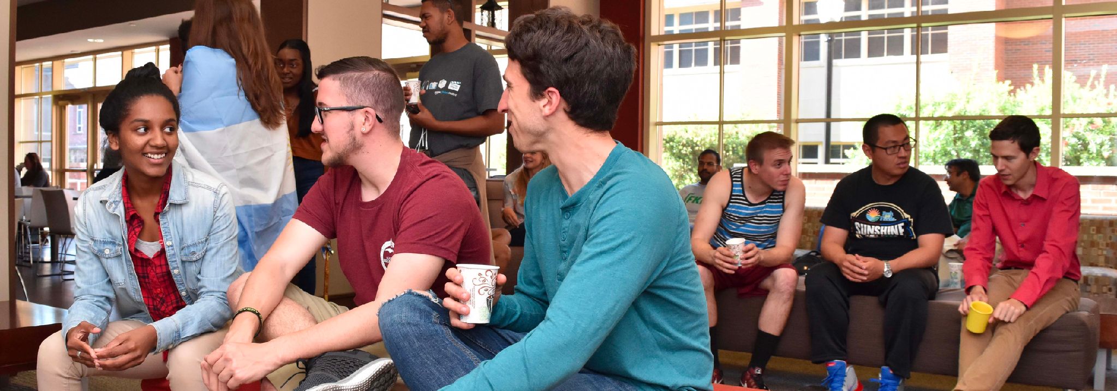
COMMUNITY

Slide 28
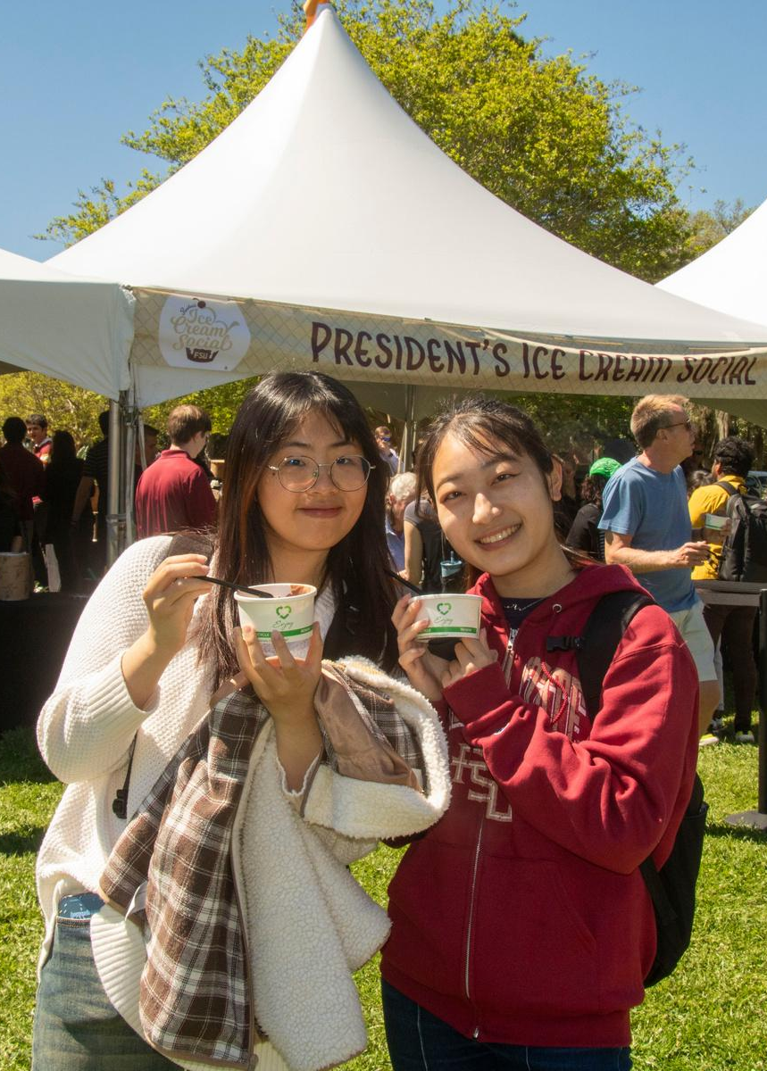
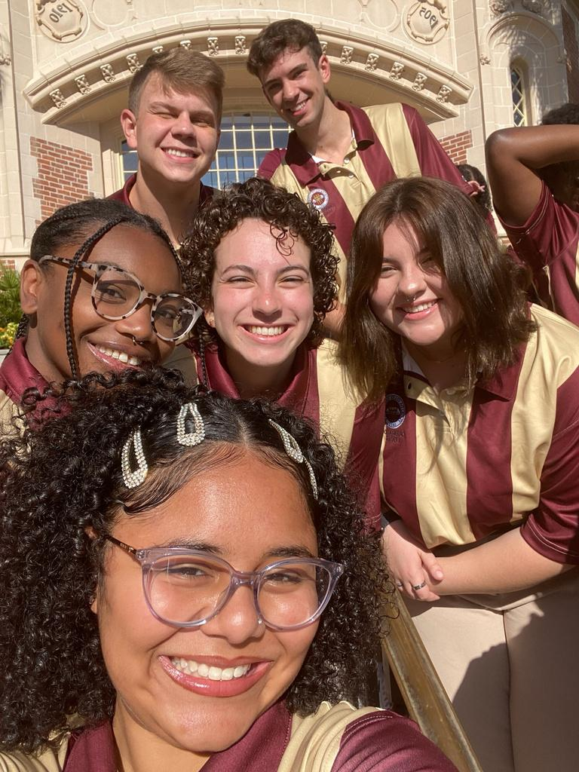

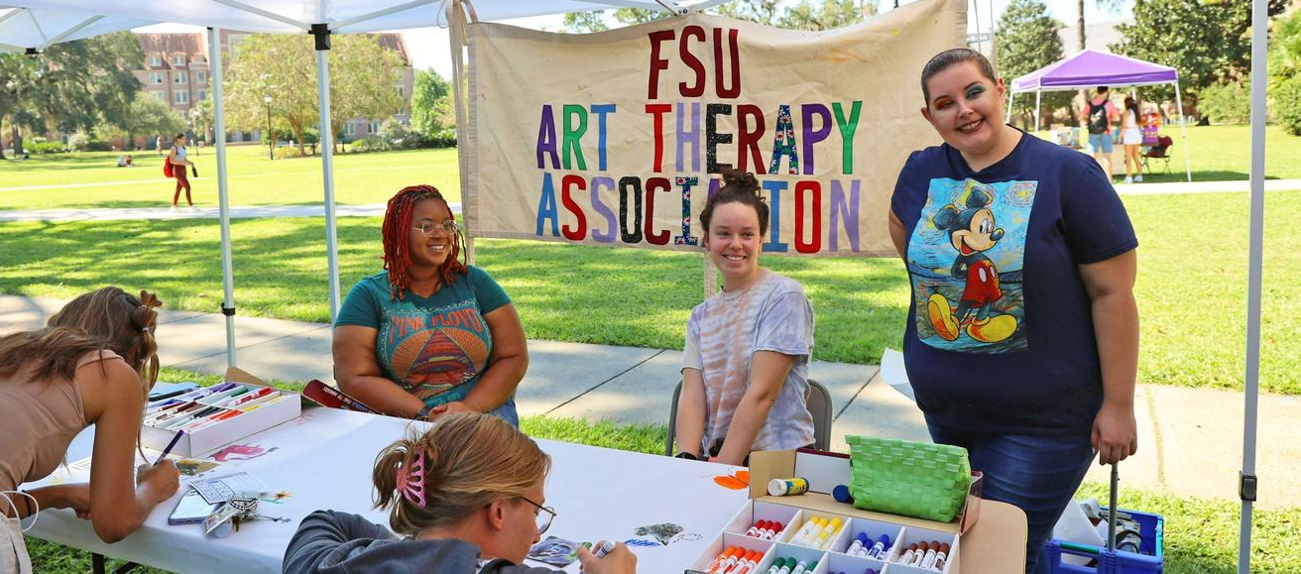

Over 4,700 On-Campus Student Organization Events
since August 2024
700+
56,000
Student Organizations
Faculty, Staff and Student users in FSU HQ
Student Leadership Development Training

Slide 29
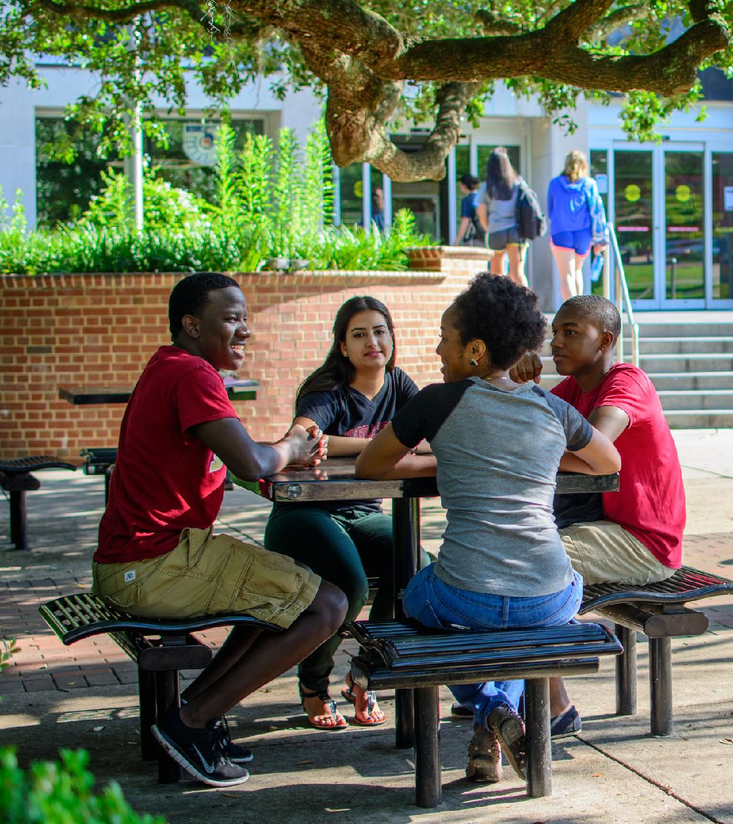

CARE
The Center for Academic Retention and Enhancement (CARE) exists to create a college-going and college success culture for students with historically underrepresented identities in higher education.
$1,500,000+
$1.5+ million in Federal grant funding received annually to support college access and success for first-generation college students.

Slide 30

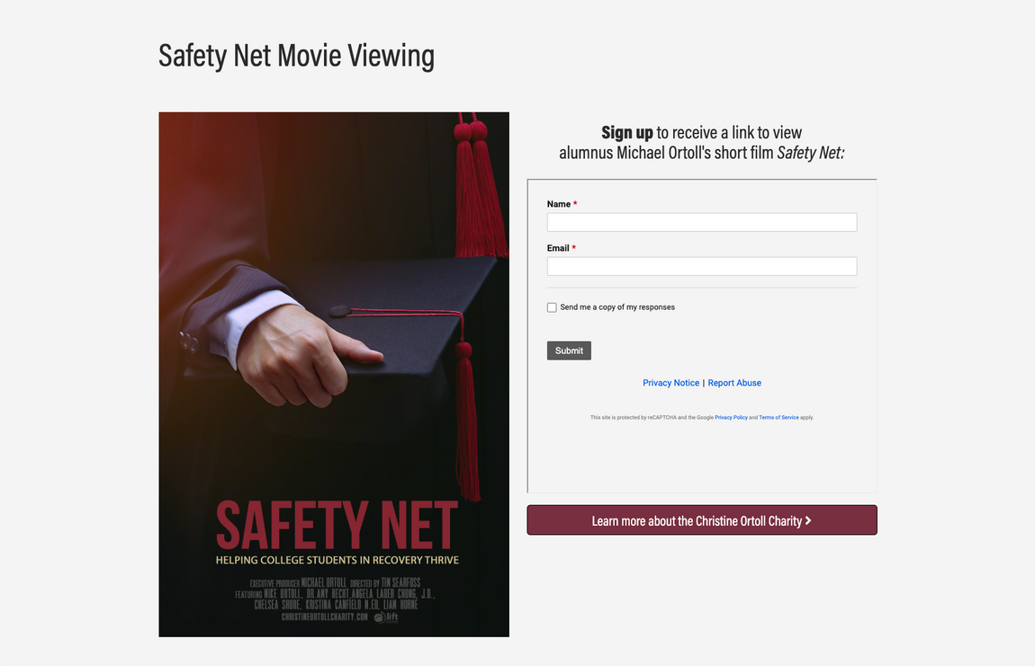
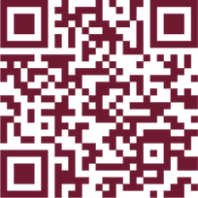

LIFT
Supporting students interested in recovery from addiction and substance misuse thrive during their college experience.

Slide 31
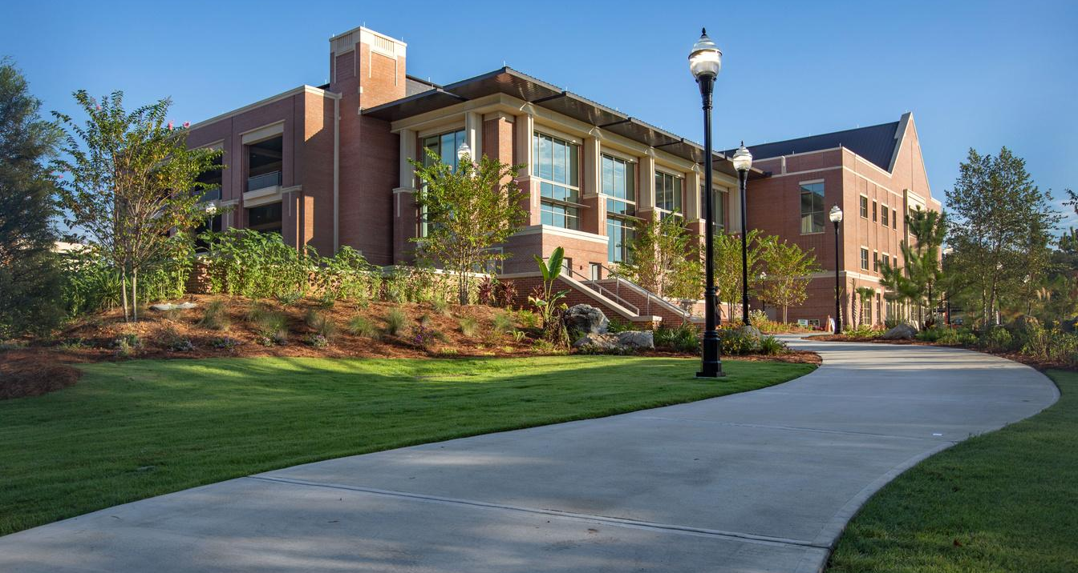
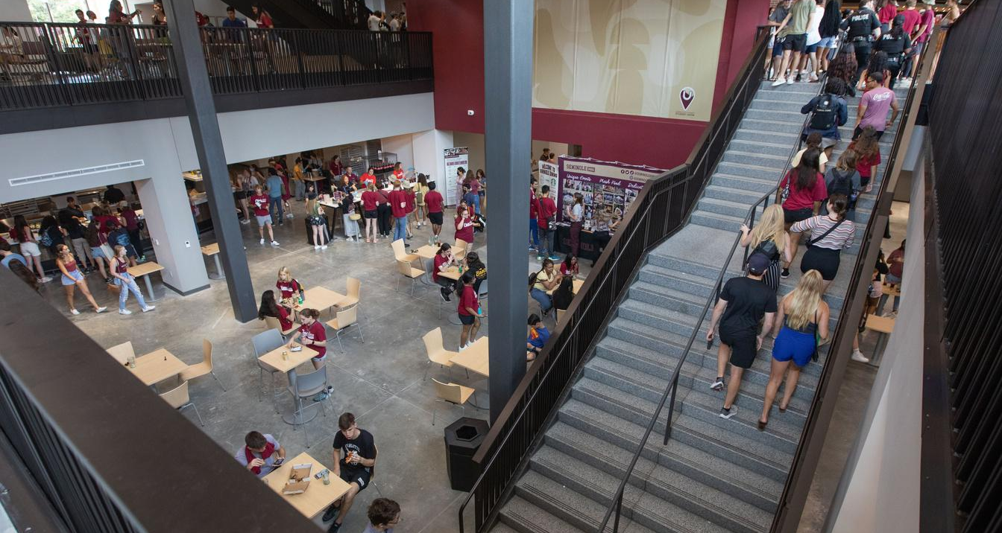

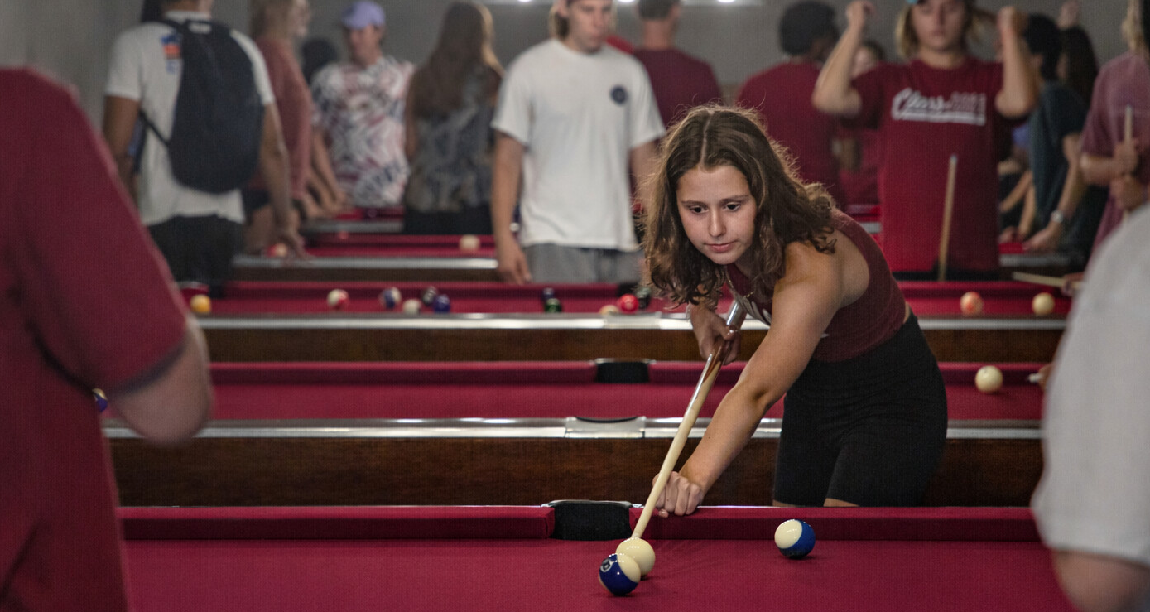
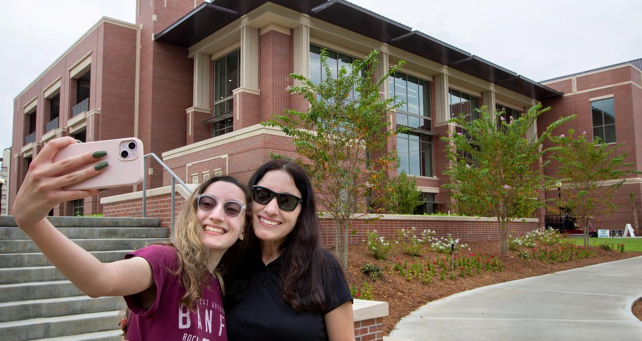
STUDENT UNION
The FSU Student Union enriches the student experience through spaces, programs, services, and leadership opportunities that promote engagement, belonging, learning, and Seminole pride.
Facilities include the Student Union, Student Services Building, Askew Student Life Center, and the Flying High Circus. Programs and services include the Art Center, Student Life Cinema, Bowling & Billiards, Campus Event Services, Garnet Gaming Lounge, Club Downunder, and Union Productions.
The Union employees more than 200 students.
2.3 Million
Visitors to the Union
during 2025

Slide 32
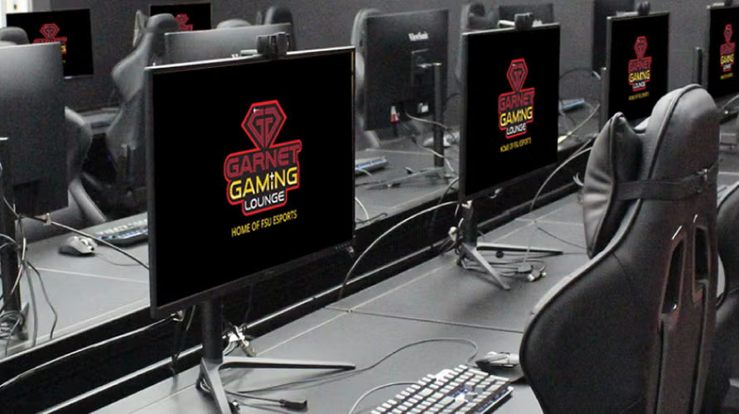
Garnet Gaming Lounge (GGL), part of the Student Union, is a premium gaming space featuring 1,000+ titles for both modern and retro game consoles. It houses 41 high-end gaming computers and a dedicated tabletop gaming area. It’s also home to the FSU Esports team, which competes in over 15 games each year.

Slide 33



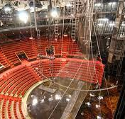
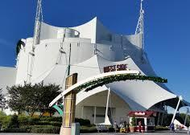

Opportunities for all students to take circus arts, dance or other performing arts classes in the space
Host revenue-generating events
Allow the FSU Circus to grow and continue to produce higher-quality performances than ever before

Slide 34
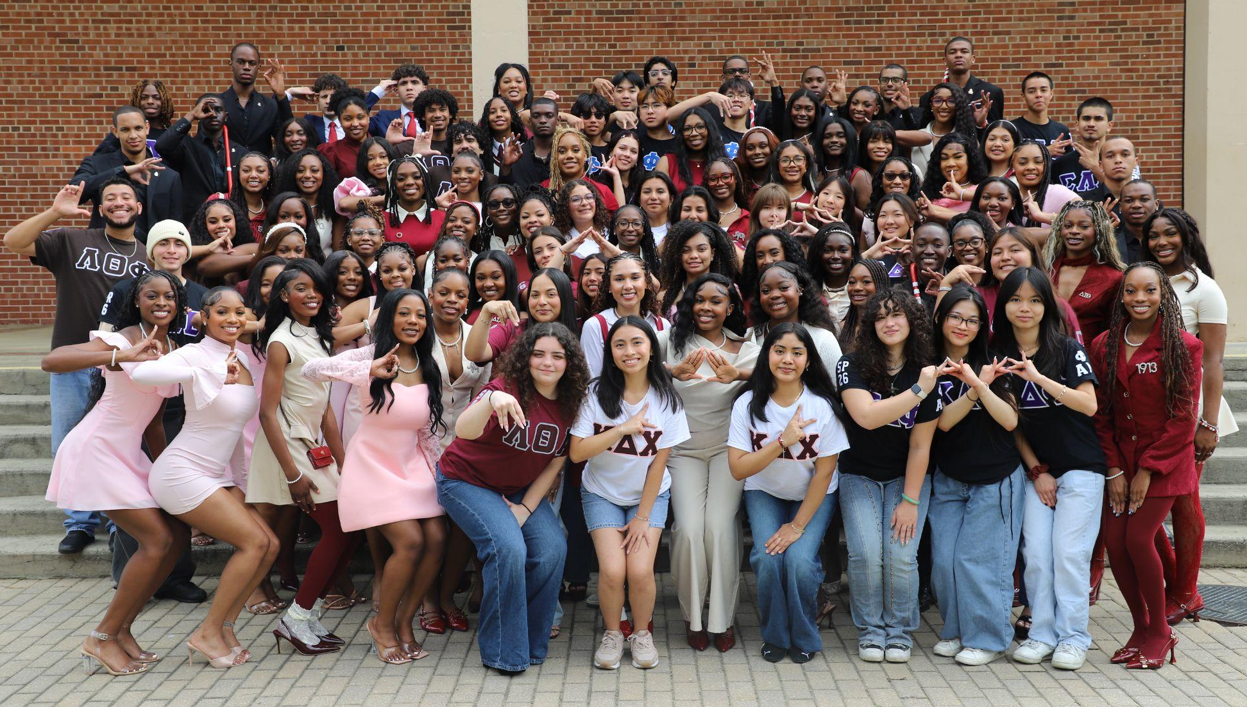

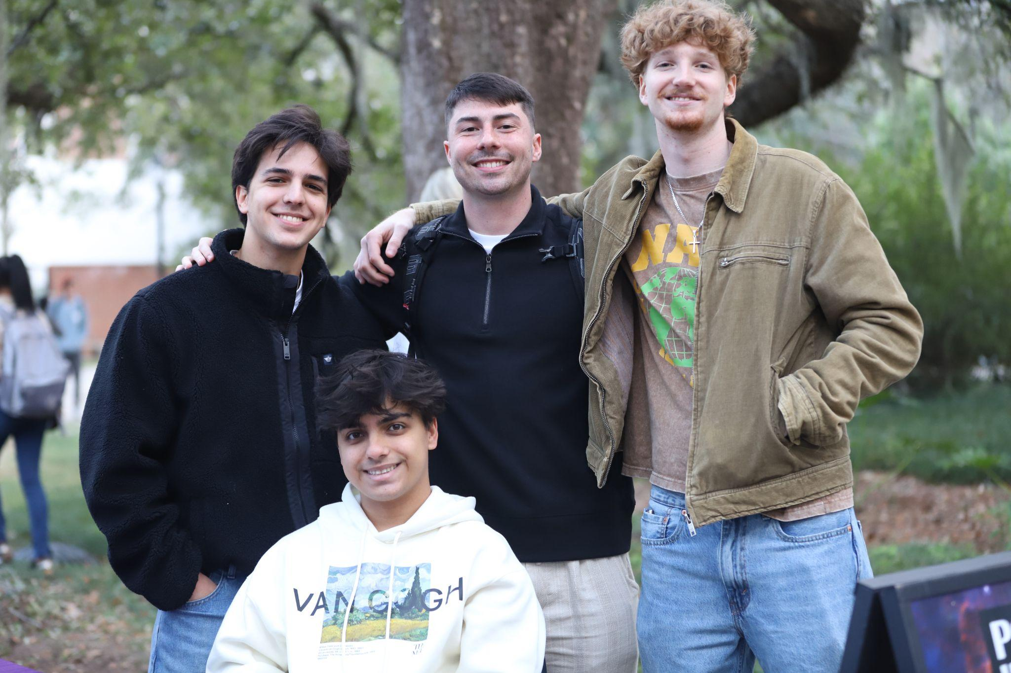
FRATERNITY & SORORITY LIFE
8,000+
3.448
Members in 2026.
Community GPA (Spring 2026)
$2.1 million
87%
raised for philanthropic causes across the U.S.
4-Year Graduation Rate
(FTIC Cohort)

Slide 35

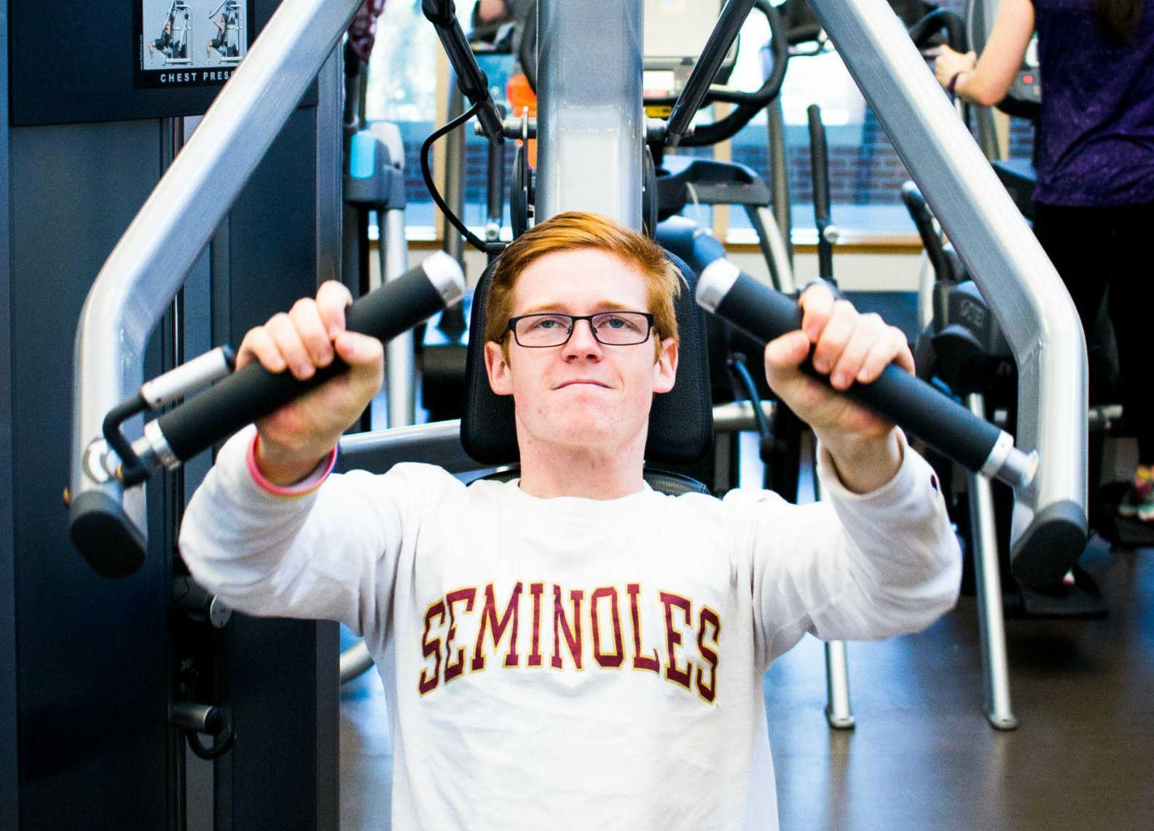
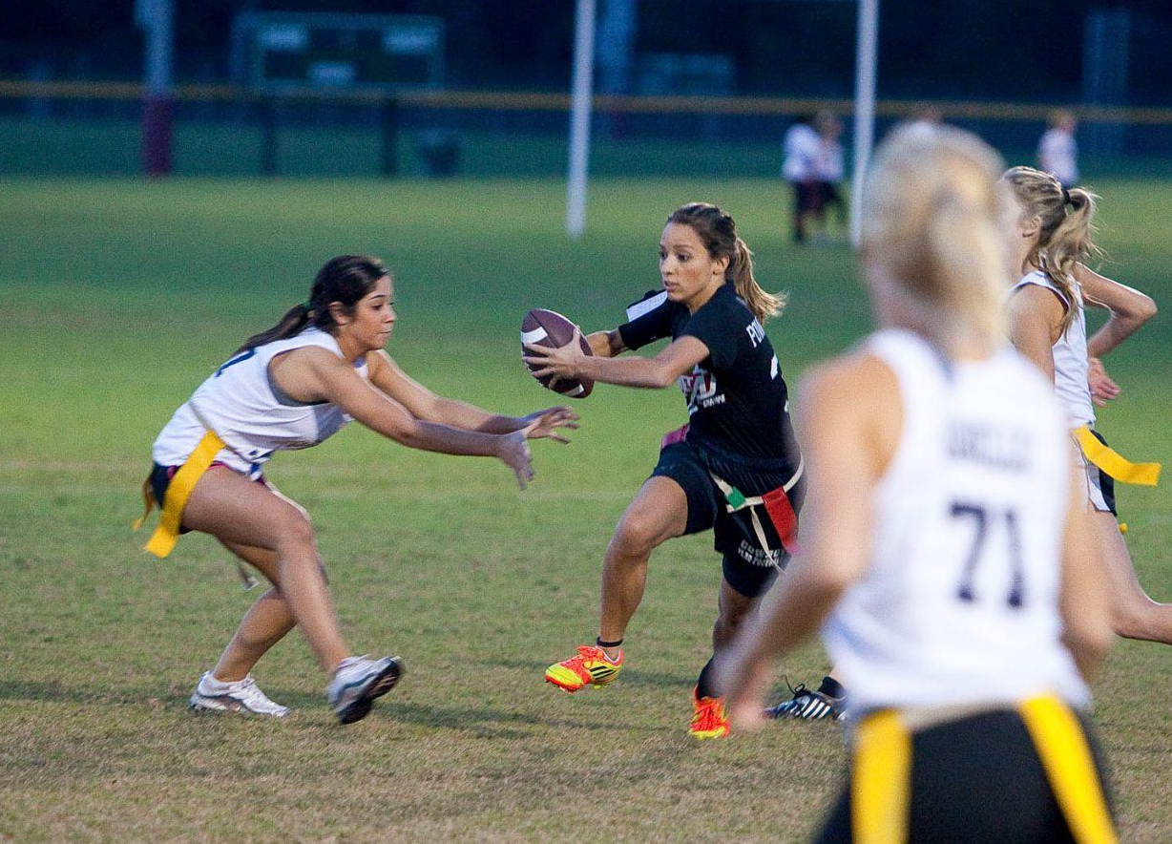
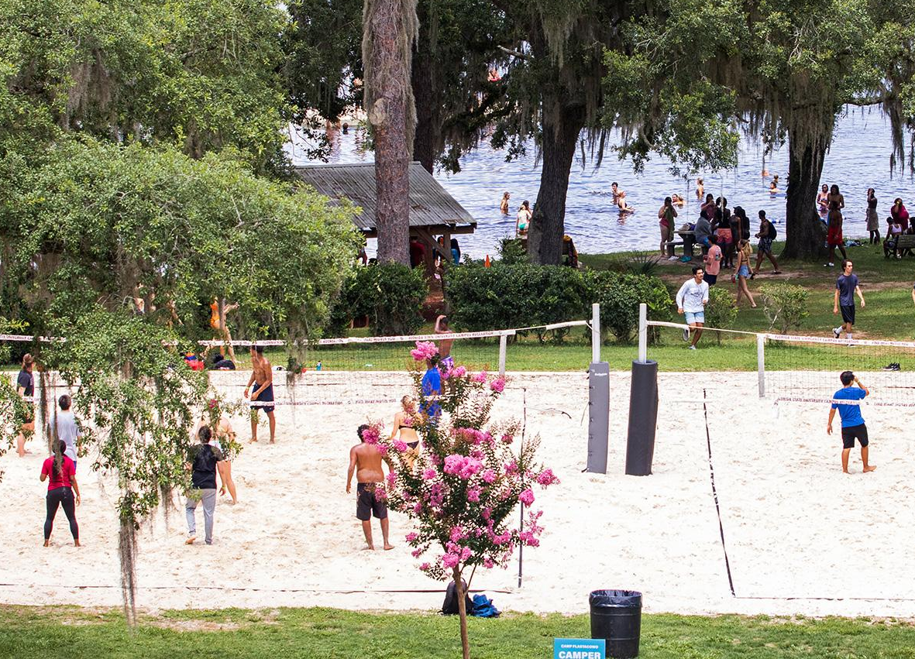
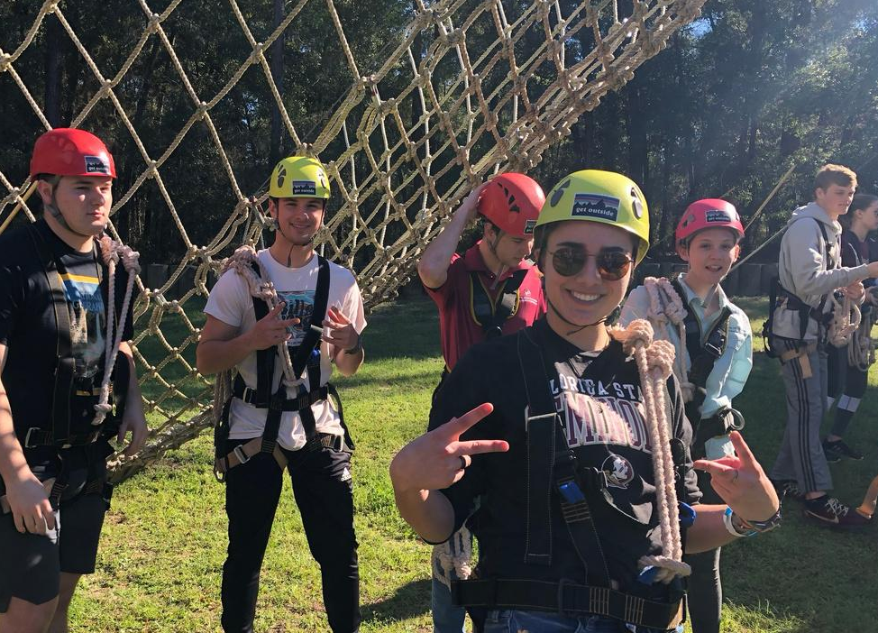
CAMPUS RECREATION
Recreational facilities including the
Dr. Bobby E. Leach Recreation Center, faculty and staff memberships available
8
40+
Intramural Sports leagues, tournaments,
and events available each year
50
Sport Clubs and affiliates with over
2,400 total student members annually
73
Acres of outdoor space at the
FSU Lakefront Park & Retreat Center
600+
Youth attending Camp Flastacowo summer camp at the Lakefront Park

Slide 36
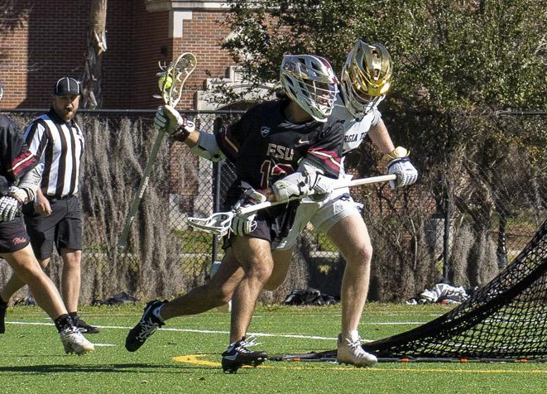
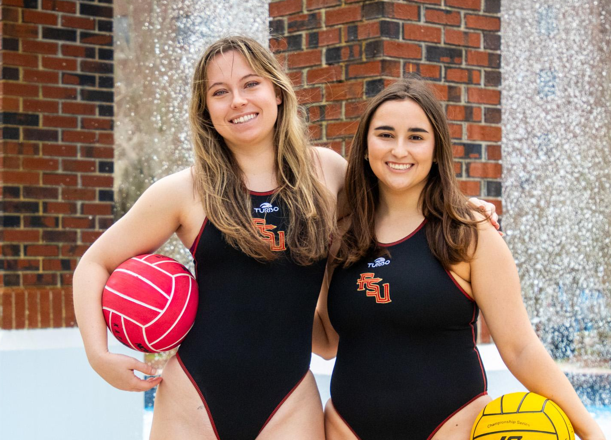
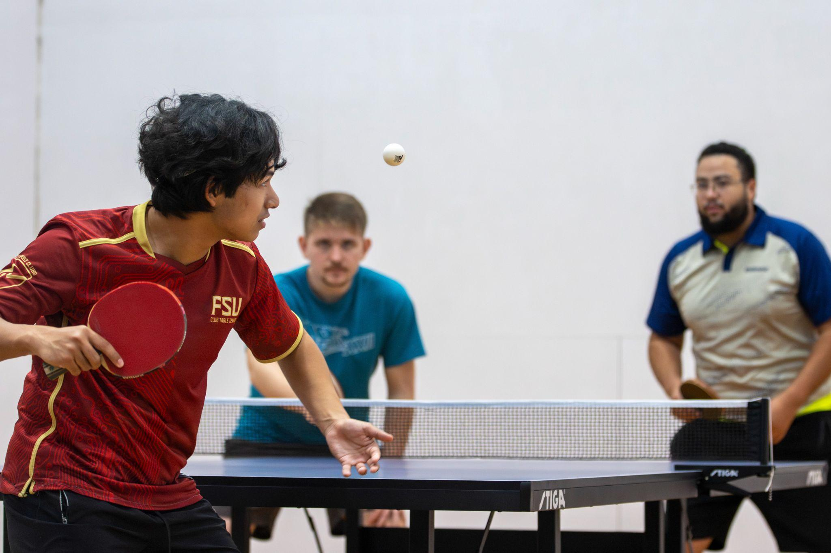
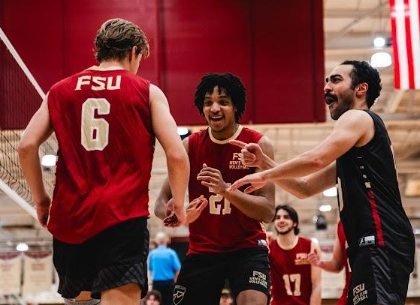

SPORT CLUBS
29 CLUBS
Fundraised more than $1,000,000 for their expenses
Qualified for Regional and/or National Championships
Men’s Lacrosse & Pickleball Clubs
Finished Top 4 in the Nation in 2026
2,400+
130+
Nearly 2,500 students as club members
Hours of community service
Home events hosted

Slide 37
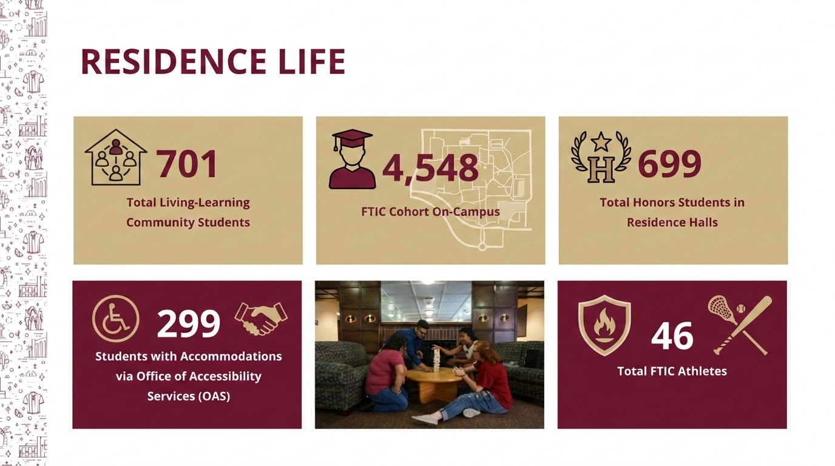

Slide 38
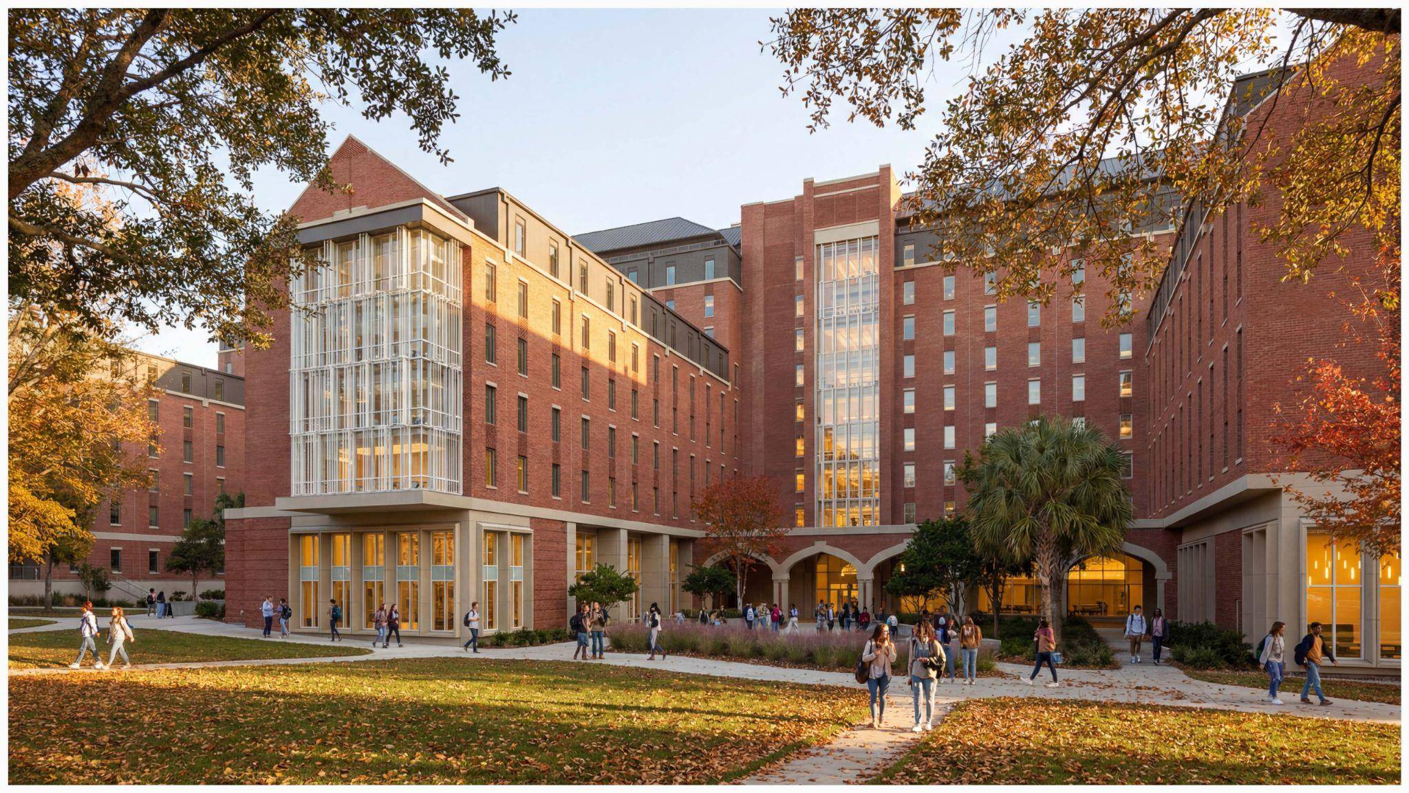
Northwest Project

Slide 39
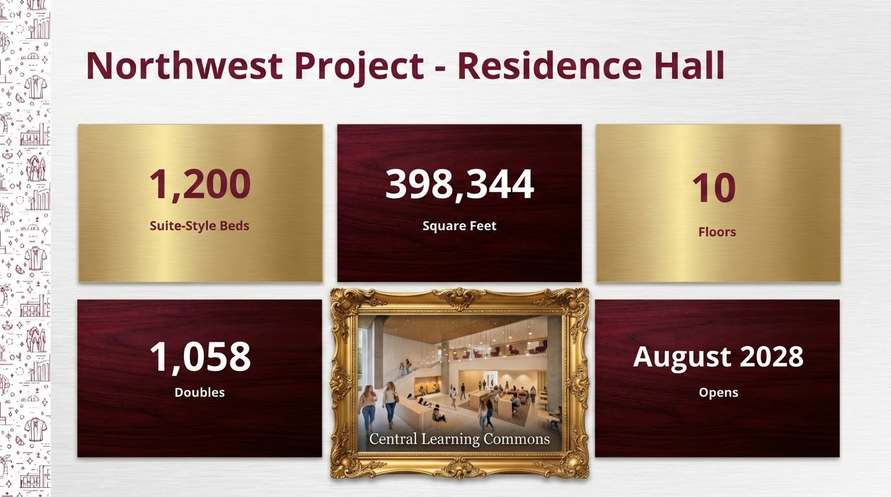

Slide 40
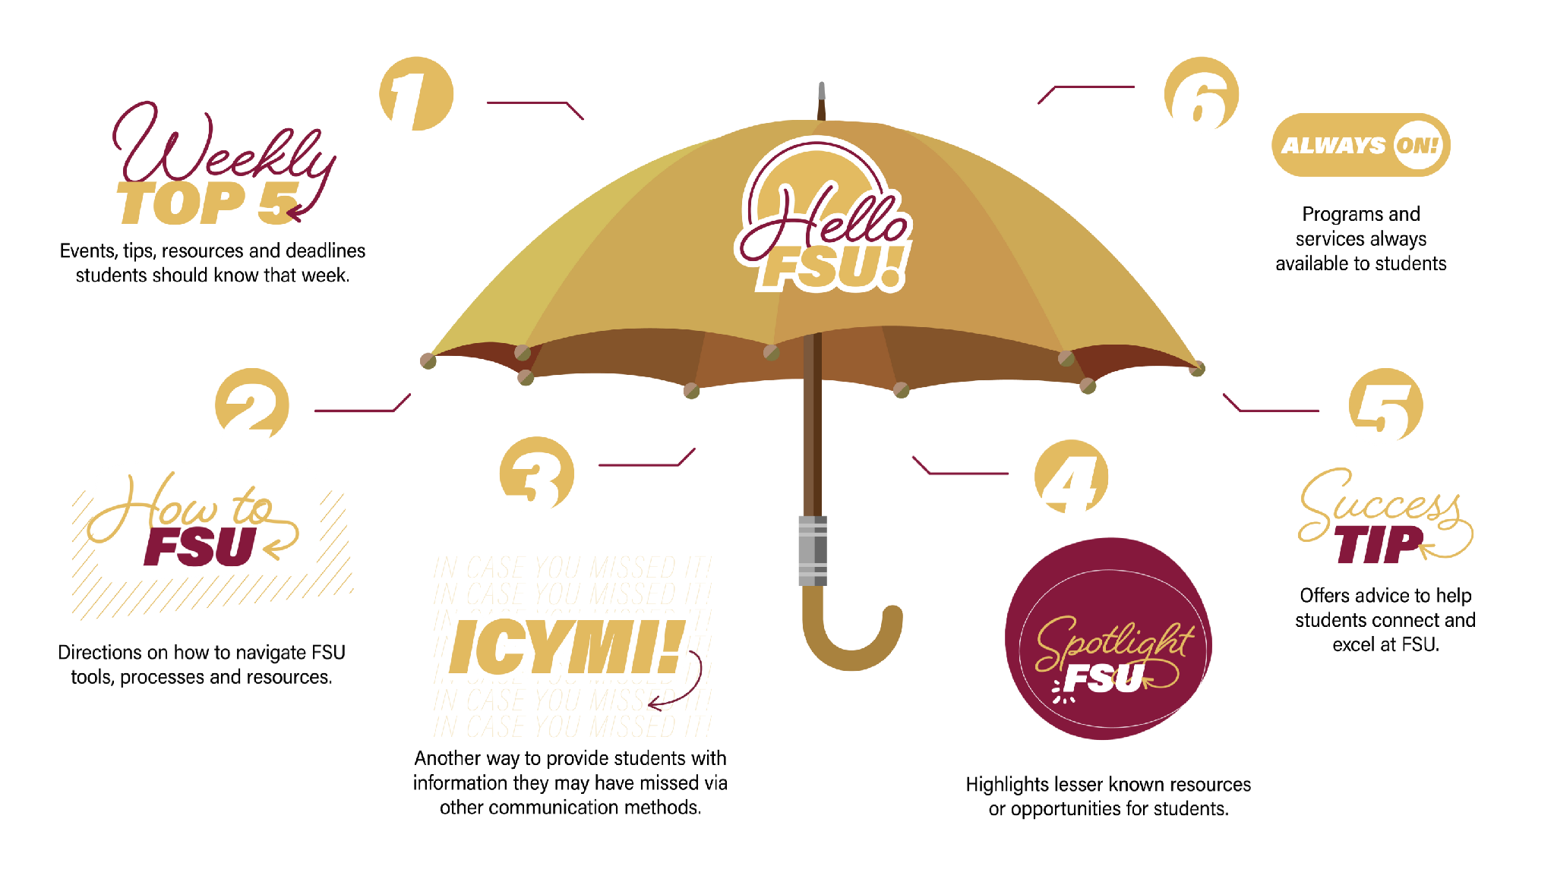

Slide 41
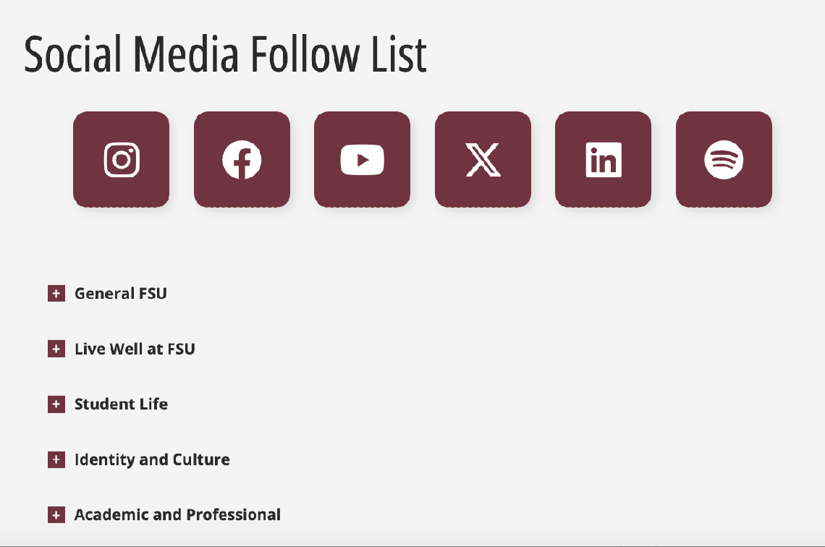
FOLLOW DSA!
Check out our social media follow list!
Follow the Division of Student Affairs on social media to stay current on messaging crafted for students, families and other stakeholders!

Slide 42
QUESTIONS?

