Slide 1
Academic Integrity
Rebekah Harris, Academic Affairs Administrator
August 17, 2026
FSU.EDU

Slide 2
The University aspires to excellence in its core activities of teaching, research, creative expression, and public service and is committed to the integrity of the academic process.
A Summons to Responsible Freedom
FLORIDA STATE UNIVERSITY

Slide 3
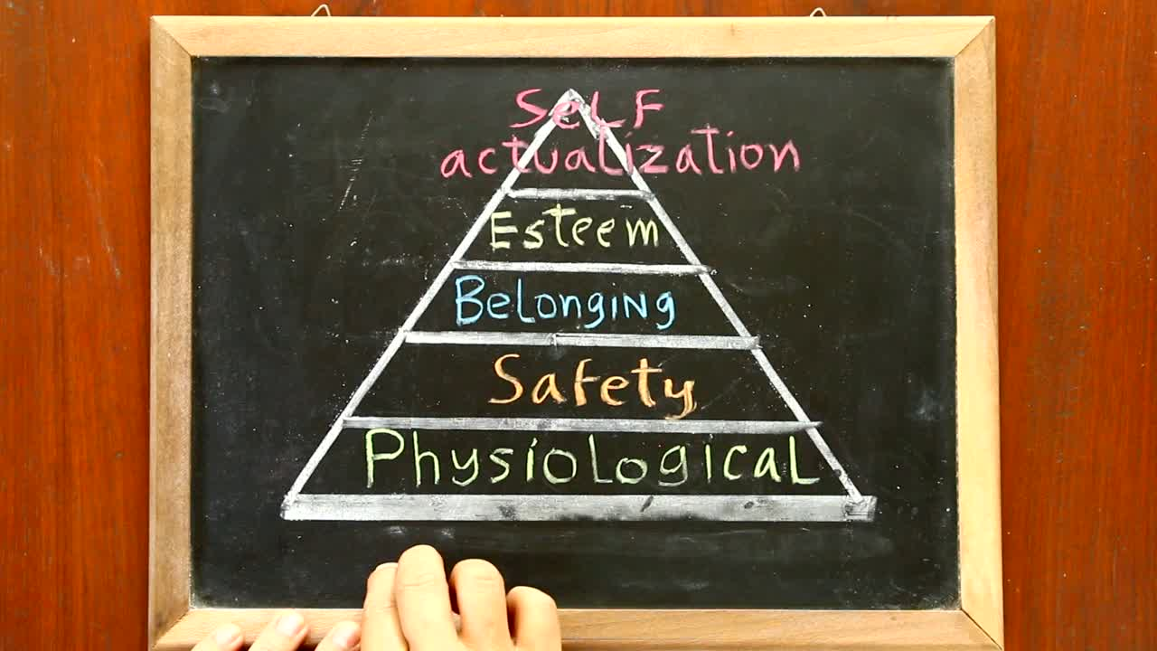
Academic Honor Policy
FLORIDA STATE UNIVERSITY

Slide 4
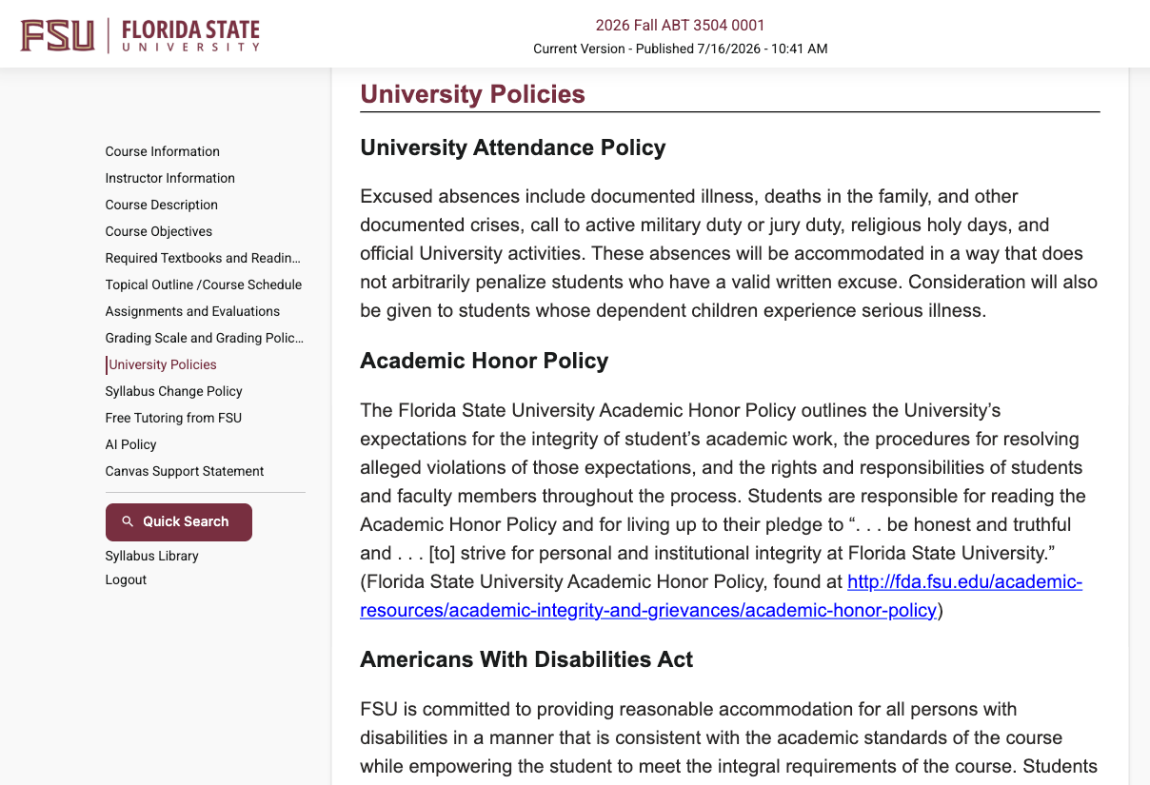
Physiological Needs:
The “Survival” Basics
Faculty Translation:
Where is the policy and what goes in my syllabus?
FLORIDA STATE UNIVERSITY

Slide 5
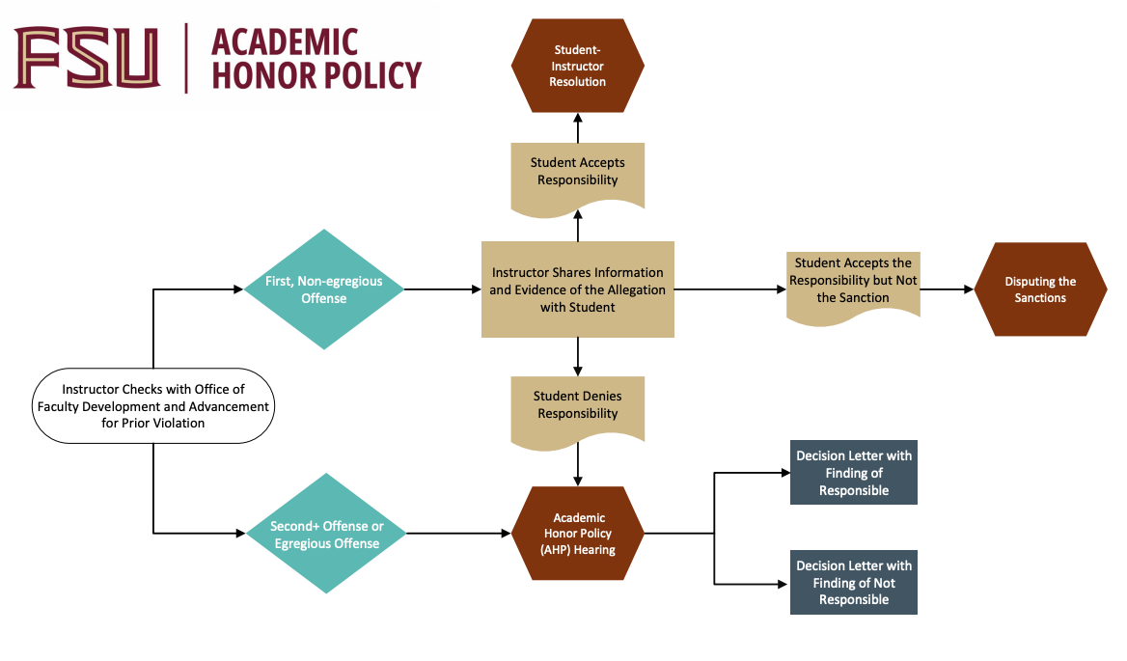
Safety Needs:
Protection & Predictability
Faculty Translation:
If I suspect a student has cheated, what happens? Am I protected?
FLORIDA STATE UNIVERSITY

Slide 6
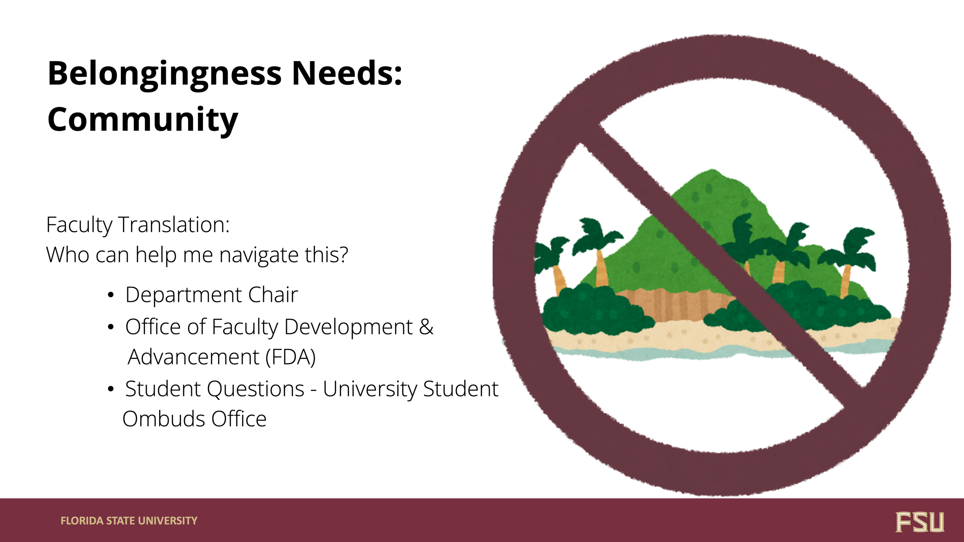

Belongingness Needs:
Community
Faculty Translation:
Who can help me navigate this?
  Department Chair
  Office of Faculty Development &
Advancement (FDA)
  Student Questions - University Student
Ombuds Office
FLORIDA STATE UNIVERSITY

Slide 7

Generative AI in the Classroom
FLORIDA STATE UNIVERSITY

Slide 8

GenAI in the Classroom:
Set Clear Expectations in Syllabi
  Red: Prohibits Use of GenAI
  Yellow: Allows Use of GenAI on Some Assignments
  Green: Allows Use of GenAI on All Assignments
FLORIDA STATE UNIVERSITY

Slide 9

GenAI in the Classroom
  Do Not Use AI Detection Tools
    Not Licensed by FSU
    Highly Unreliable
  Suspect Unauthorized Use of GenAI
    Follow the Academic Honor Policy
    Contact FDA
FLORIDA STATE UNIVERSITY

Slide 10

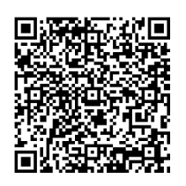
Additional Learning
FLORIDA STATE UNIVERSITY

Slide 11
https://academicintegrity.fsu.edu/

