Slide 1


Opportunities to

Slide 2
FSU International Programs Background Info
#1
University for long-term study abroad among US public universities
IIE Open Doors ‘22-’23
#10
University overall for study abroad among
US institutions
(for number of participants)
IIE Open Doors ‘22-’23
Over 65 years
2,160
103 Faculty
Student participants across Fall, Spring, & Summer this past year
From 42 FSU departments taught classes abroad this past year
Of experience sending FSU students abroad to study

Slide 3
Help Make Students’ Dreams Come True
Here’s what FSU students have said about the IP experience:
“[My study abroad program exposed me] to new foods, transportation, customs, and opportunities that allowed me to become a more worldly individual. I had some amazing professors and met some amazing locals, and for that, I will forever be grateful for this opportunity that has changed my life perspective for the better.”
"Studying abroad at the FSU Florence campus has been an absolute dream. Having the opportunity to be located at the perfect spot in the city, meeting the best people the FSU community has to offer, and getting hands on learning experience with some of [FSU’s] best faculty has been absolutely life changing. So happy I chose to spend my summer studying here in the most beautiful city!”
Peyton M.
FSU Student | Paris, France
Mia F.
FSU Student | Florence, Italy

Slide 4
Help Make Students’ Dreams Come True
Here’s what past FSU faculty members have said about the IP experience:
“Teaching abroad with FSU IP is an incredible experience. Creating meaningful, memorable experiences for students is truly rewarding, and the support from FSU IP makes the entire process seamless.”
“My experiences leading students through [FSU IP] have been among the most meaningful parts of my work as an educator and social worker [...] I am grateful to be part of experiences that foster connection, reflection, and a broader understanding of the world.”
“I have been very fortunate in my time at FSU to participate in expanding the depth and breadth of a student’s education [...] It is a uniquely transformative time, one that continues to shape me, my instruction, and my students.”
Holly Sudano
London, England
Jane Dwyer Lee
St. George’s, Grenada
Jim Dawkins
Florence, Italy & Valencia, Spain

Slide 5
Teaching Abroad Benefits
Foster relationships with students in small class sizes
Experience the host city as you teach using local context and history
Play a key role
in expanding students’ horizons and world view
Receive teaching stipend, housing, airfare, and more
Take part in FSU’s
efforts to expand international education
Potential opportunities to enhance research goals while abroad

Slide 6

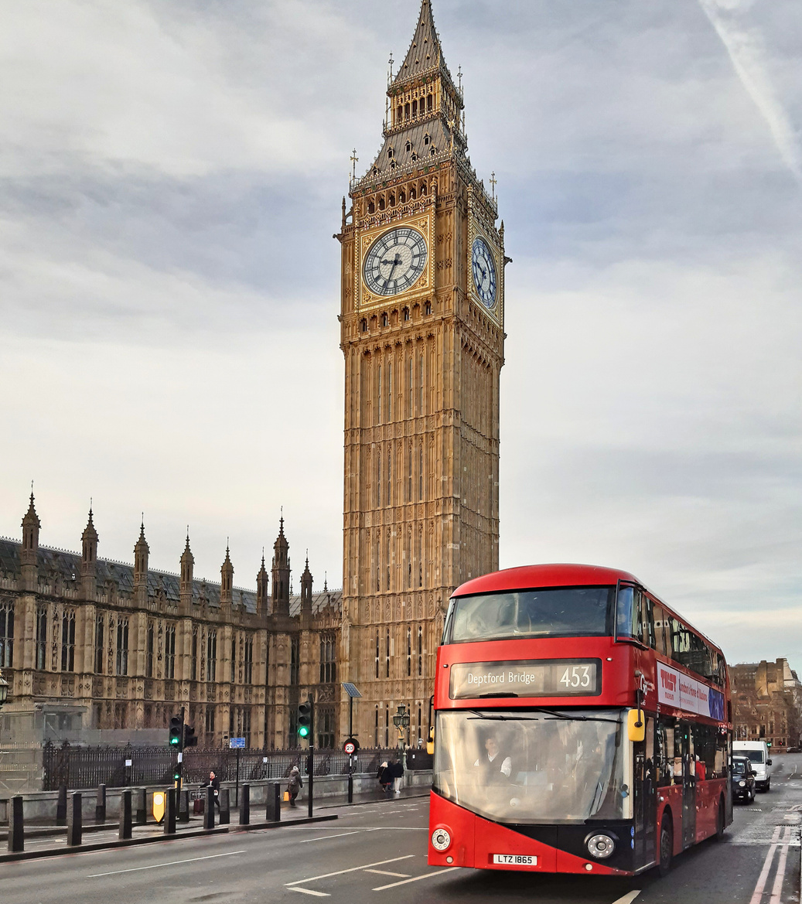
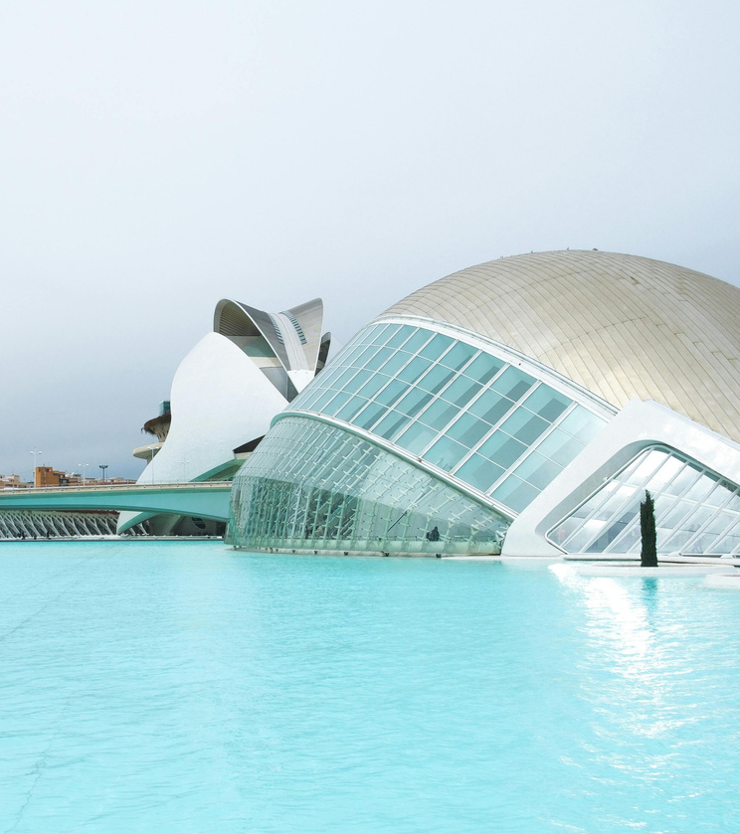
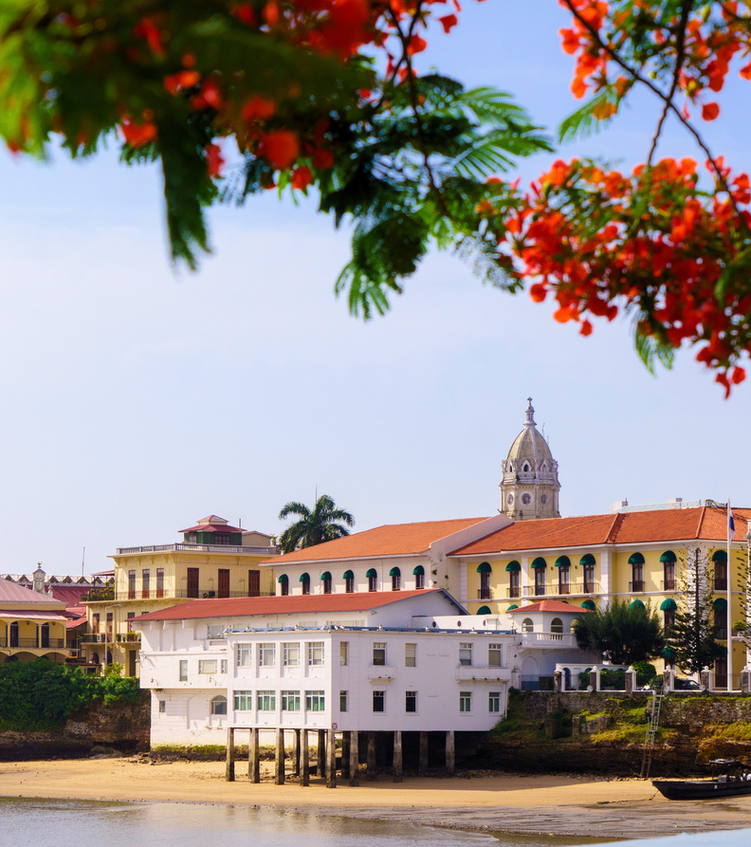

FSU Around the Globe
Programs are offered in the summer or over spring break
Teach on a broad curriculum program or lead a focused curriculum program
Study abroad centers include amenities such as classrooms, libraries, and FSU staff
FLORENCE
ITALY
LONDON
ENGLAND
VALENCIA
SPAIN
PANAMA CITY
PANAMA
AND MORE!
Notes:
We offer a variety of programs in locations around the globe. We have programs ranging from one week to a full year abroad. You can take a variety of courses needed to graduate including CoreFSU classes as well as courses for specific majors and minors. If you are interested in gaining work experience before you graduate you can do an international internship!
FSU owns and operates three study centers in Florence, Italy; London, England; and Valencia, Spain; as well as a branch campus in Panama City, in the Republic of Panama.
Students can study in each of these cities during the Fall, Spring or Summer. These locations have classrooms, libraries, computer labs and FSU staff and faculty. They are the hub for your study abroad experience. Let's go on a brief tour of these locations! First up: Florence, Italy!

Slide 7
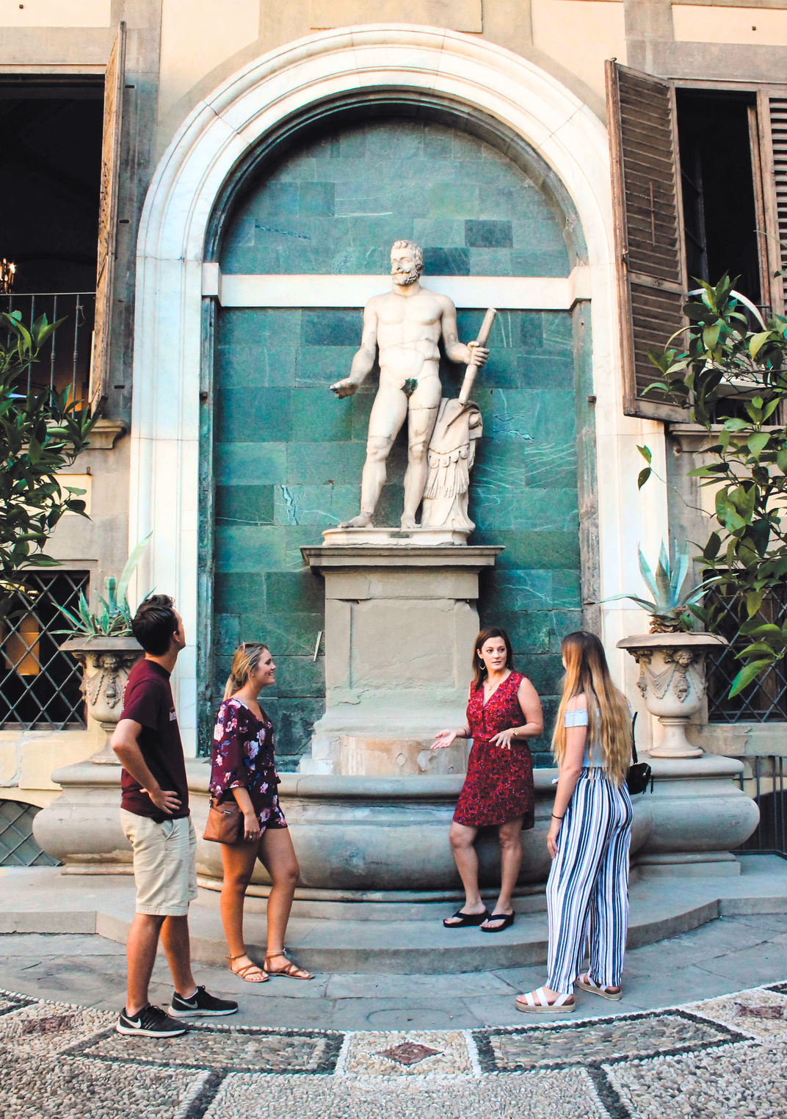
Program Types & Faculty Roles
Broad Curriculum Faculty
When: Summer 2028 (6-week sessions)
Where: European Study Center or Panama Branch Campus
Broad range of undergraduate course options, with full support
from on-site staff.
Focused Curriculum Program Leader
When: Spring Break 2028 & Summer 2028
Where: European Study Center, Panama Branch Campus, or Other Location
Focused on specific areas of study. Full support from on-site staff at study center/branch campus locations. More pastoral responsibilities for program leader faculty in other locations.

Slide 8
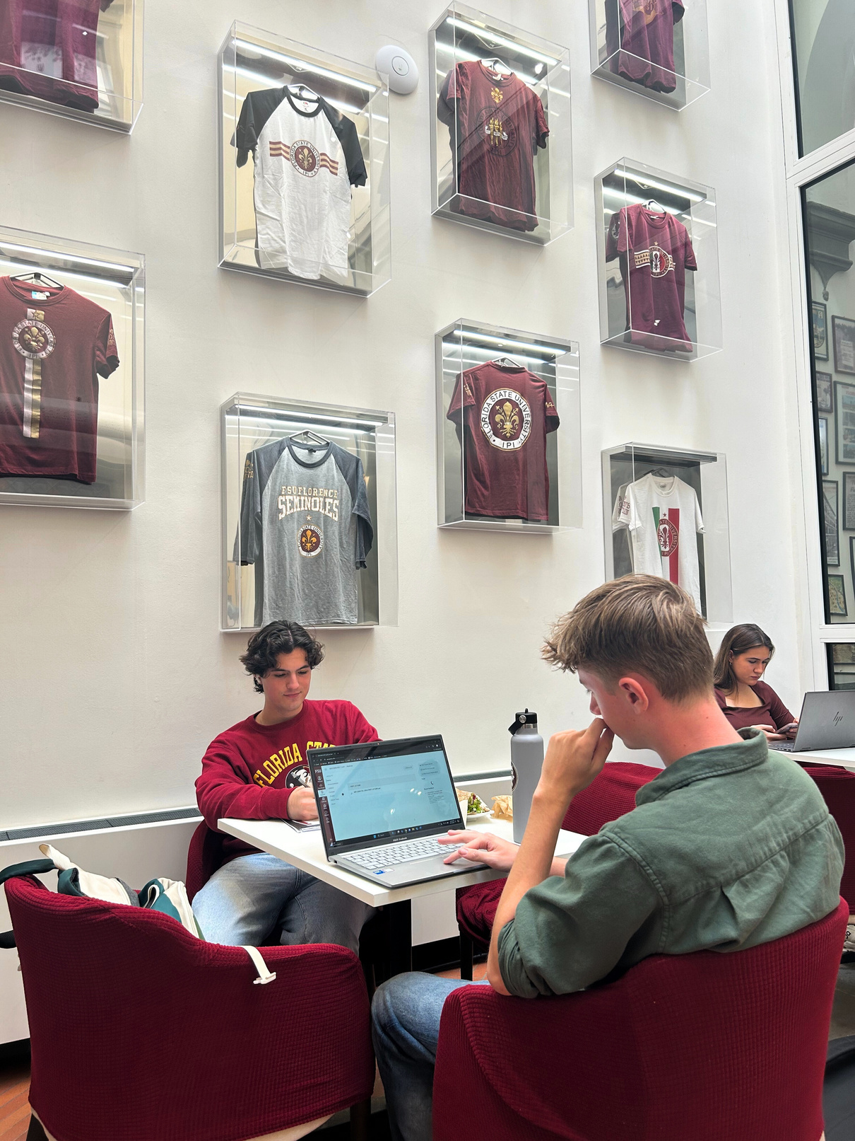
Application Timeline for 2028
Application Opens Online (once a year​): Mid-November 2026
Application Closes:
Late January 2027
Teaching Abroad Info Sessions: December 2026

Slide 9

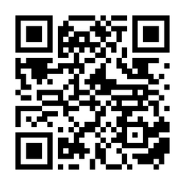
Where to Find More Information
Email IP-Faculty@fsu.edu with any questions
Scan the QR code to access more resources on teaching abroad with FSU IP

Slide 10

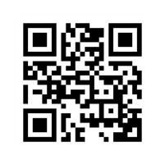
@fsuip
Stay connected!
Scan the QR code for
social media links & other resources.
Notes:
You can also connect with us on social media. Scan this QR code for links to our social media and more! Find us @fsuip on Instagram, X, Facebook, LinkedIn, and YouTube.
On the FSU IP Instagram or YouTube you can see videos created by students who are currently abroad. You can also find more resources in our story highlights and YouTube playlists.
Earlier I/we said that studying abroad is an experience worth sharing so before I/we go, I/we want to share why I/we chose to study abroad with you.
Personal story: ___________
I/we hope you are interested in learning more about having your own experience worth sharing! I/We am/are happy to answer any questions, thanks for having me/us!

