Slide 1
Promotion & Tenure
Amy R. Guerette, Associate Vice President, FDA
Aline Kalbian, Associate Dean, College of Arts and Sciences

Slide 2
Welcome to
Florida State University!
Notes:
FSU was my first faculty position – came here as an assistant professor many years ago – remember thinking: “can’t believe they’re paying me to do this” = this being establishing my own program of research, recruiting grad students to work with me, teaching really smart students on topics of which I am passionate. FSU has been great academic home for me – I hope the same holds true for you.

Slide 3
Presentation Outline
Office of Faculty Development and Advancement
Types of FSU Faculty
Department & College Bylaws
Assignment of Responsibilities
Faculty Evaluation
Promotion & Tenure Process and Timeline
Notes:
Goals of today’s meeting: 1) brief presentation (slides will be made available) not going to get into the weeds, we do that in other venues (P&T workshops, closer to time of tenure review)
or get into the history and merits of university tenure (interesting but not enough time) –
instead will give an overview of criteria & procedures for getting tenure at FSU
Other goals of this meeting – answering any questions you may have.
Hope is that today provides a good foundation for starting your career here at FSU.
But NFO will continue – we’ll meet a number of times this year.

Slide 4
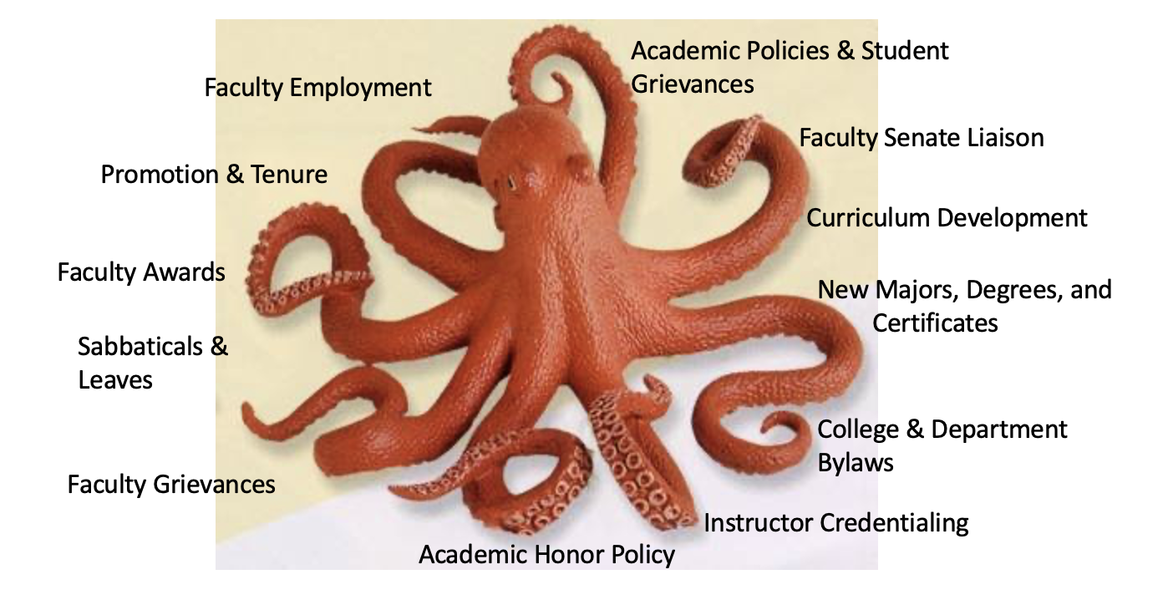
Office of Faculty Development and Advancement

Slide 5
Office of Faculty Development and Advancement
OFDA Website https://fda.fsu.edu
Academic Resources
Development
Employment
Recognition
Special Events
Leadership Toolkit
*Updated Faculty Handbook coming soon!*

Slide 6
FSU’s Pursuit of Excellence
Hiring and Tenure decisions are the most important decisions we make as an institution!
We hired you with the expectation that you will excel in your field.
Our commitment to you includes:
  Resources to launch your program of scholarship/creative works
  Support for teaching
  Positive work environment
  Constructive, timely feedback on your progress towards tenure
Notes:
Jim Smith: No “or” in the criteria. What constitutes sufficient evidence of “meritorious performance”? Not a simple answer, no formula, no minimum number of x or y. It’s about excellence, impact.
Not true that the only thing that matters is your scholarship/creative works. Lack of evidence of effectiveness in teaching and service is enough to derail tenure. But – it is true – it is the lack of evidence of excellence in scholarship/creative works that is the most common reason for not getting tenure.

Slide 7
Types of FSU Faculty

Slide 8
Tenured and Tenure Earning
Assistant Professors
Associate Professors
Full Professors
Jobs responsibilities include
Teaching + Research/Creative Works + Service
Notes:
The important thing is striking the correct balance between Teaching, Research/Creative Works, and Service! Not all are equal and we will talk more about this when we discuss your Assignment of Responsibility in a few slides.

Slide 9
Specialized Faculty
Non-Tenure Earning
Responsibilities are more focused
Promotional Ladder: Level I, II, and III
Fully participate in Faculty Governance
Notes:
Amy: 909 Specialized Faculty

Slide 10
Assignment of Responsibilities &
Faculty Evaluation

Slide 11
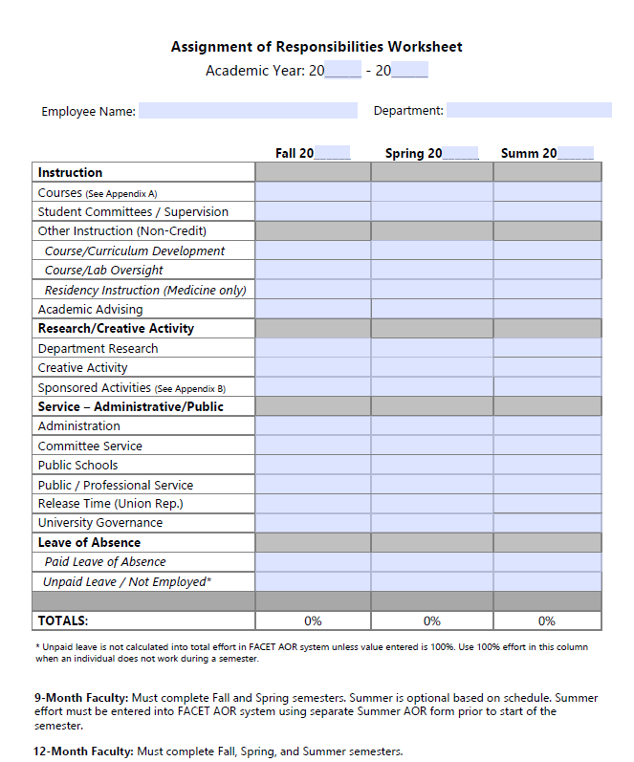
Assignment of Responsibilities (AOR)
Notes:
Tenured & Tenure-earning faculty – unique in that you are expected to have an AOR that includes teaching, research and service; and that you are eligible for tenure.
2025: Discuss that you will be asked to acknowledge you AOR.
The Chair is ultimately held responsible by FSU to determine your AOR based on the needs of the department or College.
Moving forward, this will be discussed at your Annual Evaluation Meeting in Spring for the next academic year

Slide 12
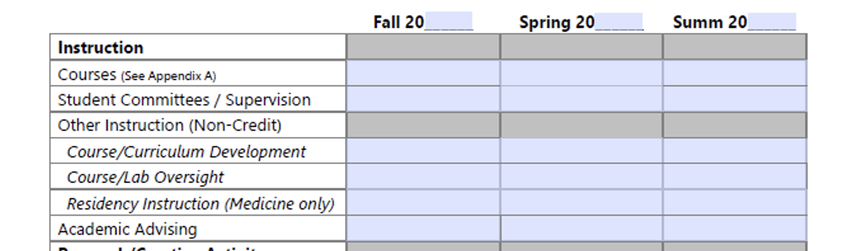
AOR: Instruction

Slide 13
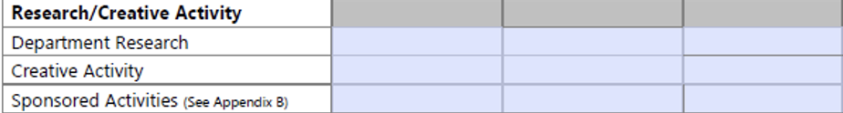
AOR: Research and Creative Activity

Slide 14
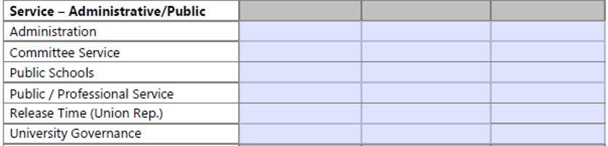
AOR: Service

Slide 15
Faculty Evaluation
Annual Faculty Evaluation
Annual ratings in each area of your AOR
Annual Letter of Progress Towards Promotion and Tenure
Third Year Review
Milestone for the Promotion and Tenure Review in the 3rd Year
Are you making appropriate progress toward meeting the Department/College and University tenure criteria?
Promotion and Tenure Review
Post Tenure Review

Slide 16
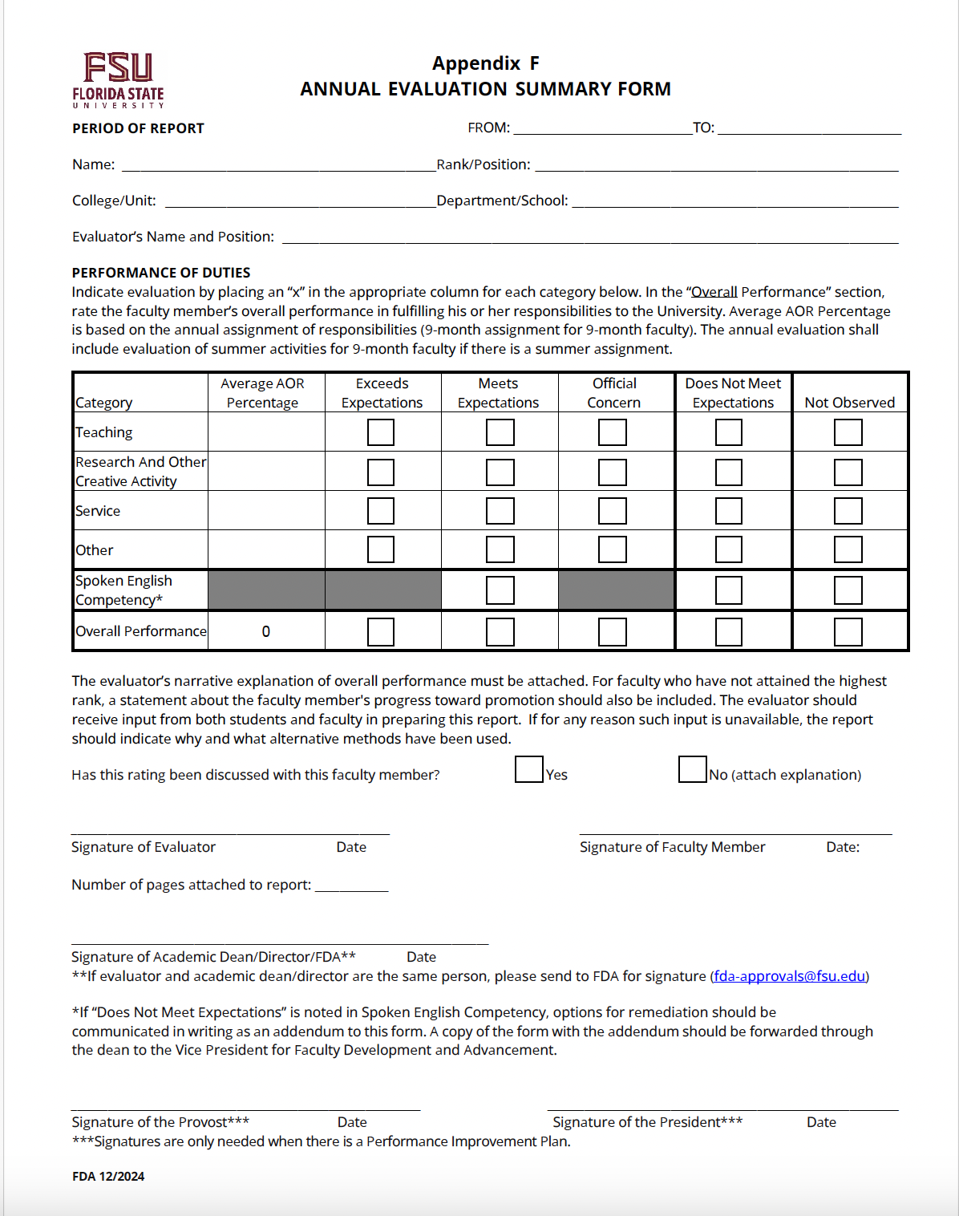
Annual Faculty Evaluation
Notes:
New 4 Rating Scale Evaluation Inserted

Slide 17
What is Your Role in the Faculty Evaluation Process ?
Make it easy for others to learn about your work
Keep track of your accomplishments
Keep your FEAS CV current
Tell “your story” well
What are your most important accomplishments?
Why is your work important?

Slide 18
Promotion and Tenure Process and Timeline

Slide 19
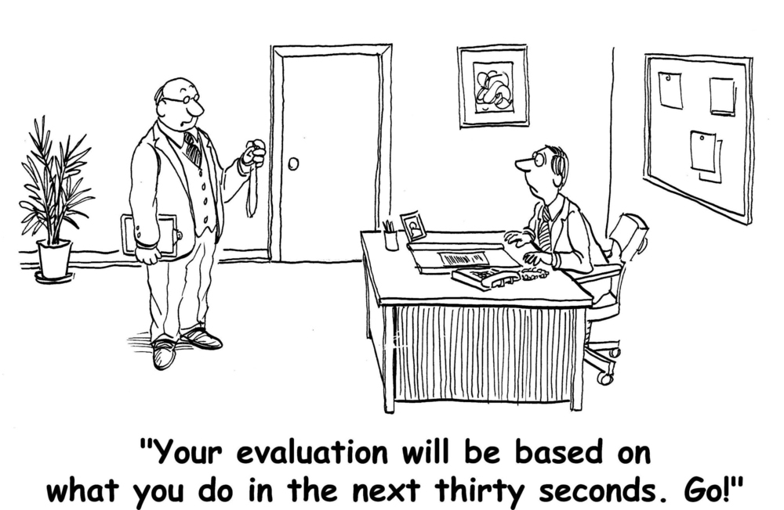
How do I know if I’m making progress toward tenure?
Notes:
There should be no surprises – you should know well in advance if you are on track (or not) for tenure. Goes back to what I said a few minutes ago about the university’s obligation to provide you with constructive timely feedback on your progress toward tenure.
Provide guidance/encouragement to actively plan and frequently participate in professional development/scholarly activities.

Slide 20
Who is Eligible for Tenure?
Faculty in tenure-earning positions
Recommended by academic unit
Minimum of 5 years in rank
  Includes “tenure credit”
  Does not include years when “tenure clock” is stopped
Notes:
Mention 7 Year Rule!

Slide 21
Who is Eligible for Promotion?
Promotion from Assistant to Associate
Faculty in tenure-earning positions
Recommended by academic unit
Typically reviewed in 6th year in rank, simultaneously with tenure review
May be reviewed prior to tenure review

Slide 22
University Promotion and Tenure Criteria
Sustained excellence in scholarly or creative accomplishments AND teaching AND service
Is there evidence that you:
  have (or will) achieve national and international recognition as a scholar or creative artist in your field?
  have demonstrated excellence as a teacher and mentor?
  make positive contributions in service to the university and your academic discipline?
Notes:
Mention Department and College Bylaws (Discussed in 2025 FSU 101)

Slide 23
Review and Approval Steps for P&T
Tenured Faculty in the Academic Unit
Department Committee and Chair
College Committee and Dean
University Committee
Provost
President
FSU Board of Trustees

Slide 24
Promotion and Tenure Timeline
Spring Semester 5th Year: Department recommends that you put together materials for P&T review (or recommends waiting a year)
Summer between 5th & 6th Year: Outside letters are requested by your Chair or Dean and you are asked to prepare your P&T “binder”; You submit your materials to the online P&T portal
Fall Semester of 6th Year: The official start of your formal P&T review

Slide 25
What Evidence Will Represent You?
Dean’s and Chair’s Letters
Outside Letters (from top scholars in your field)
Curriculum Vita
Evidence of Achievements
Research, Teaching, and Service Statements
Annual Letters of Progress Toward P&T
3rd Year Review Narratives

Slide 26
What You Can Do Next
Ask about your academic unit’s expectations of you and the criteria they most value in evaluating faculty performance
Talk to colleagues in your Department and/or College to learn more about the process in your academic unit
Take advantage of workshops and consultations offered by our Center for Advancement of Teaching (CAT)
Sign-up for NCFDD account at www.ncfdd.org
Notes:
Describe NCFDD

Slide 27
How to Maximize Your Success
Stay focused on your goals!
Find a mentor!
  Workshop on this topic later this semester
Remember your timeline!
Protect your time but say yes to projects that will advance your career!
If you say you’re going to do something, do it well and on time!

Slide 28
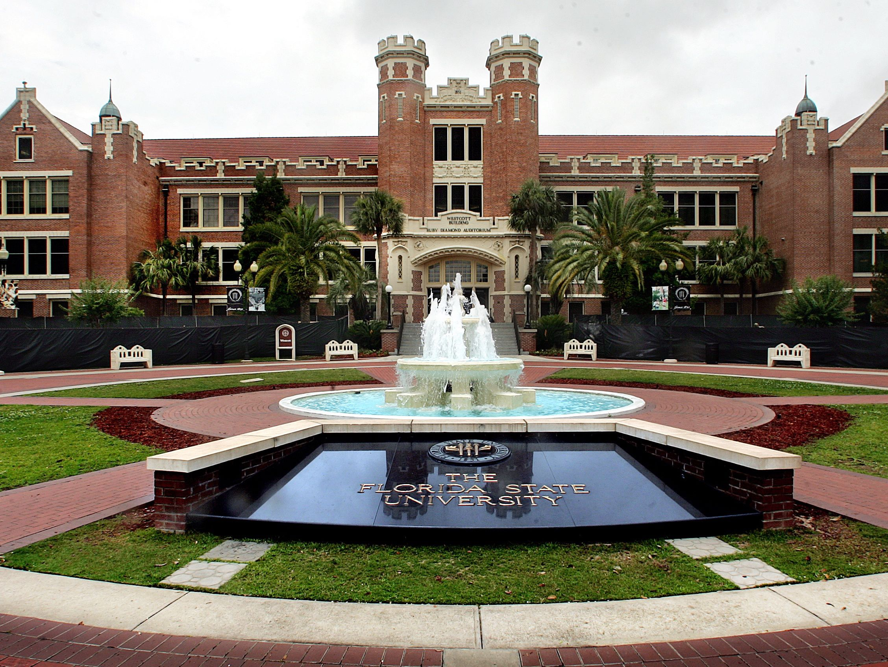
We are SO very glad you are here!

