Slide 1
Welcome to Florida State University
Jeanette Taylor
Vice President for Faculty Development & Advancement
Craig Stanley
Associate Vice President for Faculty Development and Advancement
August 17, 2026

Slide 2
Overview
Office of Faculty Development & Advancement
Types of FSU Faculty
Assignment of Responsibilities (AORs)
Faculty Evaluations
Promotion Process
Notes:
Goals of today’s meeting: 1) brief presentation (slides will be made available) not going to get into the weeds, we do that in other venues (workshops, closer to time of promotion) -instead will give an overview of criteria & procedures for getting promoted at FSU; Other goals of this meeting – answering any questions you may have. Hope is that today provides a good foundation for starting your career here at FSU.

Slide 3

Office of Faculty Development & Advancement
Faculty Employment
Academic Policies & Student Grievances
Faculty Senate Liaison
Promotion & Tenure
Curriculum Development
Faculty Awards
New Majors, Degrees and Certificates
Sabbaticals &
Leaves
College & Department Bylaws
Faculty Grievances
Instructor Credentialing
Student Academic Honor Policy
Notes:
We are involved in (almost) everything that does on in academic affairs.

Slide 4
Office of Faculty Development and Advancement
OFDA Website https://fda.fsu.edu
  Academic Resources
  Development
  Employment
  Recognition
  Special Events
  Leadership Toolkit
  Faculty Handbook

Slide 5
FSU Faculty Types
General (Tenured/Tenure-Earning)
  Assistant, Associate, Full Professors
  Teaching + Research/Creative Works + Service
  Raises with each promotion
Specialized (Non-Tenure Earning)
  Duties focused on a specialty
  Career ladder: Levels I, II, III
  Promotional Raises equivalent to General Faculty
  Multi-Year contracts with promotion

Slide 6
Specialized Faculty Tracks
  Teaching Faculty (I,II,III)
  Instructional Specialists (I,II,III)
  Research Faculty (I,II,III)
  Research Support (Assistant In, Associate In, Senior)
  University Librarian (Assistant, Associate, University Librarian)
  Curator Specialties (Assistant, Associate, Curator)
  Clinical Faculty (Assistant, Associate, Professor)
  Honorific Titles

Slide 7
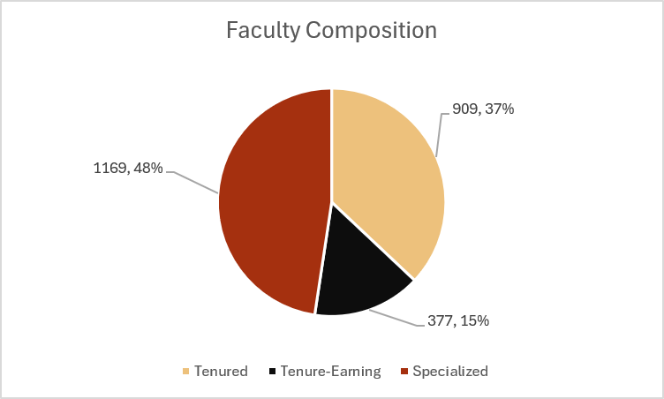
Faculty Composition at FSU

Slide 8
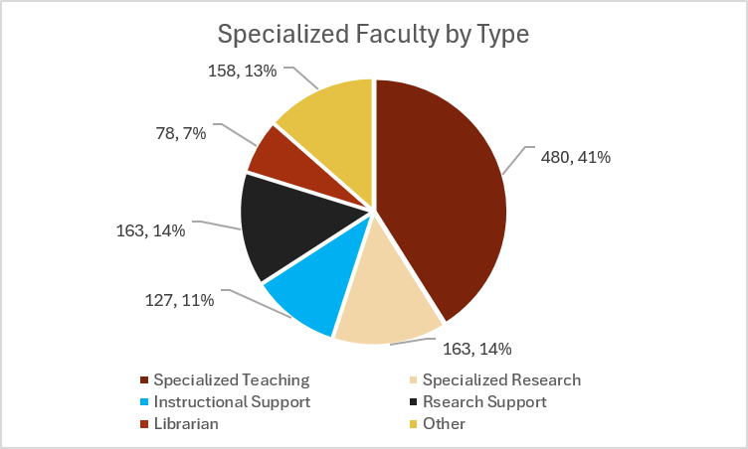
Specialized Faculty Composition
Notes:
Based on active faculty list as of October 2025.
Faculty composition by tenure status
Full time (part time excluded). Regular salaried faculty (OPS excluded).

Slide 9
Assignment of Responsibilities &
Faculty Evaluation

Slide 10
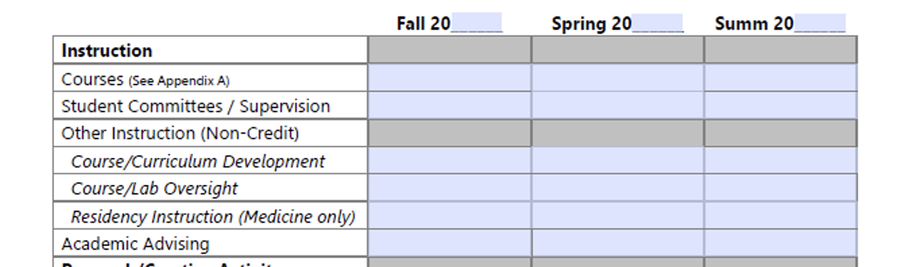
AOR: Instruction

Slide 11
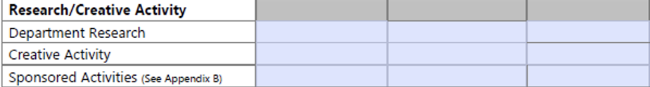
AOR: Research and Creative Activity

Slide 12
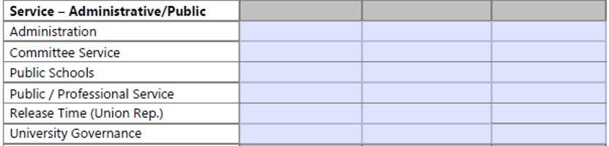
AOR: Service

Slide 13
Faculty Annual Evaluations at FSU
Based On a Calendar Year
    Conducted each Spring
    Based on the assignment and evaluation criteria (Bylaws)
    Evaluation summary form with categorical ratings
    Evaluation Narrative to include a statement on progress toward promotion
Who Contributes to Your Evaluation
    Chair/Supervisor
    Indirect Supervisors
    Faculty/Faculty Evaluation Committees*
    Students

Slide 14
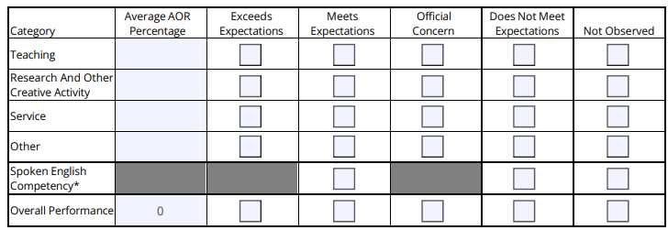
Evaluation Ratings

Slide 15
Your Role in Faculty Evaluations
Make it easy for others to learn about your work
Keep track of your accomplishments
  Keep your FEAS account updated
Tell “your story”
  Identify your most important accomplishments
  Articulate why your work is important

Slide 16
Promotion Process and Timeline

Slide 17
Pursuit Of Excellence
Hiring & promotion decisions are the most important decisions we make
Hired with the expectation that you will excel in your area of specialization
Our commitment to you:
  Support for specialization (e.g. supervision and mentorship)
  Positive work environment
  Constructive, timely feedback on your progress toward promotion

Slide 18
Promotion at FSU
Who evaluates you for promotion?
  Specialized faculty in your academic unit
  Department Committee & Chair
  College Committee & Dean
  OFDA
  President

Slide 19
Criteria for Promotion
Promotion decisions for specialized faculty will take into account the following:
Annual evaluations
Annual assignments
Fulfillment of the department/unit written promotion criteria in relation to the assignment
Evidence of sustained effectiveness relative to opportunity and according to assignment
Specialized faculty are typically eligible for consideration during their fifth year of service

Slide 20
What You Can (and Should) Do Now
Read your unit’s bylaws.
Ask about your unit’s expectations of you and the criteria they most value in evaluating faculty performance
Talk to colleagues in your department/college to learn more about the process in your academic unit
Take advantage of workshops and consultations offered by our Center for Advancement of Teaching (CAT) and Office of Digital Learning
Check out the Research Knowledge Center and Support Hub

Slide 21
How to Maximize Your Success
Stay focused on your goals
Maintain connections with leaders in your field of study
Seek mentors
Protect your time (but say yes to projects/tasks that will advance your career)
If you say you’re going to do something, do it well and on time

Slide 22
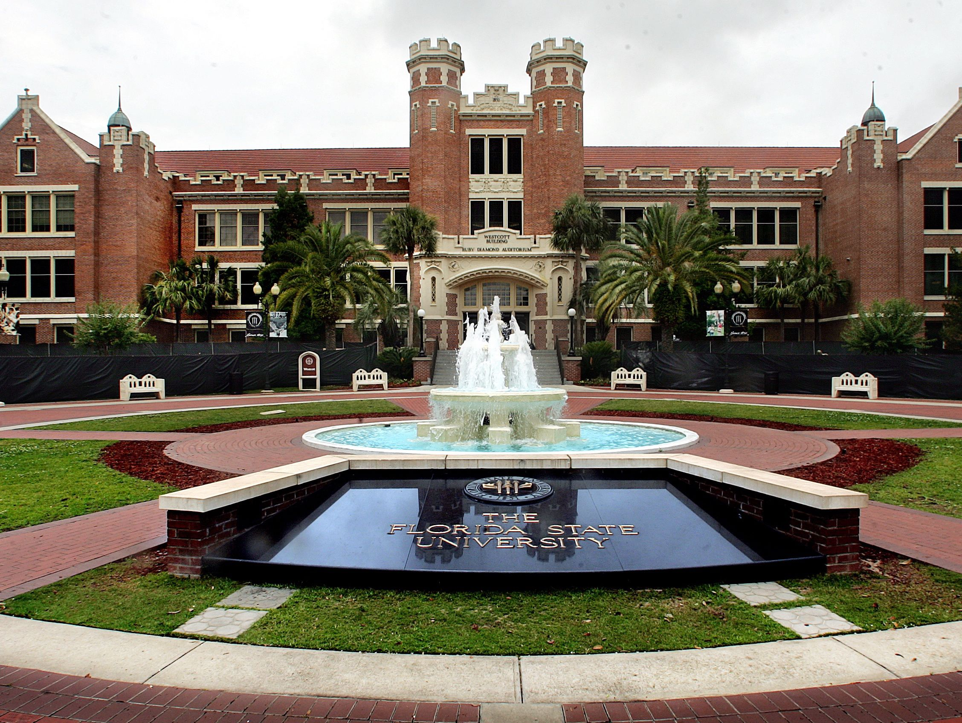
We Are Glad You’re Here

