Slide 1
ITS Update
Fall 2026 New Faculty Orientation
Jonathan A. Fozard

Slide 2
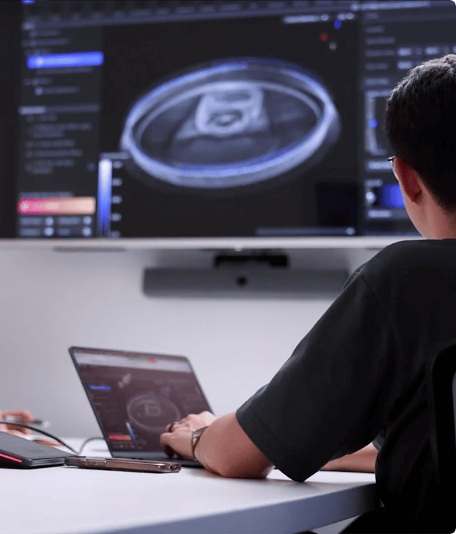
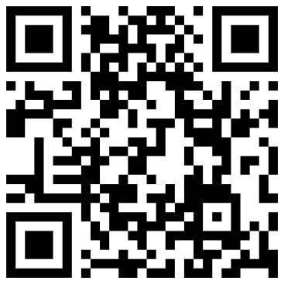


TECHNICAL ASSISTANCE
FSU ITS Support Options
Get the reliable tech help you need, when you need it. The ITS Service Desk is your primary contact for all campus technology services.
Call the IT Service Desk 850-644-4357 (HELP)
Submit a Support Request & Live Chat its.fsu.edu/help to open a ticket

Slide 3
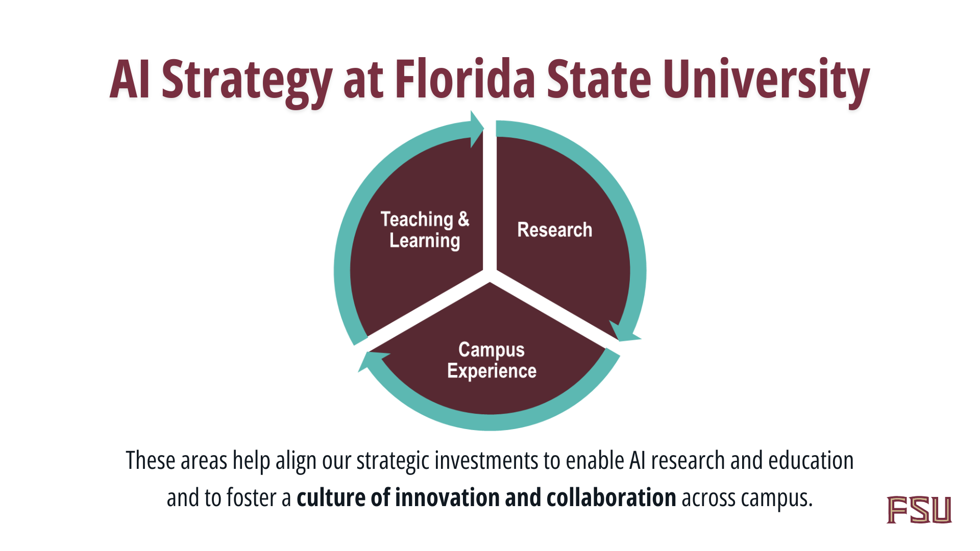

Slide 4

Our AI Strategy is centered on delivering secure, reliable, and accessible solutions that empower every member of our campus community.

Slide 5

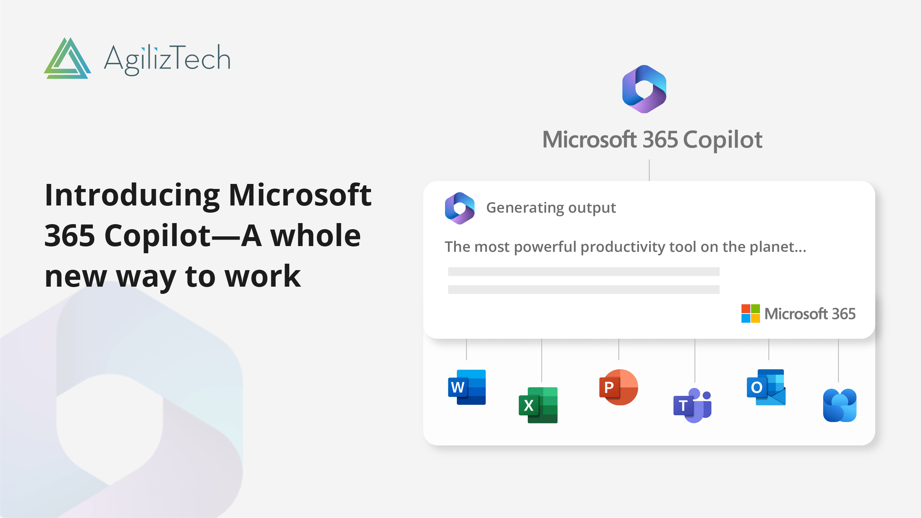






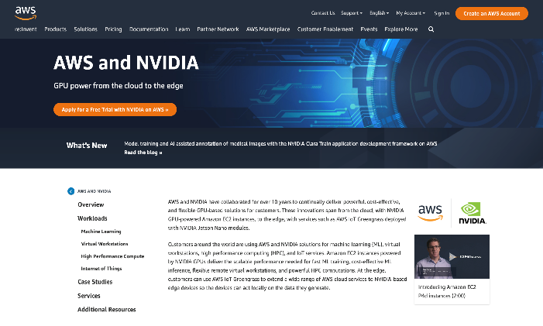
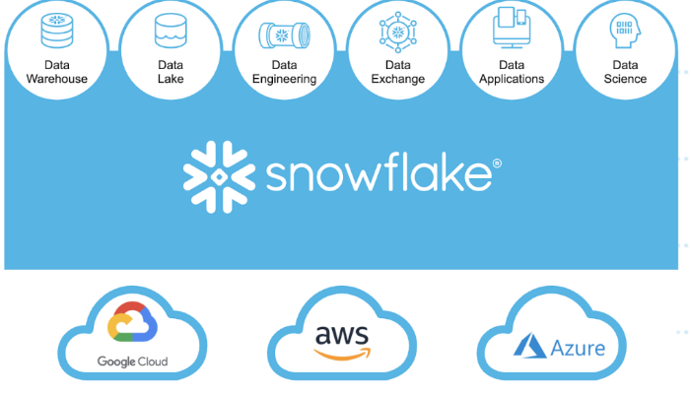
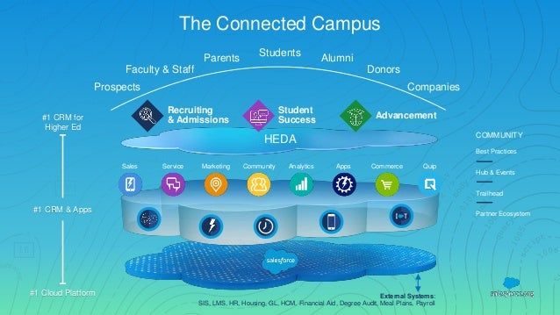

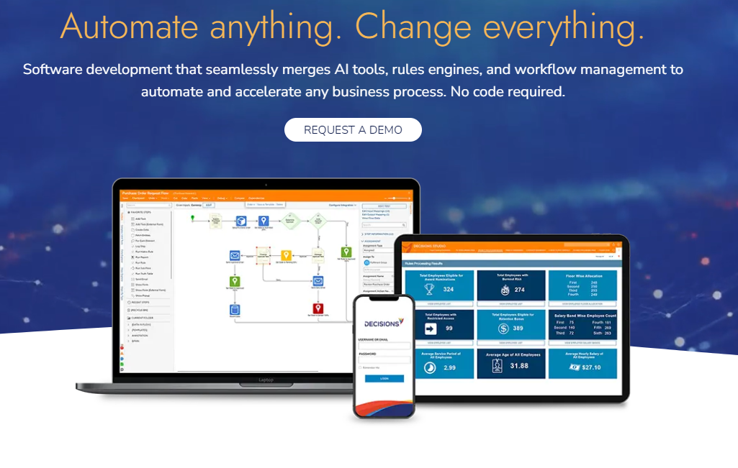

AI Empowered Platforms
Microsoft
NEW
NEW
NEW
Google
Fall ‘26
Fall ‘26
Amazon
Snowflake
Salesforce
Adobe
Decisions
Zoom

Slide 6

FSU AI & Policy Committee (AIEAC)
Artificial Intelligence in Education Advisory Committee (AIEAC) was established in the fall of 2024 to provide guidelines and resources for the use of AI in teaching and learning
Comprised of faculty, staff, students, and administrators, the AIEAC is conducting an extensive review of practices, resources, and materials from peer institutions and professional organizations
Faculty and student surveys have been distributed to assess AI adoption and use in teaching and learning
Survey data is being used to develop targeted, multi-tiered training and support resources for faculty and students
Top-level AI-focused website (ai.fsu.edu) is live, and showcases FSU’s AI initiatives, policies & guidelines, resources, and accomplishments
ai.fsu.edu

Slide 7
Importance of strategic, protected investments
Data Protection
& AI Policies
New Offerings & Space for Innovation

Slide 8
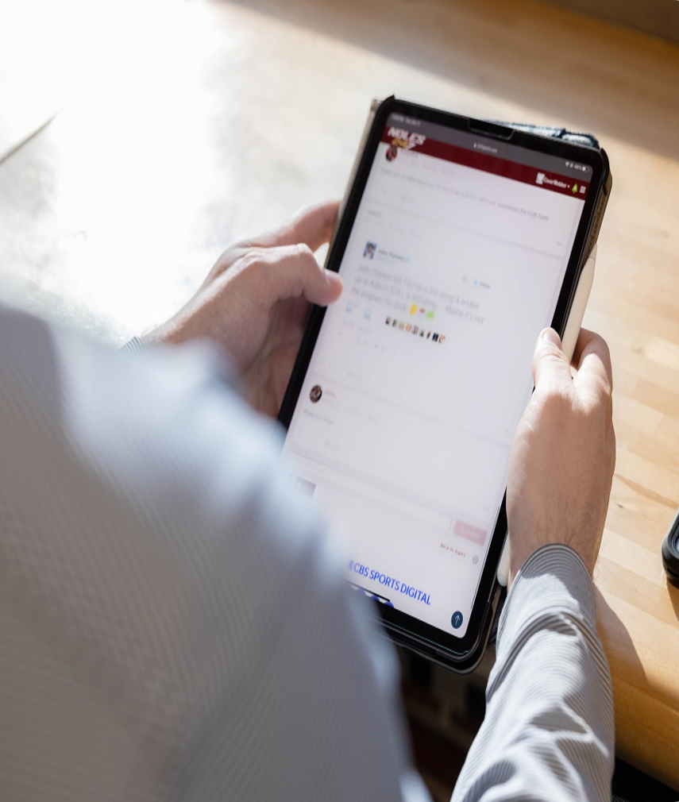
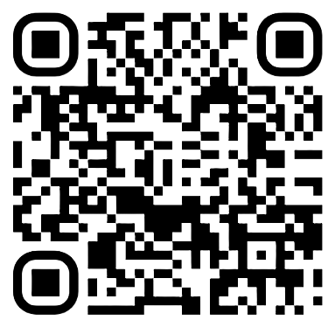
Required Annual Cybersecurity awareness training
To safeguard Florida State University's digital resources, ITS introduced an annual cybersecurity awareness training program. This training should be completed by all FSU employees by October 15 each year.
Scan to learn more

Slide 9
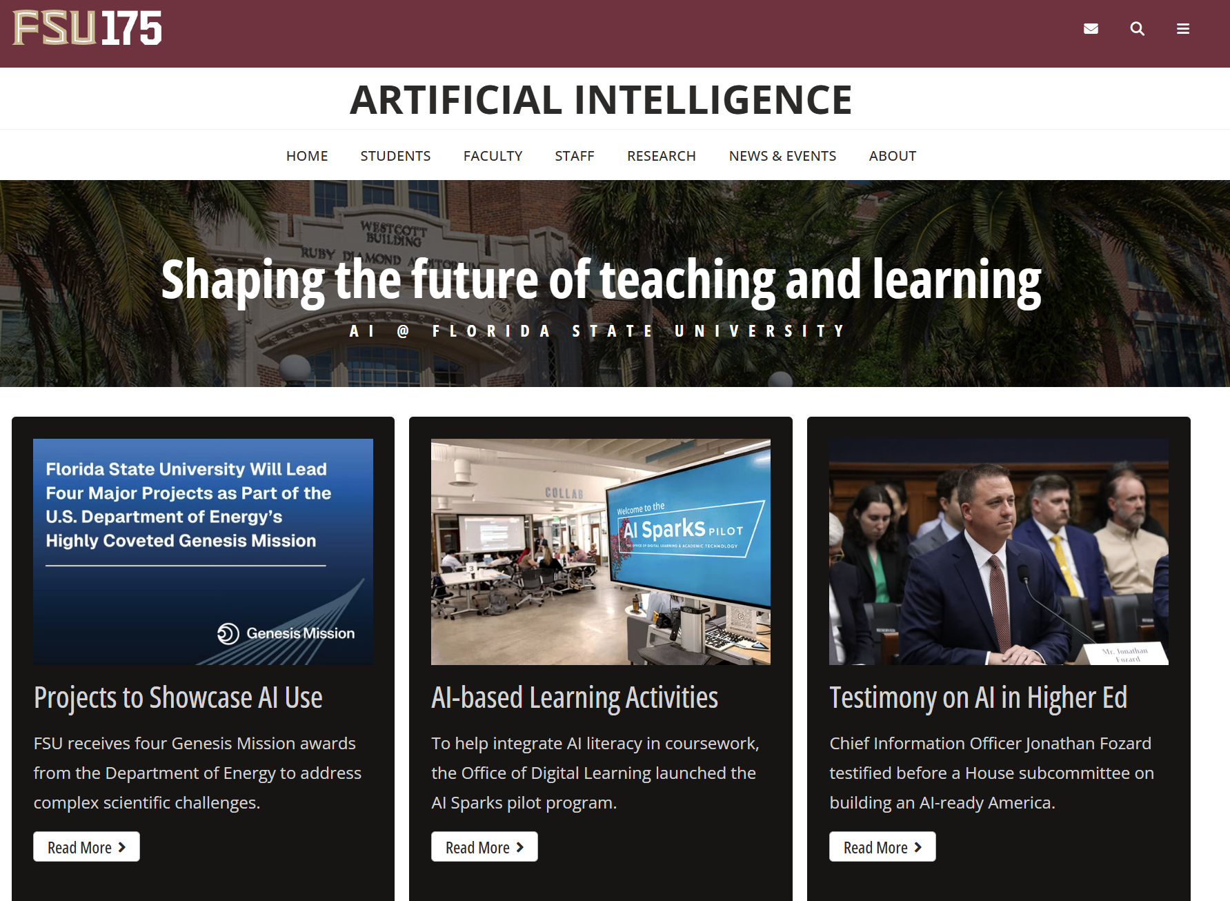
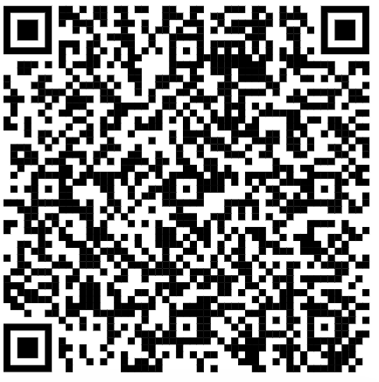
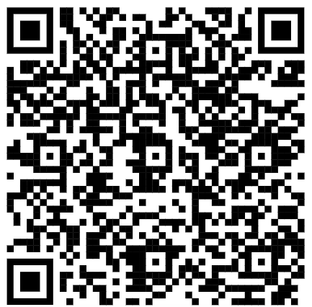
VISIT AI.FSU.EDU
AI News, Updates, Events & Free Training
View all the latest AI events, news, and research across Florida State University in one place.
FREE Google AI for Professional Certification
FREE LinkedIn Learning AI Courses

Slide 10
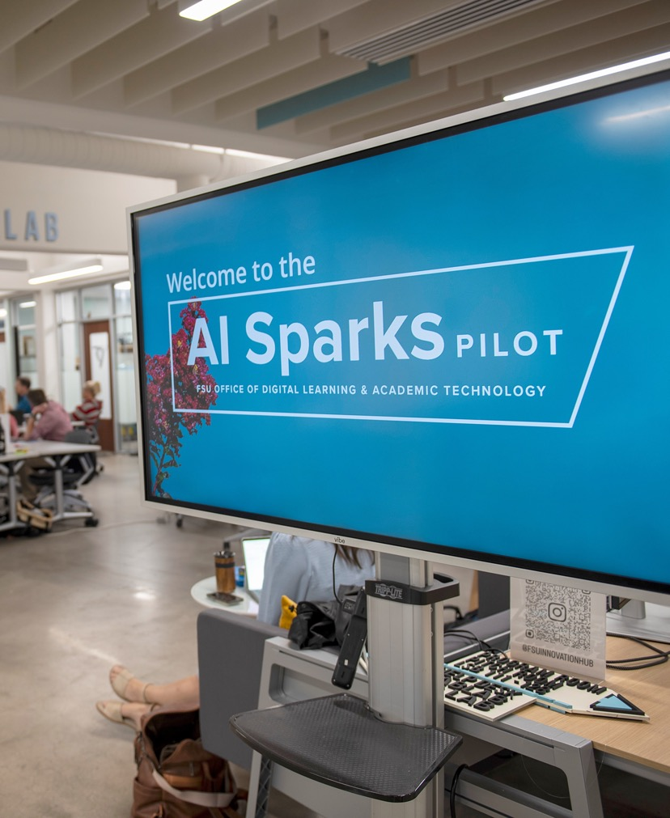


AI Sparks Pilot | 2025 - 2026
OFFICE OF Digital learning & academic technology
Funded by an educational grant from Google.org, the AI Sparks Pilot is designed to prepare students for the rapid advancement of AI technologies and their role in the workforce by equipping faculty to integrate AI literacy and applied AI learning in coursework.
ITS is working with participating faculty to
Design AI-based learning activities called AI Sparks,
Develop micro trainings for students on how to use the selected AI technology,
Deploy AI Sparks and corresponding micro trainings in their courses, and
Publish and share AI Sparks for other faculty to adapt in their disciplines.
Scan to learn more

Slide 11


Course Accessibility Training| 2025 - 2026
OFFICE OF Digital learning & academic technology
ITS provided hands-on training to equip faculty and staff with the knowledge and skills needed to design and maintain accessible Canvas course sites.
74
168
554
departmental accessibility liaisons
faculty
faculty and staff
attended training on DesignPLUS, a tool in Canvas that improves accessibility
attended accessibility workshops as
of July 2026
participated in training
Scan to learn more

Slide 12


Classroom Technologies| 2025 - 2026
OFFICE OF Digital learning & academic technology
ITS continued its investment in classroom technology and learning space improvements across campus.
300+
2,000+
technology-enhanced classrooms
new classroom seats installed across campus
Featured Technologies
Advanced audiovisual systems
Instructor-tracking cameras
Lecture capture capabilities
Streamlined room controls
Scan to learn more

Slide 13
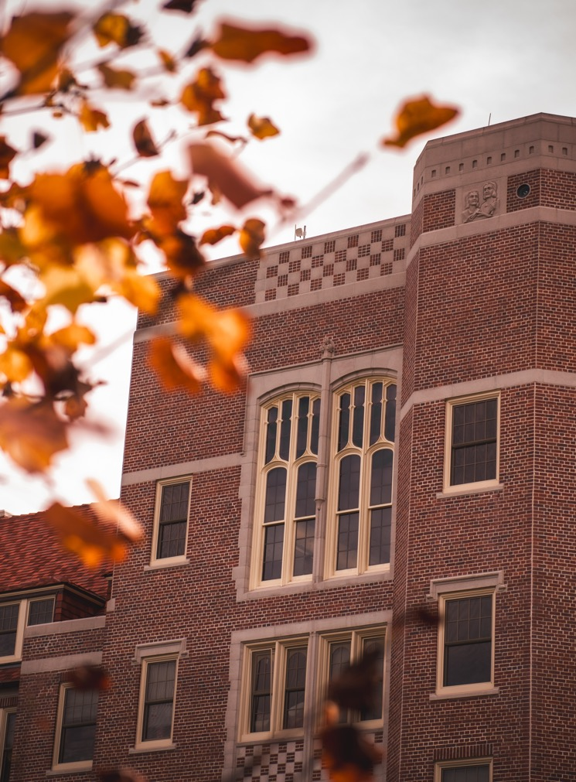


Academic Technologies| 2025 - 2026
OFFICE OF Digital learning & academic technology
In partnership with Faculty Development and Advancement, ITS implemented Simple Syllabus as FSU's exclusive syllabus management software.
Streamlines syllabus creation and management
Helps faculty monitor student engagement with course syllabi
Facilitates compliance with state regulations
Scan to learn more

Slide 14
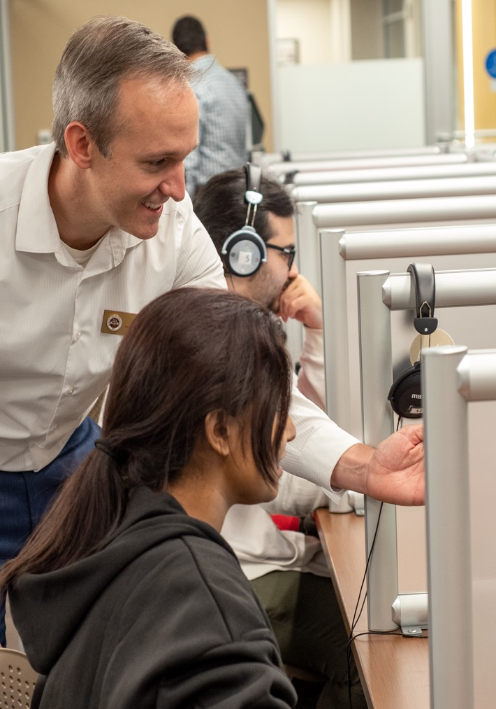



Assessment & Testing| 2025 - 2026
OFFICE OF Digital learning & academic technology
118,191 exams proctored at the FSU Testing Center
ITS introduced SmarterProctoring Live to improve the security and academic integrity of exams administered online:
Relies on human proctors to monitor online exams in real time
Records exam sessions
for instructor review
ITS implemented Akindi, a cloud-based scanning tool to modernize bubble-sheet test forms for in-class exams:
Reduces time instructors spend managing paper-based exams
Streamlines Canvas Gradebook imports
Scan to learn more

Slide 15


FSU Online Quality Initiative | 2025 - 2026
OFFICE OF Digital learning & academic technology
ITS provided instructional design and hands-on accessibility support to faculty working to structure their online courses for student success.
52
faculty
26
188
online courses
online courses
received training on applying the Quality Matters rubric in an online course this year
achieved high-quality certification this year
have been reviewed using the Quality Matters rubric since 2019
Scan to learn more

Slide 16
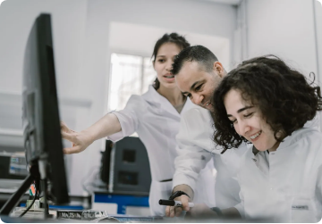
Research Computing Center (RCC)
its.fsu.edu/research
Your dedicated academic service unit, bridging the gap between raw technology and scientific discovery.
Enable Multidisciplinary Research: Supporting projects across physics, genomics, engineering, and social sciences.
Maintain Distinct Cyberinfrastructure: Managing dedicated clusters that operate independently of standard campus IT.
Accelerate Time-to-Science: Condensing weeks of computational work into mere days or hours.
Foster Institutional Partnerships: Collaborating with university libraries and research development offices.

Slide 17
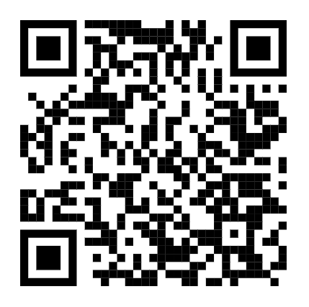

Questions & Feedback:
      Jonathan Fozard
      VP & Chief Information Officer
      jfozard@fsu.edu

