Slide 1

Florida State University Libraries
Carrie Zebrowsky Cooper
Dean of University Libraries
August 18, 2026

Slide 2
YOUR COMPETITIVE EDGE IN RESEARCH, TEACHING, AND LEARNING
We give new faculty $1000 for research materials
We are instructional partners- eager to help your students understand the changing landscape of research
We deliver materials….but PLEASE come visit!
We offer a competitive grant program for research materials up to $10,000

Slide 3
OUR WELCOME GIFT FOR YOU
New Faculty Collection Grants: New tenure-track faculty may receive up to $1000 for library resources needed for their teaching and research
Requests must be submitted by January 2026

Slide 4
BRADLEY RESEARCH MATERIALS GRANTS
A competitive grant program for $500-$10,000 through which the library acquires special materials needed by faculty for research
Open to all faculty
Look for an announcement in early Fall

Slide 5

Order materials directly from the catalog!
Office delivery & pick up
Hold requests at all campus libraries
Article & chapter scans, sent right to your email
Available to all faculty, graduate students, and staff

Slide 6
Subject & Departmental Liaisons
      Subject librarians are your first point of contact for library information. They are assigned to every department to:
      Acquire materials for teaching and research
      Arrange library instruction for your classes
      Create customized course research guides
      Provide research and data consultations

Slide 7
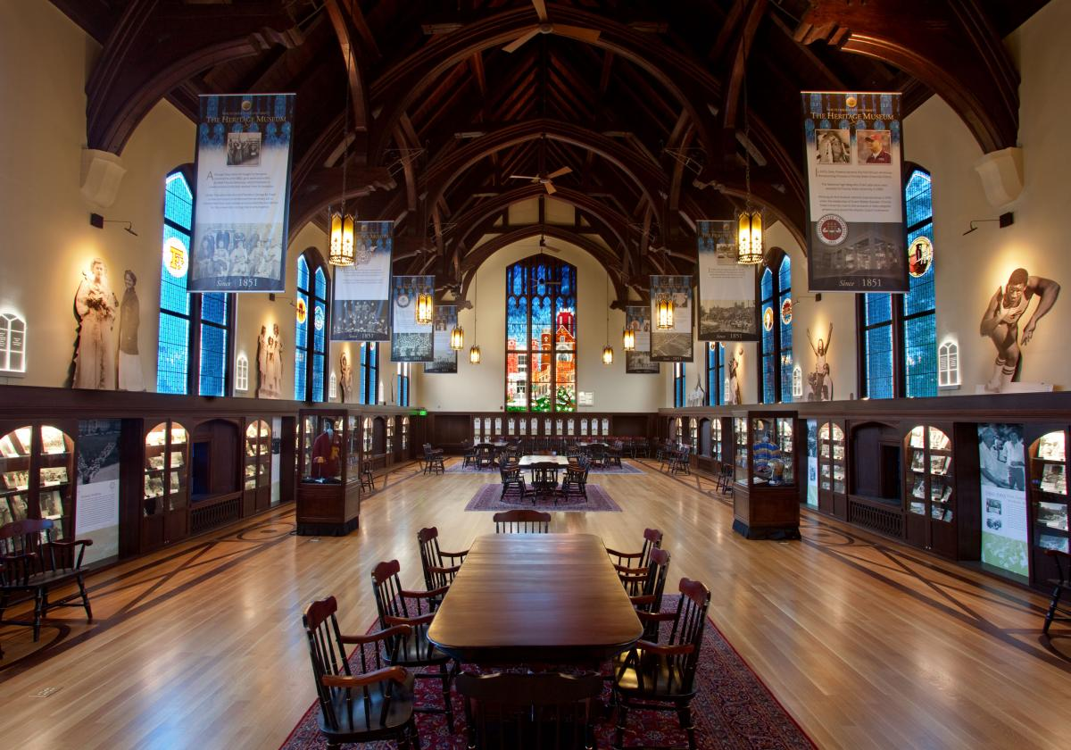
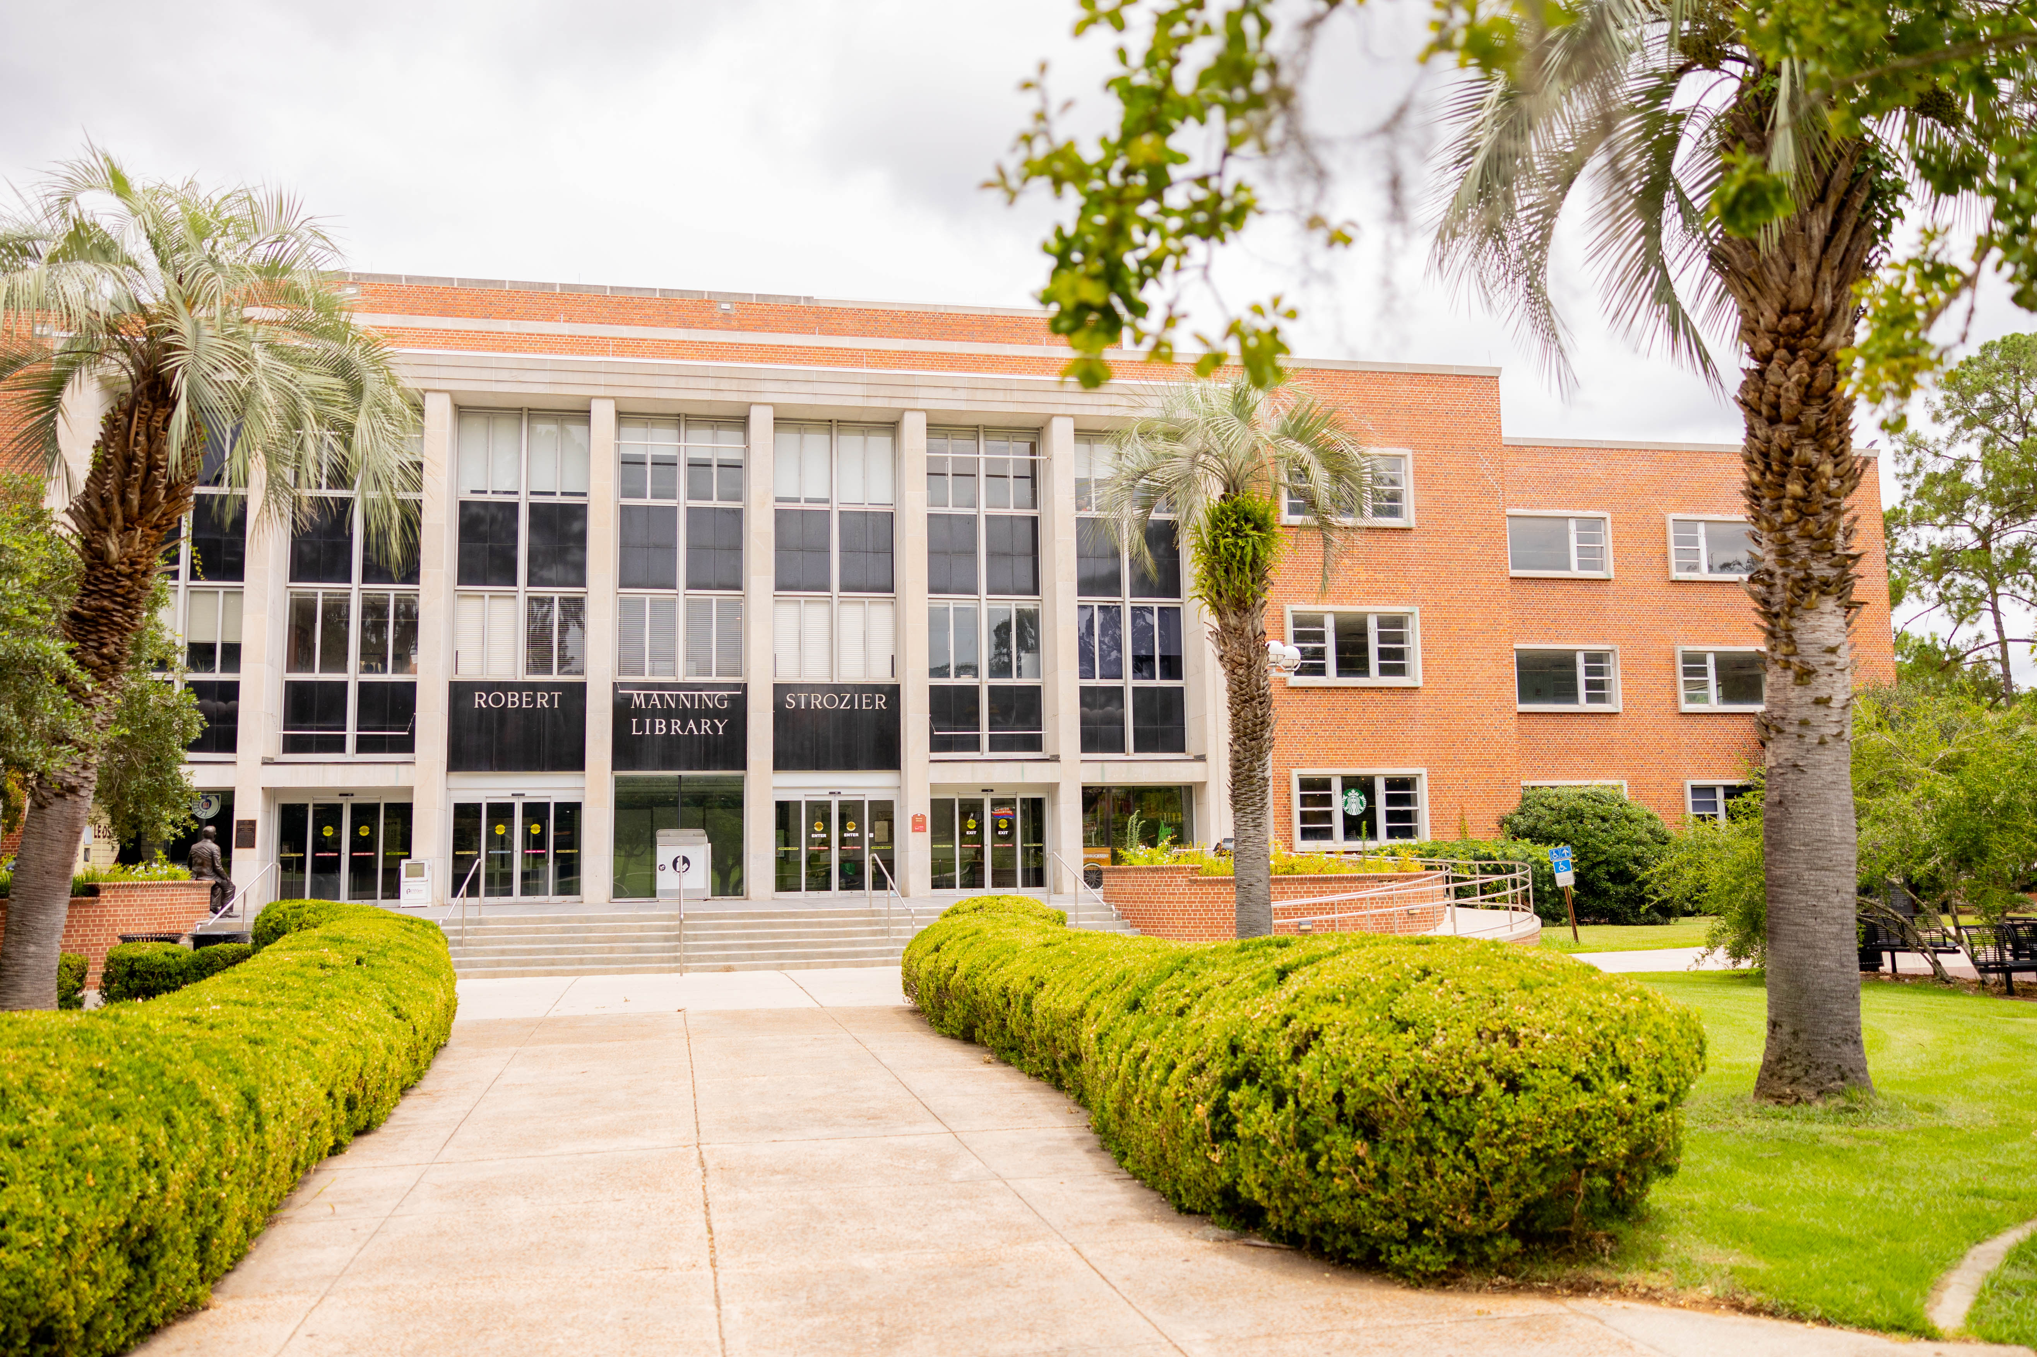
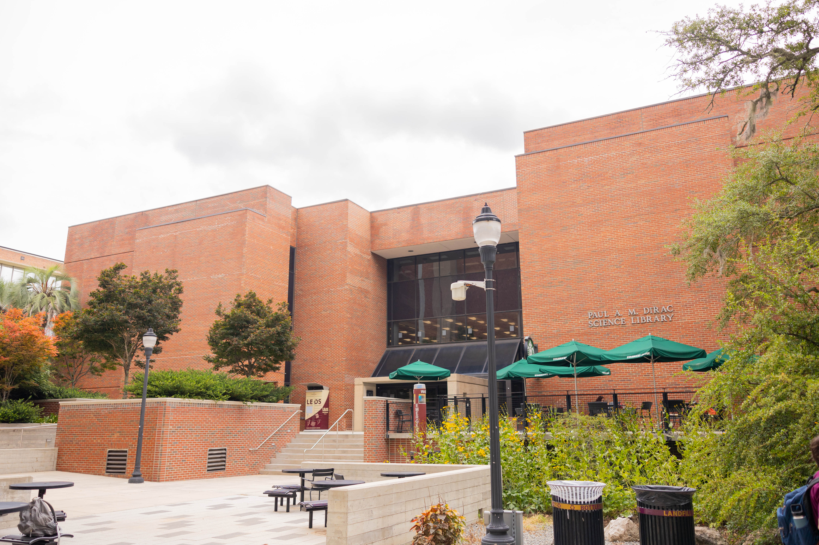
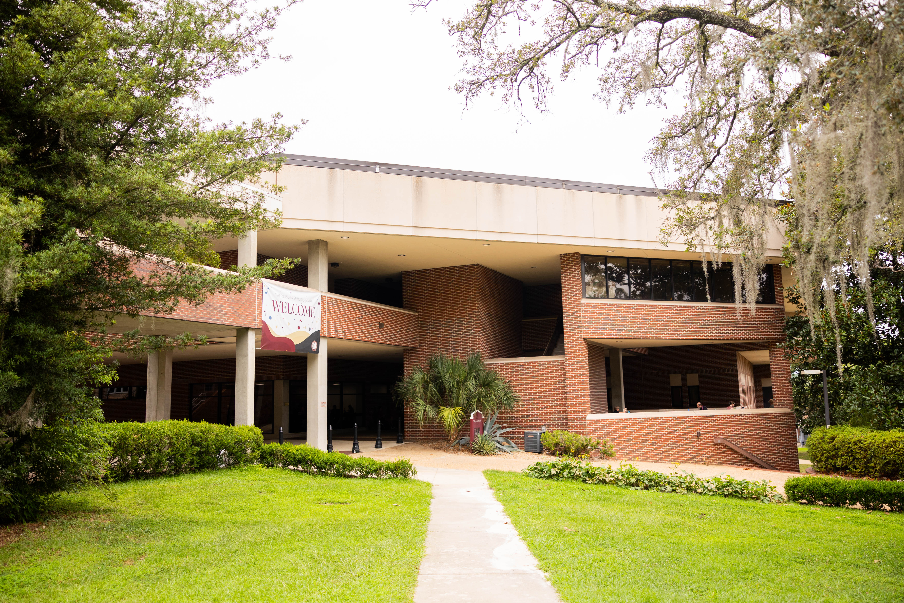
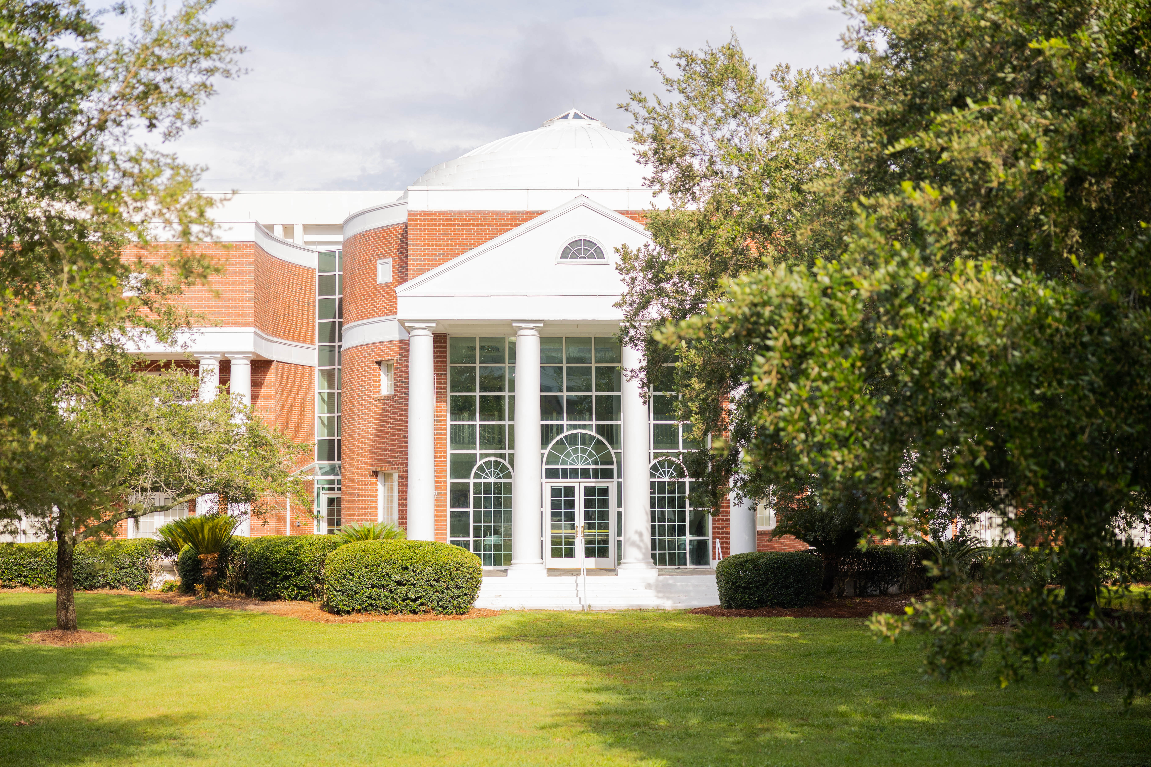
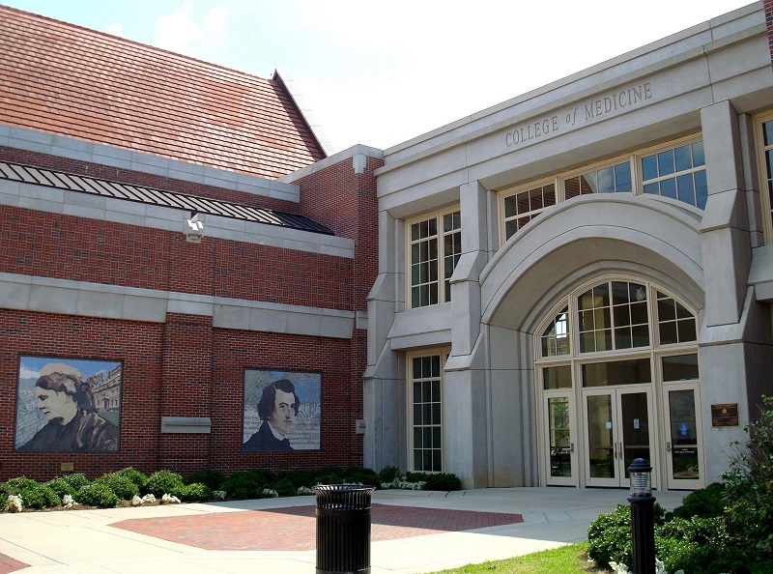
FSU Libraries: Where to Find Us?
Robert Manning Strozier Library
Paul Dirac
Science Library
Werkmeister Reading Room
& University Heritage Museum
Warren D. Allen
Music Library
Charlotte Edwards Maguire
Medical Library
Legal Research Center
In the College of Law

Slide 8
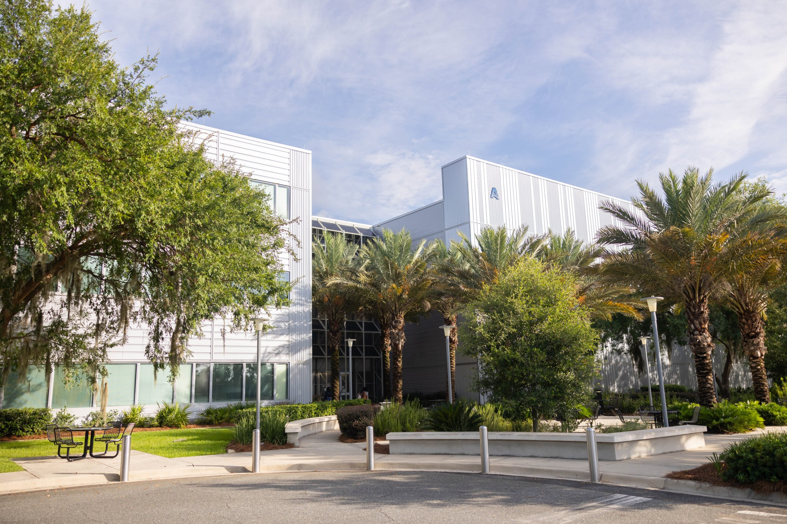
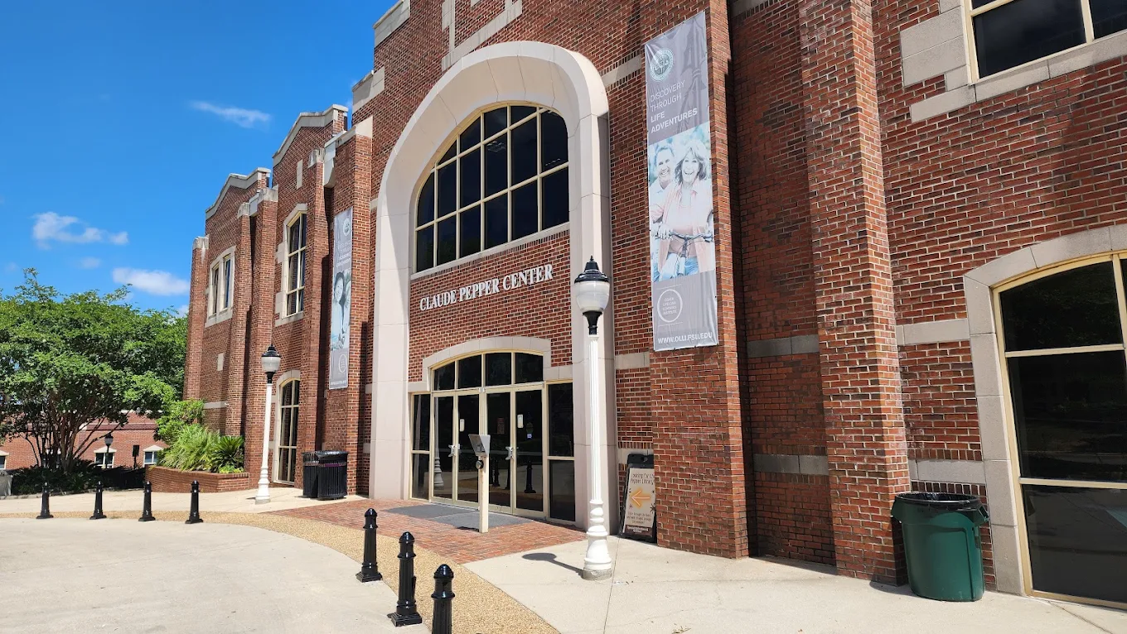
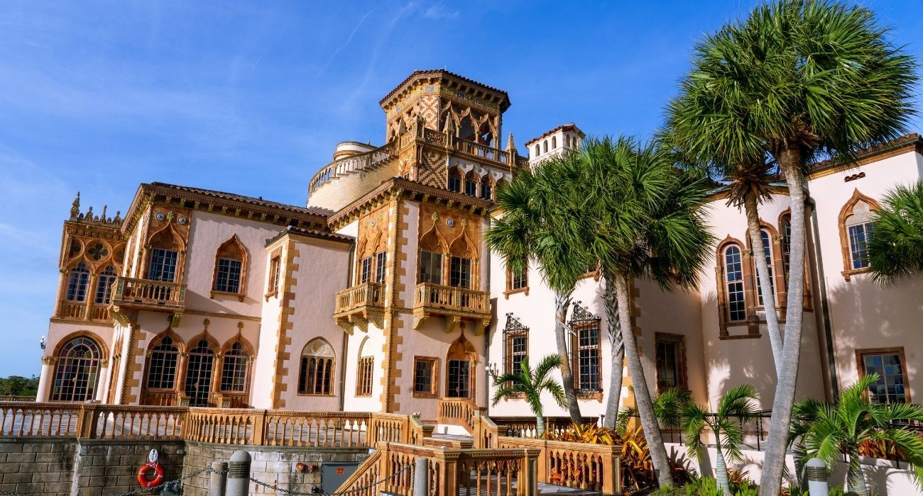
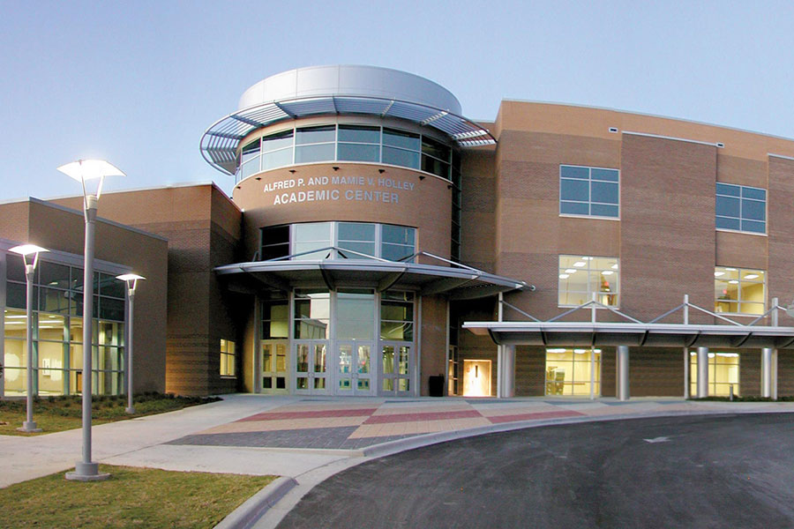
Engineering Library
FAMU-FSU College of Engineering
Claude Pepper Library
Claude Pepper Center
Ringling Art Library
Sarasota, FL
Library and Learning Center
Panama City Campus

Slide 9
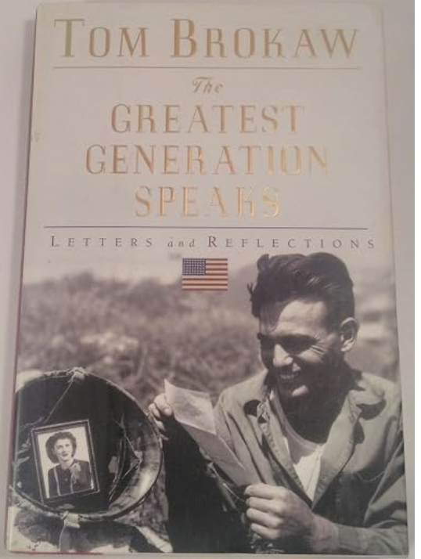
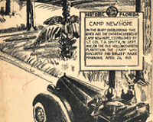

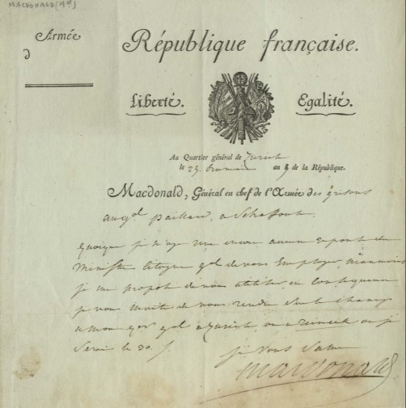
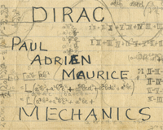
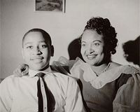
SPECIAL COLLECTIONS & ARCHIVES HAS OVER 800,000 RARE OR UNIQUE ITEMS
The Special Collections Center in Strozier Library
Pepper Library at the Claude Pepper Center
Carothers Memorial Bible Collection
Florida History
& Heritage
World War II
Archives
French Revolution
& Napoleonic Collections
Paul Dirac Collection
Emmett Till Archives

Slide 10
Services for Faculty & Grad Students
Open Access Publishing Fund - Funding to cover publishing costs for eligible open access (OA) journals and books
Florida State Open Publishing - Professional publishing services for journals, monographs, textbooks, and other scholarly and creative works
Digital Humanities Project Support and Partership- Training, consultations, and partnerships to support the development of digital projects in the humanities
AI and Data Lab (OPENS STROZIER FALL 2026)-
A collaborative workspace for teaching and learning AI and data methods across research and practice.

Slide 11
Expertise and Support Across the Research Life Cycle
Planning- Data Management, Literature Review
Collecting- Research, Data Collection
Analyzing- Writing, Analysis
Disseminating- Publish, Share, Measuring Impact
Preserving- Archive, Access

Slide 12
Connect with FSU Libraries
Talk to your students about the visiting the library, asking librarians for help, and using our resources.
Share your research interests with your liaison.
Archive your research in the FSU Research Repository.
Attend special events at the libraries – interdisciplinary seminars, featured speakers and social events.
Join the Faculty Senate Library Committee.

Slide 13
WE WANT TO HEAR FROM YOU!
Questions or suggestions?
Carrie Zebrowsky Cooper
Dean of University Libraries
644-5211 | clcooper@fsu.edu

