Slide 1

New Faculty Orientation Fall 2026
Notes:
Good morning. My name is Beth Hodges, and I am the director of Research Development. On behalf of our entire Office of Research, I extend a warm greeting. You are joining an amazing university with a rich legacy of discovery, creativity, and impact-- and today, you become a vital part of shaping its future.

Slide 2
RES
RESEARCH
RESEARCH
RESEARCH
RESEARCH
RESEARCH
Studious inquiry or examination especially: investigation or experimentation aimed at the discovery and interpretation of facts, revision of accepted theories or laws in the light of new facts, or practical application of such new or revised theories or laws.
Notes:
Research at FSU isn't just about traditional laboratory work—it's a vibrant blend of research, scholarship, and creative endeavors. Whether you're teaching faculty, specialty faculty, or on the tenure track, when we talk about research we are talking about efforts that fuel your passion and drive your curiosity. So let me be clear: this message IS meant for everyone in this room. If you're contributing to knowledge, sparking innovation, or creating meaningful work—you are part of FSU’s research mission. And we in the Office of Research are here to support you.

Slide 3
Welcome to FSU!

Slide 4

ASPIRE.FSU.EDU
5 Strategies to Achieve Our Vision
1. Our People
2. Partnerships and Innovation
3. Supporting Infrastructure
4. Focus on Scholarship and Excellence
5. Impact Areas and Crosscutting Themes
Notes:
I want to share with you that there is a strategic plan for research. Florida State University’s ASPIRE plan (A Strategic Plan to Inspire Research Excellence) was launched in 2023 by the Office of Research under Vice President Stacey Patterson. Developed with broad faculty input and data analysis, it is FSU’s first ever unified roadmap to strengthen research excellence. ASPIRE targets strategic investments in top faculty recruitment, infrastructure, industry partnerships, and interdisciplinary collaboration. Key initiatives include expanding labs, streamlining research support, and launching the IGNITE program to connect research with real-world impact. While this year has brought some interesting challenges, we remain committed to the plan.
To learn more about ASPIRE, please make a note to visit aspire.fsu.edu to read the plan in detail. There are also some handouts at the Research Development table that outlines what has been accomplished in the first year of this plan.

Slide 5
Support throughout the Research Lifecycle
Pre-Pre Award
Research Development
Research Knowledge and Support Hub
Health Connections
Grant Processes
Sponsored Research
FSU Research Foundation
Industry Partnerships
Business & Industry Solutions
Notes:
As you come from different institutions with different names for your offices and units, I have grouped support by areas, which should help you better identify the unit you may need. And, just a reminder, this PPT is available on the Faculty Development and Advancement website and all the areas I am about to talk about have hotlinks within the PPT.
First, there is what I call “PRE” pre-award. That is the space where all the work – the training, the preparation, and the proposal support takes place. This will be the space where you will most likely start. My office, Research Development, is the place where you can get that sort of support. I will go into more of the services we provide in just a minute.
I also want to add there are two other resources in this space. There is a research knowledge and support hub (an online portal) which can help you answer questions and navigate to services and support you need. Also this fall, through the FSU Health initiative, there is a new Health Connections effort that targets services for those involved in the FSU Health space.
(click) Next are the areas that will assist you with pre- and post- award activities. Sponsored Research is here to help you when you are ready to submit your proposals to government entities and for US public funding that is flowed through private organizations. Along with your departmental staff, they will make sure your proposal, including the budget, are aligned with agency requirements. If the funding is private (directly from a non- or for-profit organization) or from a foreign government/entity, you will work with the FSU Research Foundation. Both Sponsored Research and the Research Foundation have a 3-day policy, meaning you must submit your proposal to them three days prior to the agency submission date.
(click)Some of you may want to connect with Industry. Serving as the front door to research partnerships with FSU, the Business & Industry Liaison helps bridge the gap between researchers and the private sector..

Slide 6
Support throughout the Research Lifecycle
Commercialization
Commercialization
Promotion
Research Communications
Federal Relations
Federal Relations
Notes:
Invention Disclosures, IP Questions,, FSU Startups and Patents. About a year ago FSU received a $6M NSF Accelerating Research Translation grant which provides us with the ability to provide additional programs and even funding to help with research translation. Commercialization staff will partner with you to protect and license your intellectual property. Feel free to reach out to them with any questions you may have.
(click)Want to get your research promoted? Or, have you been contacted by the media about your research? In both instances, plan to reach out to Research Communications.
(click)We have someone in Washington who works with us on Federal Relations. Josh Duncan, our Federal Relations Director, works with us to help set our Federal Agenda and Strategies. He can also assist you with Congressional Meetings. Feel free to reach out to him any time.

Slide 7
Support throughout the Research Lifecycle
Compliance
Research Integrity, Security & Ethics
Laboratory Animal Resources
Human Subjects Protection
Connections
Research Development
Health Research Connections
Seed Funding
Council on Research and Creativity Programs
Other Internal Funding Programs
Notes:
Next, Compliance.
RISE: Rise ensures University compliance with federal, state and local regulations related to research. A few of the areas RISE oversees is Research Data Management, Export Control, Foreign Influence, Conflicts of Interest, Research Misconduct, and Compliance Training
We also have Laboratory Animal Resources and Human Subjects Protection. These groups serve to protect the rights and welfare Animals and People, respectively. Both have great groups of people who are there to assist you and help you navigate protocols and requirements.
Connections– Collaborations with other colleagues can be essential for securing external funding. Having collaborators broadens your scope and allows you to have more robust and competitive proposals. Research Development can help you find collaborators. We have events called collaborative collisions that are networking events based on topics- we have at least two annually. Additionally, we facilitate research interest groups, or RIGS. You may join a RIG or suggest a new RIG. Finally, you can just ask us and we can help connect you. Plan to reach out to your research development coordinator for that. You can find information about collaboration efforts both on the RD page as well as the Health Research Connections page.
And finally seed funding. FSU has numerous opportunities to obtain internal funding to help you move your research forward. There is both the CRC programs as well as other internal funding programs, all available from the Research Development page

Slide 8
Upcoming Deadlines for Funding Programs
Seed Grant - September 25, 2025
Equipment & Infrastructure Enhancement Grant (EIEG) - September 25, 2025
First Year Assistant Professor (FYAP) Grant - October 16, 2025
Summer Research Support (SRS) Grant - November 20, 2025
Arts + Humanities Program Enhancement Grant (AHPEG) - December 19, 2025
Small Grant Program (SGP) - Rolling Deadline
internal funding.research.fsu.edu
Notes:
Some upcoming internal funding deadline from the CRC are provided here. Of note is the First Year Assistant Professor grant program, which has a deadline of October 16.

Slide 9
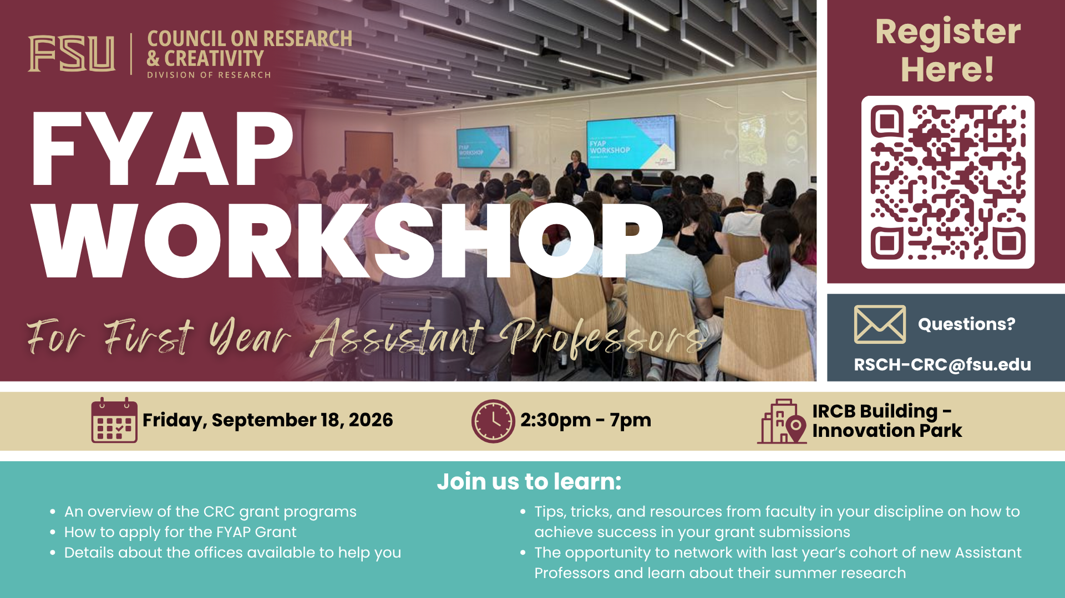

Slide 10

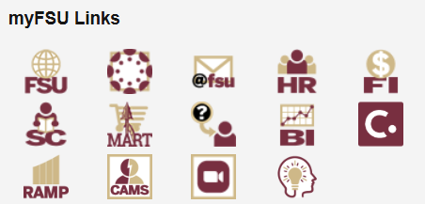
Research Administration Management Portal (RAMP)
my.fsu.edu
ramp.research.fsu.edu
Agreements
Export Control
Grants
Contracts
IACUC (Laboratory Animal Resources)
IRB (Human Subject Protections)
Notes:
RAMP, the Research Administration Management Portal is a centralized online platform designed to streamline and manage various administrative tasks related to research and sponsored projects.
RAMP encompasses several key functions, including:
Grant Proposal Management: RAMP facilitates the routing, review, and submission of grant proposals.
Animal and Human Subjects Research Protocols: It manages protocols for research involving animals (ACUC) and human subjects (IRB).
Contract and Subaward Management: RAMP handles the negotiation of contracts and the management of subawards.
Export Control: It assists with export control compliance related to research activities.
So, when you have down time, please begin looking at RAMP because, if you plan to be engaged in any of those functions I just mentioned, you must use RAMP. Know that there is a help desk for the different areas of RAMP and we also have a RAMP team who is available who can walk you through any issues you might be having. RAMP can be found on the top of your myFSU portal.

Slide 11
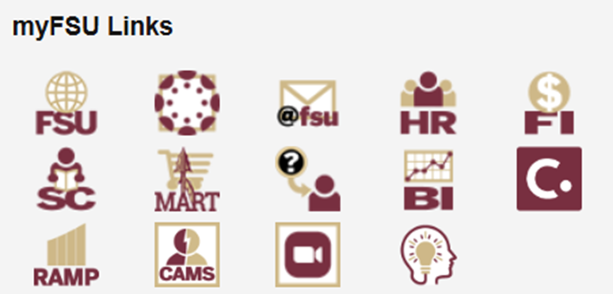

Have an Idea or Invention?
Disclose inventions to Commercialization
Commercialization supports:
  IP Protection - Patents and Copyrights
  Licensing
  Startup Facilitation
  Incubation space
my.fsu.edu
Notes:
Lastly, you need to know that faculty have an obligation to disclose their intellectual property. This can be done through the Sophia, which is a knowledge management system that FSU uses for disclosures. Sophia is a knowledge management system and online portal specifically designed to streamline and facilitate the management of intellectual property (IP) and technology transfer activities. Also, like RAMP, Sophia can be found in your MYFSU portal.

Slide 12
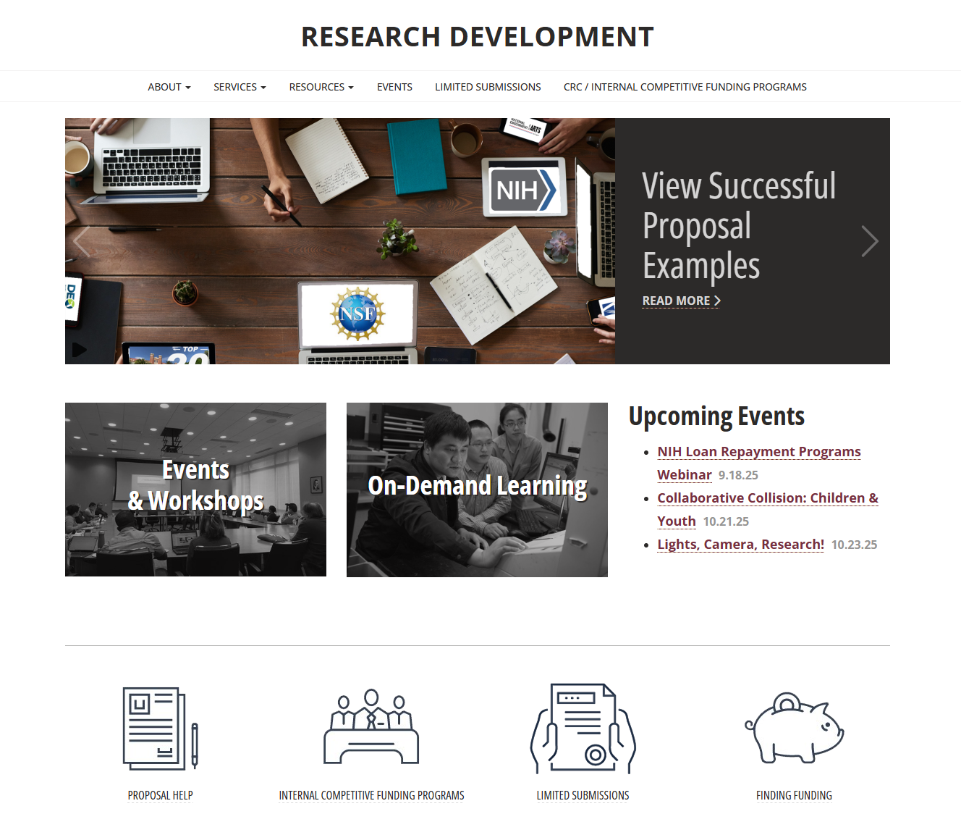
Research Development, Your First Step
rd.research.fsu.edu
Notes:
Finally, one last plug for the services and resources from Research Development. Especially for new faculty, this really is your first step in your research journey. Plan to set aside 30 minutes in the next few weeks to check out the website to learn about the different resources that are available to you.
Wenner-Gren Foundation for Anthropological Research Program Talk
FORGE Mentors - FSU Research Mentor Academy
National Institutes of Health (NIH) Loan Repayment Programs
Data Management Plans Workshop Series
AI for Team Science: Working Smarter, Together
Connecting Globally: Building Faculty Skills with the Fulbright Program

Slide 13
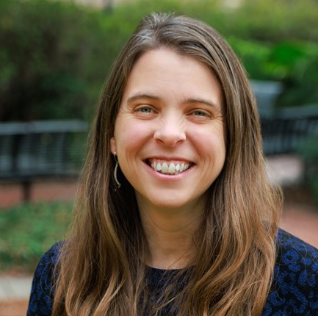
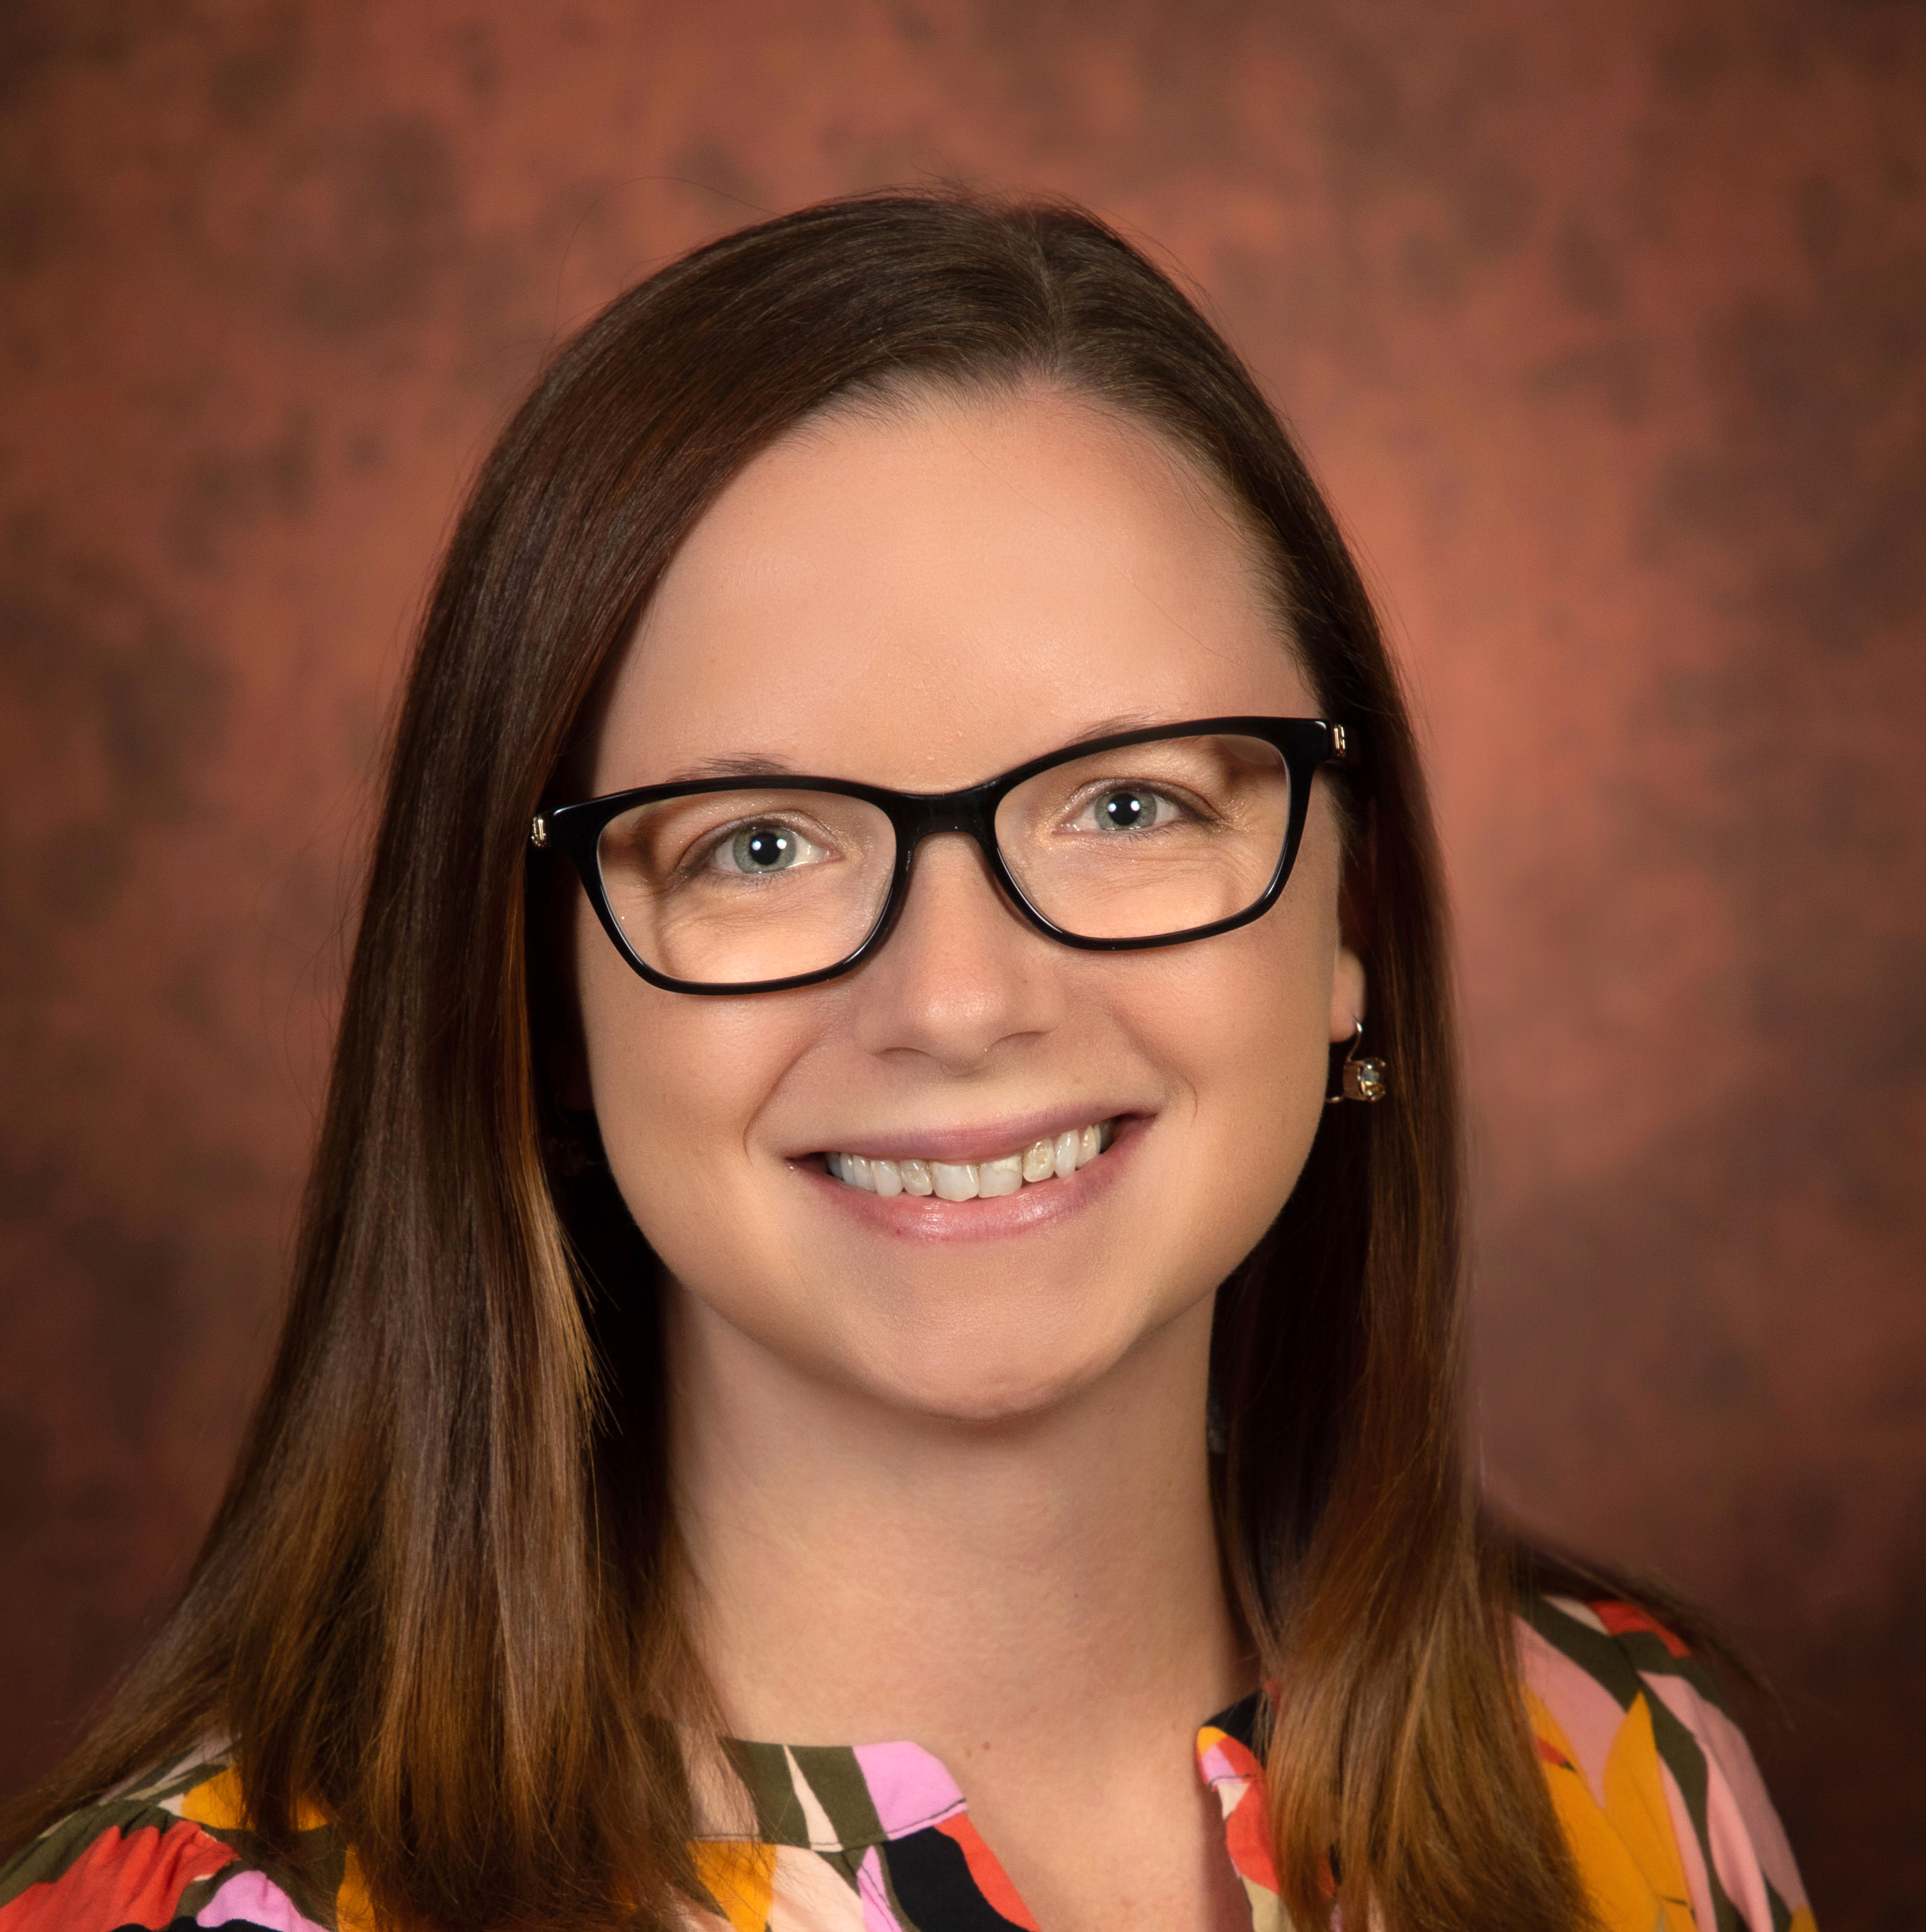
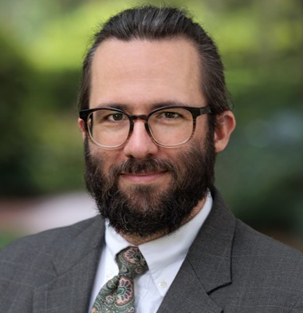
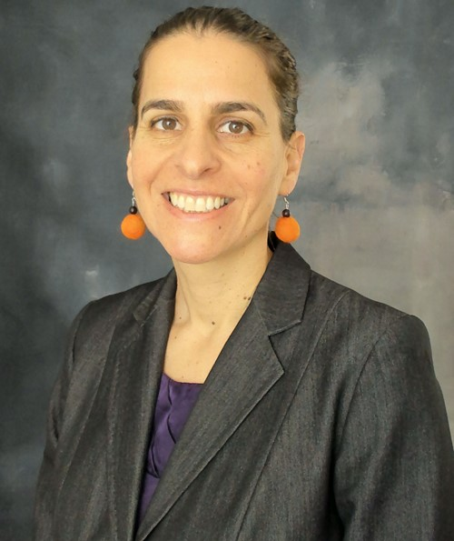

Specialized Research Support
Dr. Carolyn Bradley
Arts & Humanities
Dr. Nicole Viverito
Health & Life Sciences
Dr. W. Jared Parmer
Social Sciences
TBD
Science & Technology
Dr. Livia Navon
Strategic Research
Notes:
And lastly, let me introduce you to your contacts in Research Development. As you can see, their efforts are divided by discipline area. You can reach out to them any time- and if you see them here today, please introduce yourselves. They are all amazing proposal editors, experienced knowledge gatherers and disseminators, and overall wonderful folks who want to see you succeed.

Slide 14
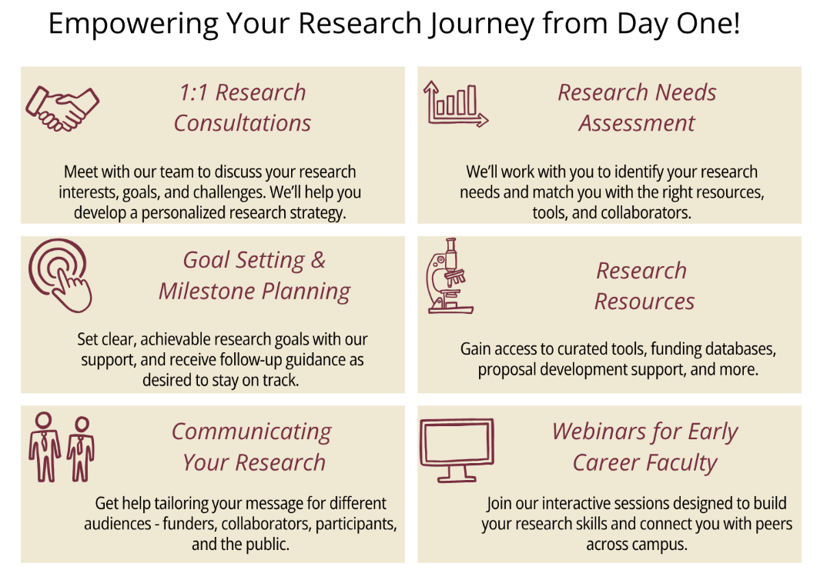
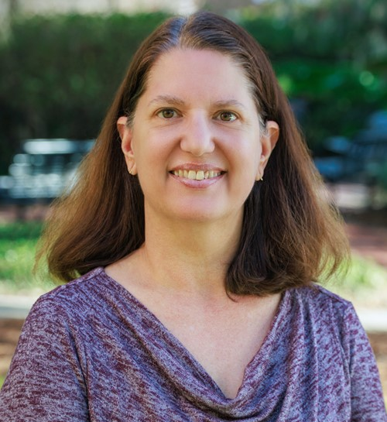
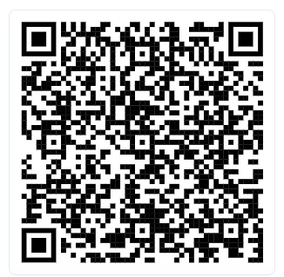
Schedule your 1:1 Meeting Today!
Dr. Crystal Ladwig
Notes:
Additionally, plan to schedule some time with Dr. Crystal Ladwig. This will give you time to discuss your goals so that we can help guide you to the resources you may need now. Her scheduling QR code is here and also available at our table.

Slide 15

October 17-24
Student Poster Sessions
Lighting Talks
Collaborative Collision: The Future of Intelligence
Carothers Lecture
Compliance Training
Communicating your Impact!
Research Open House
President’s Showcase of Undergraduate Research
Discovery Challenge
Saturday Morning Physics
Team Science Training
Kaleidoscope: Innovation in the Arts & Humanities
And more!
discoverydays.fsu.edu
Notes:
Mark your calendar for Discovery Days. This will be our third year of celebrating research and creativity at FSU in a weeklong format, and this year there are many great lectures, events and workshops that you won’t want to miss. Visit discoverydays.fsu.edu for more information

Slide 16
Thank you.
Stacey@fsu.edu
Notes:
Lastly, here is my email address. Feel free to reach out to me any time.

