Slide 1
Internal Awards
Jeanette Taylor
Vice President for Faculty Development and Advancement
August 17, 2026
New Faculty Orientation

Slide 2
Recognizing Excellent Faculty
Faculty awards for excellence in research and teaching
Multiple major offices sponsor internal faculty award programs (Provost, President, Research)
Some departments and colleges may also have internal awards

Slide 3
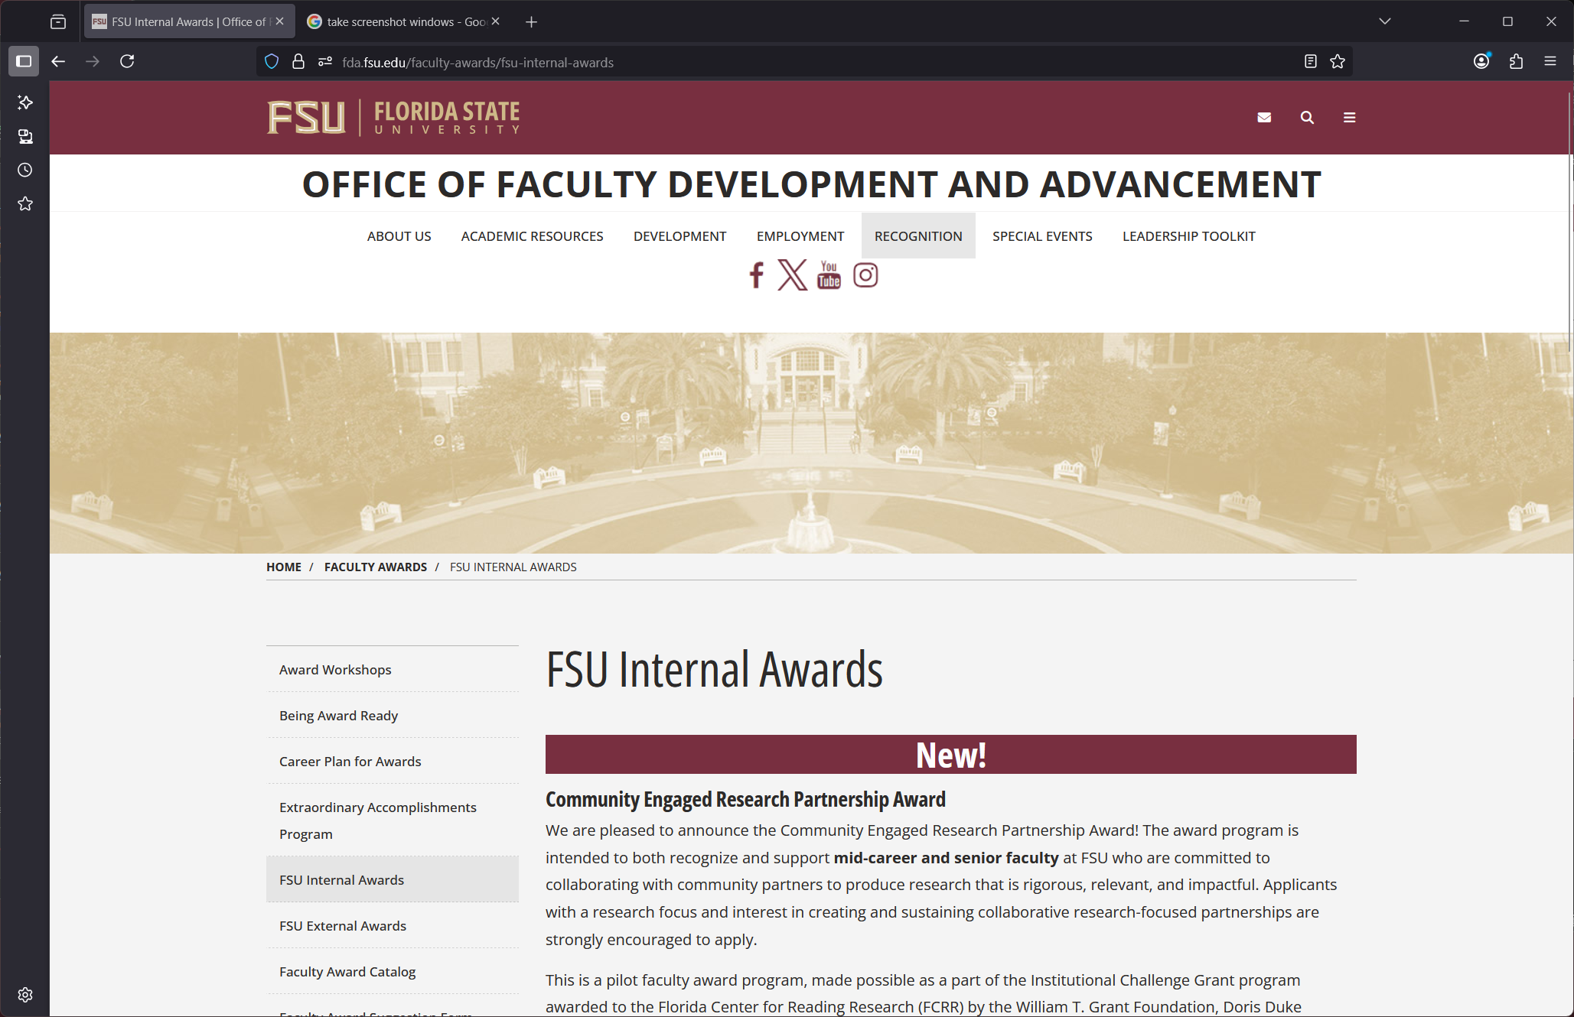
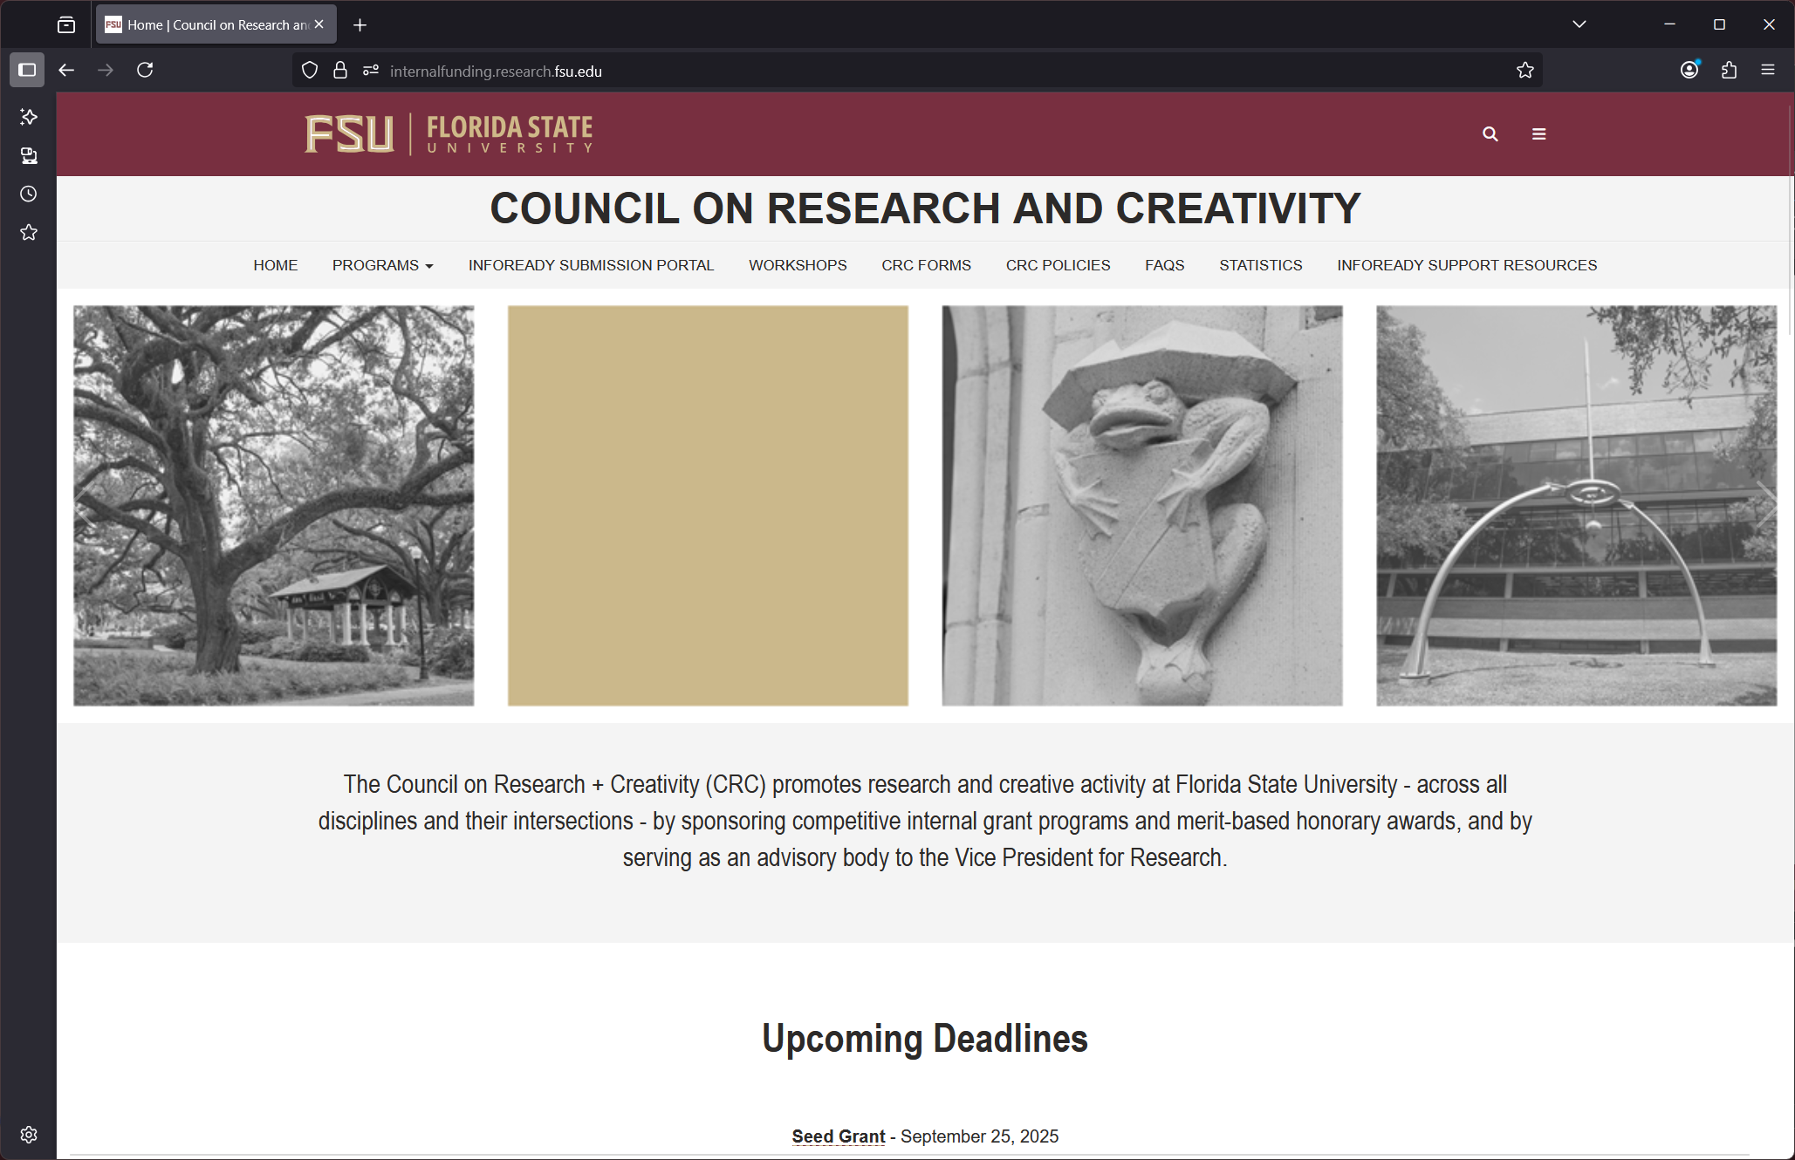
Notes:
At the OFDA website, select Recognition from the menu and then Awards and then FSU Internal Awards to find information about various internal awards.
At the Office of Research site, select the CRC / Internal Funding from the Quick Links menu

Slide 4
Teaching and Mentoring Awards
Awards for graduate and undergraduate mentoring
Classroom teaching is recognized with multiple awards, including:
  Foundational Course Excellence
  Undergraduate Teaching
  Graduate Teaching
  Innovation in Teaching
  Online Teaching
Notes:
There are a dozen distinct awards related to teaching or mentoring – some awards have multiple recipients
Full-time faculty are eligible regardless of faculty track or rank

Slide 5
Research Awards
FSU Council on Research and Creativity (CRC)
Early/mid career and distinguished career awards
Awards for specialized and tenured faculty
Notes:
Research and creativity awards for tenured and specialized faculty

Slide 6
Robert O. Lawton Professor
Highest award bestowed on a faculty member at FSU
Tenured professor with 10+ years at FSU
Selection committee comprised of faculty, including some existing Lawton Professors

Slide 7
Be Recognized!
FSU culture of recognition starts with you
Watch for opportunities to recognize your colleagues
Take a little time to nominate someone (“pay it forward”)
Discuss possible awards that you qualify for with your supervisor during annual evaluation

