Slide 1
Faculty Development at FSU
A career-long initiative

Slide 2
ESSENTIALS OF FACULTY DEVELOPMENT
Building a Career Plan
Managing Time
Engaging Communities
Notes:
If you Google this title, as I did, AI will tell list these as essentials: maximizing high-level research productivity, securing extramural funding, managing complex lab or project teams, and translating research visions into tenure while balancing baseline teaching and institutional service expectations. And they are. To a degree. But at this R1, we still do relational work. You will meet people here who are still a little surprised they spent 40 years here. People stay because they could build the careers they want and they can build those careers because they find ways to engage in relational work – relational work between ideas, colleagues, whole disciplines, institutions, and cultures. Much of my job and the programming we have built here at FSU will help you make the best use of the relational nature of your research, professional expertise, teaching, and service.

Slide 3
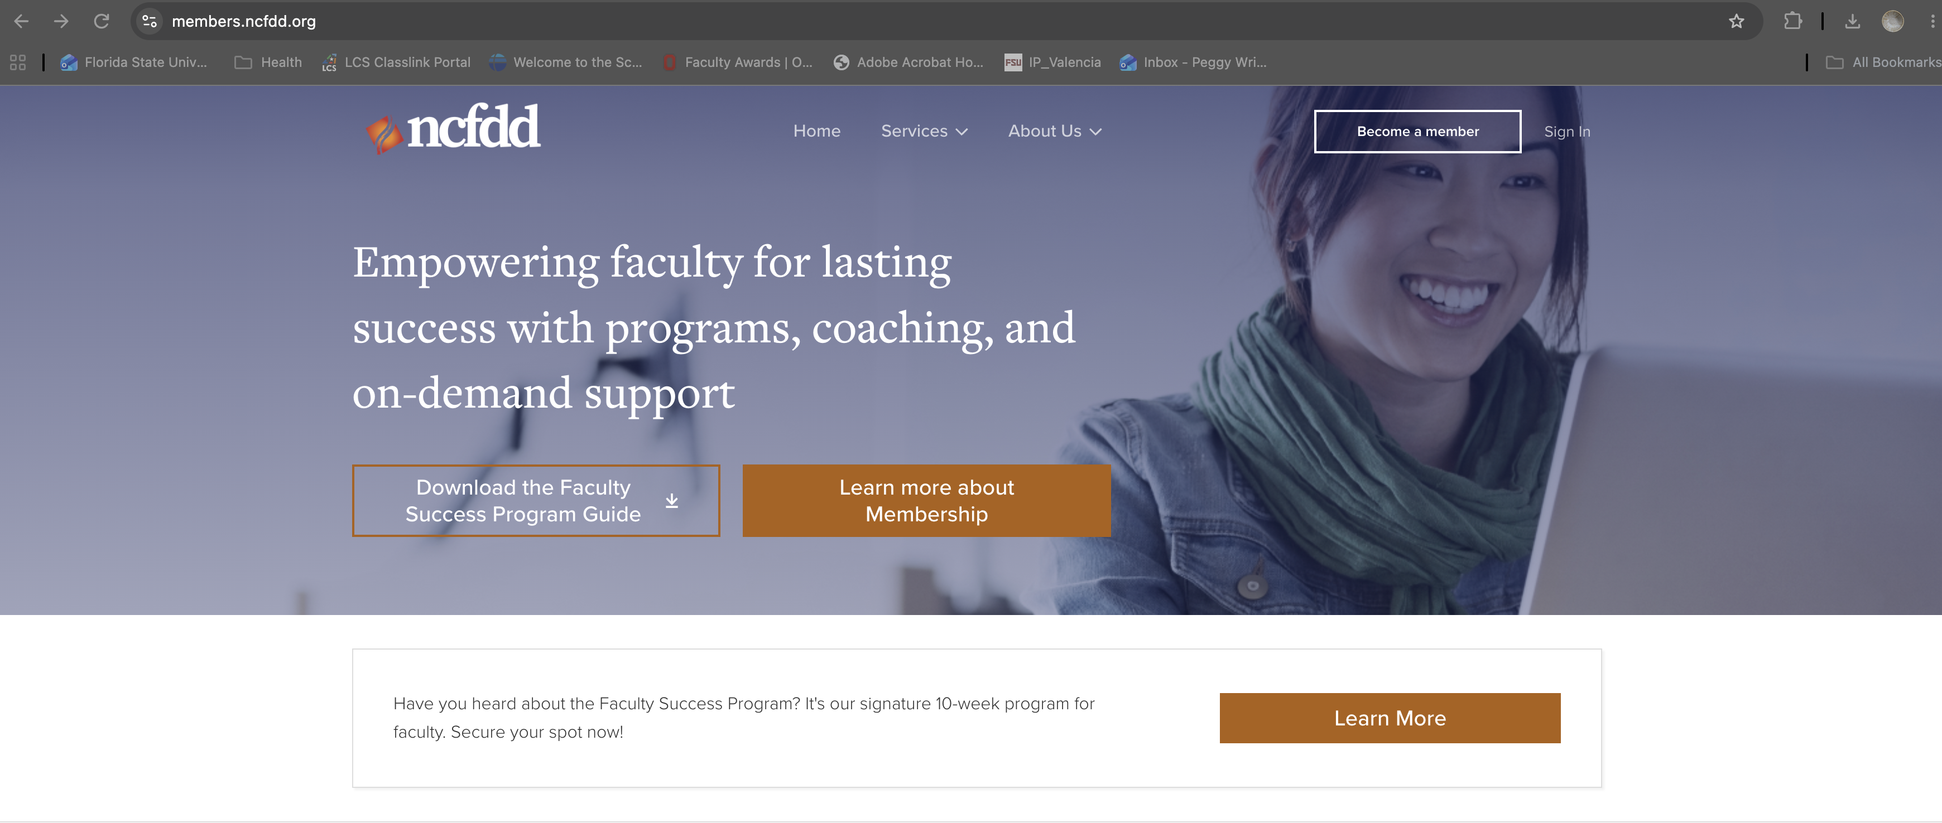
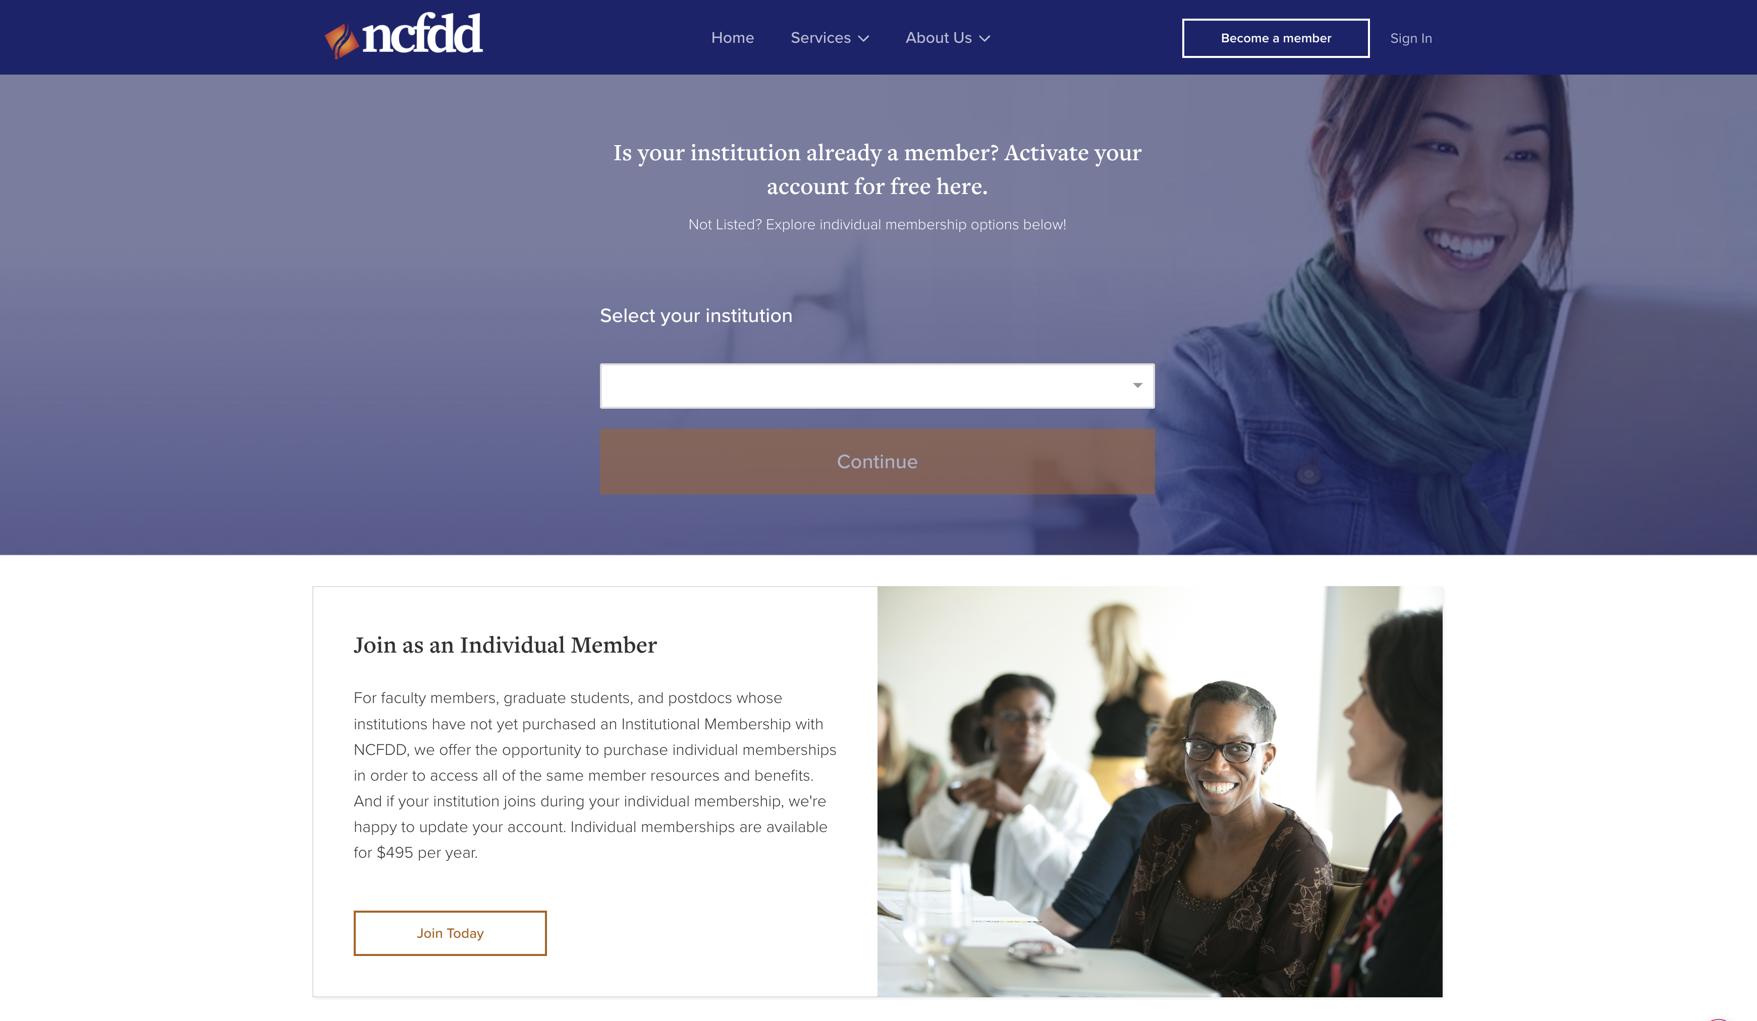
members.ncfdd.org
Notes:
Click on Become a Member; select FSU; use FSU login information

Slide 4
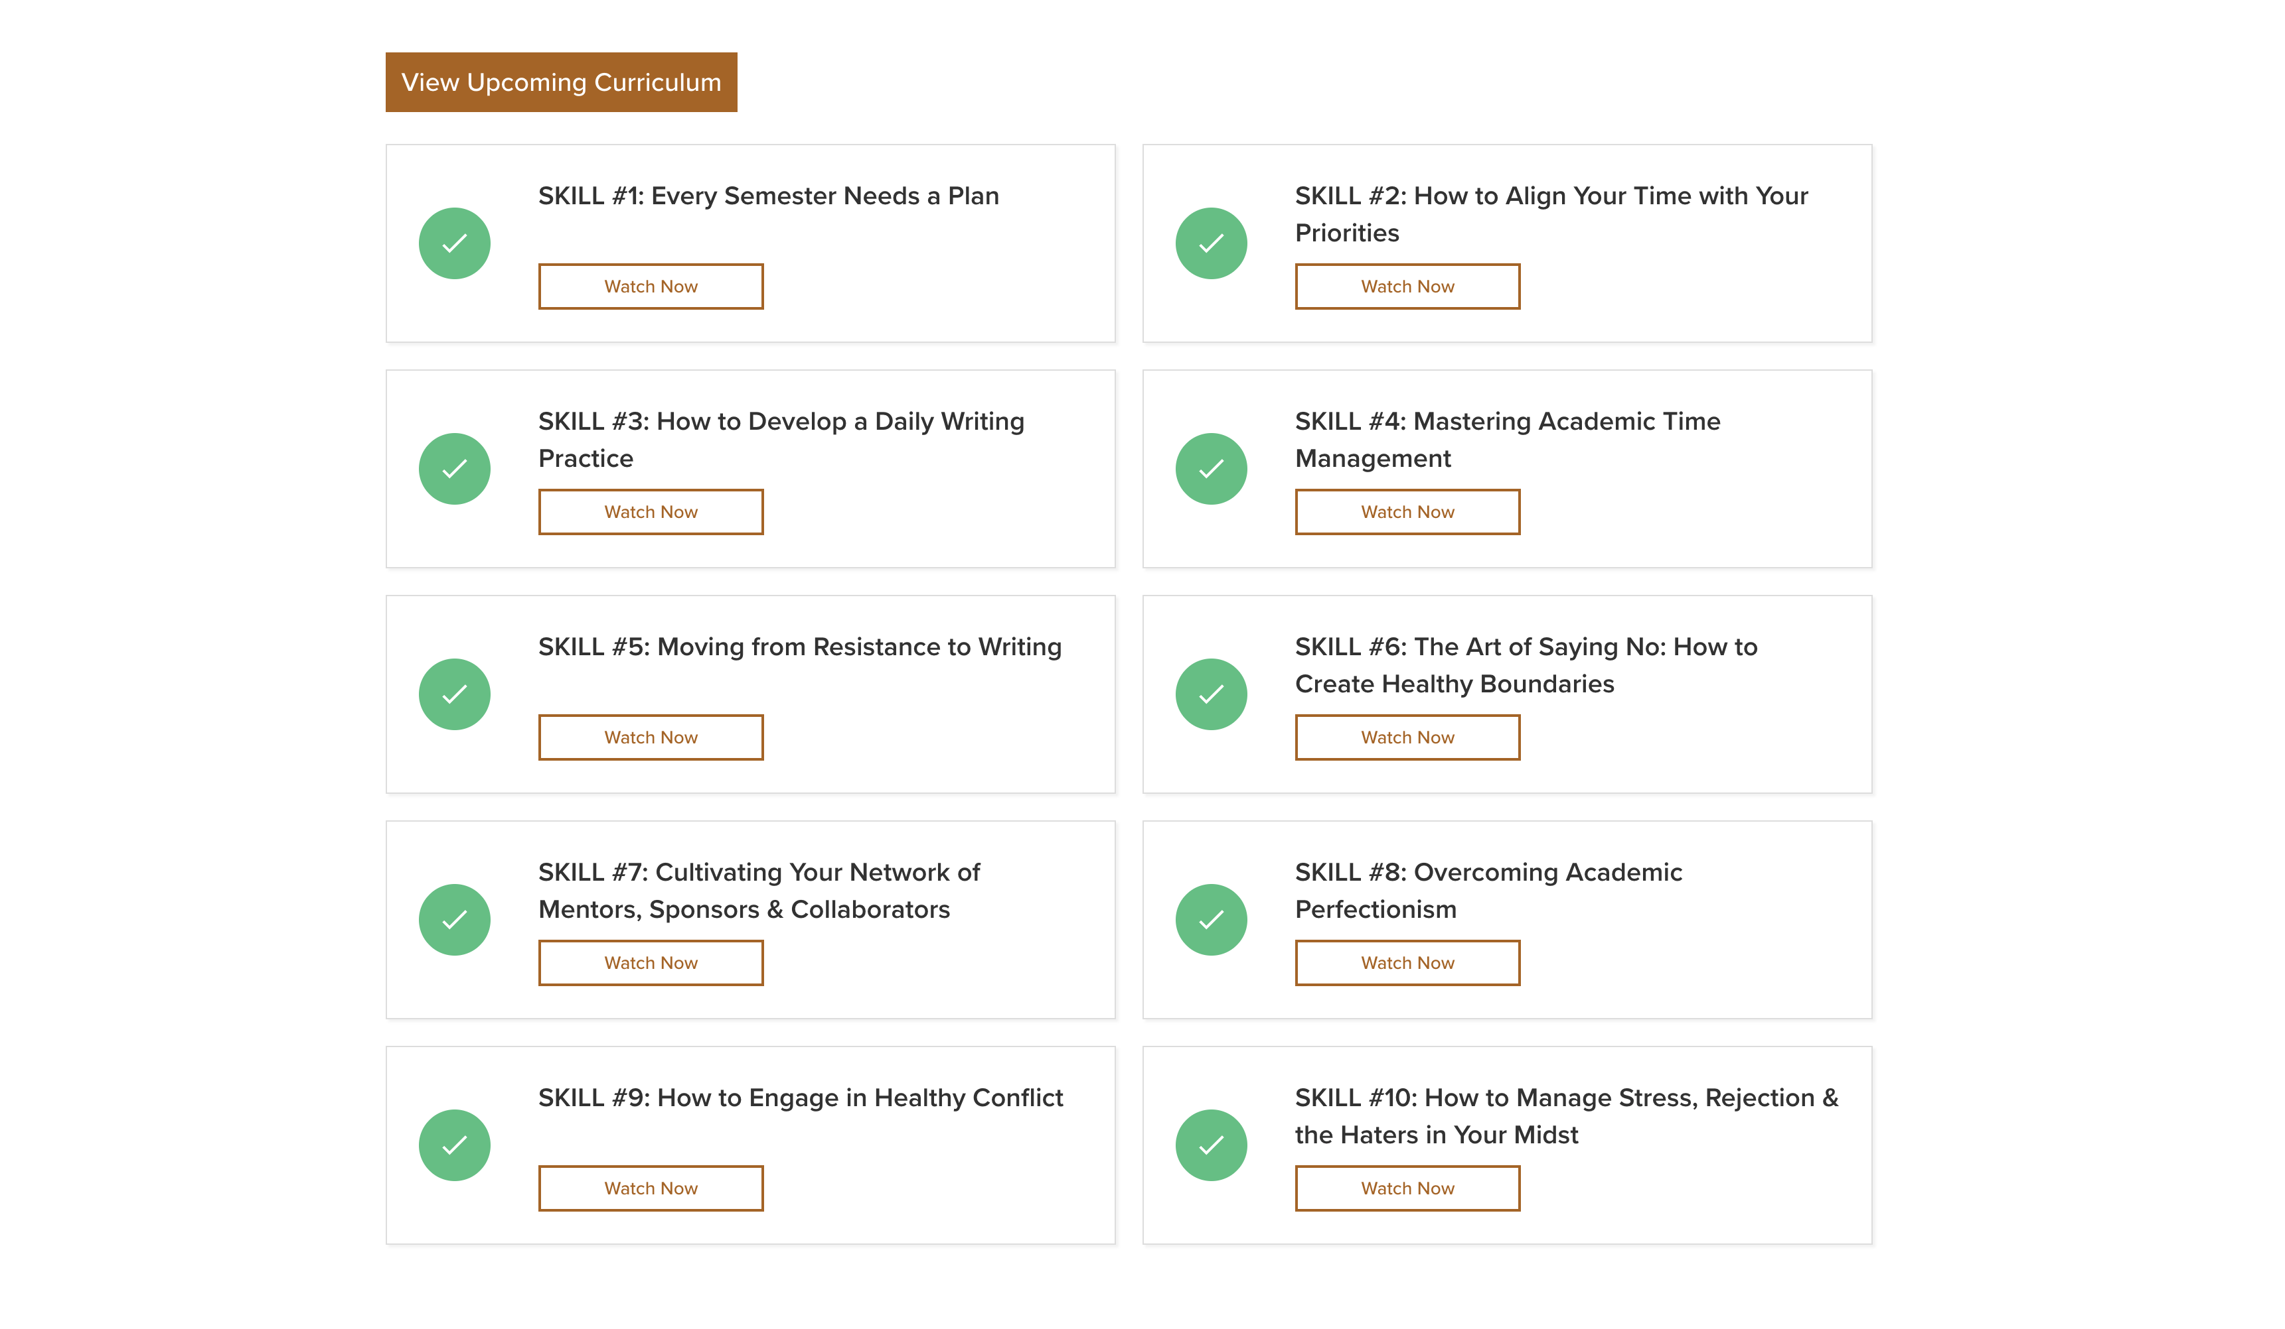
ncfdd.org

Slide 5
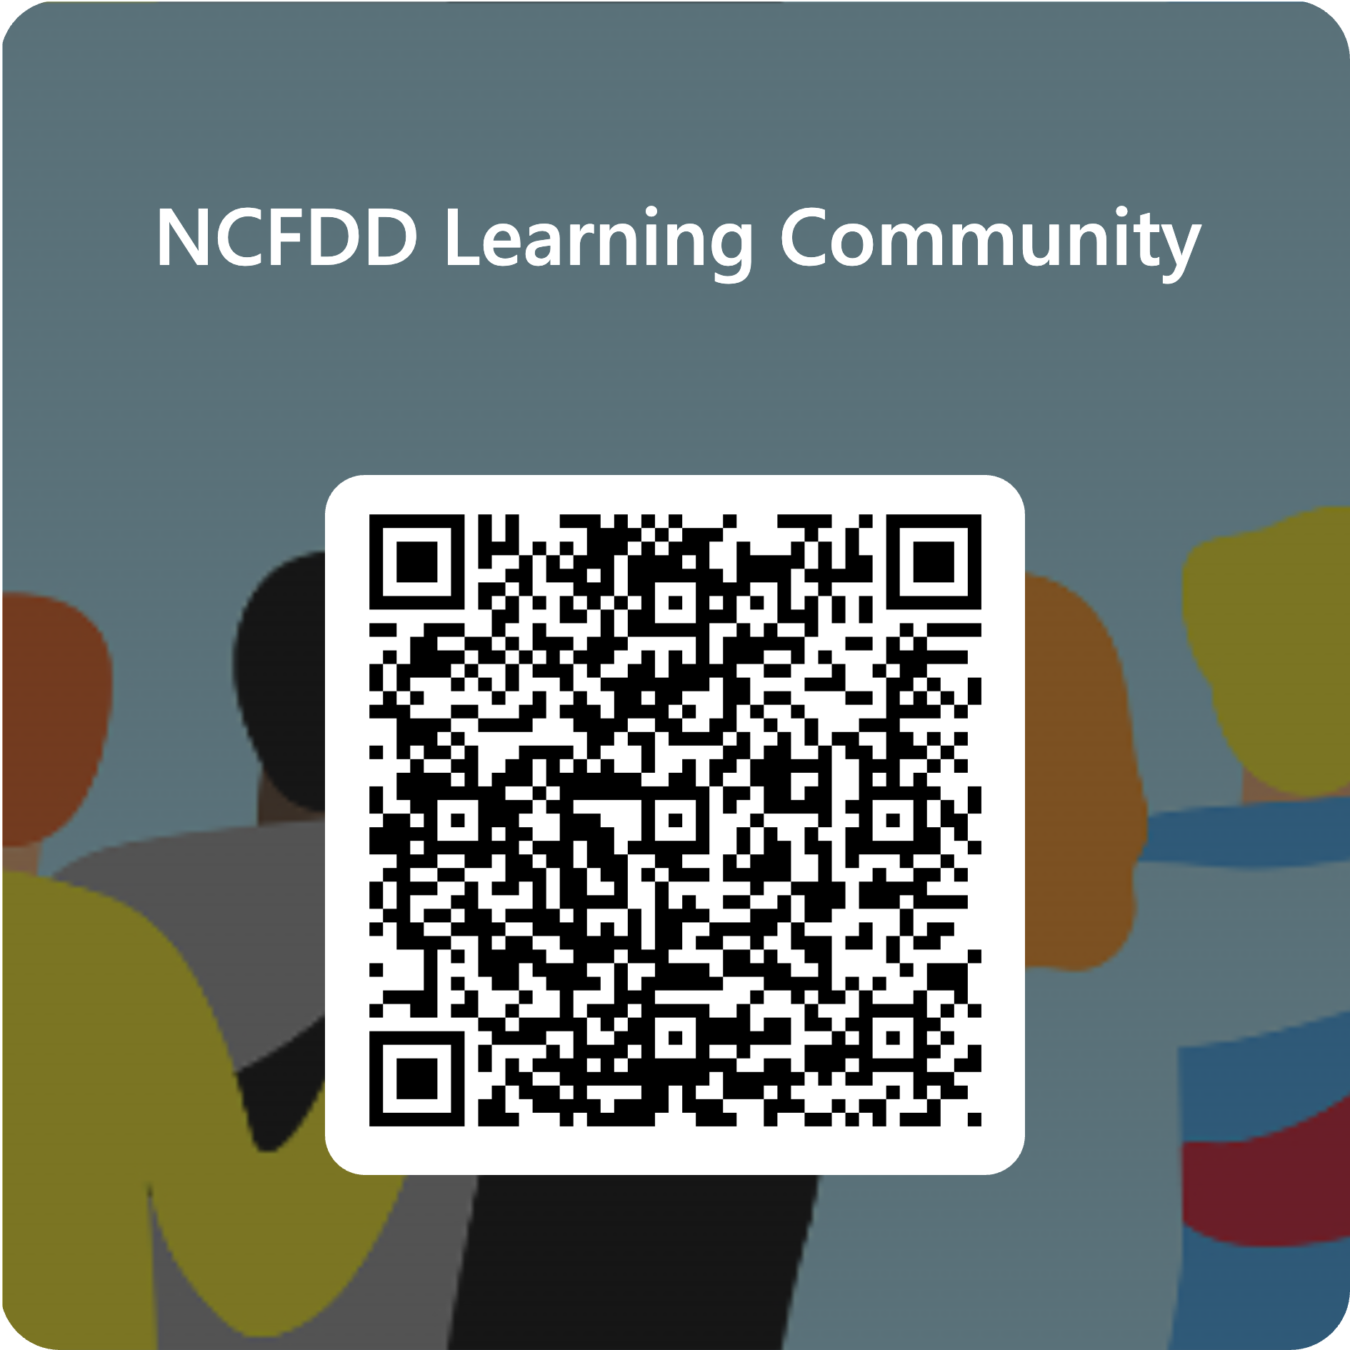
NCFDD Learning Community
Notes:
And now we have moved into managing your time…

Slide 6
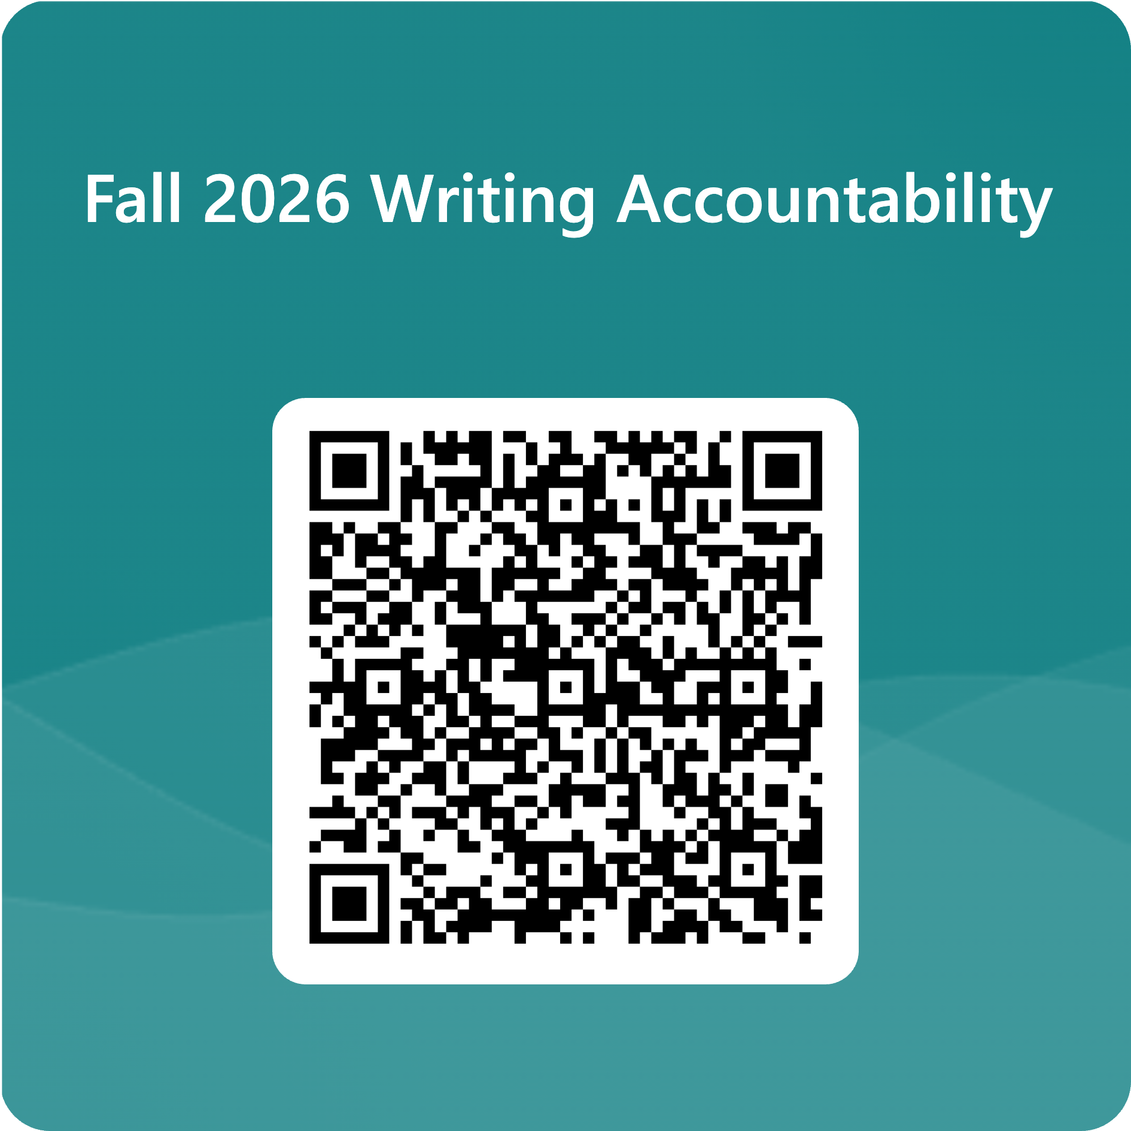
Notes:
If you schedule it, you do it and you tell others you are doing it. MTWRF 7:00 AM – 11:00 AM

Slide 7
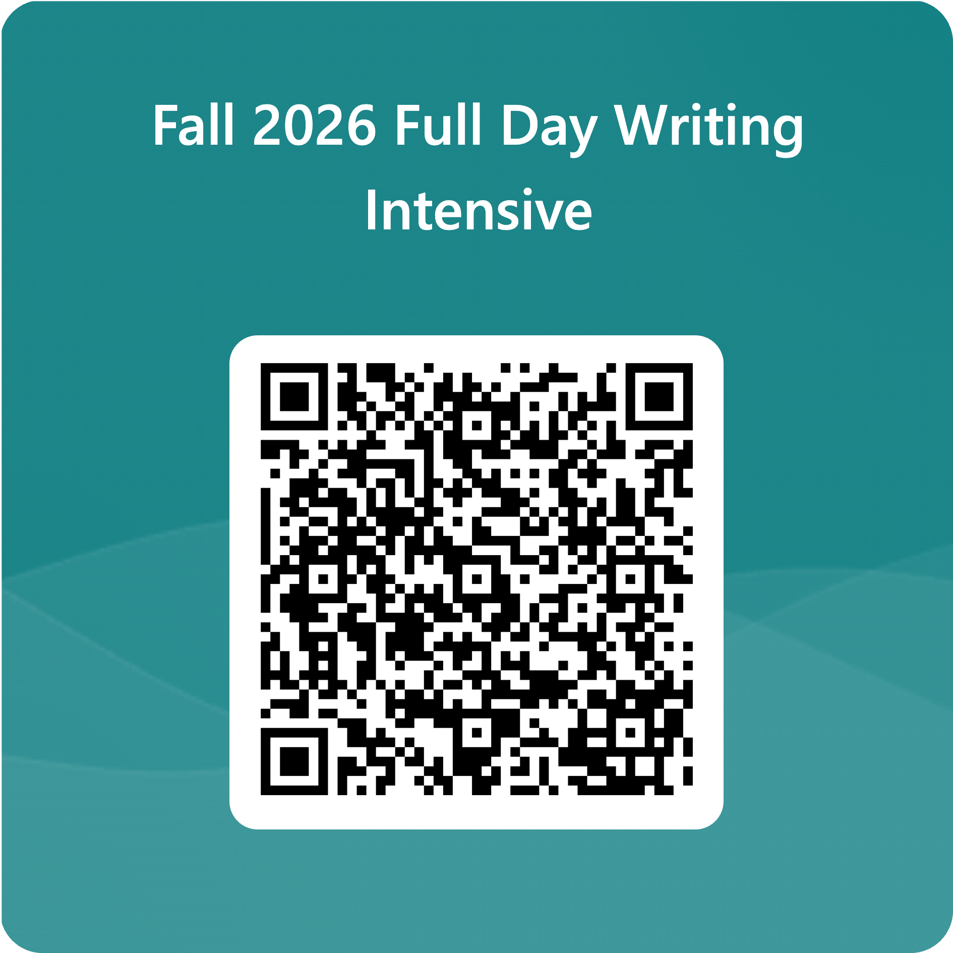
Notes:
Veterans Day, 8:00 – 4:00.

Slide 8
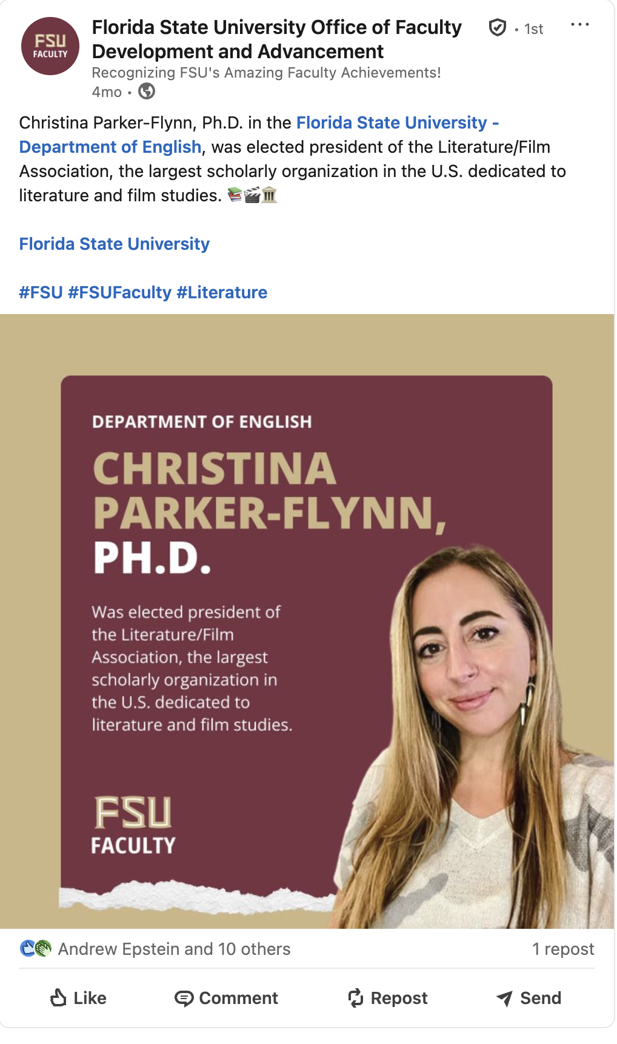
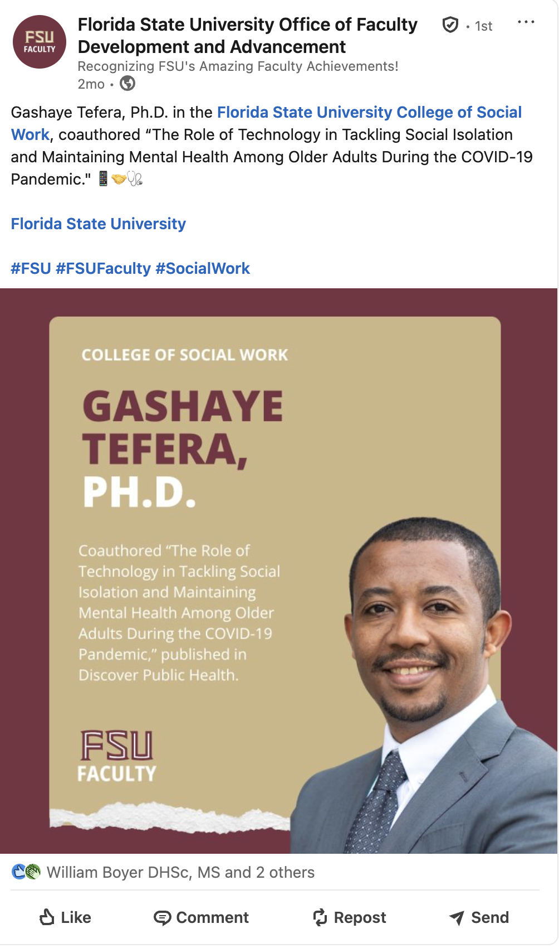
Notes:
Use some of your time to share your work, learn about others work, and build community.

Slide 9
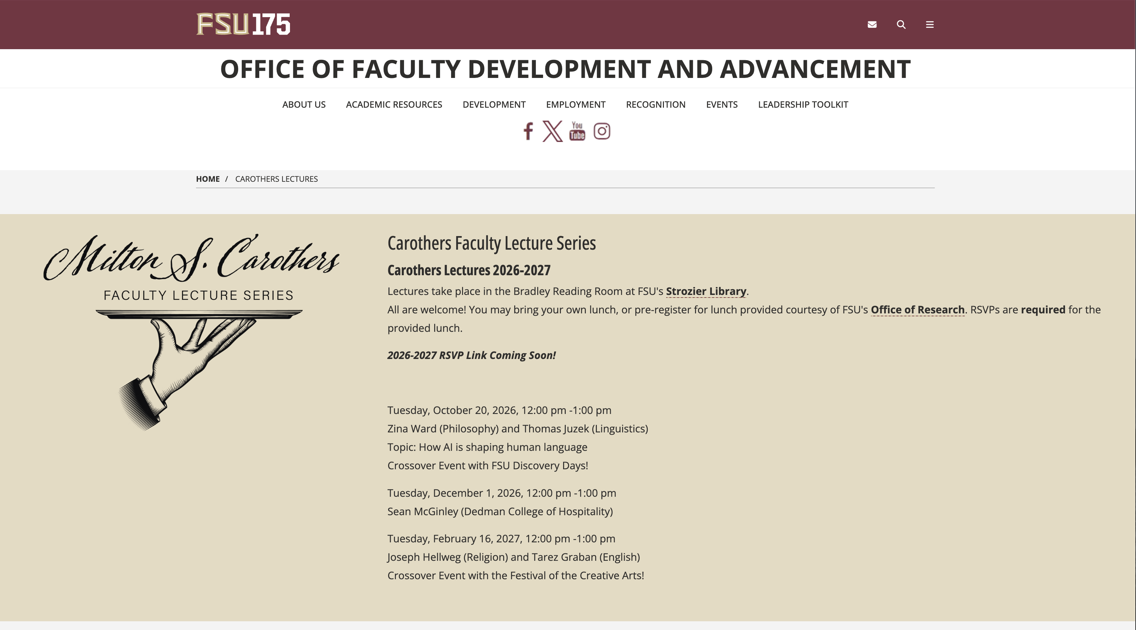

Slide 10
awards.faculty.fsu.edu
Notes:
One way to engage a broader community is to be involved in an awards culture. Promote awards. Nominate your peers for awards. Plan points in your career when you will pursue awards.

Slide 11
All Awards are Important
Internal awards
Book awards
Journal article awards
Teaching awards
Professional organization awards
Be intentional. Awards fit throughout your career.
Notes:
Peggy: All awards are important
Sonja: Internal awards. This is a great place to start. Story about external award review panels – if their colleagues don’t recognize them, why would we?
Peggy: Book and Journal and teaching
Sonja: Career path – be strategic - think about where you want to go in terms of awards, pay attention to eligibility requirements (age or career stage requirements, membership in society, service to society, what are pathways/ladder, build connections inside discipline but outside of FSU, and “do unto others” –sponsorships - nominate others both here at FSU and beyond, when deserved. Peggy and I can help coordinate but subject mater expertise – your department/peers – need to advocate for you. Builds up your experience with what nominations require and a cohort of folks who will in turn nominate you. AAAS Honorary Fellow is a good example of something to plan for…

Slide 12
All Recognition is Important
Editor of top journal
Leadership position in professional organization
Keynote speaker
Guest lecturer
Service on national and international committees

Slide 13
Resources
Peer and administrative mentors
Departmental Award Committees
FEAS
Academic Analytics
Faculty Award Catalog
ORCID
Peggy and Sonja
Notes:
Peggy: peers
Sonja: FEAS – both for your record and to help others
Sonja: Academic Analytics – powerful tool with limits. Suggested awards, pathways, collaborators with relevant awards
Peggy: FAC
Sonja: Department award committees and ORCID integration
Peggy: consultation and review,

Slide 14
Facilitation
Individual consultation
Strategizing with departments
Workshops for broadly applicable awards
Accessing other opportunities for recognition
Notes:
Sonja: Individual consulation and Strategizing with departments
Peggy: Workshops
Peggy: accessing other opportunities – law, dance, discipline and subject-matter specific

Slide 15
Stay in touch
Peggy Wright-Cleveland
Faculty Development
mwrightc@fsu.edu
Sonja Carter
Strategy and Recognition
sacarter@fsu.edu
FacultyRecognition@fsu.edu

