Slide 1
New Faculty Orientation
Kyle Clark
Senior Vice President for Finance & Administration
August 17, 2026

Slide 2
Finance and administration division

Slide 3
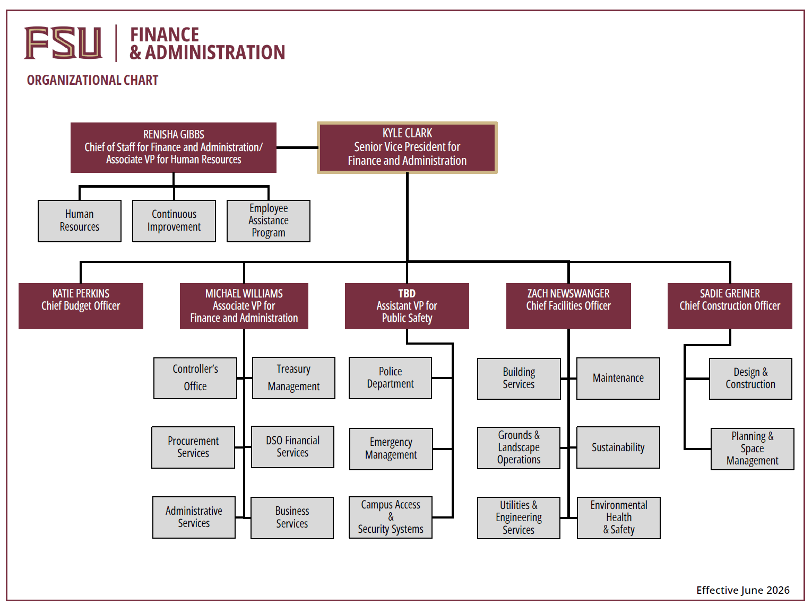

Slide 4
Fund Definitions

Slide 5
Education & General (E&G)
Appropriated by the State Legislature
  General Revenue (primarily Florida’s sales tax)
  Tuition & Fees
  Lottery
Spending must result in a direct, specific benefit to the University
Tuition Differential must be spent to enhance undergraduate education

Slide 6
Designated
Non-E&G
Collected or set aside for a specific purpose, including funds administered by central offices or administrative departments
Student Activities
  Primarily Activity and Service (A&S) fee revenues
  A&S fee spending should benefit the student body
Technology Fee – Spending should enhance instructional technology resources
Vending – Spending must result in a general benefit to the University

Slide 7
Auxiliary
Non-E&G
Primarily sales to University departments, students, faculty, staff, and others
Includes some student fees, for example:
  Health
  Transportation Access
  Student Affairs Facility Use
  Market Rate Distance Learning
Spending from an auxiliary should be consistent with its mission/purpose

Slide 8
Restricted
Non-E&G
Finance activity related to sponsored research
Includes the University’s developmental research schools
Spending must
  Comply with all university and agency requirements
  Follow the terms of the contract/grant

Slide 9
Capital Projects
Non-E&G
To track the financial resources used to acquire, construct, or renovate a major capital asset
Funds appropriated by the State Legislature for capital projects, along with funds transferred from within the university and from component units for capital projects

Slide 10
Component Units
Non-E&G
Direct Support Organizations (DSO)
Legally separate not-for-profit corporations that operate exclusively to provide the university with supplemental resources
Includes Seminole Boosters, International Programs Association, Foundation, Research Foundation, Medical Practice Plan, and others

Slide 11
FY 2026-2027 Operating Budget

Slide 12
2026-2027 Total Operating Budget Summary
 | Approved 2025-2026 | Amended 2025-2026 | Proposed 2026-2027
Education & General – State Support | $915,142,065 | $1,014,635,024 | $1,000,515,404
Education & General – Tuition & Fees | 253,774,064 | 257,977,379 | 279,114,541
Designated | 86,012,372 | 92,291,982 | 110,596,344
Auxiliary | 505,566,530 | 505,566,530 | 601,378,402
Restricted | 547,748,153 | 547,748,153 | 586,062,611
Debt Service | 24,976,271 | 24,976,271 | 36,147,469
Capital Projects | 485,637,264 | 486,423,573 | 454,642,421
Component Units | 148,579,653 | 148,579,653 | 163,655,976
Total | $2,967,436,372 | $3,078,198,565 | $3,216,849,532

Slide 13
2026-2027 Total Operating Budget Summary
Total E&G
39.3%

Slide 14
Total Budget Highlights
Operating budget of $3,216,849,532
  Net of internal sales
  Excludes cash transfers within the university
Overall total increase of 4.5% from the
2025-2026 Amended Budget

Slide 15
Restricted Budget Income by Source
Revenue Type | Amount
Federal Grants | $263,398,975
State Grants | $192,681,941
Other Grants & Donations | $101,909,862
Interest Earnings | $8,774,001
Sales of Goods & Services | $2,421,251
City & County Grants | $1,018,883
All Others | $11,493,527

Slide 16
Capital Projects
Project | Amount
NW Community - Housing, Dining, and Parking | $112,000,000
Engineering Building C | $60,000,000
Academic Health Center - Tallahassee | $55,000,000
Kellogg Remodel | $20,000,000
Veterans Legacy Complex | $15,000,000
Football Operations Facility | $13,148,688
Dittmer Remodel | $10,000,000
Rovetta Remodel | $10,000,000
220 Consolidated Projects Under $10M | $159,493,733
Total | $454,642,421

Slide 17
Component Units
Component Unit | Amount
Seminole Boosters, Inc. (includes FSU Financial Assistance, Inc) | $88,717,260
FSU International Programs Association, Inc. | $29,797,744
Florida Medical Practice Plan, Inc. | $26,707,440
FSU Foundation, Inc. | $21,146,719
FSU Athletics Association, Inc. | $19,005,000
FSU Research Foundation, Inc. | $10,642,500
John and Mable Ringling Museum of Art, Inc. | $3,712,355
FSU Alumni Association, Inc. | $2,120,486
FSU College of Business Student Investment Fund, Inc. | $100,000
*
*
*The 2026-2027 budget has not yet been approved by the component unit’s Board.

Slide 18
Total Wages and Benefits by Fund Group
Fund Group | Amount
E&G | $767,379,114
Auxiliary | $218,769,843
Restricted | $151,797,149
Designated | $28,853,011
Total | $1,166,799,117

Slide 19
Total Budget - Top Spending Categories
Before reduction for internal sales
Spending Category | Amount
Wages & Benefits | $1,166,799,117
Capital Projects | $454,642,421
Financial Aid | $387,386,846
Grad Assistant, Post Doc, Student Employment & Other OPS | $193,654,550
Professional Services | $191,855,863
Equipment & Supplies | $99,769,998
Utilities | $93,363,752
Capitalized Equipment (>$10k) | $86,839,728
Resale of Goods/Services | $76,459,950
Repair/Maintenance of Facilities & Equipment | $70,646,448

Slide 20
FSU’s Operating Budget is Larger than an
Estimated 96 Countries & Territories
Source: Budgeted Expenditures, The World Factbook, CIA.gov

Slide 21
efficiencies

Slide 22

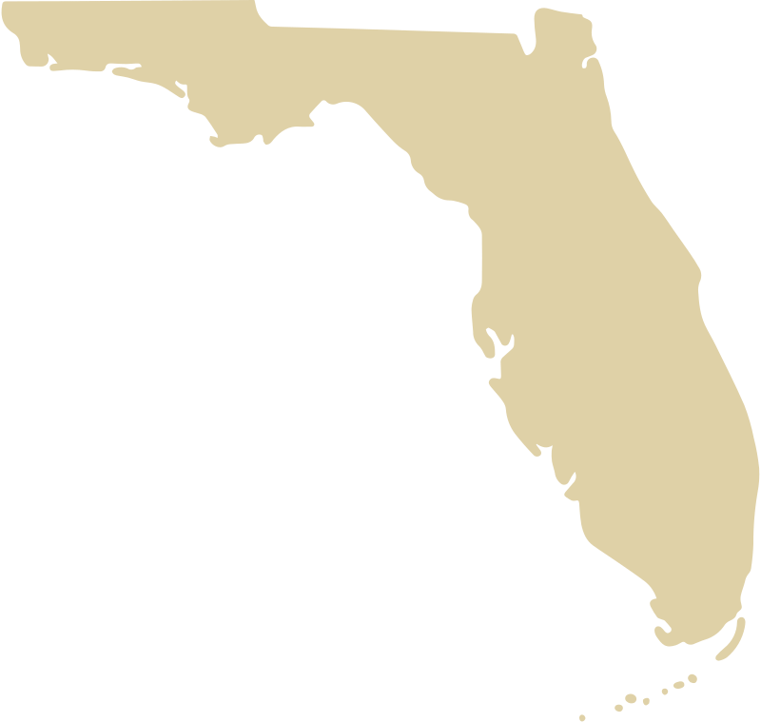
Efficiencies
50% lower administrative costs per student than the average national top tier research university
60% lower administrative costs than the State University System average

Slide 23
Efficiency Ranking
Efficiency Rank | University | Efficiency Ratio
1 | Florida State University | 425.9
2 | University of Georgia | 456.0
3 | University of Illinois Urbana-Champaign | 482.8
4 | University of California, Santa Barbara | 491.1
5 | Virginia Tech | 494.2
6 | Georgia Institute of Technology | 506.7
7 | Purdue University--Main Campus | 520.0
8 | William & Mary | 571.9
9 | University of California, Merced | 608.9
10 | The Ohio State University | 646.4
11 | Texas A&M University | 647.4
12 | Rutgers University--New Brunswick | 692.4
13 | University of California, Berkeley | 697.6
14 | University of Maryland, College Park | 703.6
15 | University of California, Irvine | 725.2
16 | The University of Texas--Austin | 751.7
17 | University of Michigan--Ann Arbor | 801.0
18 | University of Florida | 806.8
19 | University of Virginia | 822.7
20 | University of Wisconsin--Madison | 853.2
FSU ranked #1 on the list of Most Efficient Top 20 Public Universities
Based on U.S. News calculation - Expenditures per student relative to school performance ranking

Slide 24
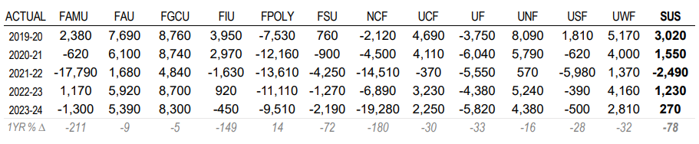
SUS Average Cost to Student
Net Tuition & Fees per 120 Credit Hours for Resident Undergraduate Students
Notes:
,

Slide 25
Public Safety

Slide 26
Public Safety Layers of Security
Public Safety
Police Department
Protection of life and property for the FSU community, law enforcement and investigation, crime prevention, security for designated functions
Emergency Management
Consultation for Security Services, FSU Card Access, Intrusion Alarm Systems (IAS), Closed-Circuit Television (CCTV)
Campus Access & Security Systems
Responsible for coordinating the University's preparation for, response to, and recovery from any major emergency, no matter the cause
Notes:
FSU’s EOC Operations & Locations
FSU’s Emergency Operations Center (EOC) may be located in Tanner Hall, Turnbull Conference Center, or the EM Office in UCC.
The EOC can also be activated virtually.
VEOCI (Pronounced: Vee-Oh-Chi)
Veoci is a software used to coordinate emergency operations in a virtual environment.
Used to share mission-critical information via chatrooms, forms, and workflows.
Track Essential Elements of Information (EEI), such as generators and fuel levels, Situation Reports, and ICS forms.

Slide 27
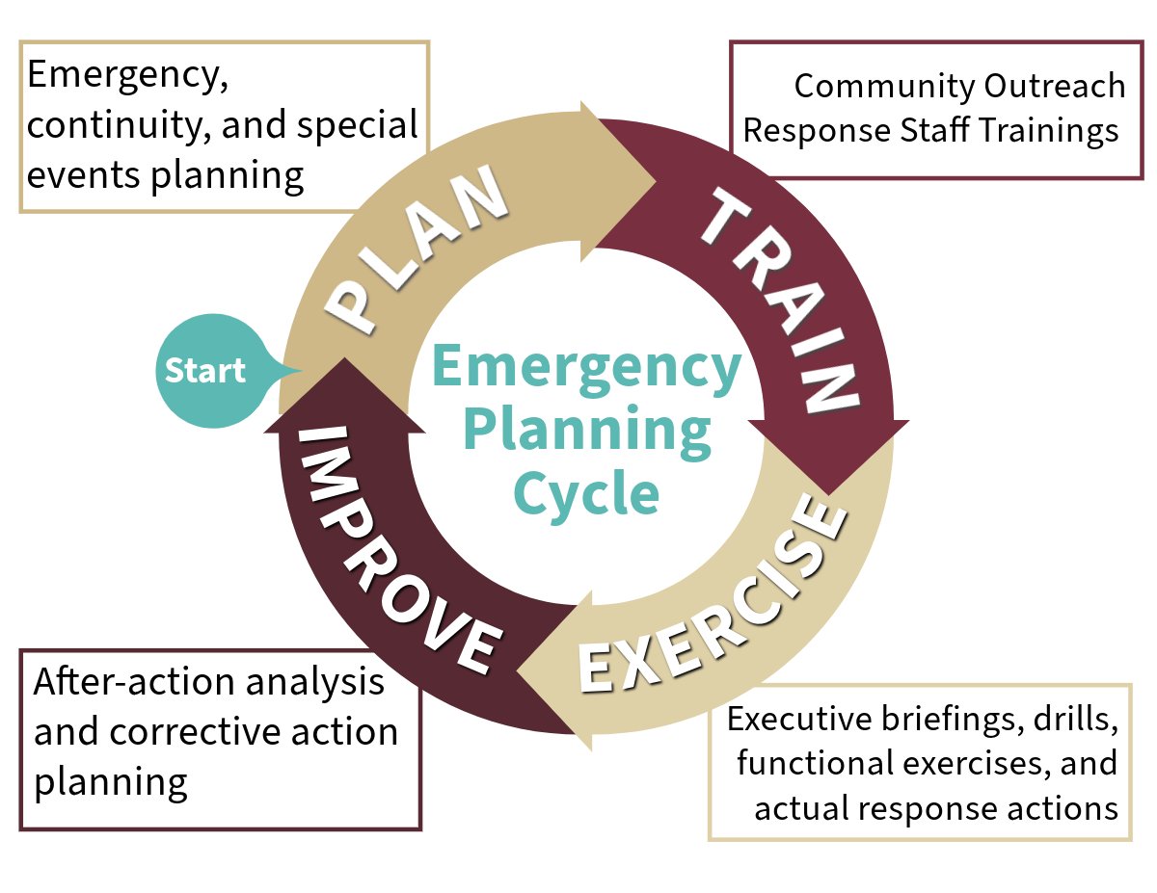
How We Prepare to Respond
Notes:
EM works in a cycle: Plan, Train, Exercise, Improve. This is done throughout the year.
Planning
FSU’s CEMP – Comprehensive Emergency Management Plan and Hazard specific annexes
COOP – Continuity of Operations Planning for FSU EM and coordination & training for departmental COOP updates
Trainings
Designed & conducted preparedness trainings for FSU community and Response staff
External FEMA trainings to improve specific capabilities
Exercises
2024 Football Tabletop
3 FSU Alerts Drills
6 real-world activations

Slide 28
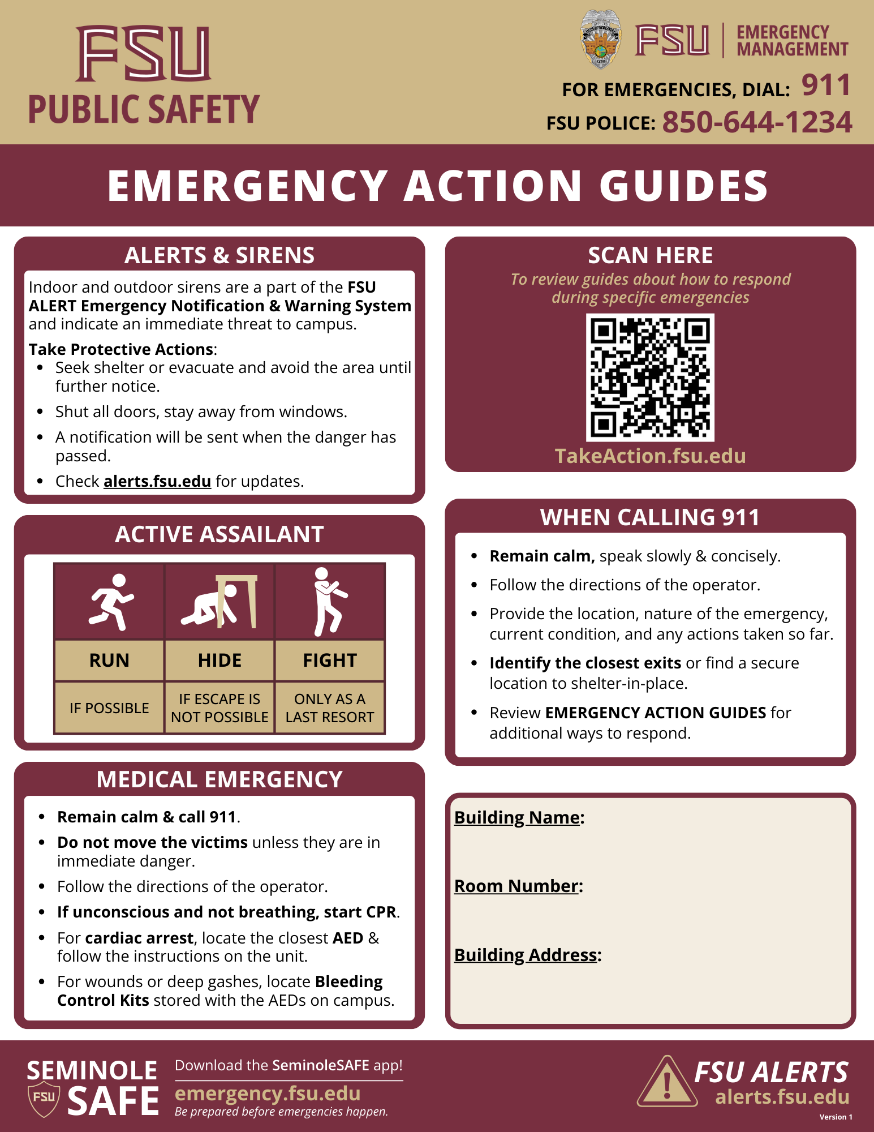
Campus Security
Working to centralize security systems to a single unified system
Classroom safety
Cameras and License Plate Recognition Systems
Suicide mitigation fencing
Pedestrian safety enhancements
Real Time Crime Center
Improve equipment for police officers
Expansion of Police command and dispatch staff
Firearms/Rifles
Body Cameras/Armor
Metal detectors

Slide 29
Public Safety
Since Fiscal Year 2022 more than $26M in new funds have been invested into public safety enhancements
Established a Real Time Crime Center
Pedestrian safety collaboration between the State, City and University

Slide 30
Pardon our dust

Slide 31
Capital Appropriations
UPDATED JULY 2026 – POST VETO
Project | Amount
College of Engineering Building C | $91,975,000
Middleton Center | $20,000,000
Moore Auditorium Remodel | $15,000,000
Veterans Legacy Complex | $13,000,000
Kellogg Research Remodel | $11,500,000
Rovetta Business Building Renovation | $10,000,000
Health Facilities Deferred Maintenance | $5,000,000
Basketball Sports Science | $5,000,000
Life Safety Upgrades | $2,500,000
Dental School – Planning | $2,500,000

Slide 32
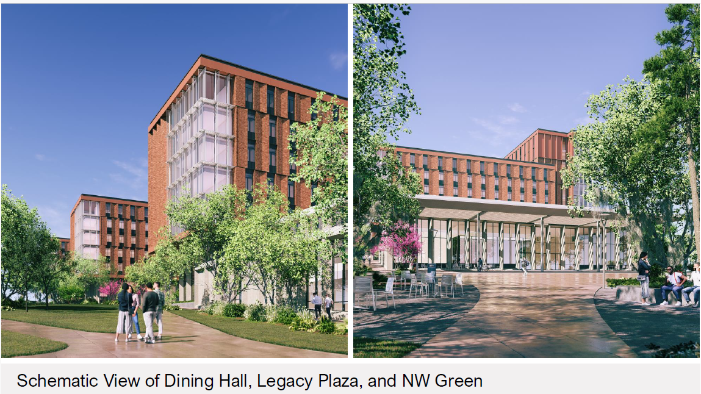
NW Housing, Dining & Parking – Phase I
32

Slide 33
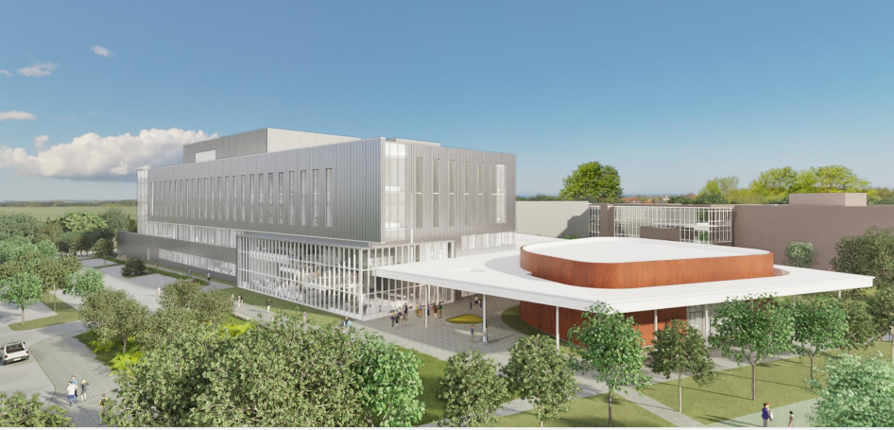
FAMU – FSU College of Engineering – Building C
33

Slide 34
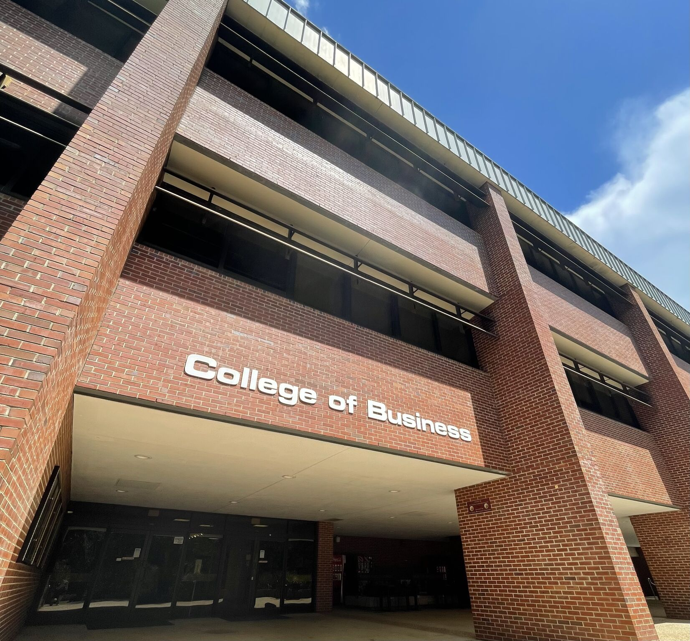
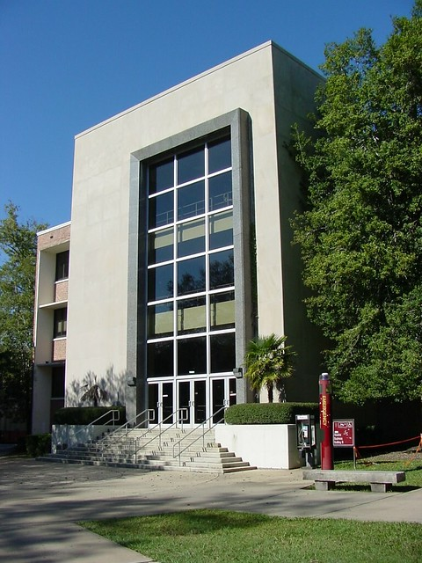
Rovetta A & B - Remodel

Slide 35
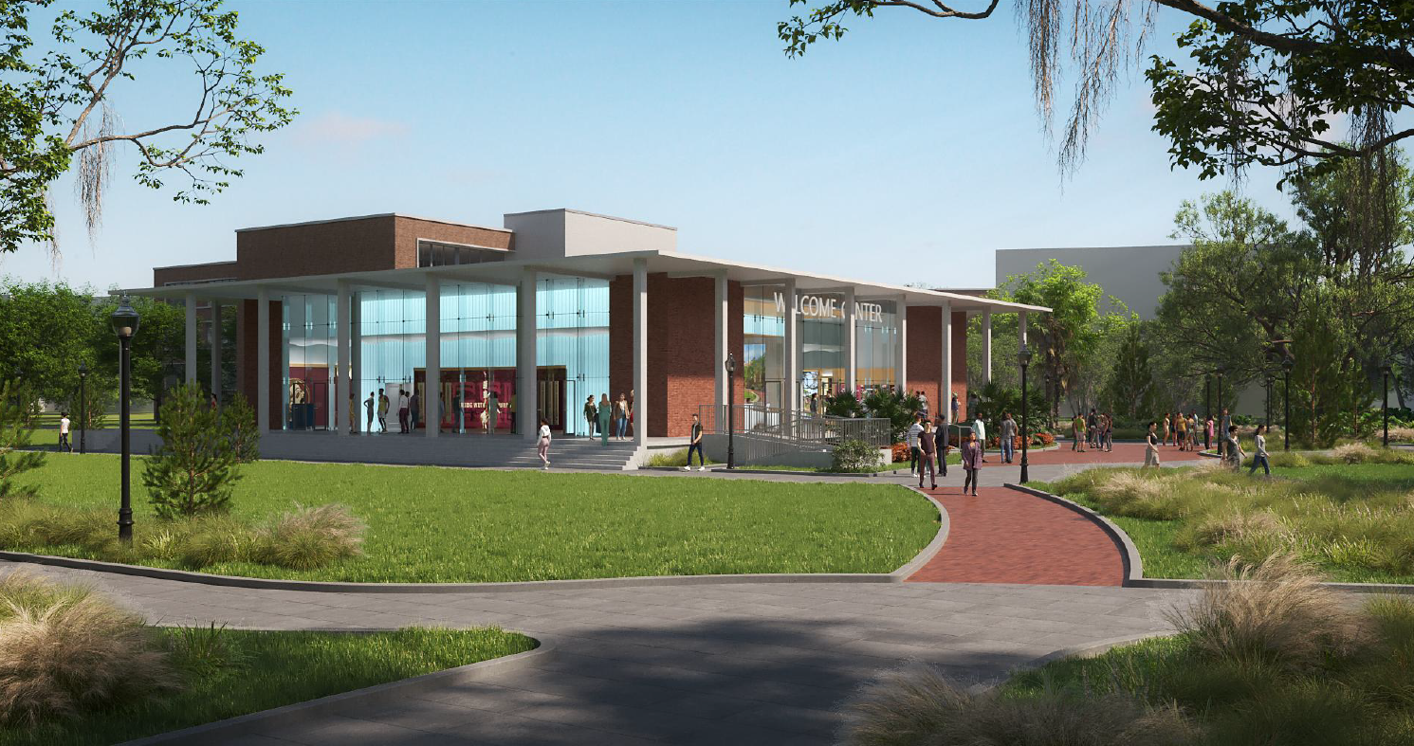
Moore Auditorium – Addition and Remodel
DRAFT

Slide 36
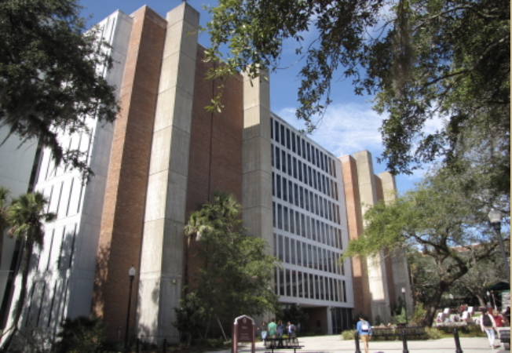
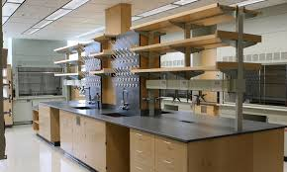
Dittmer Chemistry Lab – Remodel

Slide 37
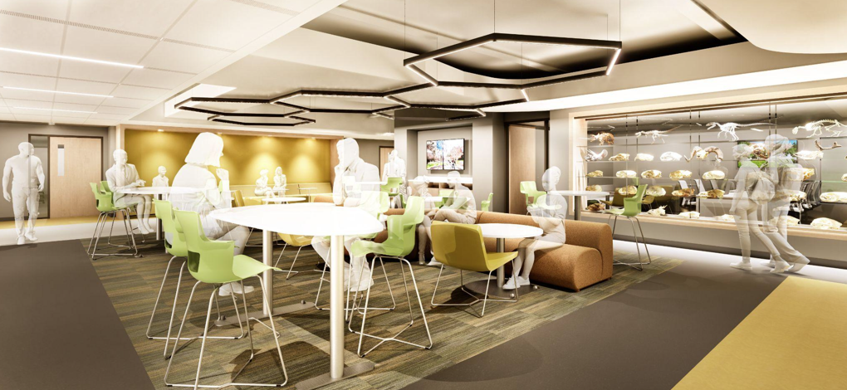
Biology Unit 1 – Second Floor Remodel

Slide 38
Deferred Maintenance
Project Status: Various (Construction and Warranty)
Main Tallahassee Campus - $66,187,052
Panama City Campus - $5,000,000
College of Engineering - $855,000
28+ Roofing improvement projects
26+ Building Envelope (windows and foundations) improvement projects
13+ Fire & Life Safety improvement projects
16+ HVAC system improvement projects
52 projects are completed (12 additional projects since October 2025)
Over 200 contracts/purchase orders have been issued
All SFRF funds fully committed and to be paid out before December 31, 2026.
38

Slide 39
Deferred Maintenance Buildings
Bellamy
Bio Medical
Bio Unit One
Ca’d Zan
Carothers Hall
College of Engineering
Collins
Critchfield
Diffenbaugh
Dittmer
Fine Arts
HCB
Housewright
Immokalee
Love
Marine Lab
Maryland Circle
Master Craftsman
Panama City Campus
Pepper
Recycling/Solid Waste
Medicine Research
Ringling Art Museum
Rogers
Rovetta
Sandels
Shaw
Strozier
Thrasher
Turnbull
University Center
Westcott
Williams

Slide 40
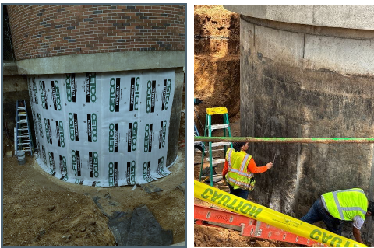
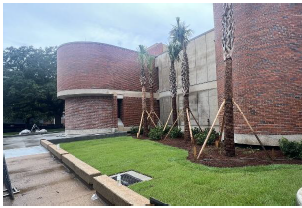
Deferred Maintenance
Fine Arts – Building Envelope

Slide 41
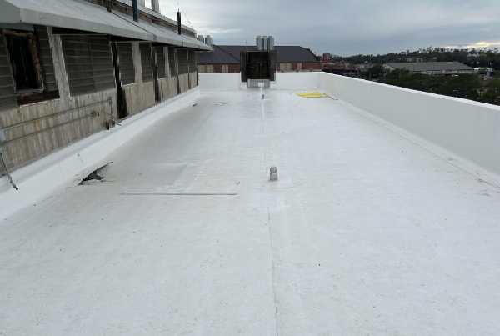
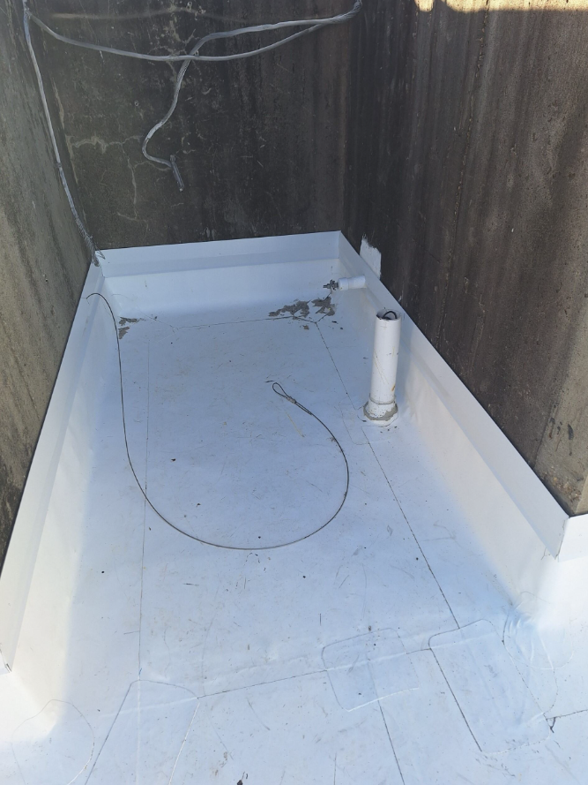
Deferred Maintenance
Dittmer Chemistry Lab - Reroofing

Slide 42
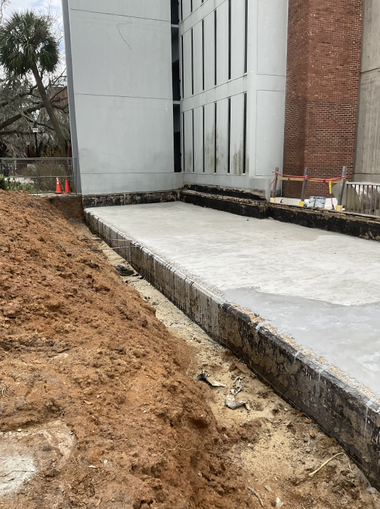
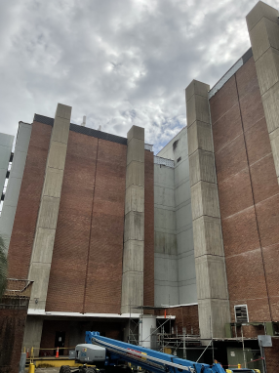
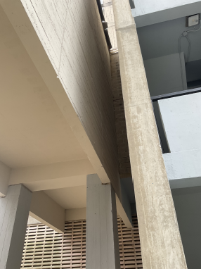
Deferred Maintenance
Dittmer Chemistry Lab – Building Envelope

Slide 43
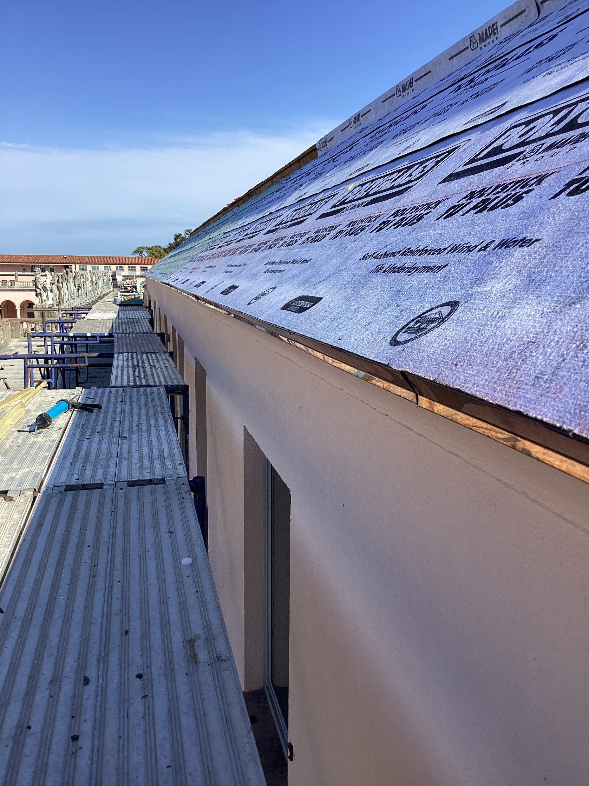
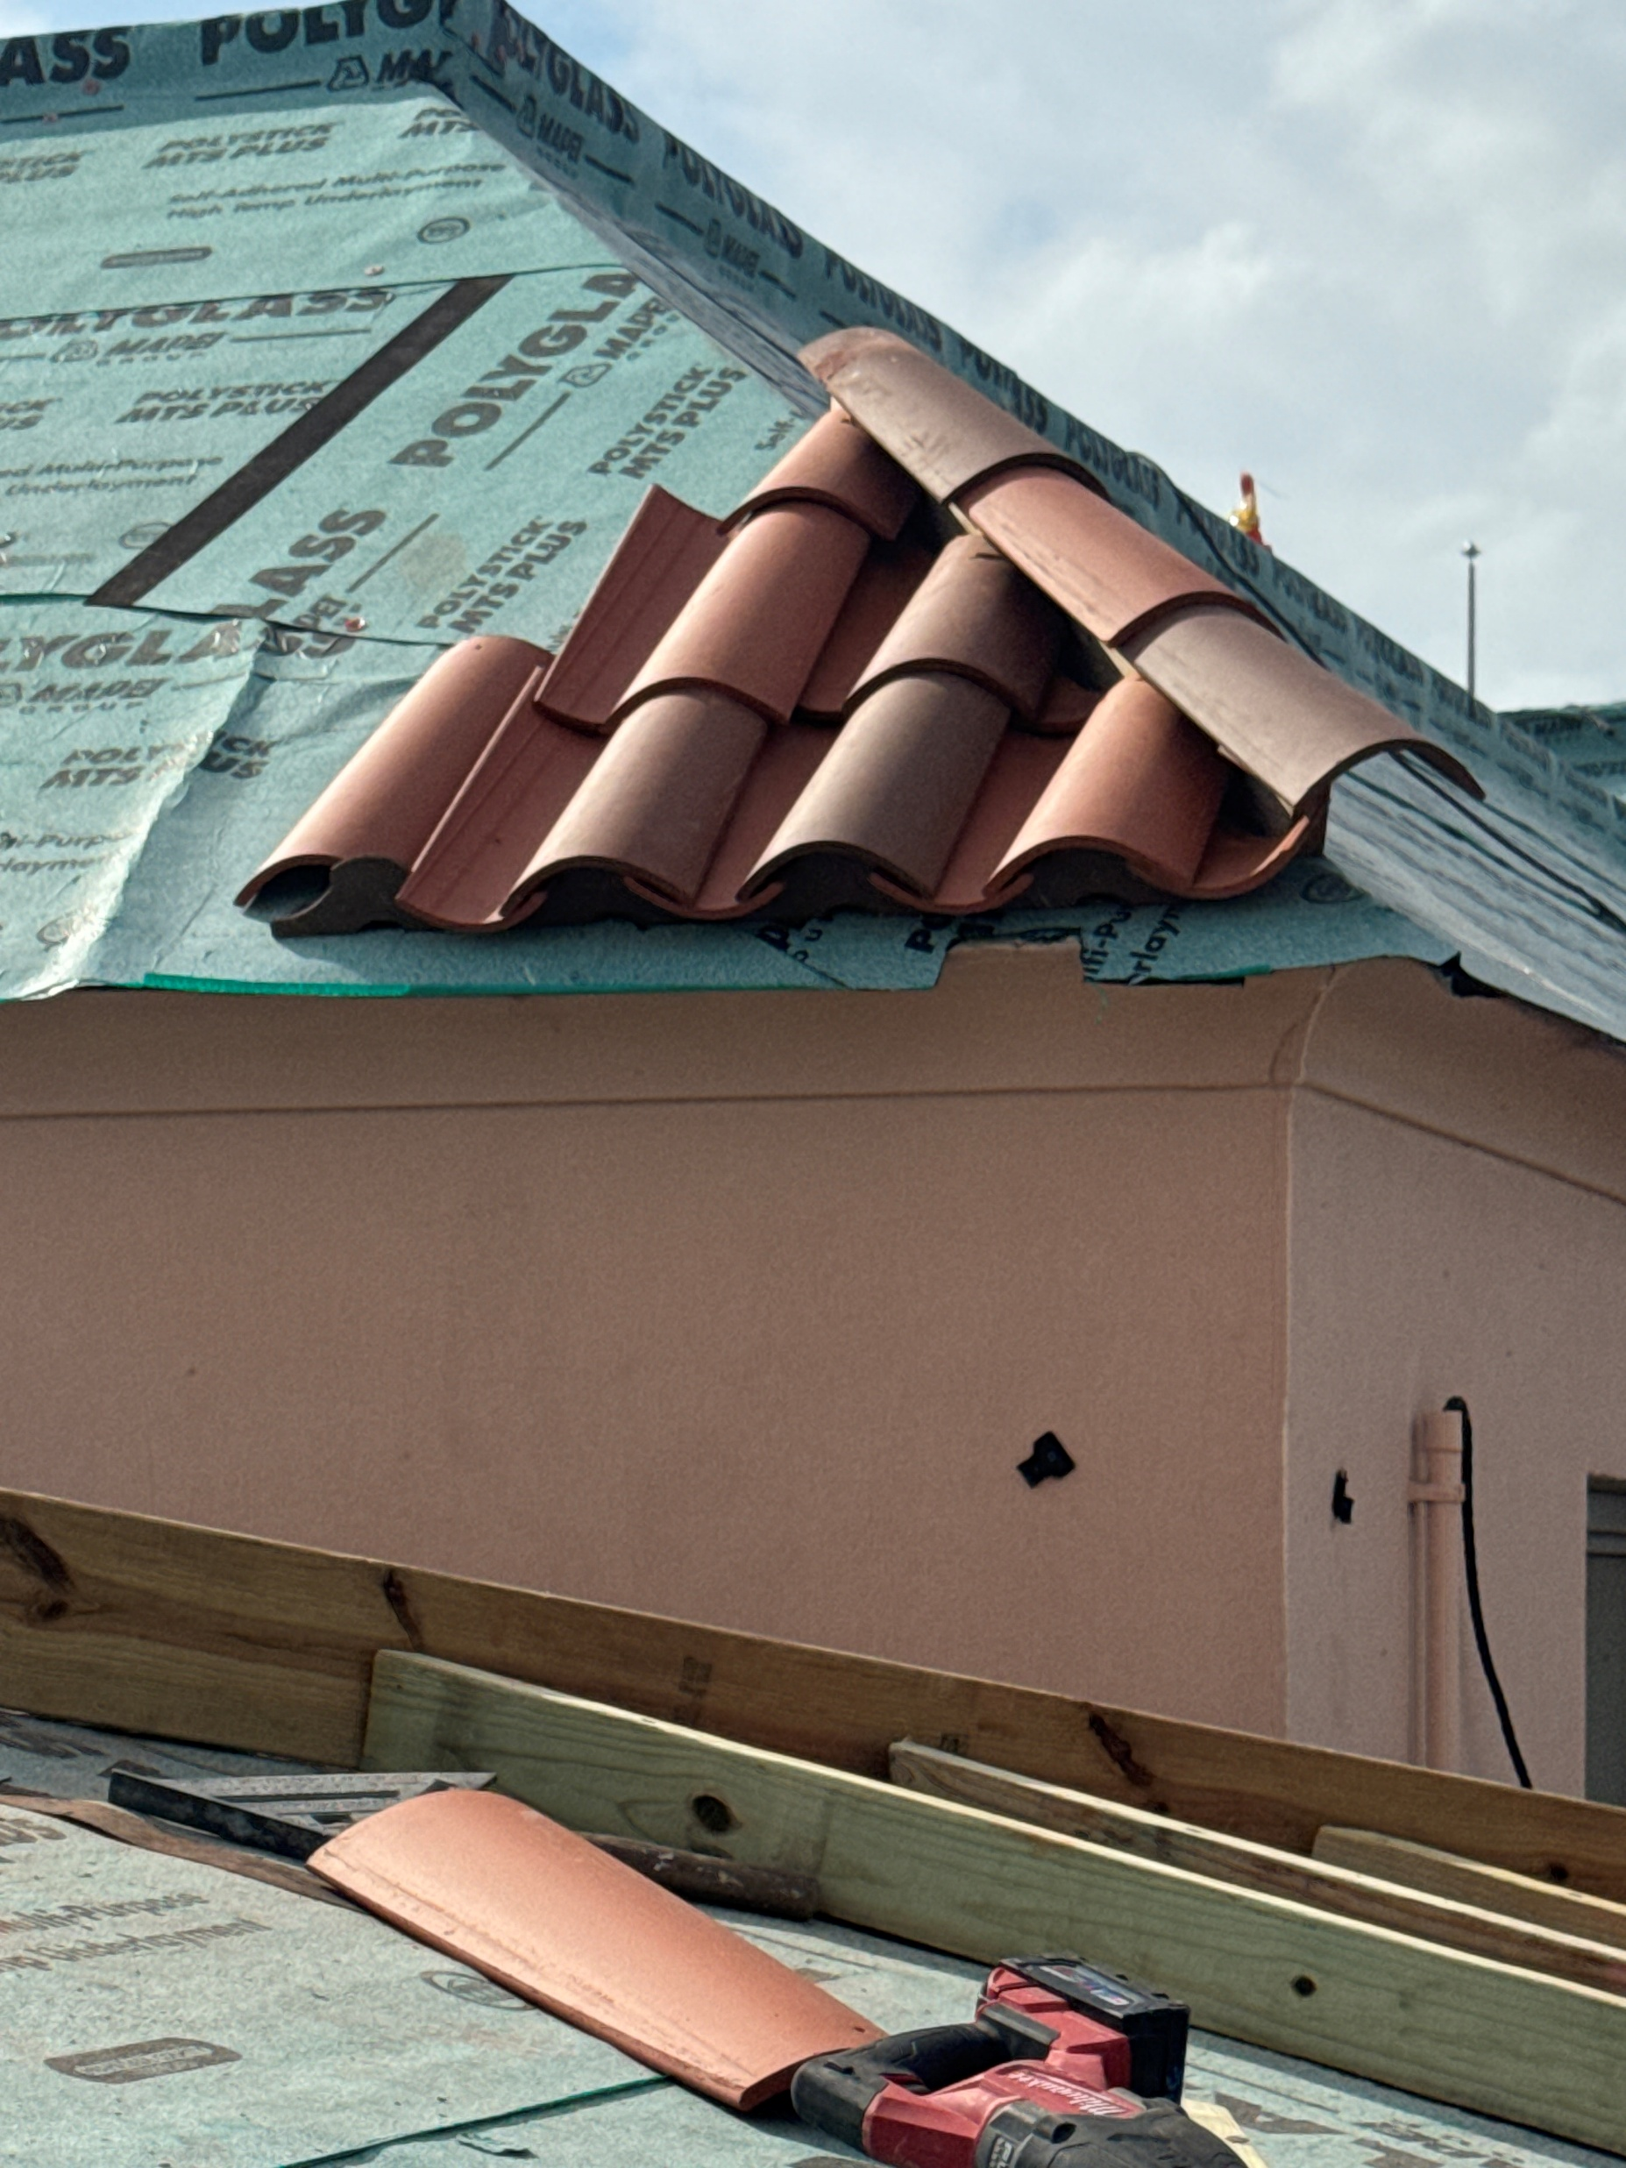
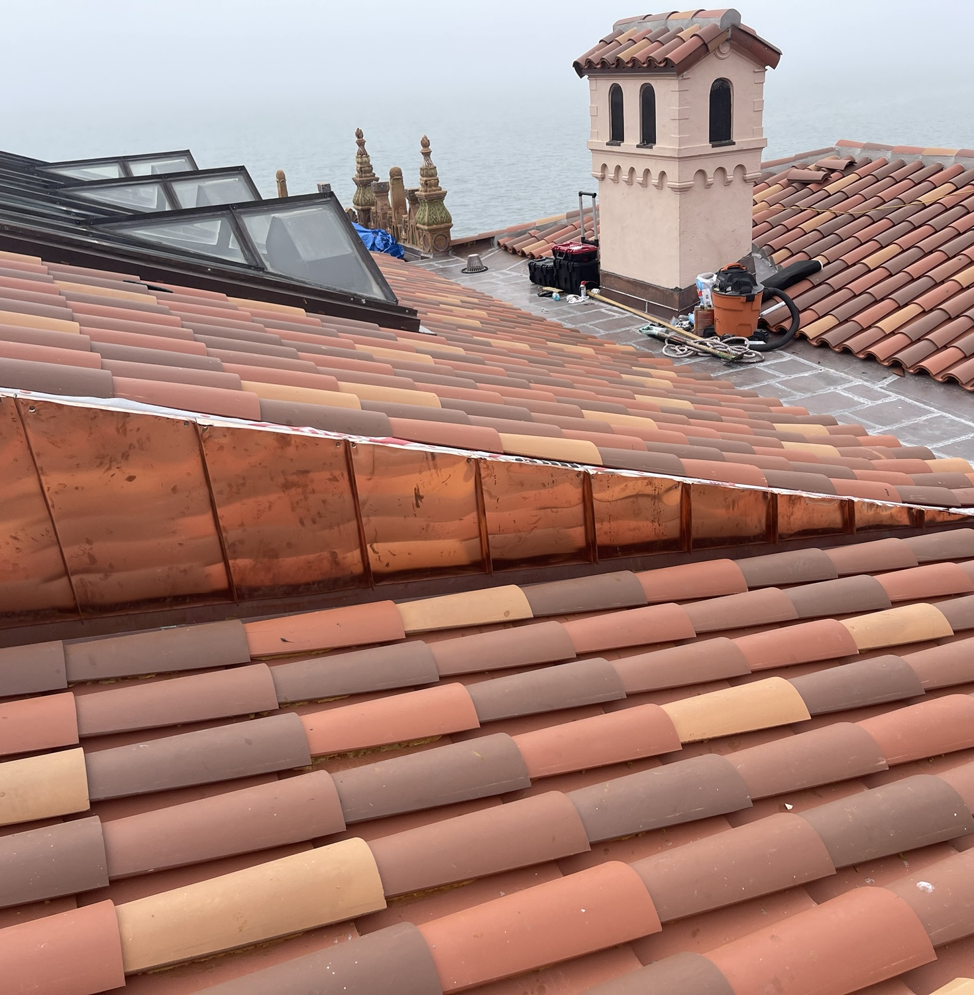
Deferred Maintenance
Ringling - Museum of Art and Ca'd'Zan - Reroofing

Slide 44
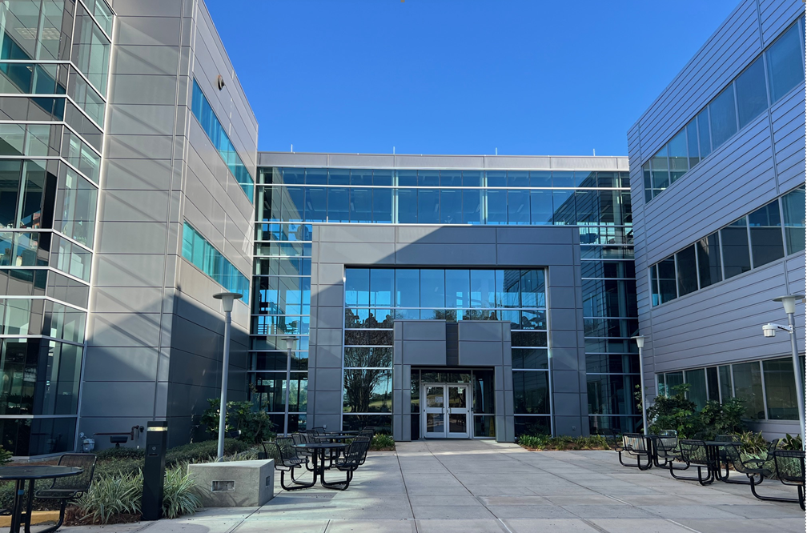
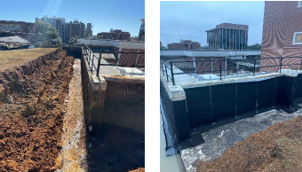
Deferred Maintenance
FAMU-FSU College of Engineering A & B – Building Envelope
Collins – Building Envelope

Slide 45
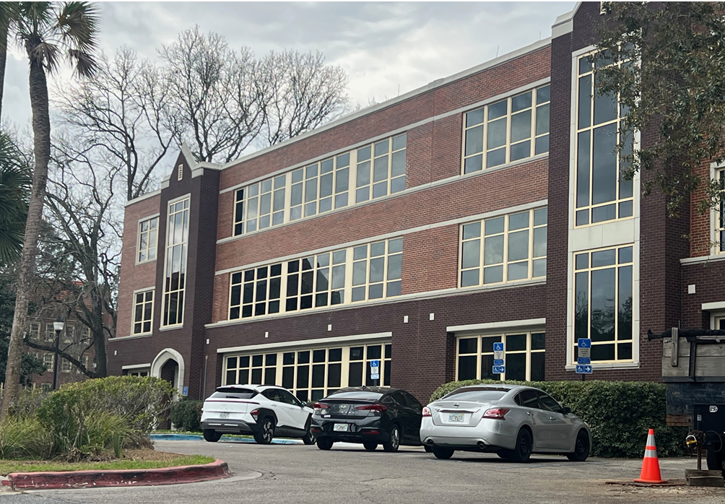
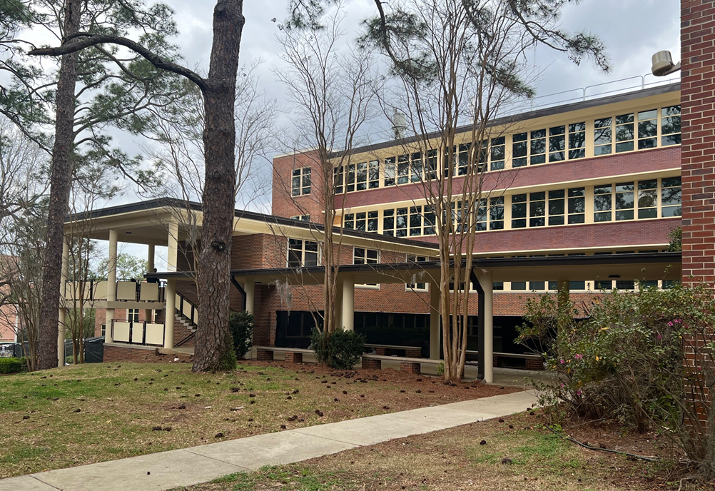
Deferred Maintenance
Sandels Building – Building Envelope

Slide 46
New Faculty Orientation
Kyle Clark
Senior Vice President for Finance & Administration
August 17, 2026

