Slide 1
Research Update
W. Ross Ellington
Associate Vice President for Research
Deans, Chairs and Directors Workshop
October 10, 2017

Slide 2
Items:
Some good news
Compliance challenges ahead

Slide 3
FSU Research Funding
FY17 Year End High-Level Overview of
Proposals, Awards and Dollars
Category | # PROPS FY16 | # PROPS FY17 | PROP CNT DIFF | # AWDS FY16 | # AWDS FY17 | AWD CNT DIFF | $ AWDS FY16 | $ AWDS FY17 | AWD $ DIFF
Federal | 846 | 860 | +14 | 609 | 699 | +90 | 142,483,638 | 162,482,210 | +19,998,571
State | 130 | 140 | +10 | 153 | 155 | +2 | 20,985,085 | 21,444,455 | +459,369
Other | 325 | 357 | +32 | 492 | 486 | (6) | 26,605,937 | 26,449,960 | (155,977)
Total | 1,301 | 1,357 | +56 | 1,254 | 1,340 | +86 | 190,074,661 | 210,376,625 | +20,301,964

Slide 4
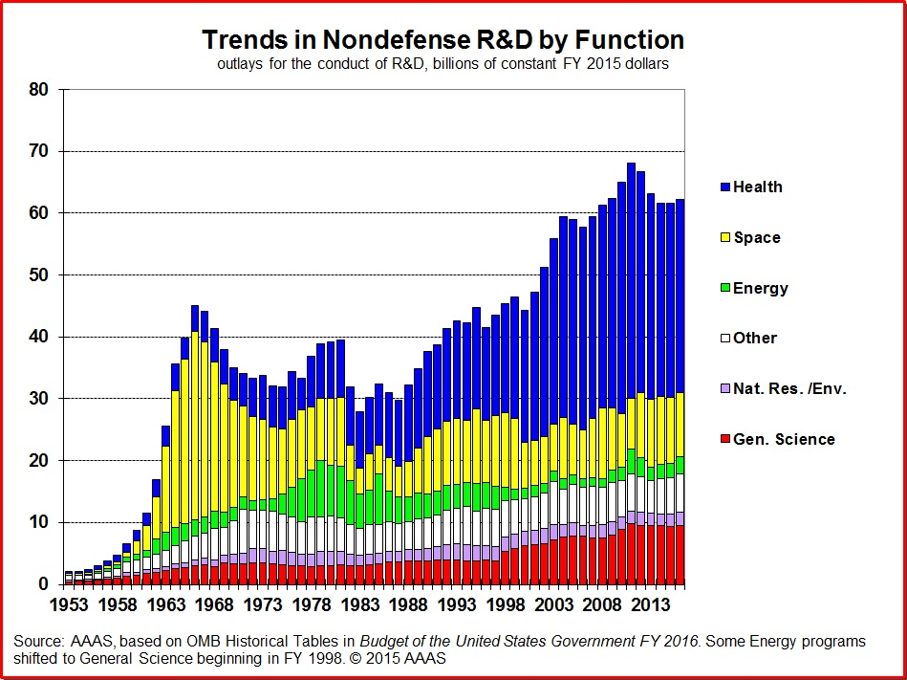
2016

Slide 5
FSU Research Funding
ORGANIZATION | AWARDS | FUNDING
UNIVERSITY OF FLORIDA | 408 | $158,809,102
UNIVERSITY OF SOUTH FLORIDA | 100 | $112,893,917
UNIVERSITY OF MIAMI SCHOOL OF MEDICINE | 238 | $105,972,693
SCRIPPS FLORIDA | 95 | $41,822,108
FLORIDA STATE UNIVERSITY | 78 | $35,790,197
MAYO CLINIC JACKSONVILLE | 50 | $34,733,763
H. LEE MOFFITT CANCER CTR & RES INST | 68 | $29,475,838
FLORIDA INTERNATIONAL UNIVERSITY | 63 | $25,399,173
JAEB CENTER FOR HEALTH RESEARCH, INC. | 3 | $9,472,049
MOUNT SINAI MEDICAL CENTER (MIAMI BEACH) | 3 | $8,967,858
NIH awards for Federal FY 17.

Slide 6
FSU Research Funding
FY17 vs. FY18 High-Level Overview of
Proposals, Awards and Dollars (July and August data)
Category | # PROPS FY17 | # PROPS FY18 | PROP CNT DIFF | # AWDS FY17 | # AWDS FY18 | AWD CNT DIFF | $ AWDS FY17 | $ AWDS FY18 | AWD $ DIFF
Federal | 89 | 50 | (39) | 45 | 55 | +10 | 8,535,387 | 12,070,314 | +3,534,927
State | 14 | 9 | (5) | 14 | 9 | (5) | 1,029,868 | 2,594,540 | +1,564,672
Other | 22 | 18 | (4) | 25 | 33 | +8 | 798,769 | 929,978 | +131,209
Total | 125 | 77 | (48) | 84 | 97 | +13 | 10,364,025 | 15,594,831 | +5,230,806

Slide 7
Compliance Challenges Ahead
Data/information security is coming under greater scrutiny by the Federal government.
NIST 800-171 standards for security of controlled unclassified information (CUI); standards consist of 110 control elements!
Applies to certain contracts & grants from Federal agencies and DOD contractors
Requires significant initial and recurring investments to implement for existing awards; must be in place by 12/31/17.
New proposals will have to certify NIST 800-171 compliance if awarded
New awards will have to be on-boarded
Joint effort of the Office of Research, ITS and the impacted units (n=4 so far)
There is an expectation that similar standards will be applied to other Federal C&G programs and health-related data (HIPAA)

Slide 8
Thank You
Questions?

