Slide 1
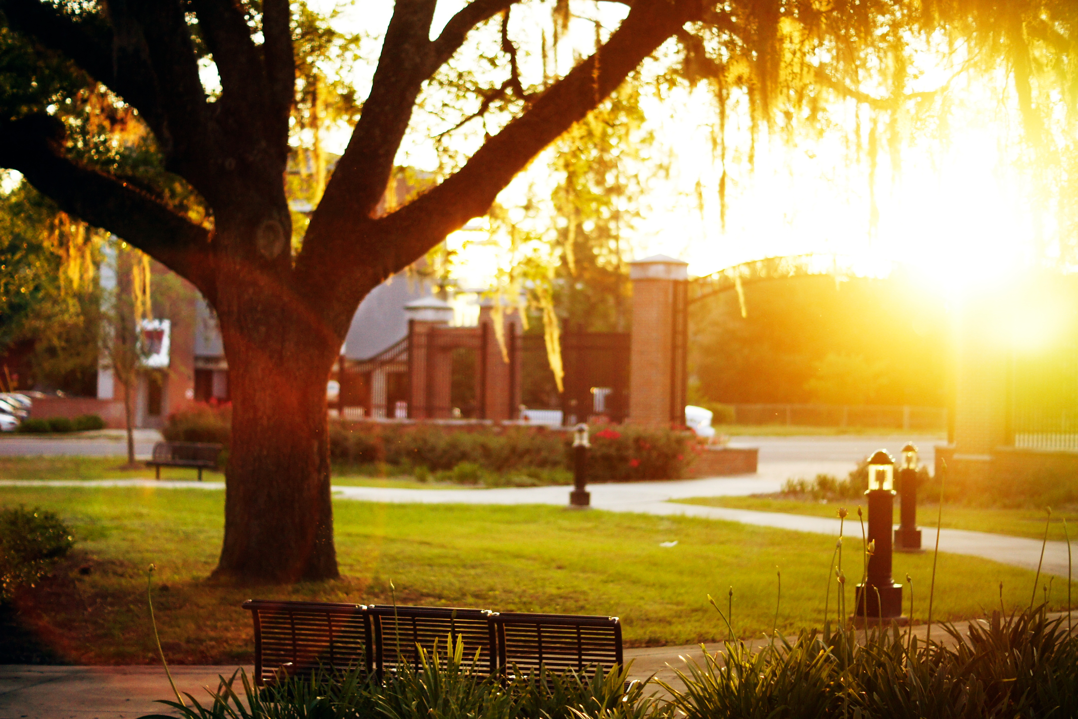
ACADEMIC AFFAIRS UPDATE
Sally McRorie, Provost
Deans and Chairs Meeting
October 10, 2017

Slide 2
Overview
Student Success Key Updates
U.S. News and World Report Ranking Breakdown
Strategic Investments to Improve FSU’s Rankings and Metrics
Faculty Hires
Student Support & Engagement
Branding, Marketing & Recruitment

Slide 3
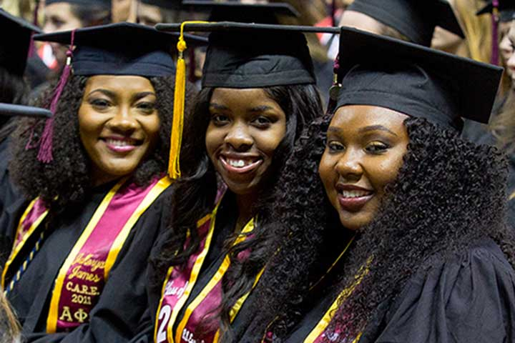
We continue to be a national leader in student success, with 4- and 6-year graduation rates (65.3%; 80.1%) among the highest in the country
We have virtually erased graduation rate disparities between all categories of underrepresented students and our traditional students
Making FSU the highest-ranked public university to have this distinction.
Notes:
We are still a national leader in student success. Our graduation rate puts us among the top 25 publics in the country, and we have virtually erased graduation rates disparities between all categories of underrepresented students and our traditional students.
Making FSU the highest-ranked public university to attain this distinction.
We continue to receive significant national attention for our student success efforts. Our most recent recognition has come from the Bill and Melinda Gates Foundation. The foundation has been working with currently completing a case study. Now we just need some of their money.

Slide 4
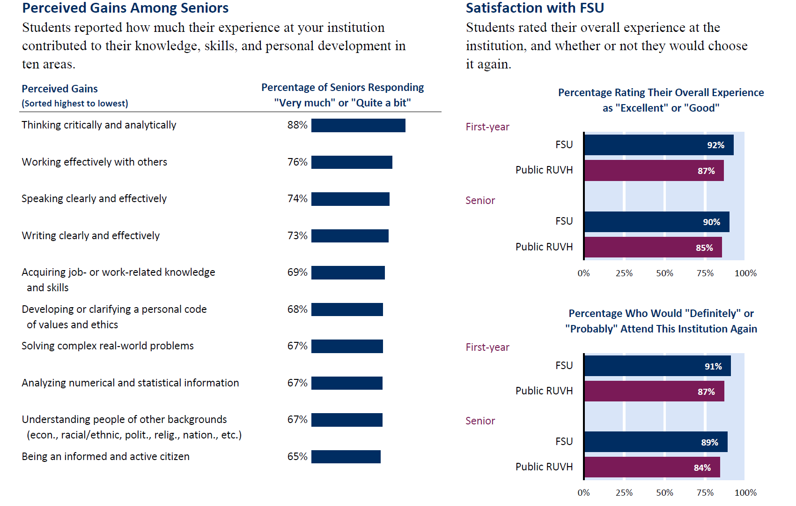

Slide 5
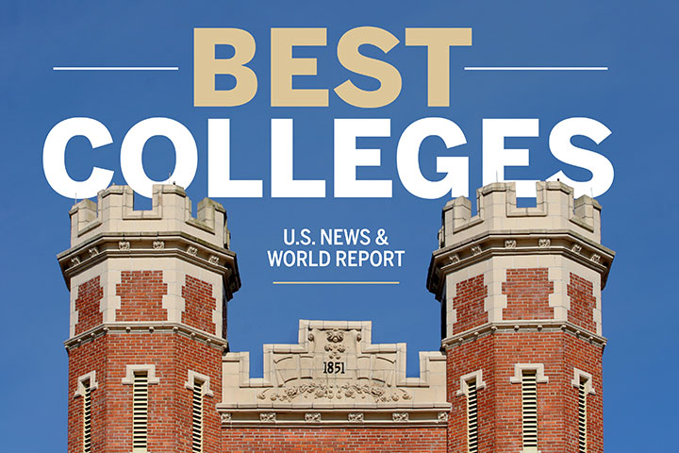
Five-rank increase over last year
Greatest gain (up 10) over last two years among Top 50 public universities
Up 21 (among publics) and 31 overall places since 2007
Business School increased 14 places, from 41st to 27th
33rd Ranked PUBLIC UNIVERSITY

Slide 6
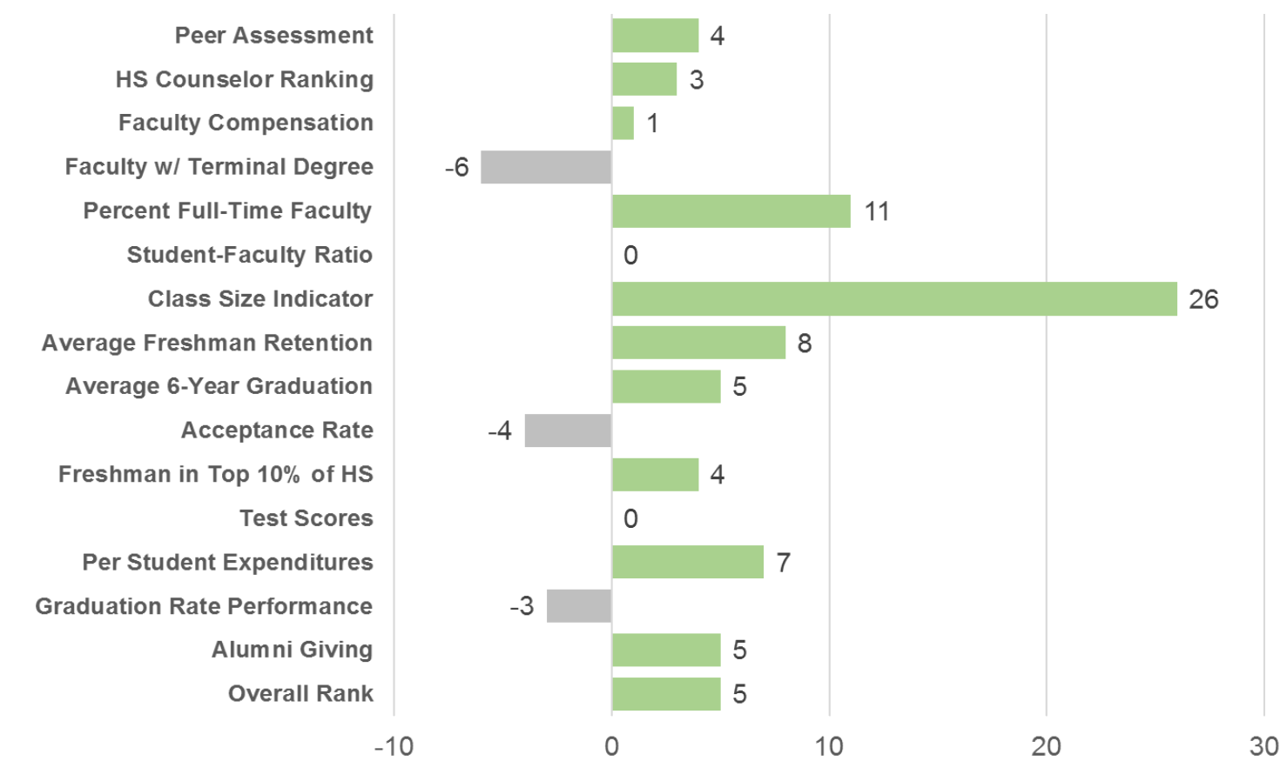
U.s. news 2016 vs. 2017 change in ranks among publics

Slide 7
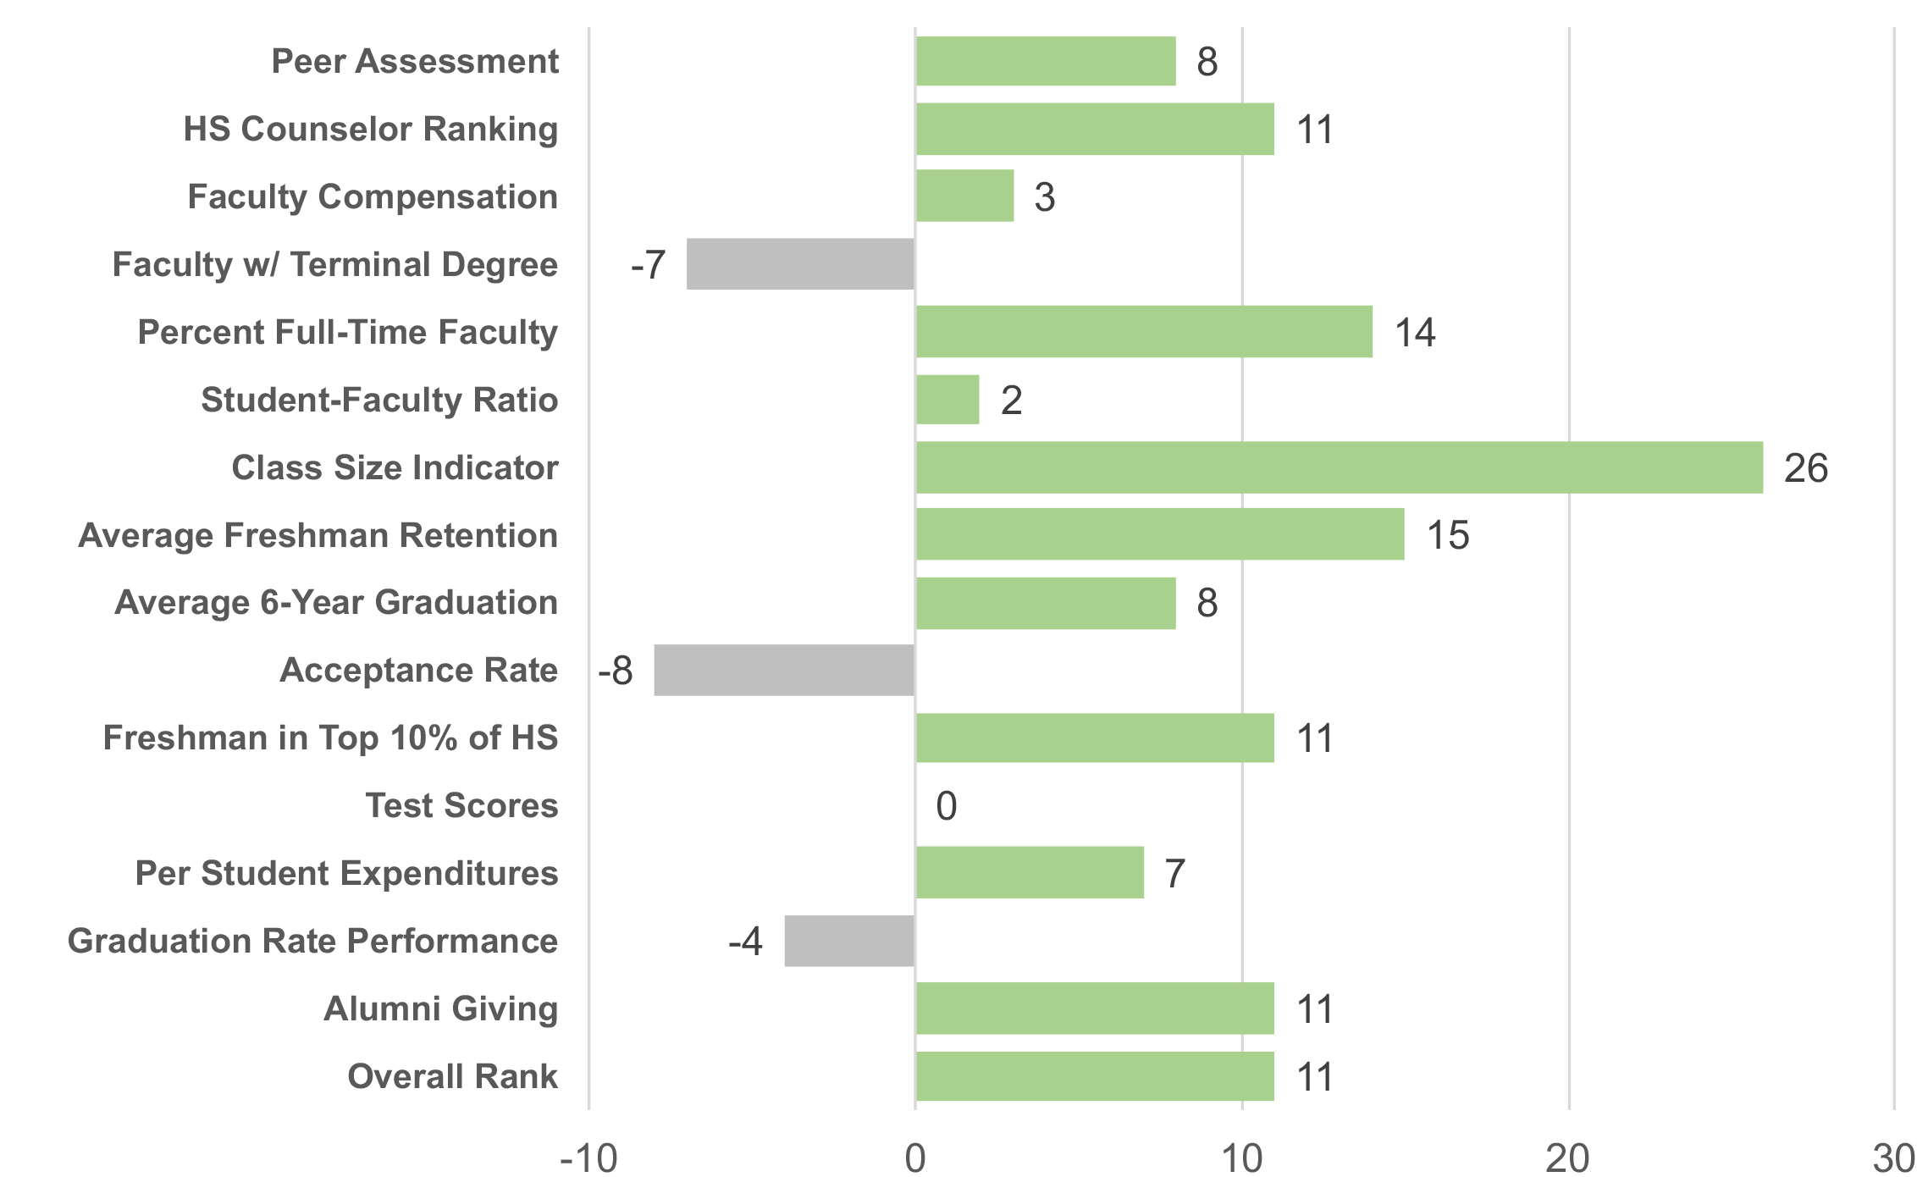
U.s. news 2016 vs. 2017 change in ranks among all schools

Slide 8
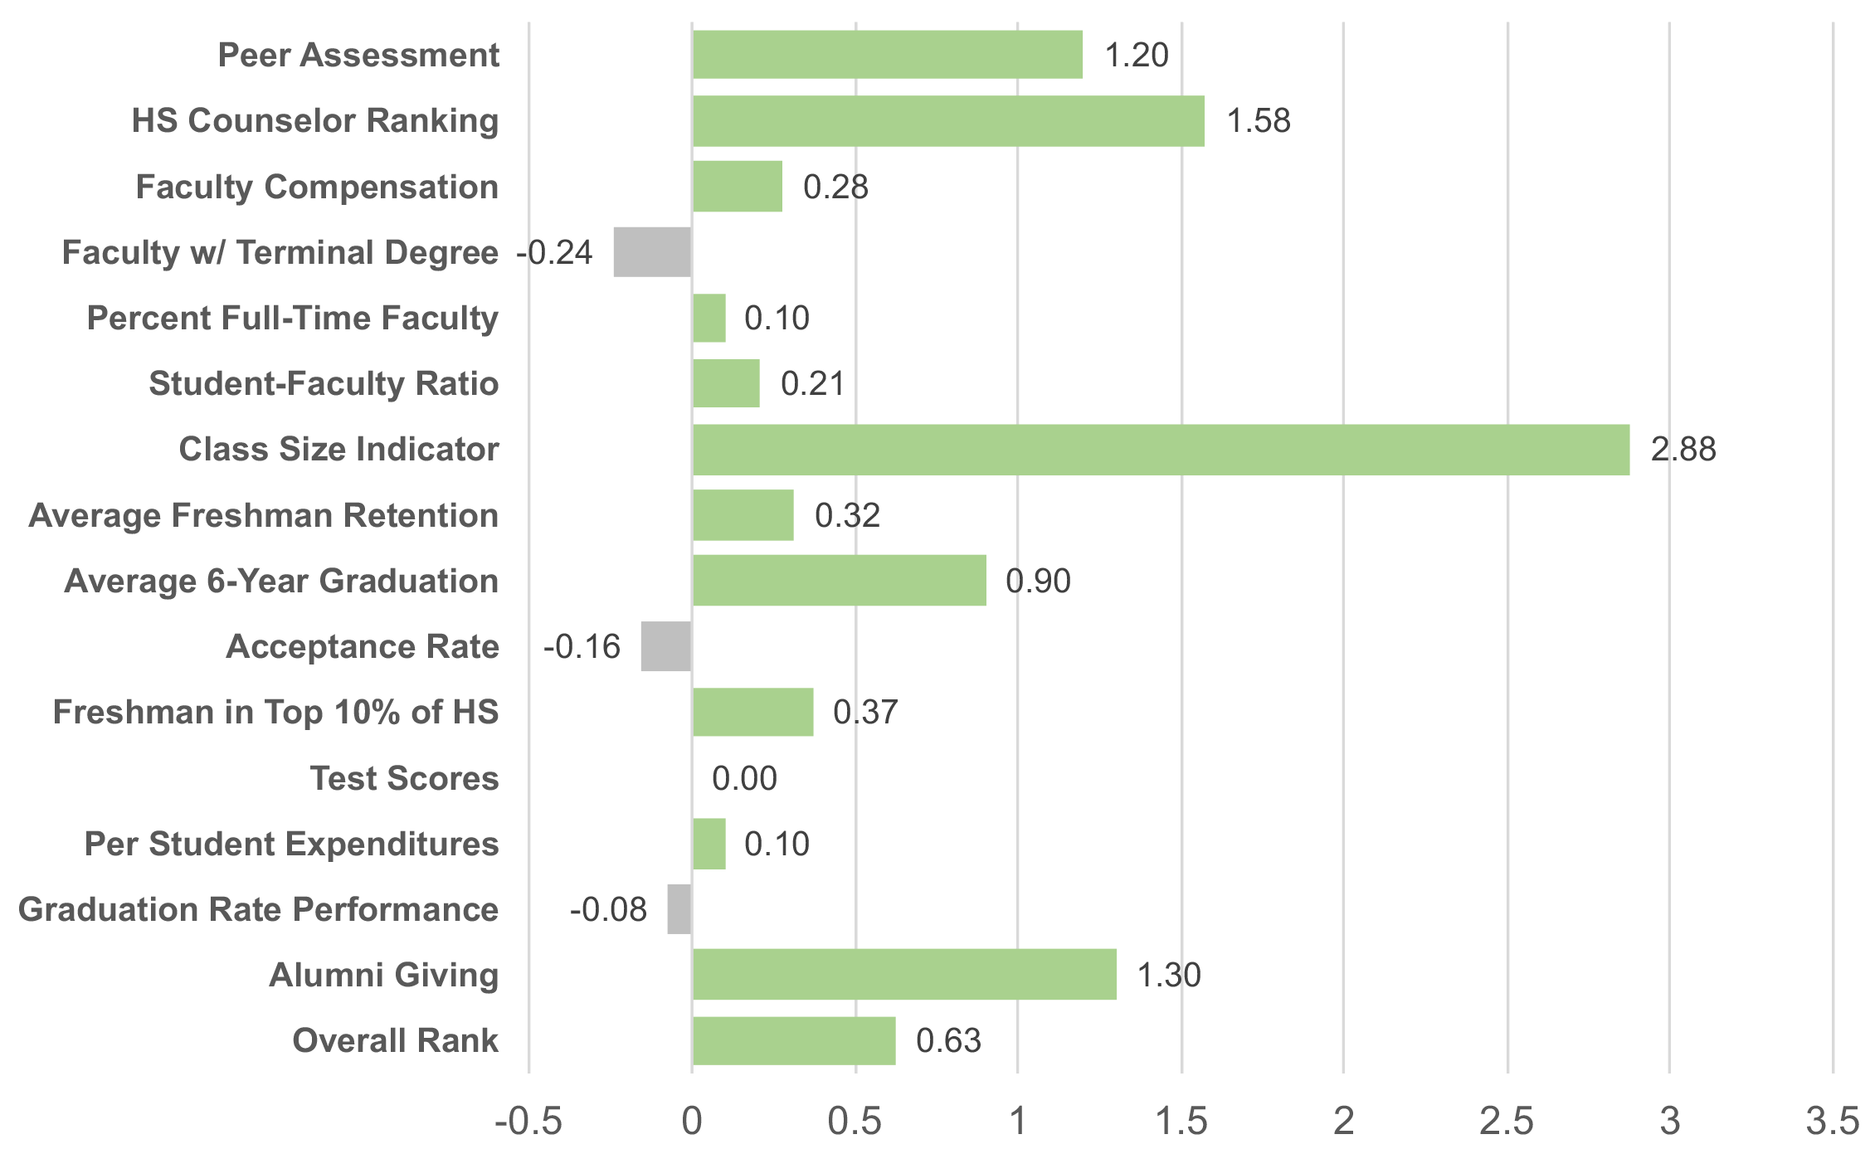
U.s. news 2016 vs. 2017 weighted change all schools

Slide 9
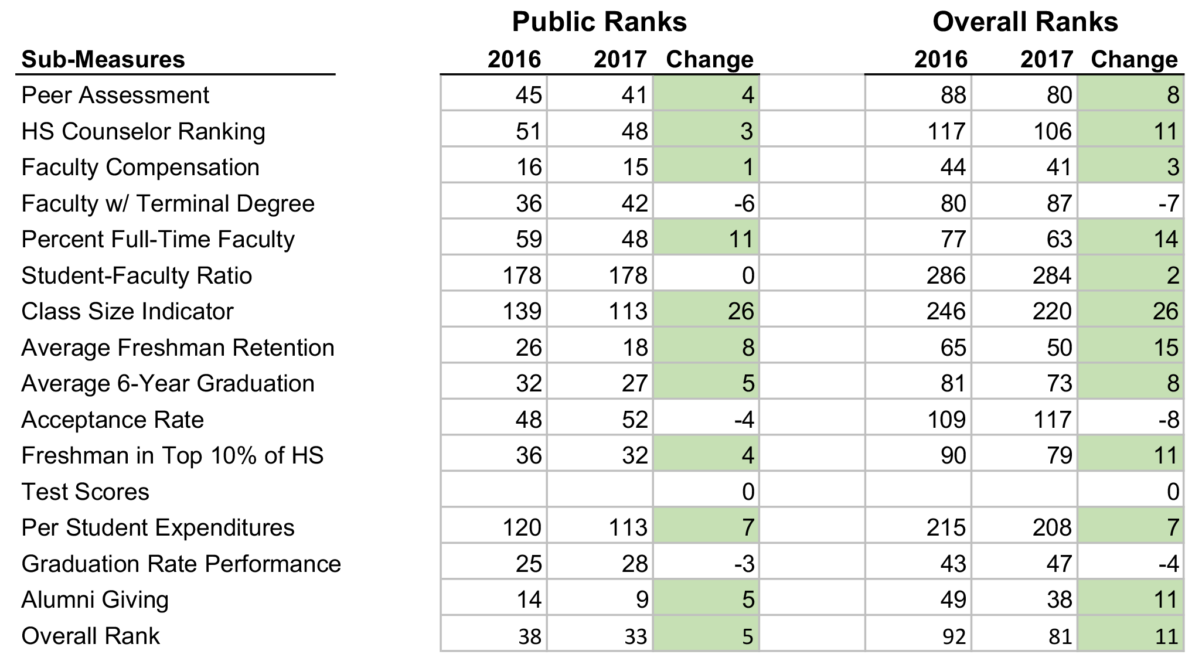

Slide 10
Faculty hiring
Launching largest single-year faculty hiring initiative in FSU’s history
Authorized recruitment of 125 new faculty lines across the university to advance metrics and profile

Slide 11
Faculty hiring
Metrics-based:
Reduce class size and bottlenecks
Improve four-graduation rates
Increase student engagement activities
Promote student post-graduation outcomes
Elevate graduation education and research

Slide 12
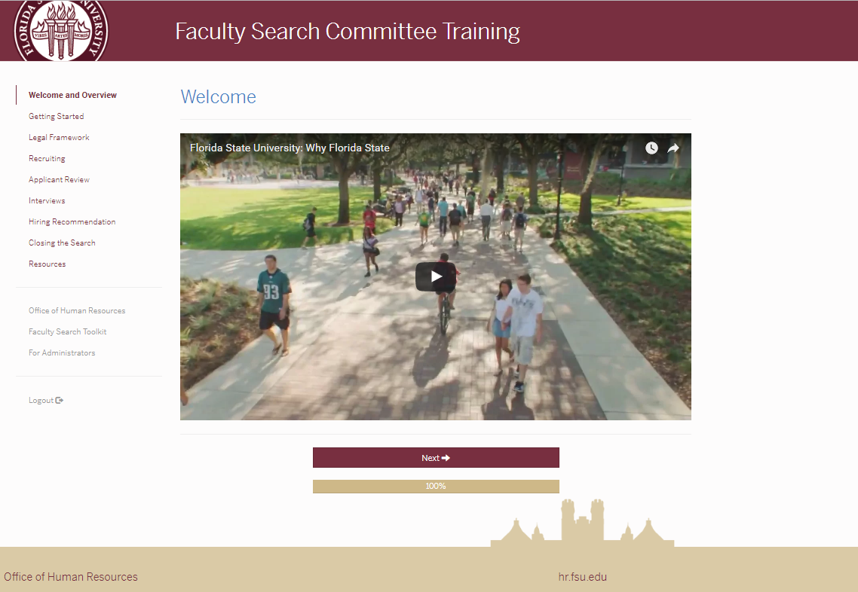
Faculty Search Committee Training
Practical and convenient online training that takes you through all phases of the recruiting process, including:
Creating a search committee and defining roles.
Building the best applicant pool through active recruiting.
Interviewing do’s and don’ts.
Diversity Resources & Implicit Bias Assessment-IAD
Legal, recordkeeping, and university requirements.
Welcoming a new colleague into your department.

Slide 13
Student support & engagement
Expand advising and student support
Improve student success in the classroom
Expand experimental learning, like internships and job shadowing, undergraduate research, service-learning, and international education

Slide 14
Marketing, branding & recruitment
Elevate FSU’s Reputation
University Branding Initiative
Improve Student Academic Profile
Acceptance Rate
Top 10% of Class and Test Scores
Increase Graduate Applications and Enrollment

Slide 15
HANDOUT & THANK YOU!

