Slide 1
Canvas LMS:
Transition & Timeline
Robert J. Fuselier
Interim Director, Office of Distance Learning

Slide 2
State of Florida Common LMS Initiative
2015: Board of Governors created a committee to evaluate and select a common learning management system (LMS) to serve as the preferred system for all Florida SUS institutions.
Finalists included Canvas by Instructure, Blackboard Learn, and Desire2Learn’s BrightSpace.
Canvas outscored the competing finalists in all evaluation categories, including ease-of-use, course delivery tools, and student support options.

Slide 3
The Canvas LMS Feasibility Workgroup
Purpose:
The Board of Governors recently announced that Canvas has been selected as the preferred Learning Management System (LMS) for the state of Florida. Adoption of Canvas is currently on an opt-in basis; however, the Board of Governors has strongly encouraged universities to carefully consider the pros and cons of a transition to the system. This workgroup is tasked with evaluating the benefits and features of the LMS as well as any limitations to determine what course of action will best meet the needs of our students and faculty.

Slide 4
The Canvas LMS Feasibility Workgroup
Participants:
Faculty Senate Distance Learning Committee
Faculty Senate Technology Committee
Chief Information Officer, Information Technology Services
Division of Student Affairs
FSU Libraries
Student Disability Resource Center
Office of the Registrar
Office of Distance Learning

Slide 5
The Canvas LMS Feasibility Workgroup
Committee Considerations:
LMS Ease-of-Use and Features
Third Party Integrations (Kaltura, TurnItIn, Bb Collaborate, etc.)
Product Support and Uptime/Service Level Agreement
Estimated Faculty Adoption Time and Effort
Available Training Resources
Budgetary Impact
Faculty Concers/Feedback

Slide 6
Faculty LSM Survey Results:
All of the Blackboard features that were indicated as “most useful” by the majority of the faculty have similar functionality in Canvas.
Of the instructors who had prior experience with Canvas, 58% preferred the system. 29% of the respondents had a preference for Blackboard.
74% of the faculty felt that a transition would require “very little” to “some” assistance migrating their online courses to Canvas.
When asked about their comfort level regarding an LMS change, 56% expressed a degree of concern.

Slide 7
Faculty LSM Survey Results: Concerns
Change:
Time investment and disruption related to adopting a new LMS.
Functional differences between Blackboard Learn and Canvas.
Training and Support:
Respondents desired reassurance that adequate training would be provided.
Course Migration:
Concerns were expressed regarding loss of course data during migration.
3rd Party Integrations:
Faculty relayed the importance of support for tools such as TurnItIn, Bb Collaborate, Kaltura, and Tegrity.

Slide 8
LMS Feasibility Workgroup Recommendation
After carefully considering the budget, contract benefits, vendor product demonstrations, faculty feedback, and transition support needs, the Canvas LMS Feasibility workgroup reached consensus to unanimously recommend the adoption of Canvas as the learning management system for FSU.

Slide 9
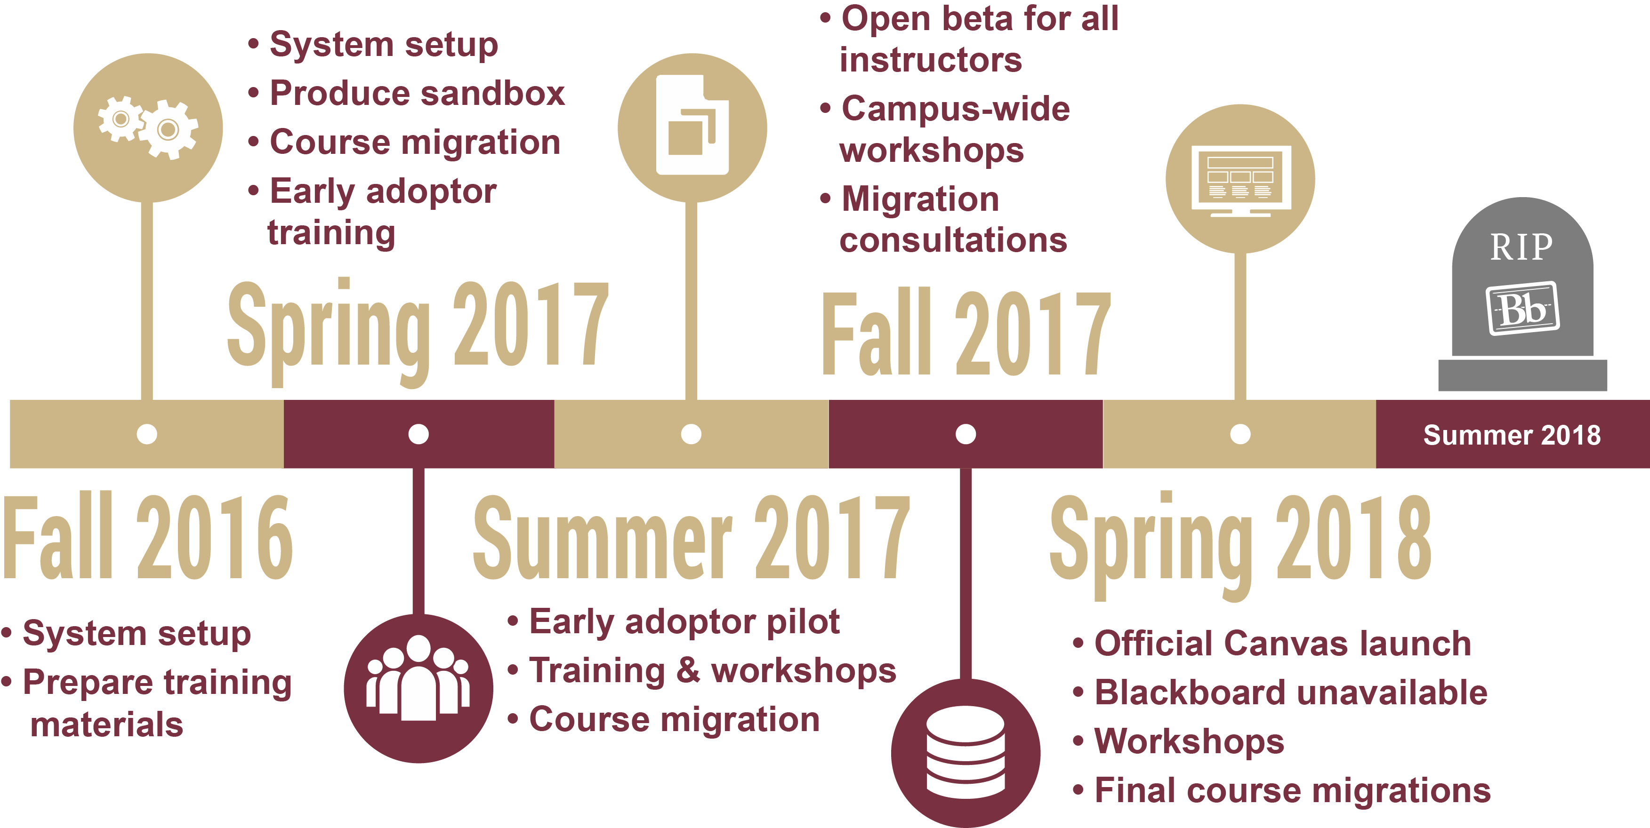
Canvas Transition Timeline

