Slide 1
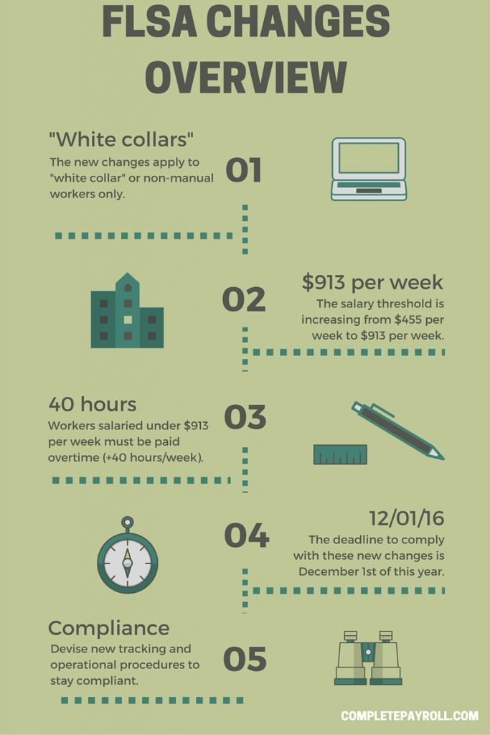
FLSA Update
Renisha Gibbs
Assistant Vice President for Human Resources
Finance & Administration Chief of Staff

Slide 2
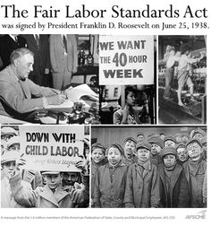
Fair Labor Standards Act (FLSA)
Designed to protect employees by setting nationwide pay and hour standards.
2016 FLSA Changes mean more FSU employees will come under the FLSA’s overtime protections.
While there will be an adjustment period, these changes ultimately give many employees:
Right to additional compensation when they are required to work more hours.
More work/life balance options.

Slide 3
FSU’s Approach
Human Resources & University Leaders worked to:
Minimize the impact on our employees.
Focus on fair and consistent treatment across departments & within job codes.
Many things won’t change (even for employees becoming overtime eligible)
Benefits | Retirement | Pay Plan | Job Duties | Union Status | Leave Accrual

Slide 4
FSU’s Philosophy
All employees contribute to the University’s mission.
FLSA classification is NOT a status symbol; it is just a federal wage and hour law requirement.
All employees are important.
Without the work each of our employees performs, FSU could not operate and grow.
All employees together make our community great.
Employees in all FLSA categories will be given opportunities to develop professionally.

Slide 5
Final Plan
Newly Nonexempt (overtime eligible)
~1,175 impacted employees becoming nonexempt.
46 Job Codes becoming nonexempt.
All employees in these codes are nonexempt (even if they make over $913 per week).
Pay, leave, and benefits are NOT impacted.
Timekeeping: will need to report all time worked & leave taken.

Slide 6
Final Plan
Remaining Exempt (ineligible for overtime)
~1,000 impacted employees remaining exempt.
34 job codes remaining exempt.
Includes Postdoctoral Scholars, Faculty, and 25 A&P/USPS codes.
13 new exempt staff job codes created.

Slide 7
Final Plan
Part-time employees in exempt codes who earn less than $913 per week will be nonexempt!

Slide 8
What Can Employees Who Become Overtime Eligible (Nonexempt) Expect?
They will earn overtime compensation (pay or compensatory leave) for all hours worked over 40 in a single workweek, beginning November 18, 2016.
Their regular rate of pay, leave accrual, insurance benefits, retirement options, and pay plan (USPS, A&P, Faculty, OPS) will stay the same.
They will begin reporting all hours worked beginning on November 18, 2016.

Slide 9
FLSA Implementation Timeline
Early next week: Departments Notified of Final Plan
University-wide Handout
Department Specific Data Spreadsheet (Deans/Directors/Department Heads)
October 27: Impacted Employees Notified through Qualtrics
October 27 – November 30: FLSA Timekeeping Training (manager & employee)
November 4-17: Moratorium on non-FLSA, A&P & USPS class & comp changes
November 18, 2016: FLSA System Changes “go live”

Slide 10
Next Steps — Department Tasks
1. Review
Data for your Unit.
2. Notify Supervisors
Department must notify supervisors of impacted employees.
Refer them to the Manager Toolkit!
3. Plan
Manager overtime costs.

Slide 11
Next Steps — Department Tasks
4. Communicate with Impacted Employees
Inform (why it’s happening).
Reassure (their value to your unit).
Remind them to acknowledge their qualtrics letter.
5. Training
Go to FLSA timekeeping training.
Encourage managers & impacted employees to attend.

Slide 12
Next Steps — Human Resources
System Changes
HR will enter OMNI HR changes.
Departments do NOT need to submit personnel actions.
Training
Live
Online (in development)
Additional FLSA Communications
HR will continue to communicate via Listservs & HR website.

Slide 13
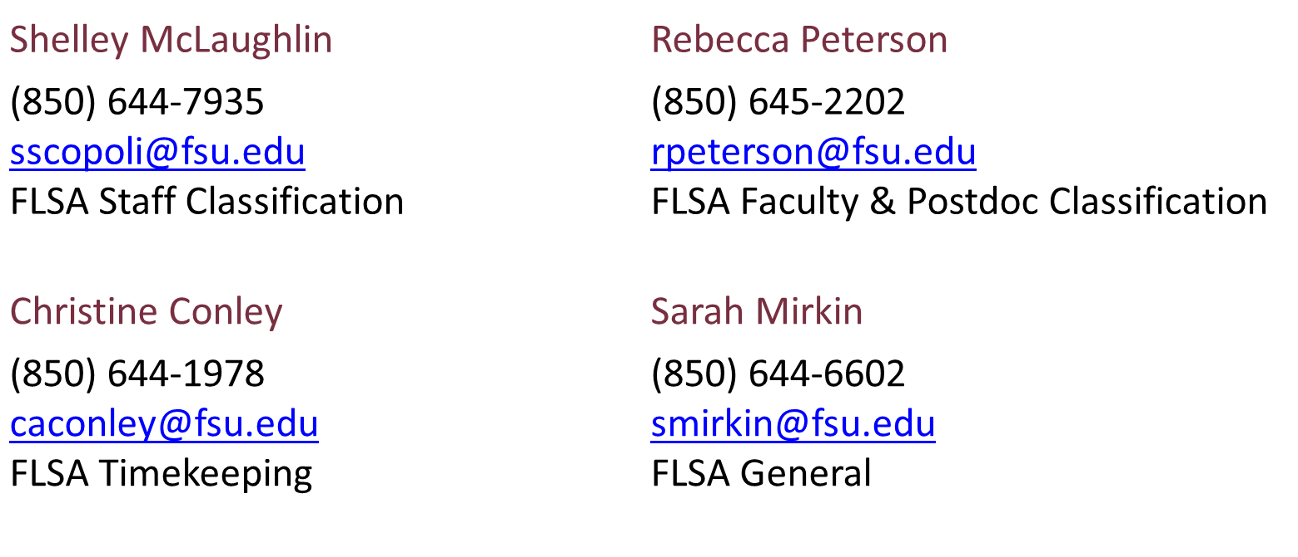
FLSA Resources & Contacts
HR FLSA Page
Training Schedule
Contacts:

