Slide 1
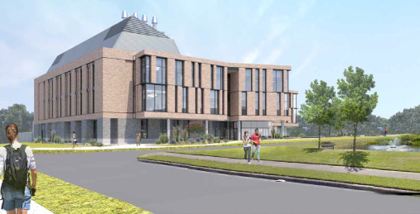
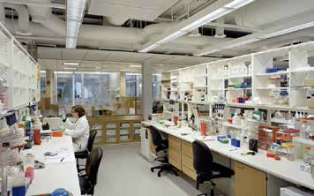
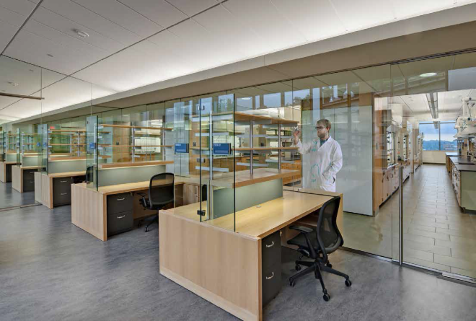
Aligning Laboratory and Related Research Space Infrastructure with Anticipated Growth of Faculty
October 21, 2016
Bruce Locke, AVP Academic Affairs
W. Ross Ellington, AVP Research

Slide 2
Looming Mismatch of Growth of Tenure-Track Faculty at FSU and Research Infrastructure
The roadmap for the Top 25 effort involves major investments in the hiring of a large number of new tenure-track faculty.
Performance and Preeminence metrics- a significant fraction of the new faculty hires will be in the STEM and health-related disciplines.
Many of these hires will require laboratories and other research-related spaces (such as computational suites, vivarium space).
The University has nearly reached its carrying capacity in terms of available and quality research space that could be offered to incoming faculty hires.
Additional capacity must be found if we are to achieve our goals.

Slide 3
Where will the additional capacity come from?
Renovation and repurposing of existing space.
Inventory has many 60s and 70s vintage buildings.
Some areas have deteriorated beyond usefulness.
Considerable base of current and projected vacant space.
All will require significant investments to achieve full functionality.
Internal resources are very limited.
(P)ublic (E)ducation (C)apital (O)utlay (PECO) funds required for the major renovation/repurposing projects.
New construction
Three new buildings with research facilities are currently on the FSU’s PECO priority list.
In recent years, PECO dollars have been very scarce.

Slide 4
The pathway to PECO is through the BOG, the Legislature and the Governor
The BOG: Each university provides a priority list to the BOG for PECO funds to renovate existing space and construct new buildings. The BOG
Takes into account each university’s space inventory and how effectively that space is utilized
Takes into account how each university’s PECO request aligns with the institution’s “Work Plan” goals
BOG then integrates the requests from all 12 institutions into a single BOG PECO priority list
The Legislature: Process is somewhat opaque but does generally conform to BOG priorities. Appropriated funds in total are always less than requested
The Governor: Historically, the line item veto mechanism has been used on certain SUS PECO projects.

Slide 5
A potential step forward
The University must demonstrate (and document) that existing laboratory and other specialized research space is being used as effectively as possible.
Allocation and continued occupation of such space by our faculty should be governed by policies adopted and administrated locally by each unit.
Some units on campus currently have such policies embedded in their respective by-laws.
This is a prudent practice which could be (arguably, should be) emulated by all units (departments, colleges, and centers/institutes) having control over laboratory and other specialized research space assigned to individual faculty.

Slide 6
A potential step forward
A Proposal- All academic departments, colleges (where appropriate), and centers/institutes would be required to have in place by-laws which address the following points:
How such space is assigned to new and current faculty.
How reallocation of such space is accomplished within the unit.
How the effectiveness of utilization of such space is regularly assessed and what metrics of productivity are used in this assessment.
The latter (the metrics) should include currencies of productivity critical to moving the university forward including scholarly productivity, contract & grant activity and mentoring of undergraduates, graduate students and postdoctoral fellows.

Slide 7
A potential step forward
Existing by-laws and new by-laws relating to such space could then be reviewed by the cognizant dean and forwarded to the Vice President for Faculty Development & Advancement for final approval.
This would apply to all units except centers/institutes and faculty occupying such space managed by the FSU Research Foundation (FSURF). FSURF would develop a similar policy within the same time frame.

Slide 8
Other potential steps
Creation of a dynamic database utilizing elements of Facilities’ AiM space inventory system
Documents functionality and space quality (= condition) by room in each FSU building
Maps faculty space assignments to rooms
Reviewed and updated by all units on an annual basis
Allows addition of new data fields on scholarly, research and student mentoring productivity to be mapped to space assignments

Slide 9
Other potential steps
Formation of a Space Management & Planning Council based in the Office of the Provost with participation of stakeholder groups
Ensures proper alignment of academic and research strategic goals with the planning for infrastructure needed to achieve these goals
Provides input on prioritization of allocation of resources to renovations and new construction
Oversees the periodic evaluation of effectiveness of space utilization

Slide 10
Feedback Most Welcome!

