Slide 1
Deans and Chairs Academic Affairs Update
March 27, 2017

Slide 2
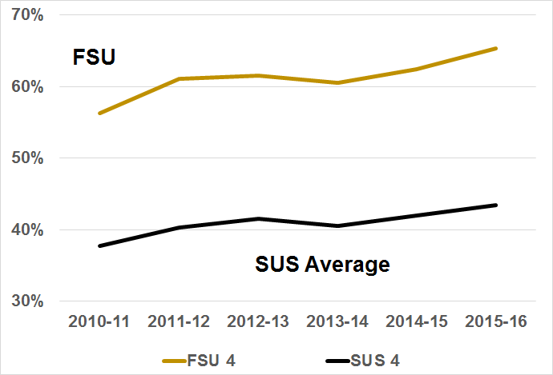
4-Year Graduation Rate vs. SUS Average
Note: Academic year represents graduation year
Notes:
We wanted to start with some great news! Our four-year graduation rate increased by 3 percentage points this year to be at 65.3%.
FSU is now in the ranks of the top 15 public universities in America for four-year graduation rates.
And we now only need 2.8 percentage points to beat UF and be the highest in the SUS! My wife thought I was ridiculous because the first night when I learned of these numbers I was tossing and turning all night with my mind racing about things we can do to improve the rate!
4 points behind UF last year
FSU: 60.5; 62.3; 65.3 now
We were 4 points behind last year;

Slide 3
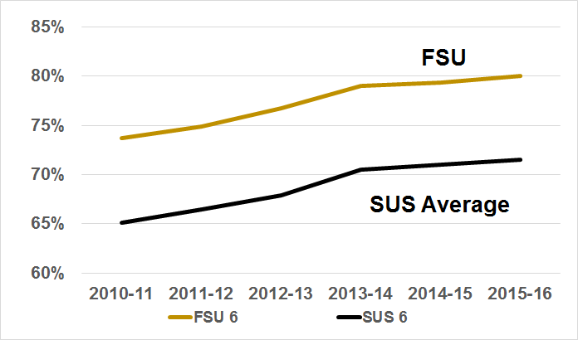
6-Year Graduation Rate vs. SUS Average
Note: Academic year represents graduation year
Notes:
And our 6-year rate is now at 80.0%, which puts FSU just outside the top 25 publics in the U.S.
73.8, 75.1, 76.9, 79.1

Slide 4
Performance Funding Update
Changes
Metrics 1 and 2 were modified
Metric 3 changed from Cost to Institution to Cost to Student (Tuition & Fees - All Aid)
Significantly improved
68 total points last year
81 total points this year
See handout
Notes:
RICK (scorecard and all metrics sheet)
Performance-Based Funding Metrics
As you know, much of our new and continued funding is dependent on how we fare on our performance funding metrics. The metrics changed this year so I want to share those changes with you and then discuss the preliminary results.
Metric 1 was changed to include a minimum earnings threshold of $25,000. They were also able to get data from 43 states, the District of Columbia and Puerto Rico. Most notably Georgia was added. Key states that are excluded include California, New York, Colorado and Massachusetts.
Metric 2 was changed to include wage data from the WRIS2 states. This increased our average wage data.
Metric 3 changed from Cost per Degree to the Institution to Net Cost per Degree to the Student. Simply stated, that is the sticker price for tuition, fees and books minus financial aid - including grants, scholarships and waivers.
Our performance Significantly improved: Each metric is scored on a ten point scale for the criterion measure and ten points for improvement. The higher of the two scores is what is reported on each metric. We improved from 68 points last year to 81 points this year.

Slide 5
 | Performance Funding Metrics | Scores |  |  | Points
# | Description | 2014-15 | 2015-16 | Change | 2014-15 | 2015-16 | +/-
1 | Percent Graduates Employed or Further Education ($25K) | 60.8% | 63.7% | 2.9% | 5 | 6 | 1
2 | Median Wages of Graduates | $34,200 | $35,700 | 4.4% | 7 | 8 | 1
3 | Net Tuition and Fee Cost (NEW) | $14,980 | $14,930 | -0.3% | 5 | 4 | -1
4 | Six-Year Graduation Rate | 79.3% | 80.0% | 0.7% | 10 | 10 | 0
5 | Academic Progress Rate | 91.0% | 90.4% | -0.6% | 10 | 10 | 0
6 | Bachelor's Degrees in STEM+SE | 39.1% | 42.8% | 3.8% | 5 | 7 | 2
7 | Access Rate (Pell Grants) | 28.4% | 27.7% | -0.7% | 8 | 8 | 0
8 | Graduate Degrees in STEM+SE | 42.00% | 45.99% | 4.0% | 7 | 8 | 1
9 | Faculty Awards | 2 | 7 | 5 | 1 | 10 | 9
10 | FSU Choice Metric (US News Rank) | 114 | 120 | 5.30% | 10 | 10 | 0
 |  |  |  | Total | 68 | 81 | 13
Notes:
RICK (performance funding scorecard)
Performance-Based Funding Metrics
The Table shown and in your handouts provides a list of all the performance funding metrics with the scores and points for the last two years. The areas highlighted in green are ones where we improved. Our total improvement was 13 points - a nice gain. You can see that we improved on eight metrics although the improvement was significant enough to gain more points in five of the measures.
Let me touch on the highlights.
Graduates employed or continuing education (61% vs. 64%) - this is a real gain not just the addition of data from other states.
Median wages of graduates ($34K vs. $36K) - this is a good sign as well.
Metric 3 changed from last year so the loss of a point there has nothing to do with our performance on this metric. Most schools lost points when they changed this metric.
We also continue to show sizable increases in our degrees awarded in STEM or Areas of Strategic Emphasis (Bachelor’s: 39% vs. 43%; Graduate: 42% vs. 46%) - We continue our efforts to grow these programs.
Faculty awards (2 vs. 7). Last year was a down year so we scored point this year based on improvement. I say “this year”, but the data reflect awards from 2014.
We have defined work groups to strategically address each of these metrics.

Slide 6
Preeminent University Update
We will meet 12 of 12 metrics to retain our status.
Challenges include:
Number of Post-Doctoral Scholars
National Academy Membership
Research Expenditures
Patents

Slide 7
Where can you help?
Percent employed or in graduate school
Median Wages
Four-year graduation rates – departmental incentives and hurdles
Degrees in Strategic Emphasis
Faculty Awards – National Academy Members
Post-Doctoral Scholars
Average Student Debt
Average Class Size

Slide 8
Strategic Plan
Deepen FSU’s Distinctive Commitment to Continuous Innovation
Amplify Excellence Across our Academic and Research Programs
Realize the Full Potential of Diversity and Inclusion
Ensure Student Success on Campus and Beyond
Prepare our Graduates for 21st Century Careers
Invest Strategically in Our Institution and Reputation

Slide 9
Strategic Plan
Implementation Team reporting to Cabinet
Work Groups for each Major Goal (6)
Identifying Key Objectives
Creating Strategies
Establishing Outcome Measures/Metrics
Developing Tracking Mechanisms
Goal: Publish action plan by Summer 2017
Notes:
We just looked at the status of the Performance Funding Metrics. We have also been tracking our Preeminence Metrics and our Top 25 metrics. You have a handout that identifies each of the 39 metrics we are tracking and strategically addressing. This past Fall, you approved the Strategic Plan. The BOT and the Cabinet have made it clear that his will be a living plan that will affect our actions as a university for the next few years and beyond.
With that in mind, we have identified a Strategic Plan Implementation Work Group that is creating the roadmap for the implementation.
The implementation team will define a Steering Committee that will report to report to BOT academic affairs committee and cabinet
We will also identify team leads for each of the six primary goals of the plan. There are some cross-cutting themes in the plan that we will address as well.
Each team lead will have a working group and their objectives will be to identify strategies that will address the goal, identify metrics to measure performance and identify data needs. The Steering Committee will be defining the tracking mechanisms and reporting dashboards.
The plan is to publish a detailed action plan this summer.
100K of pages for our SACS; narrowing in our our representative metrics; reduce admin burden

