Slide 1
Student Affairs
Deans and Department Chairs
March 20, 2018

Slide 2
Student Union

Slide 3
Fraternity and Sorority Life/RSO
Timeline
November 6: Indefinite Interim Suspension issued
January 29: Recruitment and philanthropy permitted
March 19: Start of educational programming efforts
Moving Forward Together Plan
Expectations and Values
Oversight
Risk Reduction

Slide 4
Fraternity and Sorority Life/RSO
Expectations and Values
2.5 average GPA for each Chapter
Mandatory Orientation prior to joining for recognized organizations and fraternities and sororities
Oversight
Published scorecards online
Required advisory boards
2 visits from National fraternity/sorority leadership
Improve staff/student ratio (1:2000 to 1:1000)
Risk Reduction
25% reduction in length of new member ed program (IFC)
Limited number of socials and date functions
75% of membership participation in University education

Slide 5
Health and Wellness
Healthy Campus at FSU
Initiative that connects academic success to healthy student behaviors
Executive Steering Committee co-chaired by Provost and VPSA to launch this Spring
Health and Wellness Portfolio
Associate Vice President for Student Affairs position

Slide 6
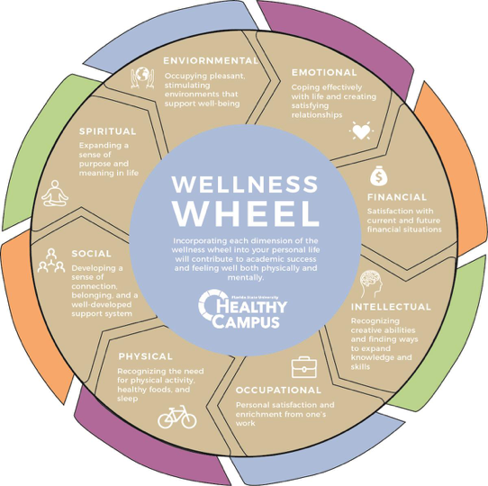

Slide 7
Students of Concern
Faculty/Staff Emergency Guide
Signs of a distressed student
How to Report
www.report.fsu.edu
If you feel the student is a danger to themselves or others, or if there is immediate threat, contact FSUPD at 850-644-1234 or 911
If you are unsure of how to best proceed, always feel free to contact the Dean of Students Department at 850-644-2428 for consultation.

Slide 8
Questions?

