Slide 1
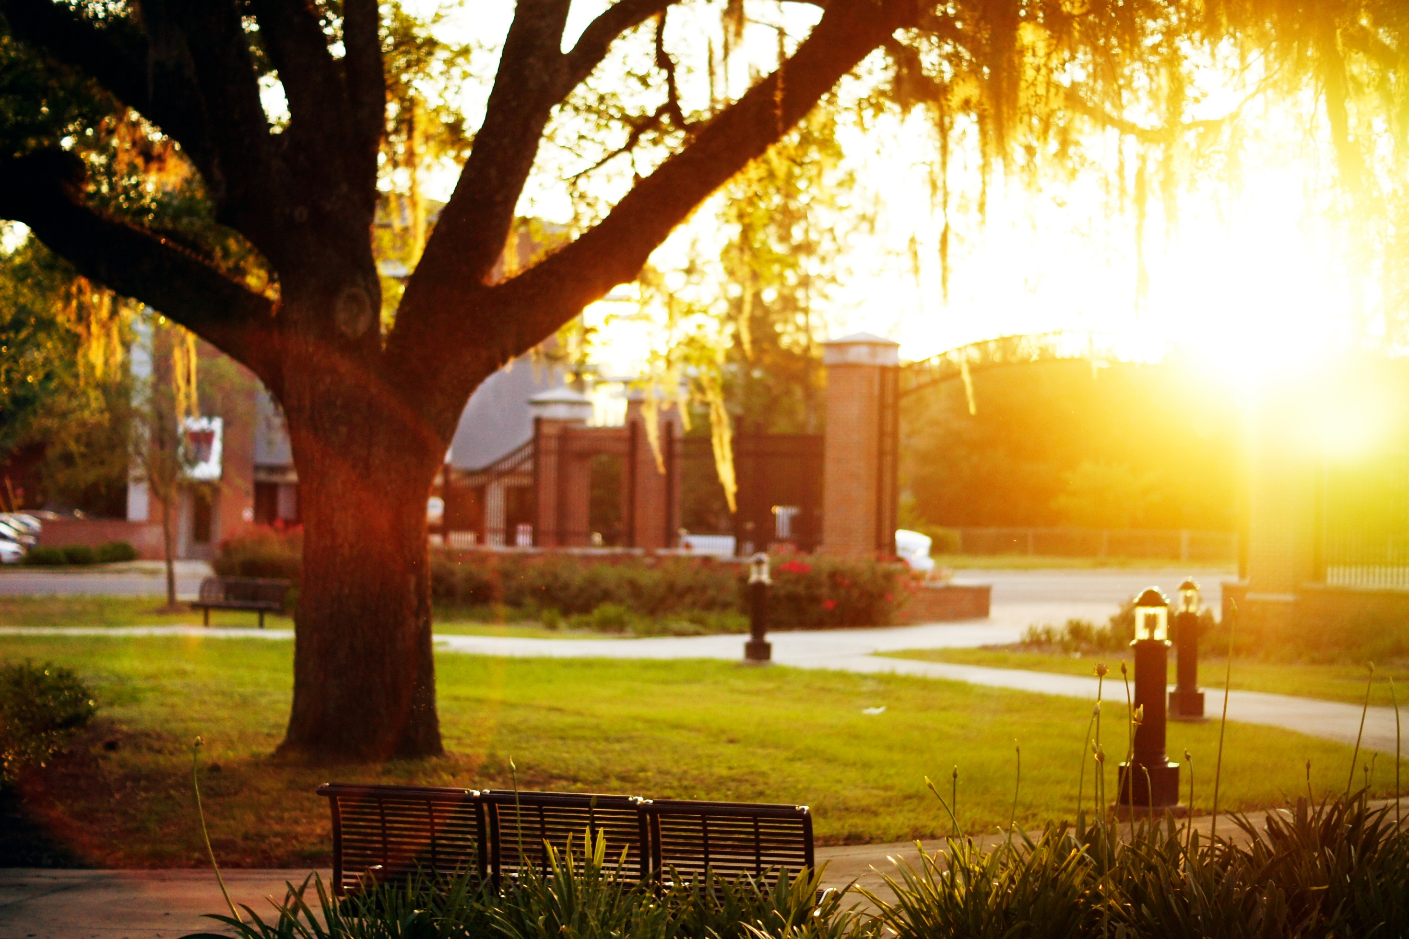
DEANS AND CHAIRS
Sally McRorie Provost
March 2018

Slide 2
Overview
Strategic Plan
Student Success
Admissions and Recruitment
Class Size Initiative
Standard Meeting Times Initiative
FL Civic Literacy Requirement
Faculty Hiring Initiative
Metrics and Rankings Handout

Slide 3
Strategic Plan Update
Completed draft metrics and initiatives (next slides)
Colleges are aligning their efforts with university’s plan
University-wide work groups are drafting action plans for key initiatives
Will continue to guide resource allocation as plan is implemented
Notes:
Implementation committee has identified key initiatives and associated outcomes, which I will show you on the next slides. The deans have identified tactics they are under to support these initiatives. We are identified work groups that rea creating action plans for institutional wide initiatives. They will be drafting tactics and identifying resources to be successful.
What is important for you: Because the strategic plan is part of our SACS accreditation, we have to demonstrate that the plan is the basis for resources allocations on campus.
Need everyone to support the plan, and as you move forward, we need everyone to be working building toward the plan.

Slide 4
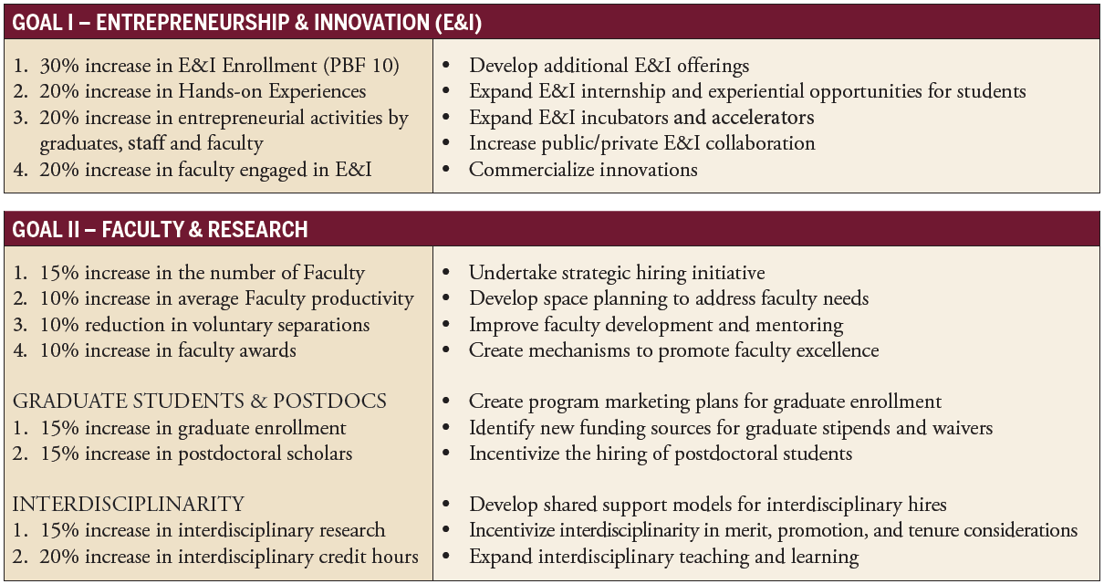

Slide 5
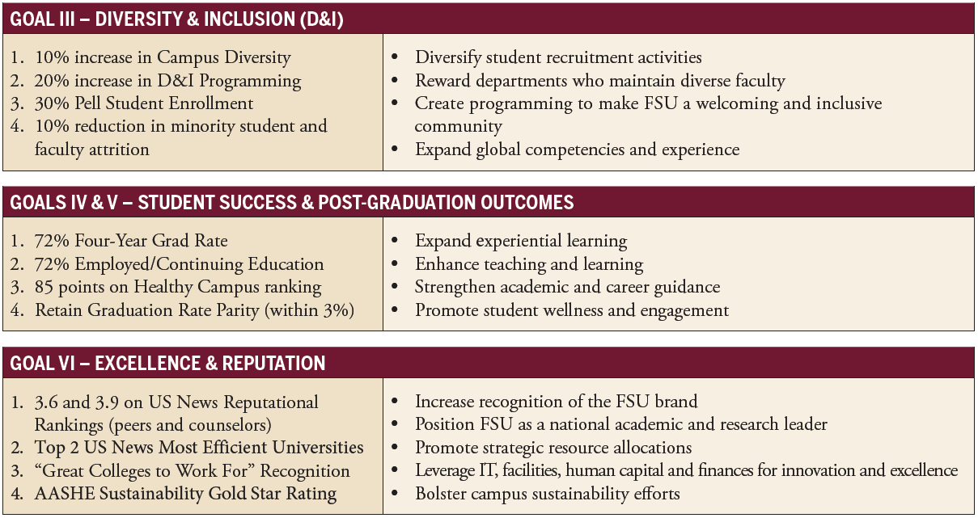

Slide 6
Branding Update
The strategic plan asks us to – “Promote and enhance FSU’s reputation”
Create and disseminate “a global identity for FSU that reflects the university's impressive academic strengths and achievements”
FSU has also joined The Conversation, a non-profit which helps faculty members share their scholarly expertise with wider public (see handout)
Will be on campus April 16th & 17th to start meeting with faculty members
BVK, a Top 25 national branding firm, has been hired to help FSU craft and test branding, key narratives, and strategies.
Notes:
The Conve

Slide 7
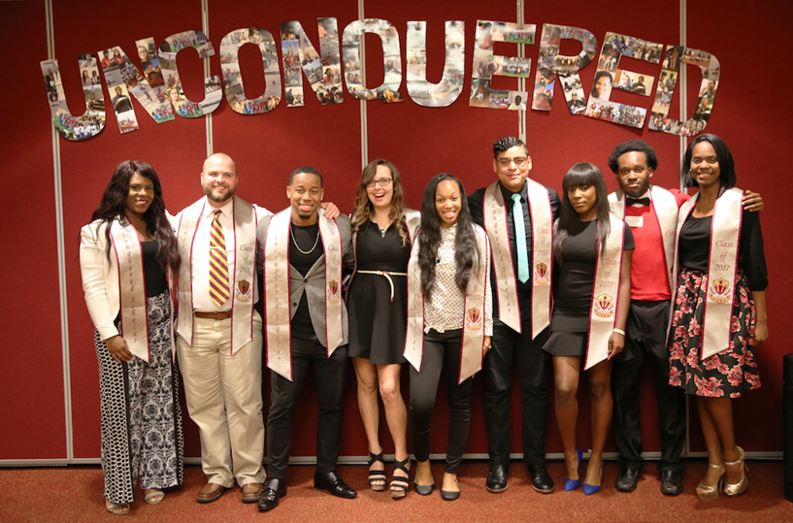
We continue to be recognized as a national leader in student success
Record student success (top 15):
2017 retention rate up to 94%
4-year graduation rate up to 68% (just ahead of UF for first time)
Performance-based funding shifting from 6 to 4-year grad rates this year
Working with departments to support their efforts to elevate student success
Notes:
It’s been a really long time since some of us have looked at our curriculum, and so much has changed, are we unnecessarily slowing students down? Are we offering enough seats? Do we have our pre/co req in order? Are they taught at a frequency for students to advance? Are the important classes taught at times where students can take them with enough seats? Where are students struggling in the curriculum, and how are we building learning experiences to ensure that all of our students are learning as much as possible?

Slide 8
Some Student Success Questions to Consider
Are students able to get what they need from our curriculum?
Are we offering enough seats?
Do we have our pre/co-requisites in order?
Are courses taught with enough frequency for students to advance?
Are the important classes taught at times where students can take them?
Where are students struggling in the curriculum, and how are we building learning experiences to ensure that all of our students are learning as much as possible?
Are we giving the right support to the most important, lower-division gateway courses that are foundational for later success?
Notes:
It’s been a really long time since some of us have looked at our curriculum, and so much has changed, are we unnecessarily slowing students down? Are we offering enough seats? Do we have our pre/co req in order? Are they taught at a frequency for students to advance? Are the important classes taught at times where students can take them with enough seats? Where are students struggling in the curriculum, and how are we building learning experiences to ensure that all of our students are learning as much as possible?

Slide 9
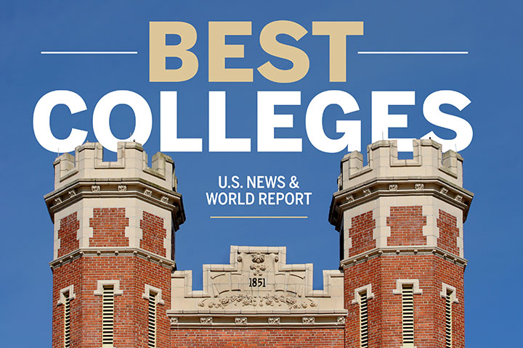
Admissions update
Record 51,016 freshman applications
Fall 2018 Admitted Student Profile:
4.3 Avg. GPA (4.1-4.5)
1340 Avg. SAT (1290-1400)
30 Avg. ACT (28-32)
Graduate and Medical Admissions:
Record 7,200 applications for 120 spots in the MD program – among the most competitive in country. 1,600 applications for 50 spots in new PA program.
Graduate School applications continue to rise to near-record levels – due July 1
New graduate recruiters working with departments & NC-SARA opens new markets
Notes:
Talking points really hammer on SN

Slide 10
Class size Initiative Update
Class size is one of the key areas for student success, and national rankings
Projected to reduce the size of up to 800 course sections across the university
Example: Reducing many calculus courses (common obstacles to student persistence) to under 20 students, allowing for new teaching approaches and deeper learning

Slide 11
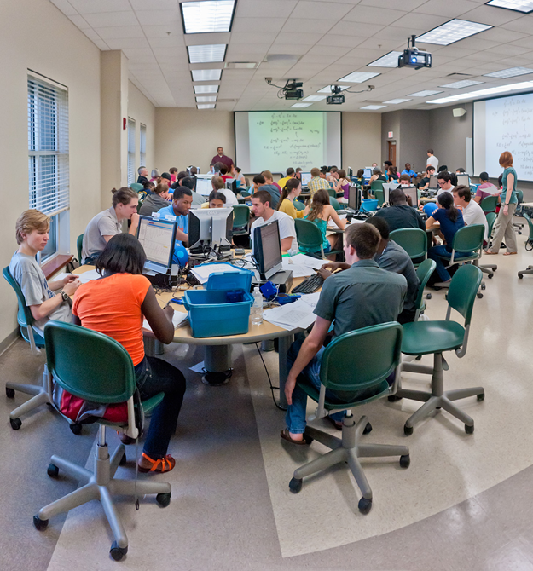
Class Size Initiative: Common Methods
1) Additional Instructors:
Leverage new faculty hires committed last year
Teaching Postdocs model (teaching 2/2 load)
Teaching Faculty (including visiting)
Graduate Student Instructors
2) Redesigned Larger Lecture Courses:
Change to small group, discussion-based
Convert to one lecture per week, with small group discussions the rest of the week
3) Partnering with Center for Advancement of
Teaching (CAT) on course design for maximum learning
Notes:
(e.g., hiring graduating PhD students for one-year visiting/professional development period)
Crim berley model
CAT
Tom blomberg become known as berkely model in crom

Slide 12
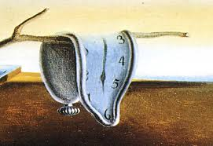
Standard Meeting TIME Initiative update
Fall 2017 began an effort to increase use of FSU’s standard meeting times for courses
Increasing the use of standard meeting times allows for better space optimization:
Allows students to get the classes they need to graduate on time, removing unnecessary class overlaps
Improves space utilization – important for building and renovation funding requests
Accommodates creation of more sections – improving ability to offer small classes
Notes:
In Fall 2017, FSU began an effort to increase the use of standard meeting times
Want to especially thank the units that are now at or above 80% standard meeting time utilization for undergraduate courses, including:
Business
Criminology
Hospitality
Social Sciences
There is still much more to go across campus. Continuing this effort is important; standard meeting times supports optimization of class schedules:
Allows for reduced class sizes by using the full range of available times
Increases space utilization, important to receive more funding for buildings
Allows students to get the classes they need to graduate on time, removing unnecessary overlaps
Promotes class attendance throughout each day and on Friday – reinforcing the expectation that students should be taking classes on Friday

Slide 13
Standard Meeting Times Initiative update
Courses scheduled on Standard Meeting Times are up to 43% from 35% (Fall 2018 versus Fall 2017)
This is a meaningful change, but there is still work to be done
Yet, we remain well below our peers
Notes:
When we approached you with our concerns about Standard Meeting Times, many of you did a good job of defining the constraints of your programs and how some of those reduce the ability to have all courses on a standard meeting schedule. I am happy that even in those disciplines, there have been cases of great improvement.
With that said, we are still well below the rate of our peers on the percent of courses offered in Standard Meeting Patterns. We still have well less that half of our courses offered in standard meeting times. We still have over 950 meeting patterns that are not standard. We are making progress, but we will need to improve.
I appreciate your continuing cooperation with adoption of standard meeting time scheduling and anticipate further improvements.

Slide 14
Civic Literacy Requirement
Florida Statute: New civic literacy graduation requirement for all Florida colleges and universities effective 2018
Students in Florida can meet the requirement through:
Passing or earning test/transfer credit for POS1041 American Government or AMH2020 Introductory Survey Since 1877
Passing the U.S. Naturalization and Citizenship Test (FSU will administer with help from Testing Center)

Slide 15
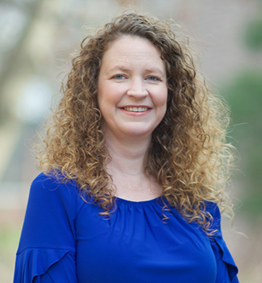
Faculty hiring update
Carrie Pettus-Davis, Associate Professor, College of Social Work
Formerly faculty at Washington University in St. Louis
Will lead $1 million grant-funded research initiative on the re-entry of incarcerated persons into communities
Nicole Terry, Professor, FSU’s College of Education & Florida Center for Reading Research (FCRR)
Formerly executive director of the Urban Child Study Center at Georgia State University
Will direct new interdisciplinary Center on Children and Families
Total funded grants to date: ~$6 million
Notes:
Recuriting all the candidates with new hi

Slide 16
THANK YOU!

