Slide 1
Spring 2018 Deans & Department Chairs Meeting Research at FSU
Gary K. Ostrander Ph.D.
Vice President for Research
President, FSU Research Foundation

Slide 2
Today’s Topics
Research Funding Trends
Space
Interdisciplinary Research & Commercialization Building (IRCB)
CRC Grants
New Hires
2019 Retirement - ???

Slide 3
FY-17 vs. FY-18 Overview of Proposals, Awards and Dollars
CATEGORY | # PROPS FY17 | # PROPS FY18 | PROP CNT DIFF | # AWDS FY17 | # AWDS FY18 | AWD CNT DIFF | $ AWDS FY17 | $ AWDS FY18 | AWD $ DIFF
Federal | 615 | 523 | (92) | 437 | 422 | (15) | 96,573,925 | 93,345,813 | (3,228,112)
State | 90 | 78 | (12) | 108 | 115 | +7 | 15,953,494 | 21,162,978 | 5,209,483
Other | 239 | 198 | (41) | 284 | 249 | (35) | 15,533,472 | 15,619,577 | 86,106
TOTAL | 944 | 799 | (145) | 829 | 786 | (43) | 128,060,891 | 130,128,368 | 2,067,477

Slide 4
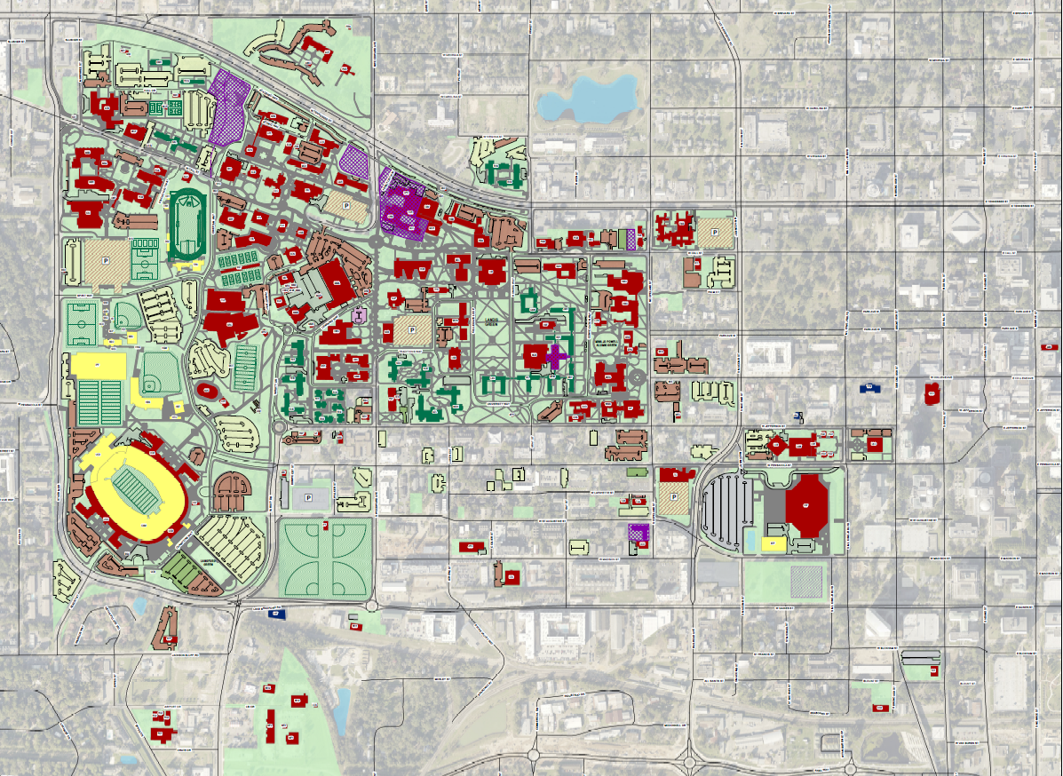
Space

Slide 5
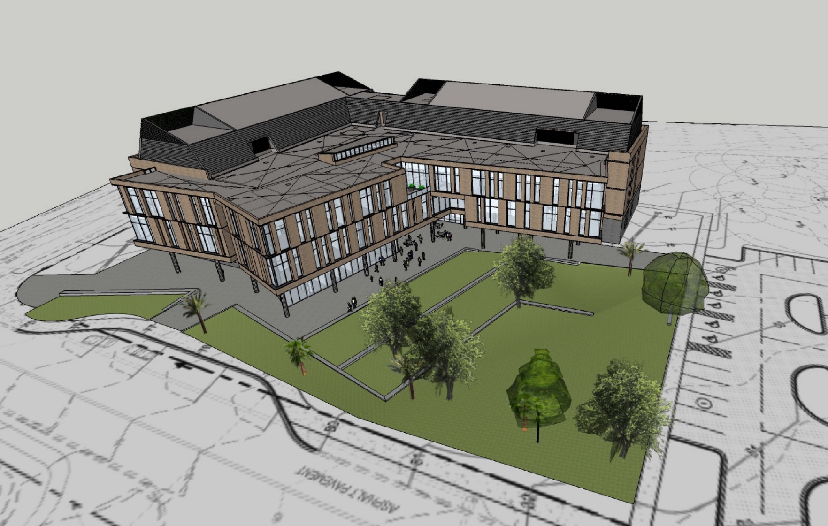
Interdisciplinary Research and Commercialization Building (IRCB)

Slide 6
CRC
~ $2.5M dispersed each year
Proposal numbers increasing
FYAP

Slide 7
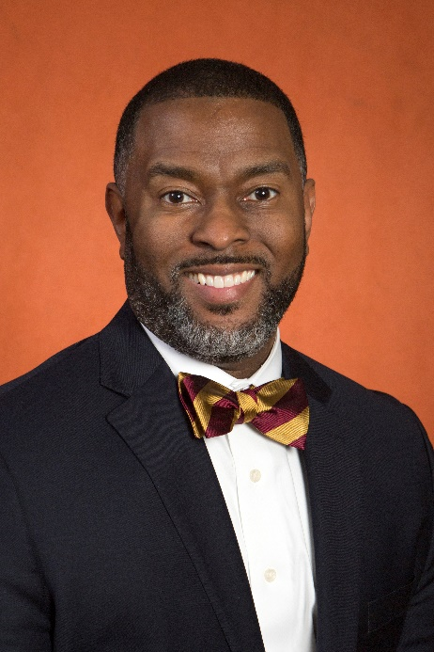
New Hires
William Allen Hill, DVM, MPH,
DACLAM, CPIA
Director, Laboratory Animal Resources and
Attending Veterinarian

Slide 8
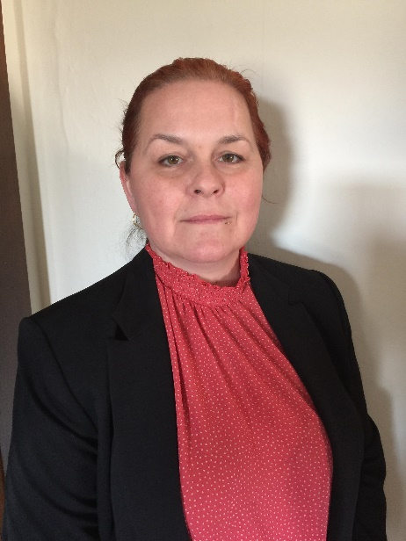
New Hires
Stacy Carey
Director of the Office of Human Subjects

Slide 9
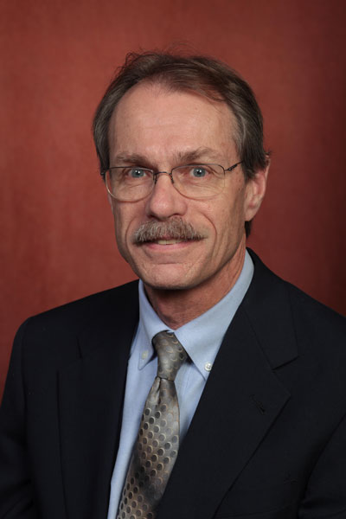
2019 Retirement
Dr. Ross Ellington
37 years at FSU
11 years as Associate VP Research
Search Process

Slide 10
Thank You
Questions?

