Slide 1
Update on International Graduate Applications:
Increasing the likelihood that departments secure the highest caliber graduate students.
Creating increased efficiencies
Reducing workloads & time to admit
Improving yield rate

Slide 2
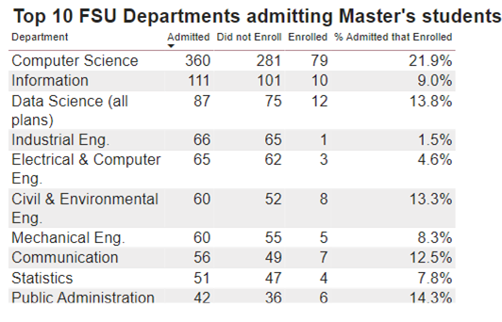

Slide 3
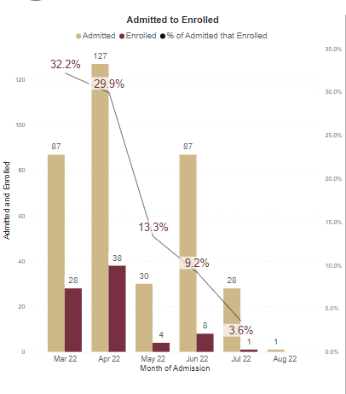

Slide 4
Graduate Applications and Improving Yield Ratios
International applications continue to reach record levels.
Increased workload on academic departments, CGE, and the Graduate School.
In an effort to increase our international application yield and future enrollment numbers, a Presidential Task Force on Internationalization, was formed co-chaired by the Provost and Vice President Hecht.
Over the past six months, carefully examined the recruitment, application, admissions, and Visa process to recommend improvements or efficiencies.
Met with the top ten international student enrollment departments and took a deep dive into possible solutions to improve the whole process for FSU and the applicants.
Steps identified to create increased efficiencies, reduce the processing workload & time to admit, improve the yield rate, and increase the likelihood that departments secure the highest caliber graduate students.
These plans were warmly received at the Academic Deans Council in September. ☺

Slide 5
Graduate Applications and Improving Yield Ratios
Plan is to Step 1:
Implement a NACES approved, SLATE compatible credential evaluation requirement for all international applications (Nov. 2023).
Game-changer since:
Uniform validation of individuals and schools attended (align us with the practices of the vast majority of the top 25 public and SUS institutions)
Calculate GPA and Upper-Division GPA, saving our departments thousands of hours!
Allow us to process applications faster
Improve yield rate and quality

Slide 6
Graduate Applications and Improving Yield Ratios
Step 2:
Implement additional efficiency tools and processes (Spring 2024).
Create aging reports and “point-in-time” reports
Continued standardization of application deadlines across schools/colleges
Step 3:
Improve, standardize, and make more efficient letters of offer (Fall 2024).
Implement increased standardization of deadlines (Fall 2024).
Establish separate deadlines for international students (applicant deadline, Dept decisions, Grad. School decisions, and I-20 requests to CGE.
Establishing additional policies to provide guidance on late enrollees, re-applications, and the recension of decision process (Fall 2024).
Note: Dates are “Roll-Out” dates thus Fall 2024 is for Fall 2025 cycle

Slide 7
Graduate Applications and Improving Yield Ratios
These items require extensive planning and coordination with multiple units, and so the timelines above are our best estimates for when they will be implemented.
We will be in touch with additional details and implementation specifics as plans unfold ..... TBC! ☺
Conversations this week with:
Council of Associate and Assistant Deans (CAAD)
Graduate Enrollment Management Committee (GEMC)
GO NOLES ☺ and TBC ☺

