Slide 1
Research Update
Stacey S. Patterson, Ph.D.
Vice President for Research President, FSU Research Foundation
stacey@fsu.edu

Slide 2
FSU Research by the Numbers
Fiscal Year | Proposals | Awards | Expenditures
2022 | $730.3M | $287.3M | $356M
2023 | $873.6M | $301.9M | TBD
$14.5M NIH grant to foster diverse perspectives in health science research!
National High Magnetic Field Laboratory receives $195M renewal through 2027!
$72.7M NIH grant to lead an adolescent HIV clinical trial network!
Notes:
Proposals up 19.6%
Awards up 5.1%
Expenditures – too early to be sure, but estimating at least 10%

Slide 3
Director Search
Notes:
I thought I would start out with an update on the Magnet Laboratory Director search, which is why Stacey is not available today. After 20 years as the head of the National High Magnetic Field Laboratory, Greg Boebinger is stepping down from his post and we are in the middle of a national search for his replacement. We have 5 candidates visiting campus. Some were here last week, and we have a couple here this week. Once this round of visits have been completed, two will be asked back for a second visit. They will visit all three sites (here, Los Alamos and the University of Florida) before a final decision are made.

Slide 5
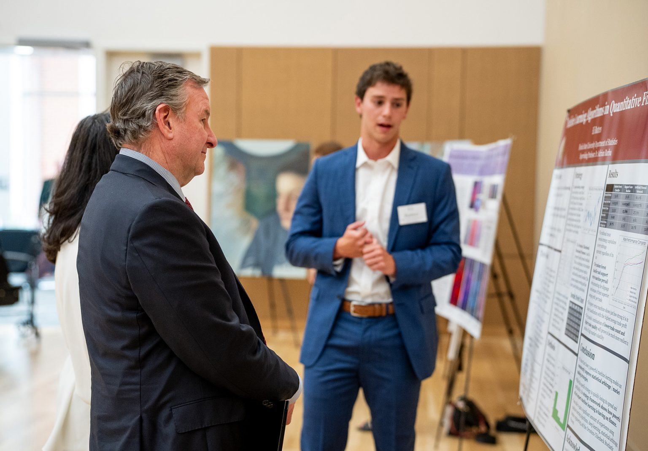
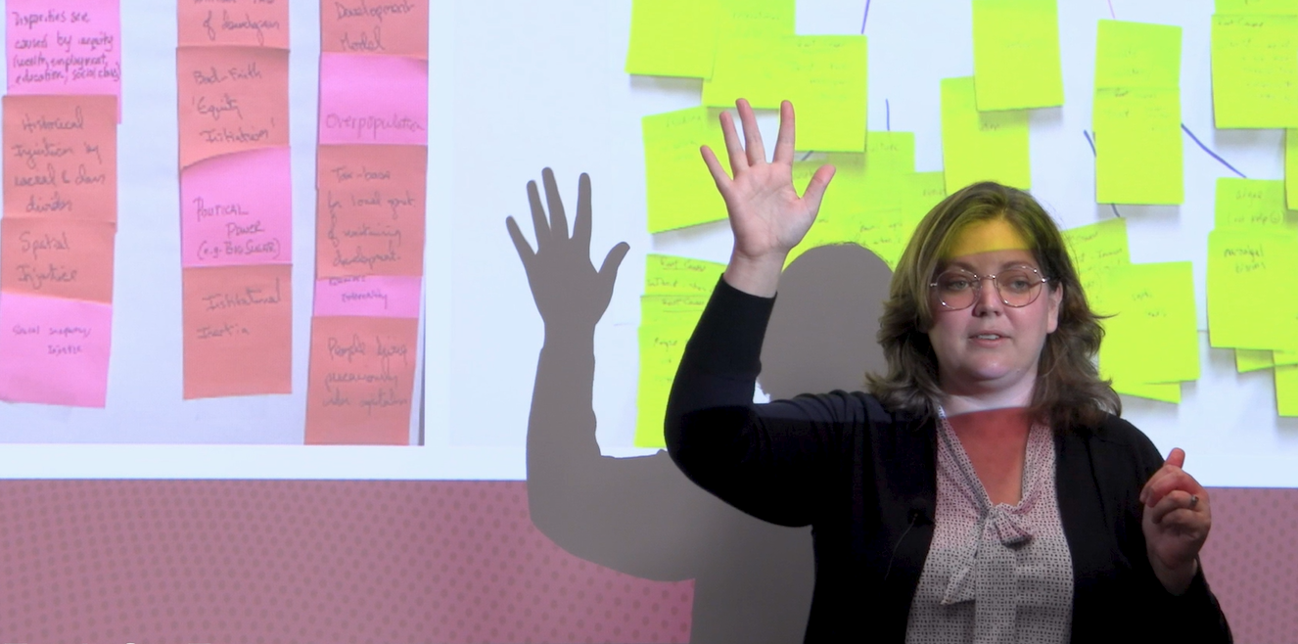
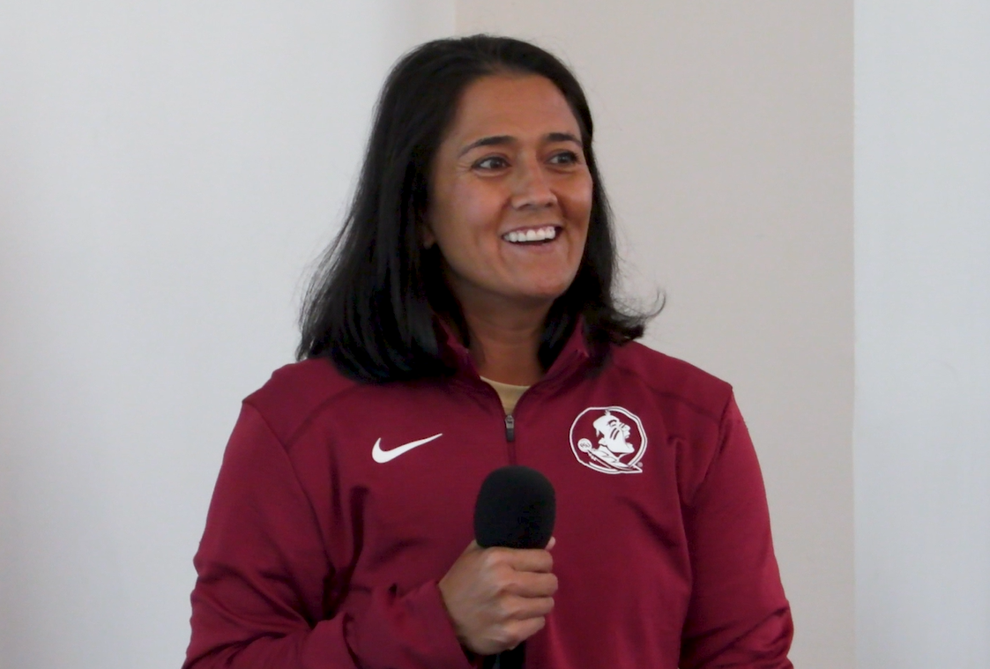
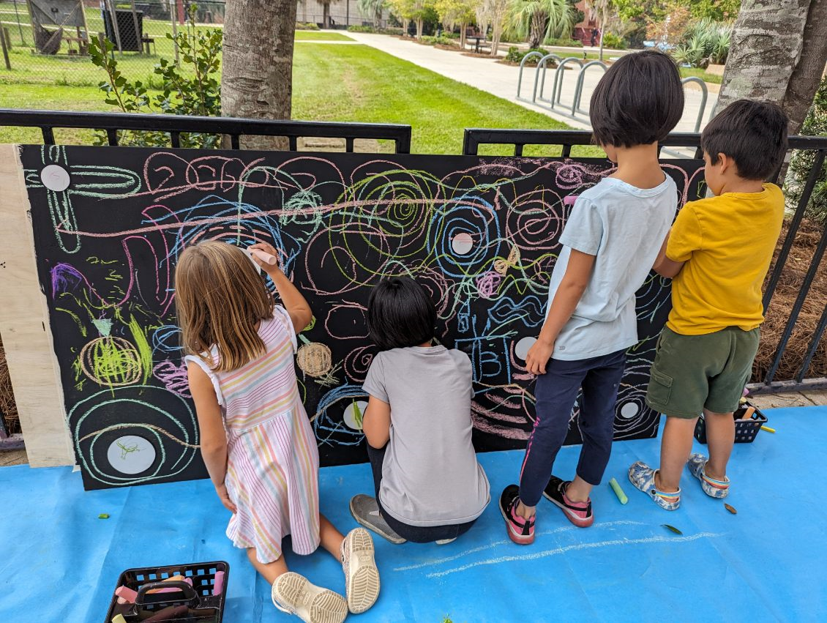
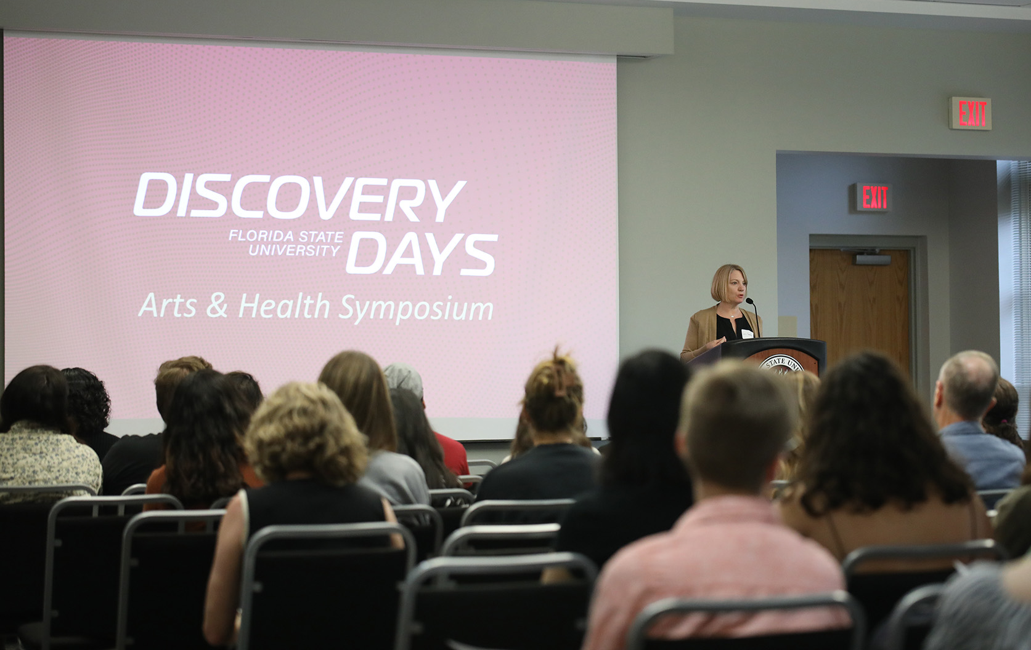
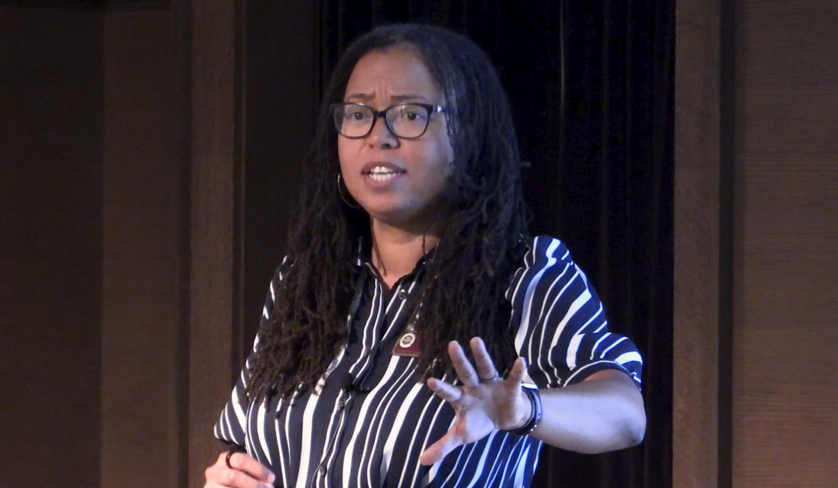
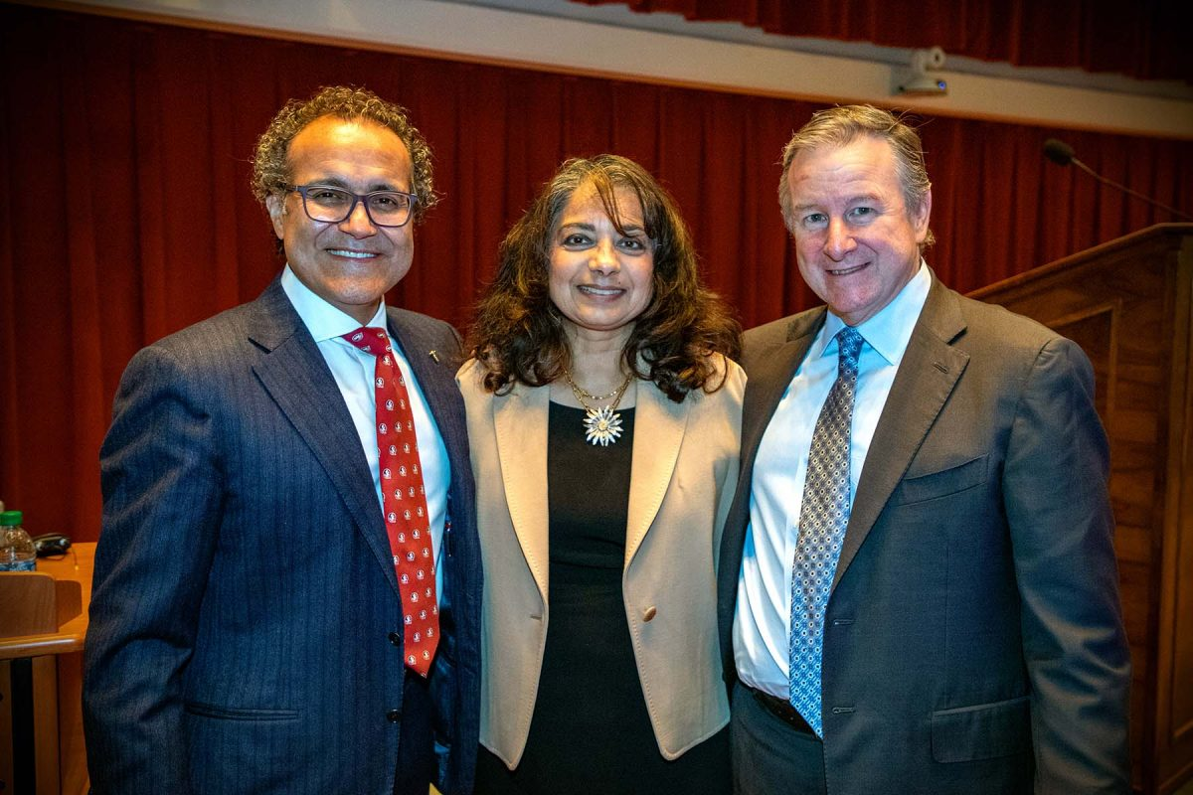
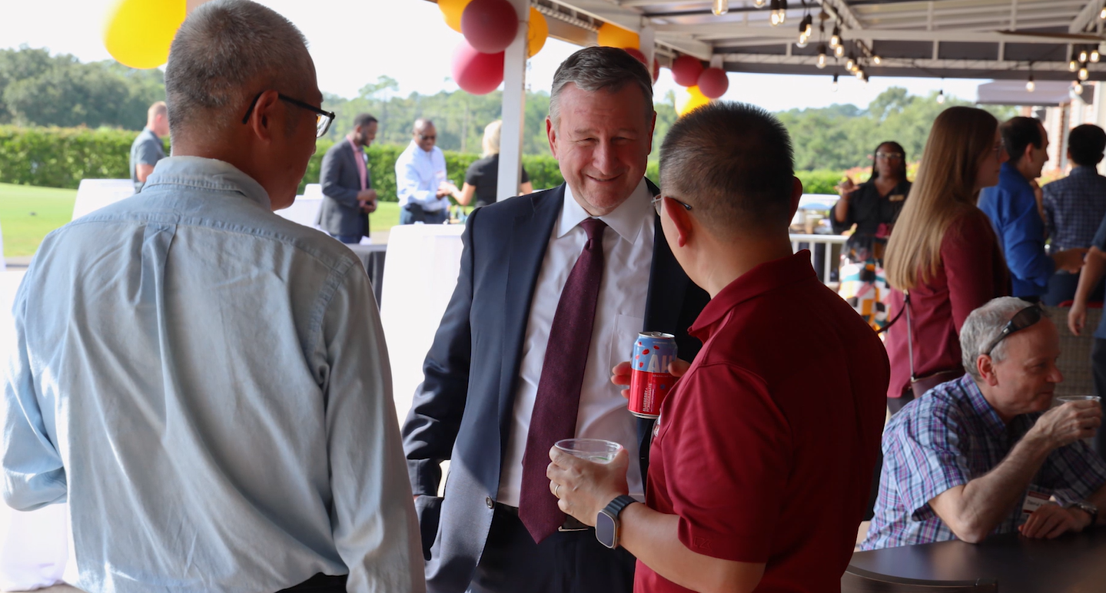
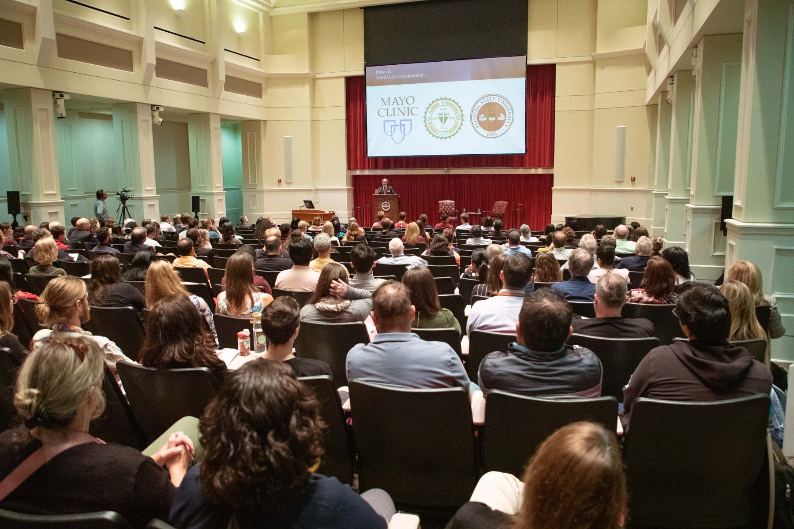
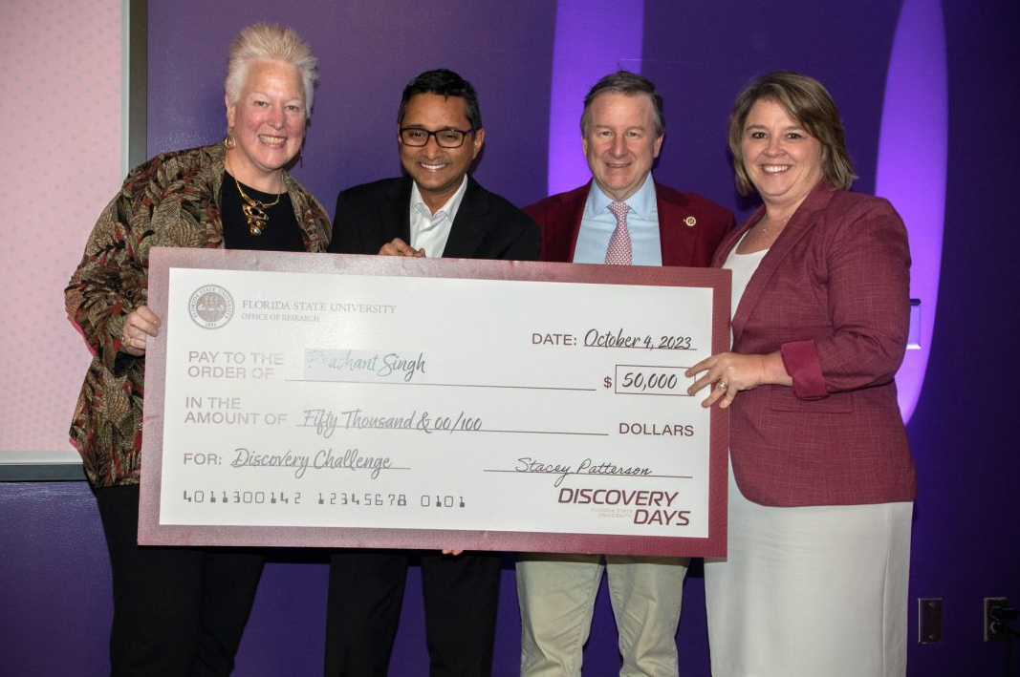
Thank You
Notes:
Thank you so much to all of those who were engaged in Discovery Days the week before last. Some colleges hosted events to coincide, and next year we are hoping for even more. In all 17 events were held over 6 days with approximately 2,000 attending the combined events. $100,000 was also given away to help researchers develop their work. Next year’s discovery days is already being discussed so look for something from Stacey about next year’s dates. We hope to have even more partners in year 2!

Slide 7
Developing a World-Class Academic Health Center

Slide 8
Building Infrastructure
Clinical Research Support
Office for Clinical Research Advancement (ORCA)
Biostatistician support
Clinical trials study coordination
Pilot Clinical Trials & Research Unit (CTRU)
Clinical research space on campus (2200 sq-ft)
Health Data Science
REDCap – secure data platform that is HIPPA-compliant
Implemented the Harvard Dataverse– repository for data
Developing reciprocal agreements for data sharing with TMH and others
Joint Recruitments with TMH
Formal partnership with Mayo
NIH Clinical and Translational Science Award

Slide 9
Current Focus
Resource planning – Research, Clinical Practice, and Health Education
Leverages the work and recommendations from the visioning committees
Prioritizes opportunities and needs
FSU Health Building 1
Site selection and readiness evaluation
Facility Programming
Avoid duplication
Promote high-impact opportunities
Partnership and governance determination
Models that work
Community insights – Transformation Committee

Slide 10
FSU Health – TMH Transformation Committee
Understand the strategic direction and goals of FSU and TMH
Identify areas of goal alignment
Provide input on the community’s goals for the FSU -TMH relationship
Explore successful Academic Medical Centers and identify critical success factors
Delineate “guardrails” for the FSU -TMH relationship
Ensure key constituents are engaged & both organizations are committed to the process and the results
Purpose
Committee Role
Provide guidance to FSU and TMH on appropriate organizational structures for the FSU Health-TMH relationship that facilitates both organizations’ strategic goals and optimizes community benefits.

Slide 11
Academic Health Centers Typically Fall Into One of Five General Models
Strategic Alignment
Interrelated
FPP Owned by SOM
FPP Owned by AHS
Fully Integrated
While these five model types are the general categories of AHC structures, each AHC is a somewhat unique entity and typically does not fit neatly into any one of the model types. Each AHC’s structure reflects its historical development as well as its specific political and economic/financial situation.
Univ/SOM
FPP
AHS

Slide 12
What’s the best model for FSU-TMH?
Key Considerations:
Governance (possible DSO structure)
Membership
Financial oversight
Operating agreement
Licensure
Leasing arrangements
Employment agreements
Co-branding opportunities/strategies
Shared research infrastructure

Slide 14
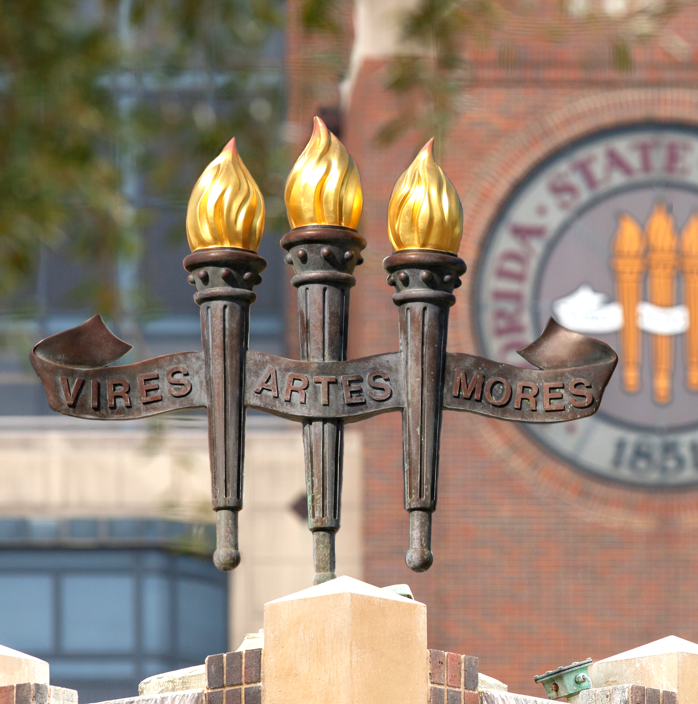
Notes:
Next, an update on ASPIRE which is A Strategic Plan Inspiring Research Excellence. We are currently engaged in the strategic planning process, I would say about half way through our meetings. The approach we are using engages your faculty heavily in the process and it will be their recommendations that will serve as the foundation for the Office of Research’s final strategic plan. I want to say how impressed I am with all of the faculty members with their efforts to gage their colleagues and to come to the meetings with great insights.

Slide 15
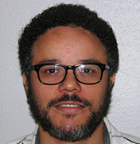
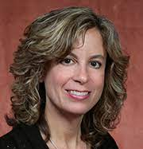
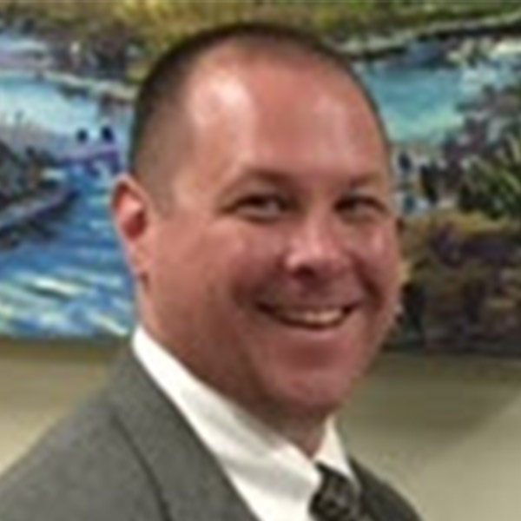
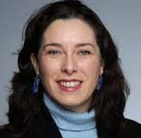
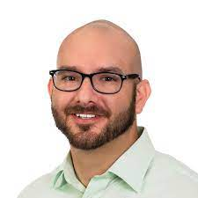
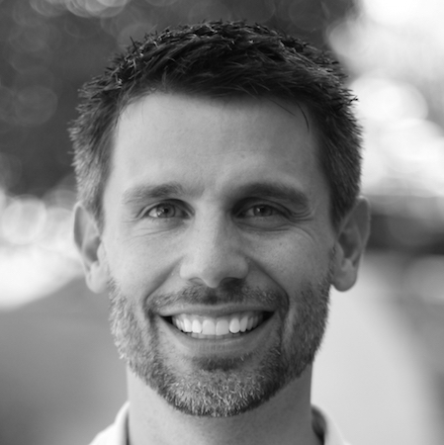
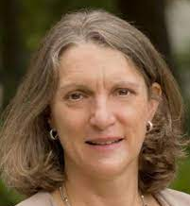
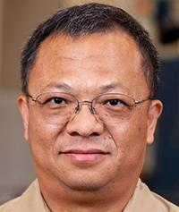
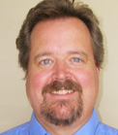
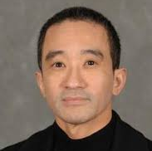
ASPIRE COMMITTEE MEMBERS
 | Ali Bangura Mag Lab |  | Heather Flynn Medicine |  | Jake Linford Law
 | Brian Barton Graduate School* |  | Jonathan Fozard ITS* |  | Marcia Mardis Communication & Inform.
 | Neelam Bharti Libraries* |  | Carolina Gonzalez A&S-Modern Lang. |  | Meredith McQuerry Entrepreneurship
 | Bridget Birmingham Faculty Senate President |  | Matt Hauer Social Sci. & Pub. Pol. |  | Josh Newman Education/HHS
 | Patricia Born Business |  | Roxanne Hughes MagLab |  | Yaacov Petscher Social Work
 | Jennifer Copp Criminology & Criminal J. |  | Katie Kehoe Fine Arts |  | Harrison Prosper A&S-Physics
 | Sarah Eyerly Music |  | Richard Liang Engineering |  | Gary Tyson Arts & Sci-Comp. Sci.
 | Debi Fadool A&S-Bio & Postdoc Dir. |  | Nathan Line Hospitality |  | Frankie Wong Nursing
*members representing overarching areas
Notes:
As a reminder, we have faculty members participating from all over campus. Here are the members in case you may not recall who your member is.

Slide 16
4 Teams 5 Topics
Each team will address the same 5 topics:
People
Partnerships & Innovation
Grand Challenges
Infrastructure
Scholarship & Excellence
Notes:
They have been broken up into teams of 4 and are participating in 5 topic sessions, with specific focus areas. (list the areas)

Slide 17
Notes:
Currently, we are about halfway through the sub-group meetings, some are further along than others, and in about two weeks from now that part of the process will be concluded. Leads from each of these teams will then be meeting to determine the final recommendations. Once the draft plan is created, Stacey will be hosting three open forums where faculty and staff can weigh in on the draft. The final plan will be rolled out in the new year.

Slide 18
Upcoming CRC Deadlines (2023-2024)
First Year Assistant Professor (FYAP) October 26
Small Grant Program (SGP) November 30
Honorary Awards:
Distinguished Research Professor (DRP) Award
Developing Scholar Award (DSA)
Developing Specialized Faculty (DSF) Award
Distinguished University Scholar (DUS) Award
Arts & Humanities Program Enhancement Grant (AHPEG) February 8
Equipment & Infrastructure Enhancement Grant (EIEG) February 29
Seed Program February 29
January 26
Notes:
So let's start with my area which is research development,

Slide 19
Upcoming Workshops
Next Month:
How to Fund a Research Center- Tuesday, November 14 | 1:00 - 2:30pm
Later this Semester:
NEA Grants for Arts Projects program workshop. NEA’s largest funding program, with funding opportunities in 15 different arts disciplines.
January:
DOD Medical Research Programs Webinar
https://www.research.fsu.edu/research-offices/ord/events/

