Slide 1
Update from the Provost
Deans and Department Chairs Meeting
April 2, 2024
Notes:
Good morning, everyone. I’m glad to see you all here today and spend some time together. I’d like to thank President McCullough for his updates and for his leadership.
Thank you to everyone here for all you are doing. We’re in the throes of a very busy semester, but it’s never been more exciting to be a Seminole and I so appreciate everything you do for your department, your college, and our university.

Slide 2
99%
FALL-TO-SPRING RETENTION RATE

Slide 3
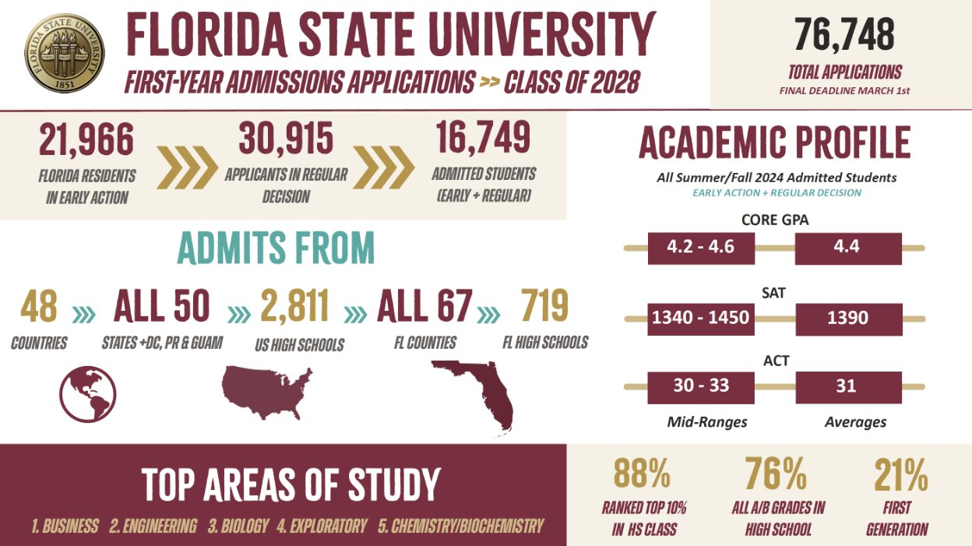

Slide 5
SACSCOC Review
Quality Enhancement Plan
Enhancing Doctoral Education at FSU
Graduate Resource Center
Notes:
Last month, U.S. News and World Report released their 2024 rankings.
As many of you know, this year, U.S. News retooled its methodology. They altered 22 metrics in weight or by adding or removing different factors. They removed four key factors from its formula in which FSU has previously scored well — class size, alumni giving rates, the percentage of faculty with a terminal degree, and students’ high school standing.
We scored our highest-ever ranking among national universities (both public and private) at No. 53, up two spots from last year. However, we fell four spots to No. 23 among national public universities in the new calculation.
This drop among public universities is despite improving in nearly all previous metrics. Based on the previous methodology, we estimate that FSU would have placed No. 16 among public universities.
Earlier this fall, the online rankings platform Niche ranked Florida State No. 11 on its list of top national public universities, up two places from No. 13 last year. Niche combines verifiable data from the U.S. Department of Education with user input — reviews and ratings from current students, alumni and parents.

Slide 6
provost.fsu.edu/gsrc
Notes:
Last month, U.S. News and World Report released their 2024 rankings.
As many of you know, this year, U.S. News retooled its methodology. They altered 22 metrics in weight or by adding or removing different factors. They removed four key factors from its formula in which FSU has previously scored well — class size, alumni giving rates, the percentage of faculty with a terminal degree, and students’ high school standing.
We scored our highest-ever ranking among national universities (both public and private) at No. 53, up two spots from last year. However, we fell four spots to No. 23 among national public universities in the new calculation.
This drop among public universities is despite improving in nearly all previous metrics. Based on the previous methodology, we estimate that FSU would have placed No. 16 among public universities.
Earlier this fall, the online rankings platform Niche ranked Florida State No. 11 on its list of top national public universities, up two places from No. 13 last year. Niche combines verifiable data from the U.S. Department of Education with user input — reviews and ratings from current students, alumni and parents.

Slide 7
Cybersecurity at FSU
Vision 2030
Institutional Research
Notes:
Last month, U.S. News and World Report released their 2024 rankings.
As many of you know, this year, U.S. News retooled its methodology. They altered 22 metrics in weight or by adding or removing different factors. They removed four key factors from its formula in which FSU has previously scored well — class size, alumni giving rates, the percentage of faculty with a terminal degree, and students’ high school standing.
We scored our highest-ever ranking among national universities (both public and private) at No. 53, up two spots from last year. However, we fell four spots to No. 23 among national public universities in the new calculation.
This drop among public universities is despite improving in nearly all previous metrics. Based on the previous methodology, we estimate that FSU would have placed No. 16 among public universities.
Earlier this fall, the online rankings platform Niche ranked Florida State No. 11 on its list of top national public universities, up two places from No. 13 last year. Niche combines verifiable data from the U.S. Department of Education with user input — reviews and ratings from current students, alumni and parents.

Slide 8
Questions
Notes:
Thank you. I’m happy to take any questions you have.

