Slide 1
Welcome to Florida State University
Craig Stanley
Associate Vice President
Office of Faculty Development & Advancement
August 18, 2025
New Faculty Orientation

Slide 2
Overview
Office of Faculty Development & Advancement
Types of FSU Faculty
Assignment of Responsibilities (AORs)
Faculty Evaluations
Promotion Process
Notes:
Goals of today’s meeting: 1) brief presentation (slides will be made available) not going to get into the weeds, we do that in other venues (workshops, closer to time of promotion) -instead will give an overview of criteria & procedures for getting promoted at FSU; Other goals of this meeting – answering any questions you may have. Hope is that today provides a good foundation for starting your career here at FSU.

Slide 3

OFFICE OF FACULTY DEVELOPMENT & ADVANCEMENT
Faculty Employment
Academic Policies & Student Grievances
Faculty Senate Liaison
Promotion & Tenure
Curriculum Development
Faculty Awards
New Majors, Degrees and Certificates
Sabbaticals &
Leaves
College & Department Bylaws
Faculty Grievances
Instructor Credentialing
Student Academic Honor Policy
Notes:
We are involved in (almost) everything that does on in academic affairs.

Slide 4
Office of Faculty Development and Advancement
OFDA Website https://fda.fsu.edu
Academic Resources
Development
Employment
Recognition
Special Events
Leadership Toolkit
Faculty Handbook

Slide 5


FSU Faculty Types
General (Tenured/Tenure-Earning)
Assistant, Associate, Full Professors
Teaching + Research/Creative Works + Service
Raises with each promotion
Specialized (Non-Tenure Earning)
Duties focused on a specialty
Career ladder: Levels I, II, III
Promotional Raises equivalent to General Faculty
Multi-Year contracts with promotion

Slide 6
Specialized Faculty Tracks
Teaching Faculty (I, II, III)
Instructional Specialists (I, II, III)
Research Faculty (I, II, III)
Research Support (Assistant In, Associate In, Senior)
University Librarian (Assistant, Associate, Unive Librarian)
Curator Specialties (Assistant, Associate, Curator)
Clinical Faculty (Asst./Assoc./Prof)

Slide 7
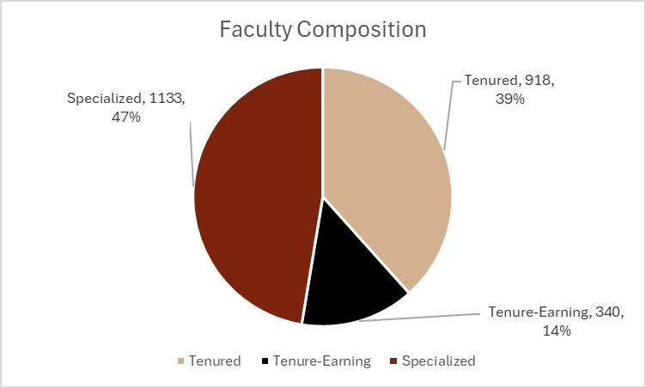

Slide 8
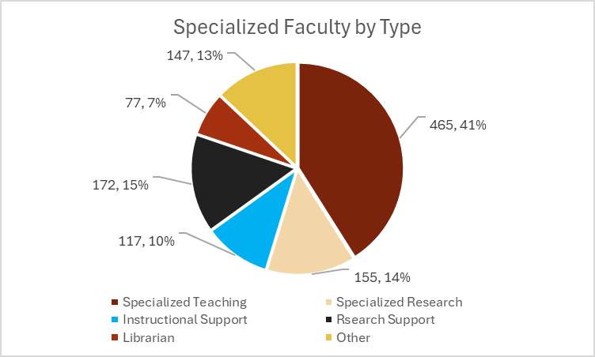
Notes:
Based on active faculty list as of October 2024.
Faculty composition by tenure status
Full time (part time excluded). Regular salaried faculty (OPS excluded).

Slide 9
Assignment of Responsibilities & Faculty Evaluation

Slide 10
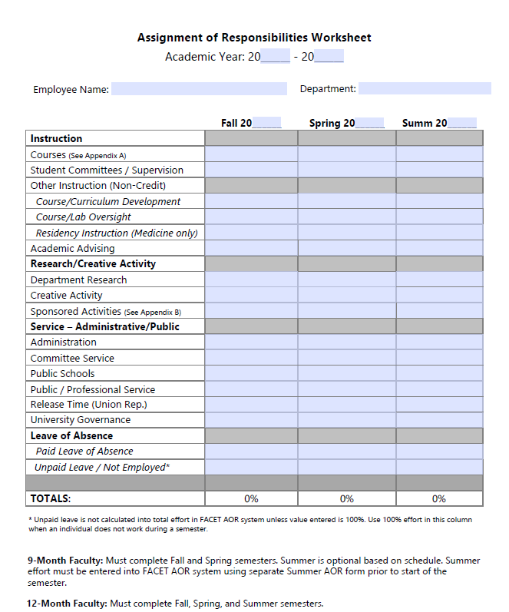
Notes:
Your AOR will map out your assignments for the upcoming year.

Slide 11
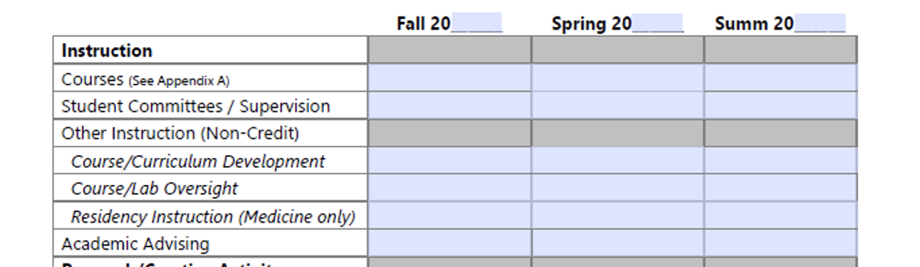
AOR: Instruction

Slide 12
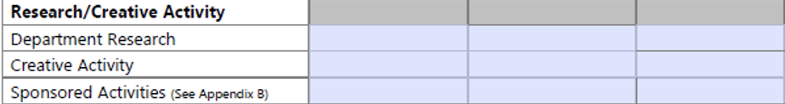
AOR: Research and Creative Activity

Slide 13
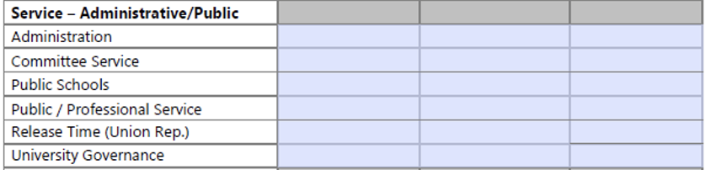
AOR: Service

Slide 14
Faculty Evaluations at FSU
When do evaluations occur?
Annual ratings in each area of your AOR
Summary letter to include a statement on progress toward promotion
Who contributes to your evaluation
Chair/Supervisor
Indirect Supervisors
Faculty Evaluation Committees*

Slide 15
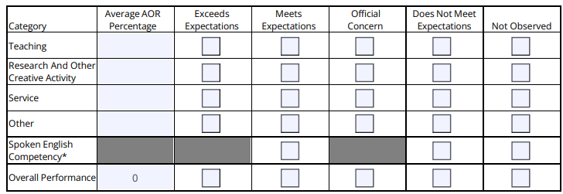
Evaluation Ratings

Slide 16
Your Role in Faculty Evaluations
Make it easy for others to learn about your work
Keep track of your accomplishments
Keep your FEAS CV current
Tell “your story” well
What are your most important accomplishments?
Why is your work important?

Slide 17
Promotion Process and Timeline

Slide 18
Pursuit Of Excellence
Hiring & promotion decisions are the most important decisions we make
Hired with the expectation that you will excel in your area of specialization
Our commitment to you:
Support for specialization (e.g. supervision and mentorship)
Positive work environment
Constructive, timely feedback on your progress toward promotion

Slide 19
Promotion at FSU
Who evaluates you for promotion?
Specialized faculty in your academic unit
Department Committee & Chair
College Committee & Dean
OFDA
President

Slide 20
Criteria for Promotion
Promotion decisions for specialized faculty will take into account the following:
Annual evaluations
Annual assignments
Fulfillment of the department/unit written promotion criteria in relation to the assignment
Evidence of sustained effectiveness relative to opportunity and according to assignment
Specialized faculty are typically eligible for consideration during their fifth year of service

Slide 21

What You Can (and Should) Do Now
Ask about your unit’s expectations of you and the criteria they most value in evaluating faculty performance
Talk to colleagues in your department/college to learn more about the process in your academic unit
Take advantage of workshops and consultations offered by our Center for Advancement of Teaching (CAT) and Office of Digital Learning
Check out the Research Knowledge Center and Support Hub

Slide 22
How to Maximize Your Success
Stay focused on your goals
Maintain connections with leaders in your field of study
Seek mentors
Protect your time (but say yes to projects/tasks that will advance your career)
If you say you’re going to do something, do it well and on time

Slide 23
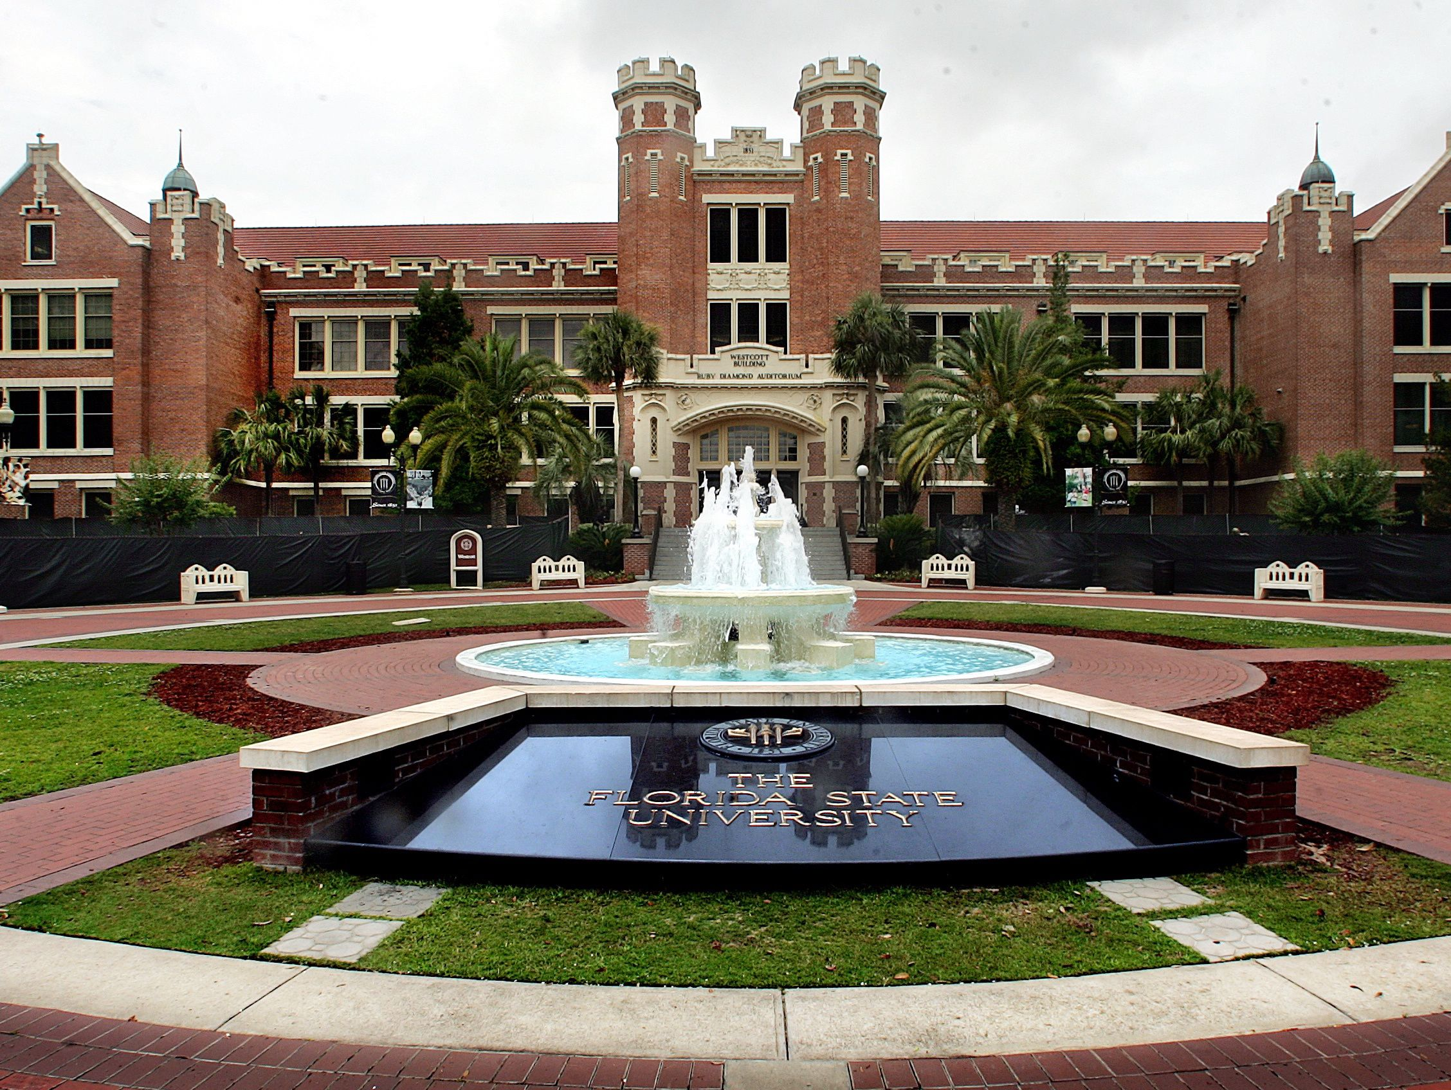
So glad you’re here

