Slide 1
Promotion & Tenure Workshop for Assistant Professors
Janet Kistner
VP Faculty Development & Advancement
April 1, 2024
Notes:
Today’s audience likely includes faculty at varying stages on the path P/T. Goals of today’s meeting: 1) brief presentation (slides will be made available) – Melissa will follow-up with details of the process, she will also have a workshop just for staff in your college/department who will assist you. My goal is to provide an overview of the process and then open up for questions (also fine to ask questions during the presentation).

Slide 2
University promotion & tenure criteria
Sustained Excellence in scholarly or creative accomplishments AND teaching AND service
Is there evidence that you:
have (or will) achieve national and international recognition as a scholar or creative artist in your field?
have demonstrated excellence as a teacher and mentor?
make positive contributions in service to the university and your academic discipline?
Notes:
Jim Smith: No “or” in the criteria
What constitutes sufficient evidence? Not a simple answer, no formula, no minimum number of x or y. It’s about excellence, impact. Not true that the only thing that matters is your scholarship/creative works. Lack of evidence of effectiveness in teaching and service is enough to derail tenure. But – it is true – it is the lack of evidence of excellence in scholarship/creative works that is the most common reason for not getting tenure.
BUT – there should be no surprises – you should know well in advance if you are on track (or not) for tenure through annual evaluations, progress toward P/T letters, 3rd year reviews. It is the university’s obligation to provide you with constructive timely feedback on your progress toward promotion and tenure.

Slide 3
What evidence will represent you?
Dean’s and Chair’s letters
External letters (from top scholars in your field)
C.V.
Evidence of Achievements (publications/supporting materials)
Research, Teaching and Service Statements
Annual Letters of Progress toward P&T
3rd Year (or 2nd/4th year) Review Narratives
Notes:
Same for promotion to associate and for tenure; for promotion to full, all are relevant except the 3rd year review.

Slide 4
Peer review, peer review, peer review…
Peer reviews of scholarship and creative works
Peer reviews of grant proposals (in disciplines where external support is expected)
Peer (and student) “reviews” of your teaching
OUTSIDE LETTERS – all about peer review

Slide 5
Who is eligible?
For tenure:
In tenure-earning positions
Recommended by academic unit
Minimum of 5 years in rank
includes “tenure credit”
Does not include years when “tenure clock” is stopped
Notes:
For P&T, you are nominated tenure or promotion review. Based on this year’s annual review, should know if you are being nominated and should have a pretty good idea about this from prior “Progress toward P/T letters”.
With tenure there is a minimum number of years in rank (include tenure credit and excludes years when tenure clock is stopped, e.g., for leaves).

Slide 6
Who is eligible?
For promotion to Associate:
In tenure-earning position
Recommended by academic unit
Typically reviewed in 6th year in rank, simultaneously with tenure review
May be reviewed prior to tenure review

Slide 7
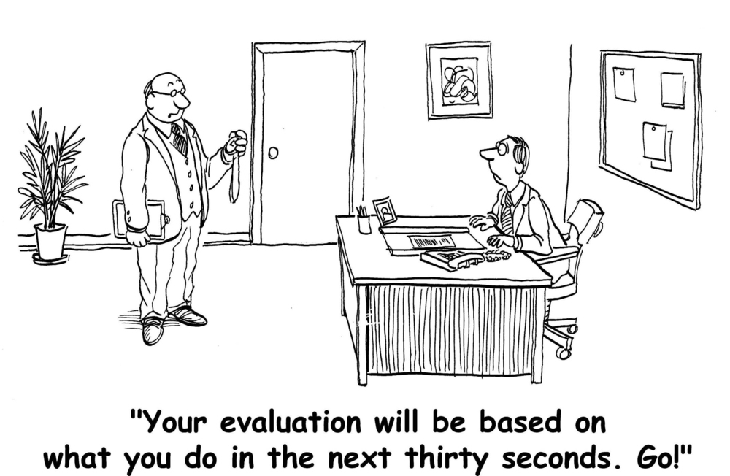
How do I know if I’m making progress toward promotion/tenure?
Notes:
Provide guidance/encouragement to actively plan and frequently participate in professional development/scholarly activities.

Slide 8
Faculty Evaluations at FSU
When do evaluations occur?
Annually: ratings plus progress toward P&T letters
3rd year mini-P&T reviews
P&T review (full formal review with outside letters)
Who evaluates you for promotion and tenure?
Tenured faculty in your academic unit
Department Committee & Chair
College Committee & Dean
University Committee
Provost, President, Board of Trustees
Notes:
Progress toward promotion letters are very important; 3rd year reviews –Mini-P&T reviews – differs from formal review in that outside letters are not included and materials not in the online P&T system; but it’s an excellent way to make progress on writing statements and getting your CV in proper format.
All of these evaluative materials are included in your P&T materials

Slide 9
Typical Tenure Timeline* *for assistant professors with no “tenure credit”
Spring semester of your 5th year: department recommends that you put together materials for P&T review (or recommends waiting a year)
Summer between your 5th & 6th years: outside letters are requested by your chair/dean and you are asked to prepare your P&T “binder”
Fall semester of your 6th year: you submit your materials to the online P&T portal - the official start of your formal P&T review

Slide 10
Tenure timeline (cont’d)
Fall Semester of your 6th year:
September: Department/School vote
October: College vote (in A&S, college vote is preceded by votes by the Humanities and Sciences committees
December: University P&T Committee votes
January: review by Provost & President
Final Decision: typically, January-February

Slide 11
Modifications and Considerations Due to covid-19
Include professional activities (e.g., conference presentation; invited address) that were cancelled due to COVID on your P&T CV with this note: “Cancelled due to COVID”
If relevant (e.g., gaps in your record of accomplishments due to COVID) provide information (e.g., Human Subjects research not permitted; delays in reviews of book contracts, journal submissions) with your supervisors (chairs, directors, deans) and mentor committees; this information should be noted in your progress toward P&T letters.
Notes:
Make sure your supervisor (usually department chair) knows the impact of the pandemic on your ability to do your research, scholarship, creative works as well as the impact on your teaching and service. If you are planning to be a candidate for tenure review in 2021-22 then must “decline” the tenure clock extension prior to formally becoming a candidate (October 15 of your 5th year of tenure-earning service).

Slide 12
Faculty Candidate’s Role
Make it easy for your faculty colleagues, chair, dean to see what you’ve accomplished
Tell “your story” well
What are your most important professional accomplishments?
Why is your work important to the university, nation, world?
Notes:
Need to write about your work in a way that can be understood by academics not in your academic discipline. Get feedback on the statements about your research, teaching and service from trusted colleagues (here or elsewhere) and do this well in advance of the fall when you are going up for review, complete them in time to be sent (by your chair) to your external letter writers.

Slide 13
Teaching Statement
The teaching statement is an opportunity to describe what you’ve accomplished and should include information on each of the areas below:
Goals for Student Learning
Teaching Methods
Results & Effectiveness
Evaluation & Reflection
Notes:
What are your goals for student learning in your courses? (Consider any goals you have for students to develop intellectually, personally, and professionally through your work with them and/or what should they know or be able to do because they took your course.) What strategies or approaches do you use in order to help students achieve your goals for student learning? (Consider what you ask students to do that helps them learn and/or how you give them feedback that helps them make progress.) How/why have you chosen these strategies? (Consider how you use the scholarship on teaching and learning/education research in your field and/or research on best practices.) What strategies or approaches do you use to foster an inclusive environment in your classroom? (e.g., structuring small-group activities; adopting a mindset that all students can learn; connecting with students; etc.)?
How do you gather evidence of student learning? (Consider strategies you use to evaluate students’ progress toward the learning goals and objectives.) How have you used evidence you gather to improve your teaching?
What efforts have you engaged in to develop or refine your teaching methods? (Consider any outside resources [workshops, consultations, reading material, research, conferences, teaching observations, etc.] you have used to make your teaching more effective and inclusive.)

Slide 14
Faculty Candidate’s Role
Selection of external letter writers
Provide list of possible letter writers (if asked)
DON’T directly contact potential letter writers
Prepare short bio’s of potential letter writers to chair/director/deans
Be clear about whether there are “existing” relationships
Notes:
Consider not only the excellence of the letter writer but also their professional affiliation (carries weight, especially for those who are not in your discipline).

Slide 15
Questions?

Slide 16
Melissa Crawford faculty administrator
mucrawford@fsu.edu

Slide 17
First Rule of Promotion and Tenure
Know who your promotion and tenure delegate is in your department/school and/or college!
This person will help you navigate the online P&T system.
If you don’t know who your delegate is, ask your department chair/director or dean!

Slide 18
How do I get to my eBinder?
Your promotion and tenure delegate will create your eBinder in the online system.
Faculty Quick Start Guide - https://fda.fsu.edu/faculty-development/promotion-and-tenure
You have access to upload your own documents EXCEPT for the outside letters and for information on the cover sheet.

Slide 19
Relax, you DON’T need to know the details.

Slide 20
Canvas site for sample eBinders
Email me (mucrawford@fsu.edu) your FSUID
Other resources can be found on the FDA website - https://fda.fsu.edu/faculty-development/promotion-and-tenure
P&T Memo
Guidelines for teaching statements
ORCID/FEAS+ Guides

Slide 21
FEAS+/ORCID Questions
Tiffany Phillips
tphillips@fsu.edu
https://feas.fsu.edu
https://orcid.fsu.edu/

Slide 22
Questions?
Department/School/College Delegate
OR
Dr. Janet Kistner or Melissa Crawford
jkistner@fsu.edu
mucrawford@fsu.edu
http://fda.fsu.edu/faculty-development/promotion-and-tenure

