Slide 1
2024-2025 Specialized Faculty Promotion Cycle Staff Review
Melissa Crawford, Faculty Administrator
Office of Faculty Development & Advancement
April 10, 2024

Slide 2
What will we discuss?
Who is eligible for promotion?
What is early promotion?
Prior years of service
Putting together the binder

Slide 3
Who is eligible for promotion?
Faculty in the following tracks who have not yet reached the top rank (III):
Teaching Faculty I and II
Research Faculty/Curator I and II
Instructional Support (Instructional Specialists I and II)
Research Support (Assistant in Research, Associate in Research)
Library or Information Specialties (Assistant Librarian, Associate Librarian)

Slide 4
What is early promotion?
Promoted prior to completion of 5 years in rank
Requires evidence of exceptionally meritorious performance
Highly unlikely to be promoted with fewer than 3 years in rank at FSU because it is difficult to judge “sustained” excellence in the position.
Specialized faculty are typically reviewed for promotion during the 5th year in their current rank. However, faculty may be reviewed for promotion in the 4th year if the supervisor thinks the faculty member is ready.

Slide 5
Prior Years of Service
Count toward years in rank if specified in one’s offer letter.
Please note that bringing in credit does not guarantee promotion but allows for the candidate to be considered earlier than is typical.
Limits:
Two years for a faculty member hired at the first level
Three years for a faculty member hired at the second level
Visiting status may count if the assignment of responsibilities remains the same

Slide 6
Preparing the Binder
Informational memo and other information are on the FDA website
Summary Cover Sheet
Guidelines for Writing Personal Statements
FEAS+ and ORCID Guides
Checklists for each track (details in memo)
Teaching Faculty (page 5)
Research Faculty/Curator (page 9)
Instructional Specialist (page 12)
Research Support (page 15)
Librarian (page 18)

Slide 7
There is no “online” process in myFSU-HR (OMNI) for Specialized Faculty promotions.

Slide 8
Preparing the Binder
Therefore…Each faculty candidate’s promotion binder must be submitted as one (1) .pdf file on or before October 25, 2024.
Please do not use the “portfolio” option when combining pdf documents.
Please submit via email or FSU NiFTy (https://nifty.fsu.edu/). (Formerly FSU Dropbox.)
PDFs are required to be bookmarked before they are turned into FDA. A list of bookmark names are on the FDA website.
Please do not use cover pages for each section since more pages makes the PDF file bigger.

Slide 9
Common Mistakes
Must be finalized CV from FEAS+. It should not say DRAFT at the top.
CV missing one-sentence description of each published work since employment at FSU, or since last promotion at FSU.
CV missing co-authors.
All AORs must be fully approved and in printable format. Save as PDF and insert into the eBinder.
All Specialized Faculty should have annual progress towards promotion letters.
Annual evaluation forms not included.
AORs, SPCI reports, Annual Evaluation Letters, Progress Letters must all be submitted in the eBinder from most recent to oldest.

Slide 10
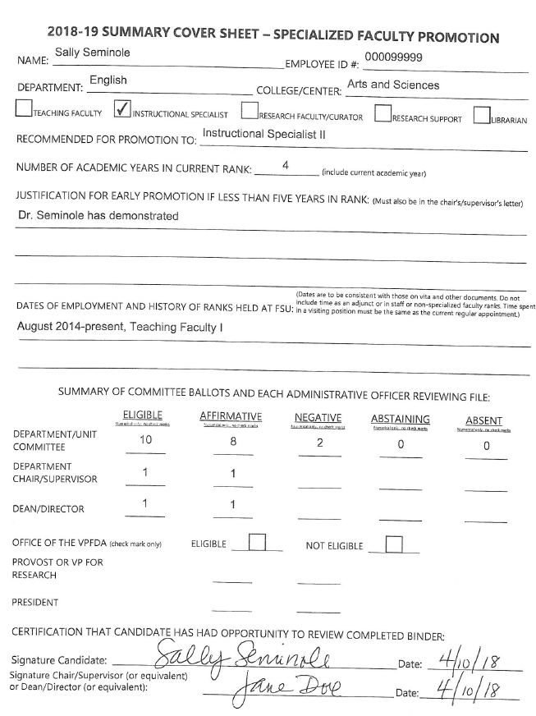
Sample Cover Sheet
If number of years in rank is less than 5, there must be a justification for early promotion on the cover sheet and the chair’s/supervisor’s letter
Votes are all numerical. Please do not use “X” or check marks.
Make sure coversheet is signed.

Slide 11
Abstentions v. Absences
Abstentions are limited to situations involving real or perceived conflicts of interest (familial relations or substantial professional or financial entanglements that prevent judging the candidate objectively). All abstentions should be subtracted from the number of eligible voting faculty on the Summary Cover Sheets.
Absences from campus that result in a failure to ballot during the review process should be recorded as “absent,” not as an “abstention.”

Slide 12
Questions?
Melissa Crawford
mucrawford@fsu.edu
FEAS+/ORCID Questions
Tiffany Phillips
tphillips@fsu.edu
https://feas.fsu.edu
https://orcid.fsu.edu
Notes:
All documents are on the website above.

Slide 13
Thank you, Angela!

